Slide 1
Student Assistant app
Created by Nick Hranuelli, Matthew Nguyen, Vincent Rodriguez

Slide 2
Overview of project
This product assists students in managing their time and keeping helpful reminders set by themselves in order to create a less stressful and more productive school semester. Some features included:
Creating custom notifications for class times
Setting custom reminders
Easy to use grade calculator
Quick access to Zoom meeting

Slide 3
App features
Quick and simple class add(class name, time period, subject, credits, study time)
Set reminder time (classes, exams, homework, project deadlines, quizzes)
Multiple sorting options (Time, class, due dates)
Periodic reminders on studying/project progress
Quick link to the classes Zoom
Customizable grade calculator for weighted grades

Slide 4


tools
Designed in Android Studio (https://developer.android.com/studio)
Coded in Java
SQLite Database

Slide 5
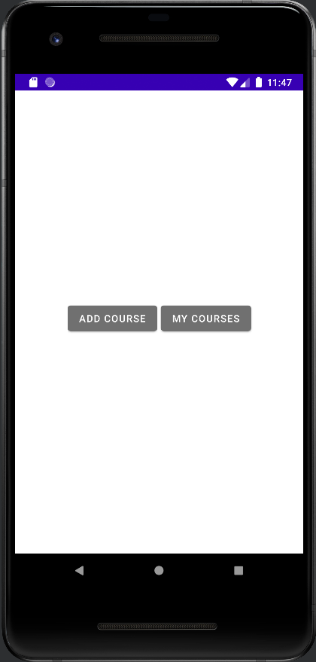
HomePage
The Homepage consists of two buttons:
1. Add Course
2. My Courses
Add Course will take the user to a page where they will be able to put in their course information and save it.
My Courses will take the user to a page that lists out the courses they have saved.

Slide 6
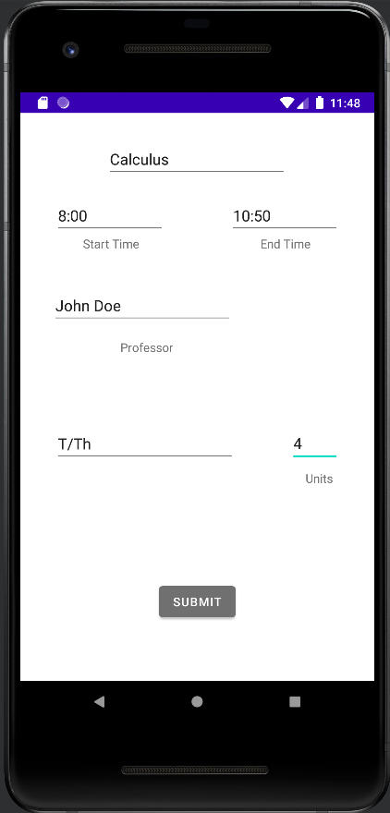
Add Course
The Add Course page allows the user to provide information about the course they are adding and save it.
The required fields are:
- Course Name
- Start Time/ End Time
- Professor Name
- Days the class is held
- Units

Slide 7
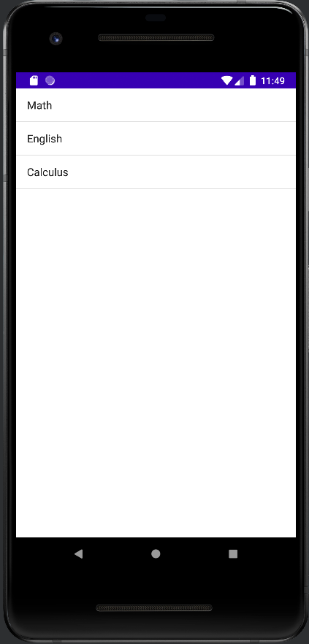
My Courses
The My Courses page lists out the courses that the user has saved.
Next step:
- Our next step is to allow the user to select a course from their list and take the user to a page that lists out the information they provided about such course.
- We are also working on a feature that allows the user to edit the course information or delete the course.

