Slide 1
Student Assistant app
Created by Nick Hranuelli, Matthew Nguyen, Vincent Rodriguez

Slide 2
Overview of project
This product assists students in managing their time and keeping helpful reminders set by themselves in order to create a less stressful and more productive school semester. Some features included:
Creating custom notifications for class times
Setting custom reminders
Easy to use grade calculator
Quick access to Zoom meeting

Slide 3
App features
Quick and simple class add(class name, time period, subject, credits, study time)
Set reminder time (classes, exams, homework, project deadlines, quizzes)
Multiple sorting options (Time, class, due dates)
Periodic reminders on studying/project progress
Quick link to the classes Zoom
Customizable grade calculator for weighted grades

Slide 4


tools
Designed in Android Studio (https://developer.android.com/studio)
Coded in Java
SQLite Database

Slide 5
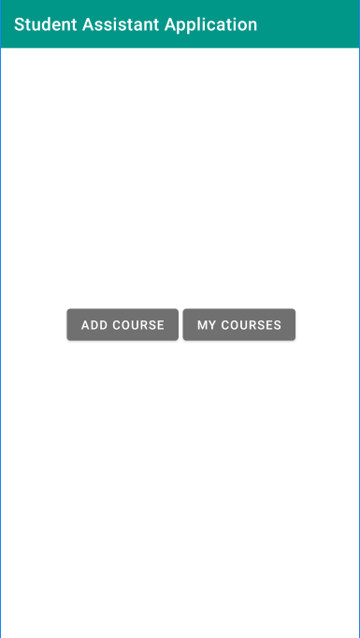
HomePage
The Homepage consists of two buttons:
1. Add Course
2. My Courses
Add Course will take the user to an activity where they will be able to put in their course information and save it.
My Courses will take the user to an activity that lists out the courses they have saved.

Slide 6
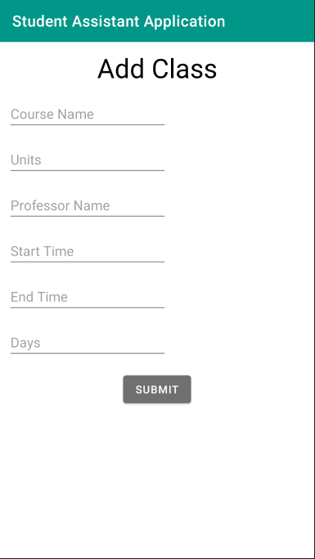
Add Course
The Add Course activity allows the user to provide information about the course they are adding and save it.
The required fields are:
- Course Name
- Start Time/ End Time
- Professor Name
- Days the class is held
- Units

Slide 7
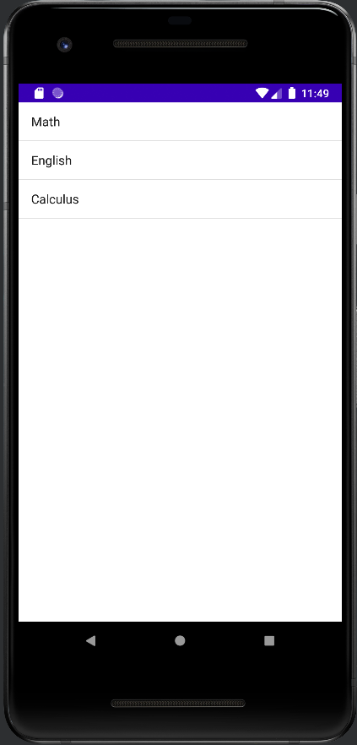
My Courses
The My Courses activity lists out the courses that the user has saved.
Next step:
- Our next step is to allow the user to select a course from their list and take the user to an activity that lists out the information they provided about such course.
- We are also working on a feature that allows the user to edit the course information or delete the course.

Slide 8
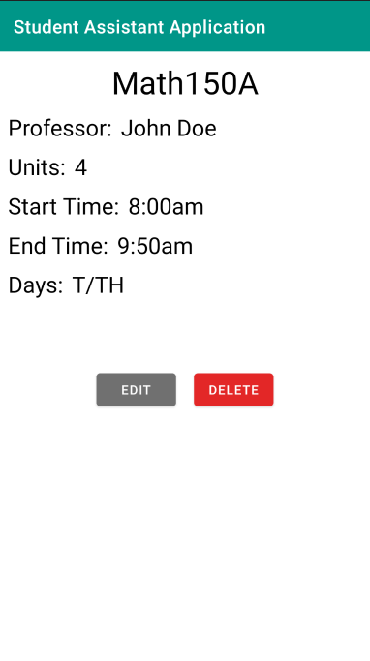
Course Information
Here is the Course Information activity. On this page, the user can see the information they provided about their course.
The Course Information page gives the user the option to EDIT or DELETE the course they are viewing.
- We are currently working on making those buttons operational.
-For now, EDIT will take the user to another activity that allows them to edit and save any changes to the course information.

Slide 9
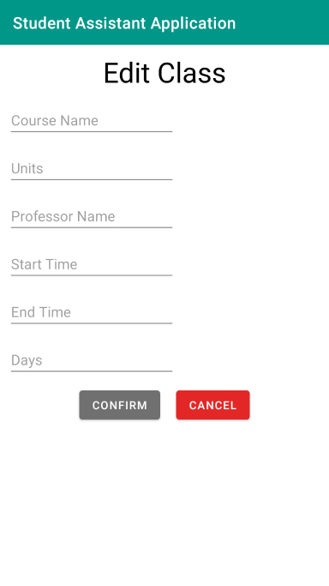
Edit Course Information
The Edit Course activity gives the user the ability to make any changes to the information about a course.
Should the user change their mind about making changes, the Edit Course activity offers a CANCEL button that will take the user back to their list of courses.

Slide 10
What’s Next?
TODO:
From the My Courses list, take the user to their selected course to display information about such course.
From the Course Information activity, make the DELETE button operational. This button should delete the course from the database and remove the course from the list of courses.
From the Edit Course activity, make the CONFIRM button operational. The button should make changes to the course information and keep the course in the list of courses. The button should not create a new course.
Create an activity that allows the user to create reminders about class time, homework, quizzes, or exams.
Create an activity that allows the user to calculate their grade for the class.

