Slide 1
“Tutorial” - VPR data processing
(what we have learned so far)

Slide 2
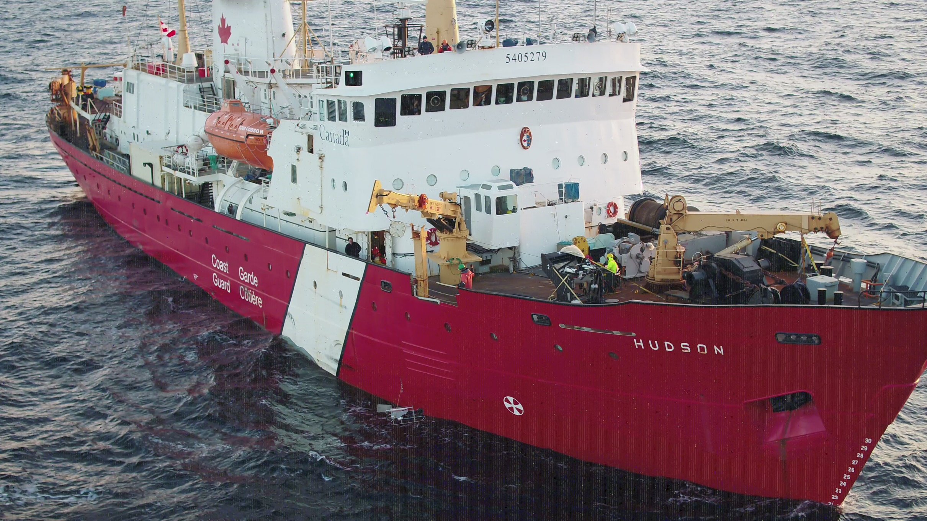
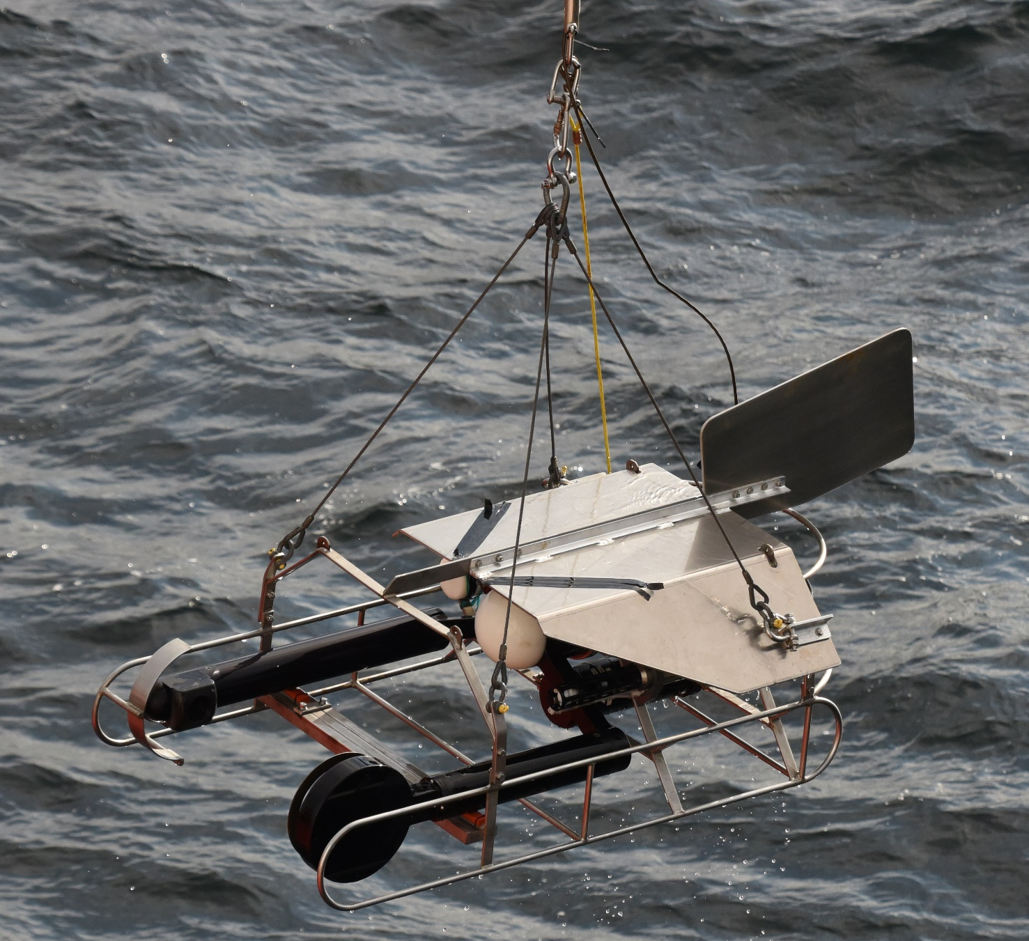
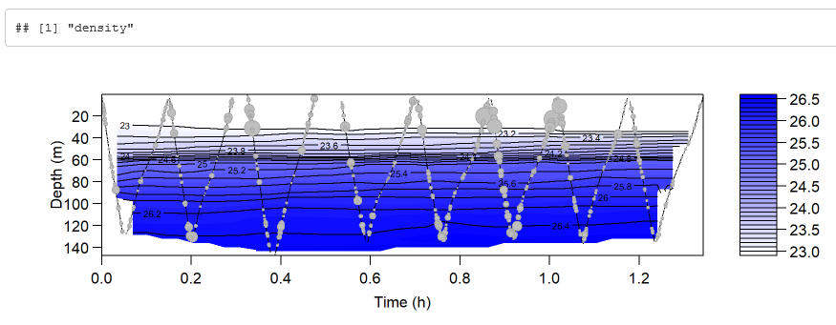
VPR operation
Frame rate: ~ 13 fps
Forward tow speed: 2 knots
Tow duration: usually >= 1 hour
Total frames: >=46800
Sigma-t

Slide 3
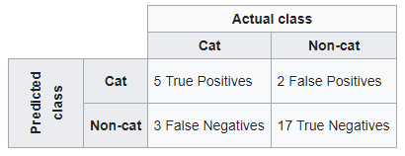
Process
(Calibration)
Filtering
Build library
Build classifier → confusion matrix, model(s) used for prediction
Classification → filenames, sizes (by category)
Confusion matrix

Slide 4
Filtering
Show autodeck options and outputs
You can run autodeck without generating rois

Slide 5
Library
An R script to randomly sample rois from multiple stations was written by RK.
This was used to build an initial library, which was then added to after classification
Show categories

Slide 6
Build classifier
Produces parameters needed for prediction by machine learning
- Granulometry features (geometry), used by NN
- Texture (cooccurance matrix), used by SVM
Show directory structure (hard coded)
Show output files (.dat files, .mat files, feature files)

Slide 7
Classification of rois
Extract features (gran and texture)
Get image measurements
Classify images
If dual, do the classifications agree?
Show output from VP classification

Slide 8
Problems:
Filtering:
Autodeck crashes (presumably due to data corruption, hopefully this will not happen in future)
Can max out folder storage
Calculate variation in frame rate of camera
Building the training set:
Could use more images for certain categories
Building classifier:
Complete understanding of building, plotting, and interpreting confusion matrix is required
Classification
Which classifier is the best for fully automated classification?

