Slide 1
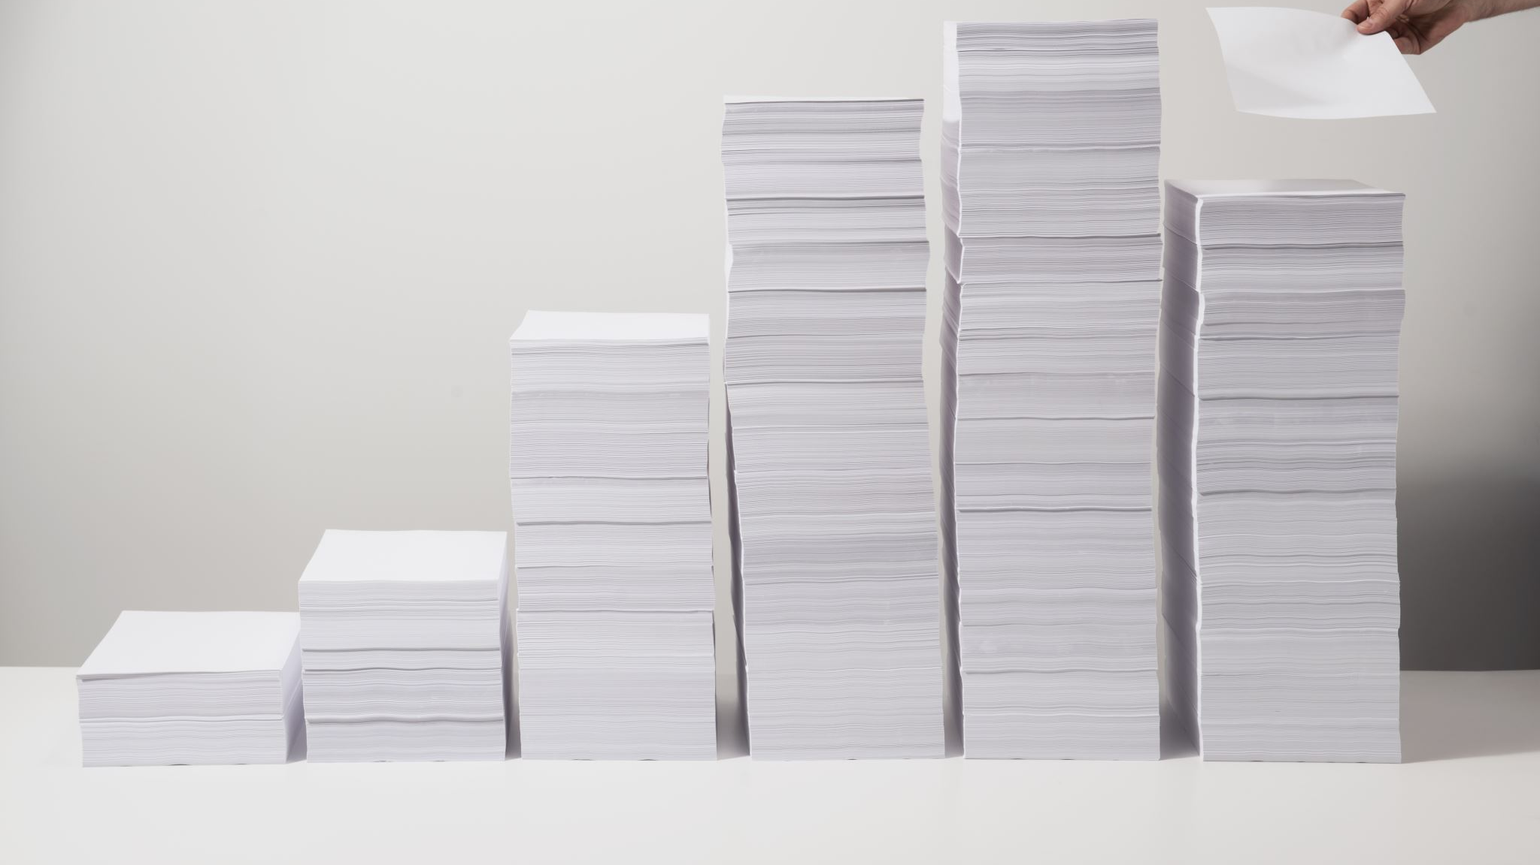
Pile of Shame
ITC4214
Vaggelis Passas

Slide 2

Idea
Problem: Video games bought, but never finished
Solution: Pile of Shame

Slide 3
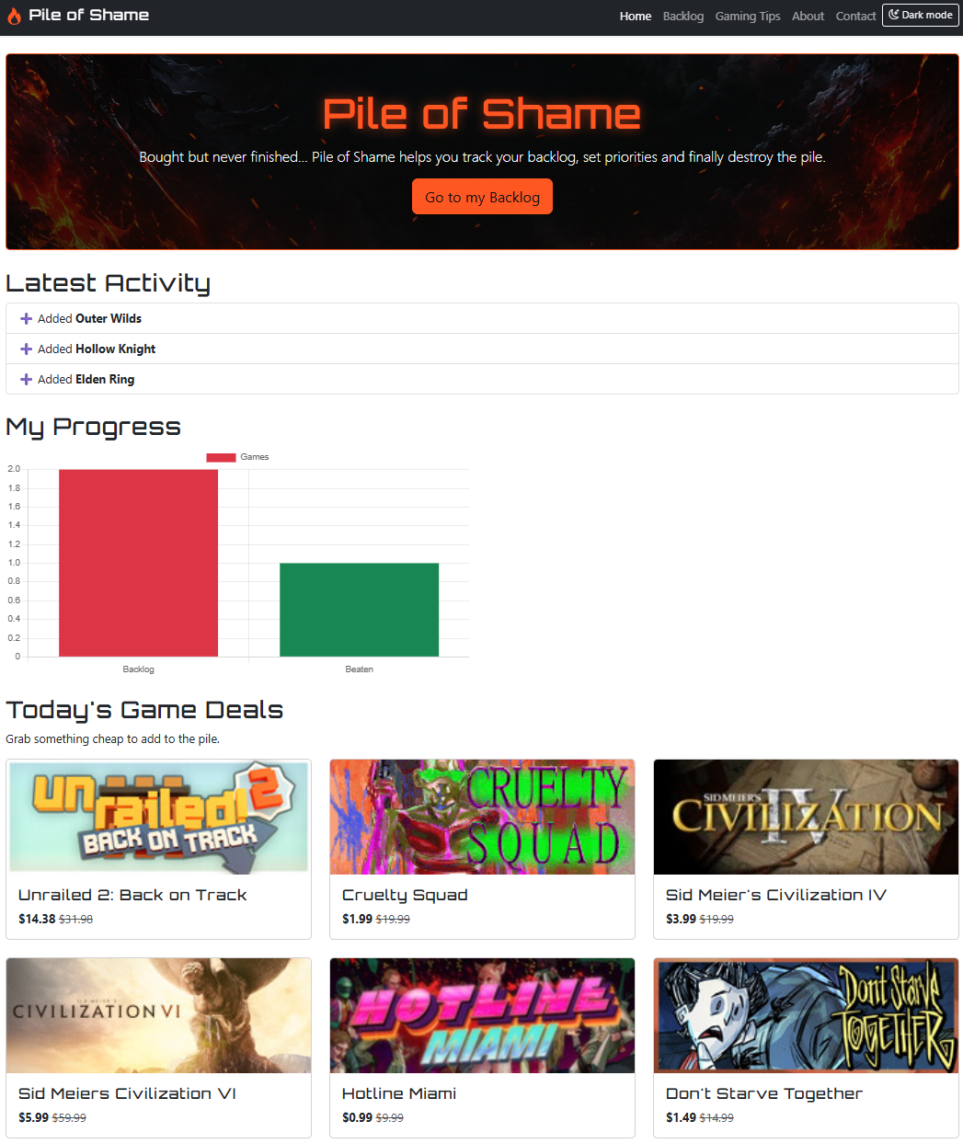
Home
Jump straight to your games
See your latest activity and progress
Find out about video game deals

Slide 4
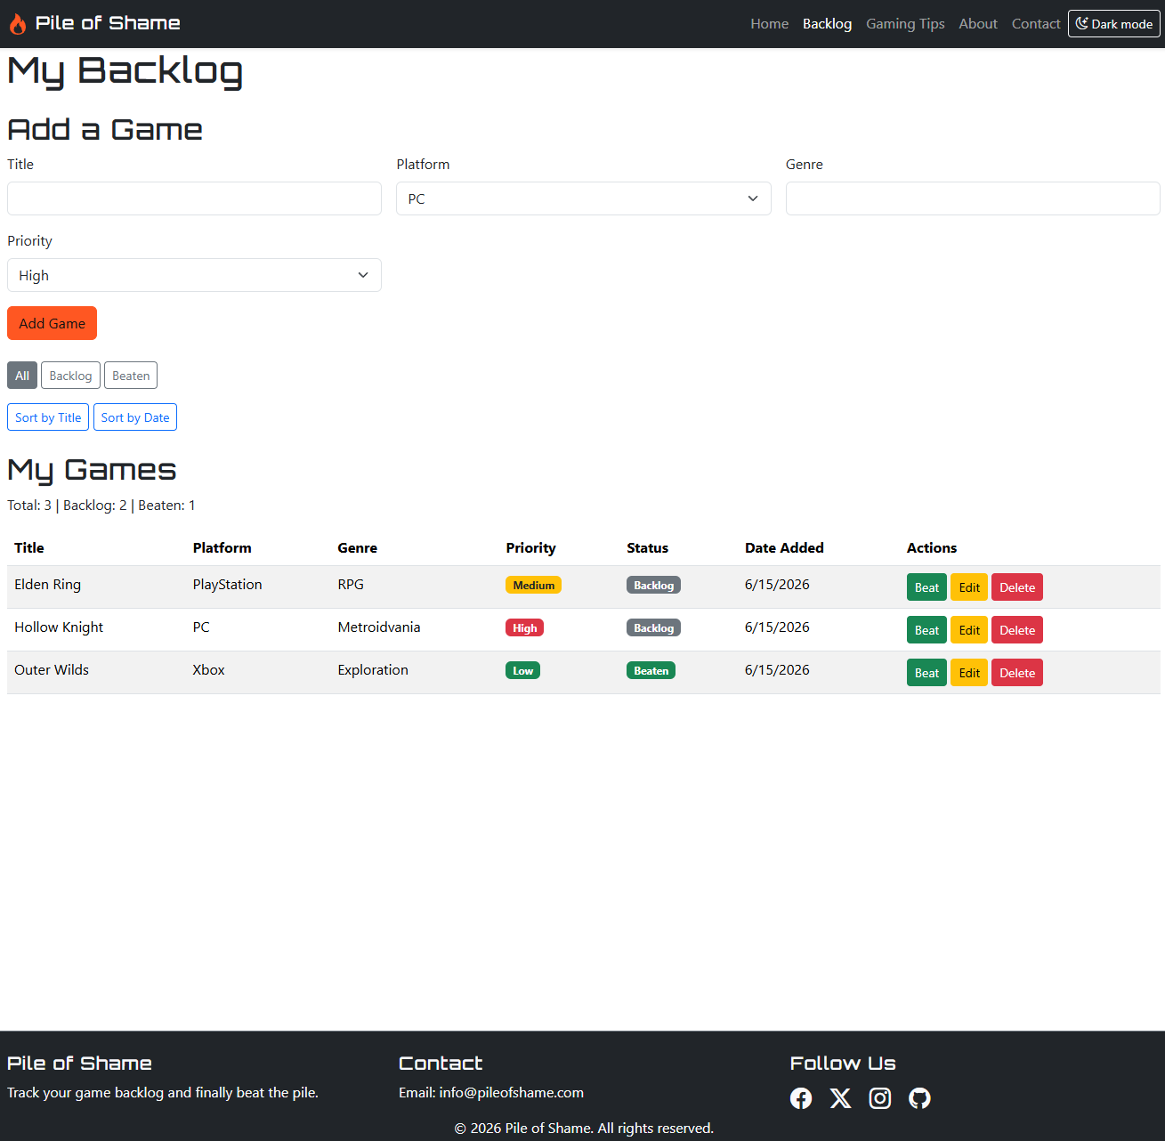
Your Backlog
Add any game: platform, genre, priority
Mark games as beaten, edit or delete
Filter/sort to decide what to play next
See scores

Slide 5
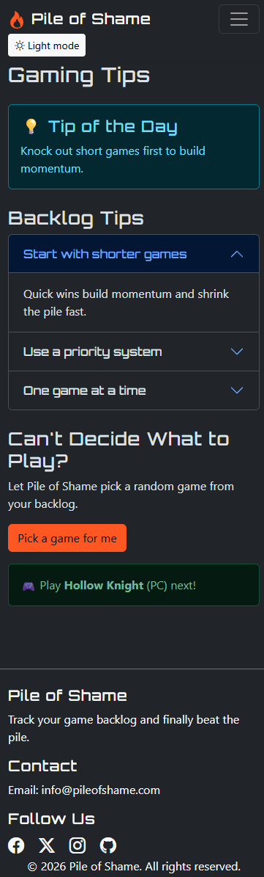
More features!
Light/dark mode
Works on phone, tablet and desktop
Gaming tips

Slide 6
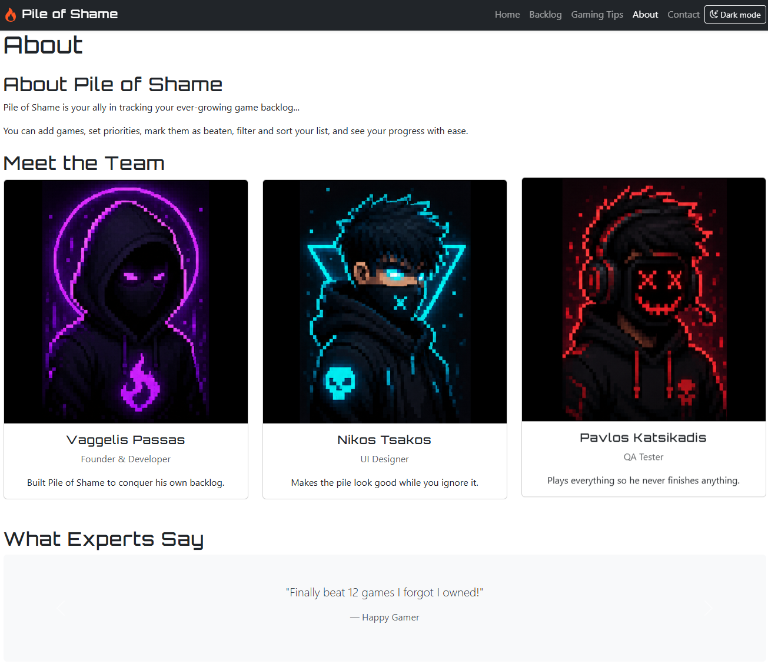
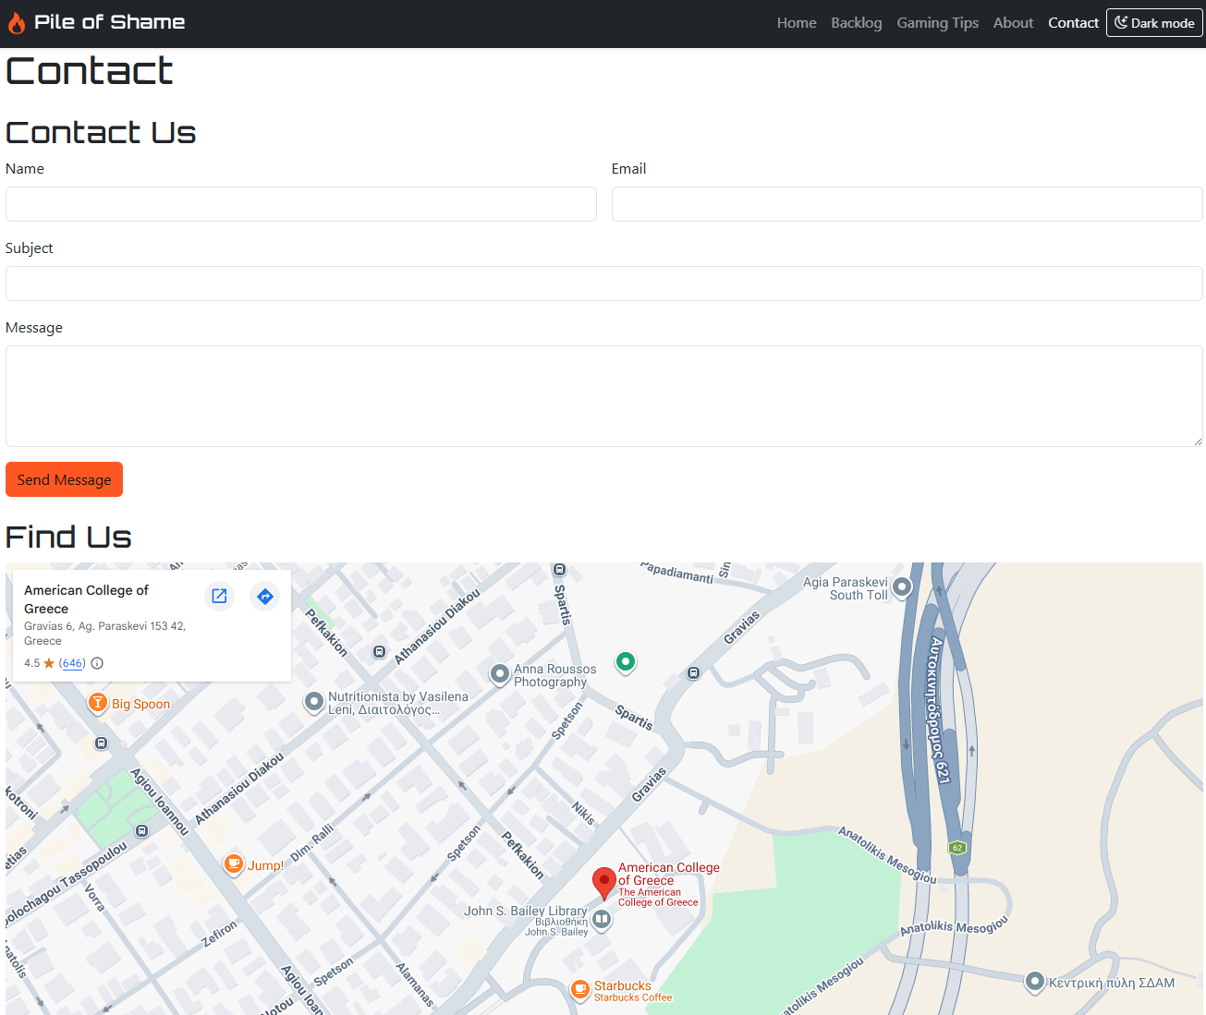
About & Contact
Meet the team
Easy to get in touch

Slide 7
Thank You!
Repository: https://github.com/VPassas/ITC4214-PileOfShame.git
Live Site: https://vpassas.github.io/ITC4214-PileOfShame/

