Slide 1
LOCAL · GOAL-DRIVEN · VISION-BASED
IVI Visual Agent
Testing car infotainment from a goal — not a script.
An offline agent that observes an Android IVI screen, decides one grounded action, executes it over ADB, and independently verifies the outcome. No recorded routes, no fixed coordinates, no cloud.
qwen3-vl:8b · fully local · Android / AAOS / custom OEM IVI
Notes:
Opening: this is an offline AI agent that tests car infotainment screens. You give it a goal, it figures out the taps itself by looking at the screen, and verifies the result. Everything runs locally.

Slide 2
THE PROBLEM
IVI QA is the hardest UI to automate — under the tightest privacy constraint
Manual & brittle
Scripts don't survive
Can't go to the cloud
IVI test today is humans tapping through climate, seat, and nav screens by hand. Slow, unrepeatable, expensive at scale.
Record-and-replay pins fixed coordinates or element IDs. OEM screens are often Unity/pixel-rendered with no accessibility tree — scripts break on any layout shift.
Screens of an unreleased head unit can't be shipped to a hosted VLM API. IP and confidentiality rule out the obvious cloud-agent shortcut.
Hardest possible UI × strongest privacy constraint = the gap we fill.
Notes:
You have the hardest UI to automate and the strongest reason not to use cloud AI. That intersection is the opportunity.

Slide 3
CORE IDEA
A closed observe → plan → act → verify loop
Every step is decided from what is on screen right now. No menu path is ever memorized — so it survives layout changes.
1
Observe
2
Plan
3
Ground & act
4
Verify
→
→
→
Screenshot + accessibility tree (when present) + OCR of the live screen.
Local VLM proposes ONE next action toward the goal, given a retrieved manual hint.
Locate the control on this screen (coords or candidate), tap / swipe via ADB.
Independently confirm the goal — not trust the planner's claim; loop if not done.
Loop-back: if verify fails, the failed action is remembered and re-planning avoids the dead move — with an overall-goal recheck so it stops the moment the goal is actually met.
Notes:
The key differentiator: it never memorizes a route. Verification is independent of the planner, which is what makes results trustworthy.

Slide 4
ARCHITECTURE
Components — a thin, swappable stack
GoalAgent
OllamaVisionModel
Perception
The decision loop: plan → subgoals → grounded action → verify, with loop/dead-action memory.
Planner + grounder + verifier over a local VLM via Ollama HTTP. num_ctx / keep-alive tuned.
uiautomator XML parse, OCR, perceptual hash, numbered visual grid for pixel-only surfaces.
AdbDevice
Knowledge (RAG)
AndroidWorld bridge
Screencap, taps, swipes, text; live-orientation screen sizing; app launch by package.
PDF manual → semantic text + icon embeddings; retrieves the step & icon for the goal.
Same brain, scored on Google's benchmark: State→PNG, UI forest→XML, Action→JSONAction.
Model, device, and knowledge source are all pluggable — the same loop runs on an emulator, a phone, or a real head unit.
Notes:
Point out the AndroidWorld bridge reuses the exact same planner/grounder/verifier — only the I/O is translated. That's how we get a comparable benchmark number.

Slide 5
THE HARD PART — GROUNDING
Turning “tap A/C” into an actual pixel
When there's an accessibility tree
When it's pixels only (custom OEM / Unity)
Resolve the named target to a labelled node
Tap the node's bounds — exact, no guessing
Convert a tap on a scrollable container into a scroll
Works on stock Android / AAOS settings apps
point mode: ask a grounding-capable VLM for normalized (x,y), with 0–1000/pixel rescale defense
grid mode: overlay a numbered grid; model names a cell (model-agnostic fallback)
Manual-retrieved icon crops sharpen recognition of proprietary controls
No stored coordinates — located fresh on every screen
Same planner, two grounding strategies chosen by config — degrade gracefully from structured to purely visual.
Notes:
This slide is the crux for a technical audience: how does a language model produce a tap coordinate. Two modes, chosen by config; point mode for grounding-capable VLMs, grid as the universal fallback.

Slide 6
RECOGNITION WITHOUT TRAINING
The owner's manual is the training data — at runtime
OEM manual (PDF)
Index once
Retrieve for goal
Feed the model
›
›
›
Text + page images + icon crops with meanings/synonyms.
Per-chunk semantic text embeddings + optional CLIP icon-image vectors.
Blend cosine similarity with keyword score — “wireless internet” → Wi-Fi icon.
Only the active step + relevant icon crop, alongside the live screenshot.
Why this matters
No fine-tuning, no fixed coordinates. A new vehicle = a new manual, not a new model. Embeddings run locally over Ollama (urllib only, no cloud); CLIP is an optional extra and degrades to keyword when absent.
Notes:
Emphasize: onboarding a new OEM IVI is a documentation task, not an ML task. The manual's icon meanings/synonyms directly drive proprietary-control recognition.

Slide 7
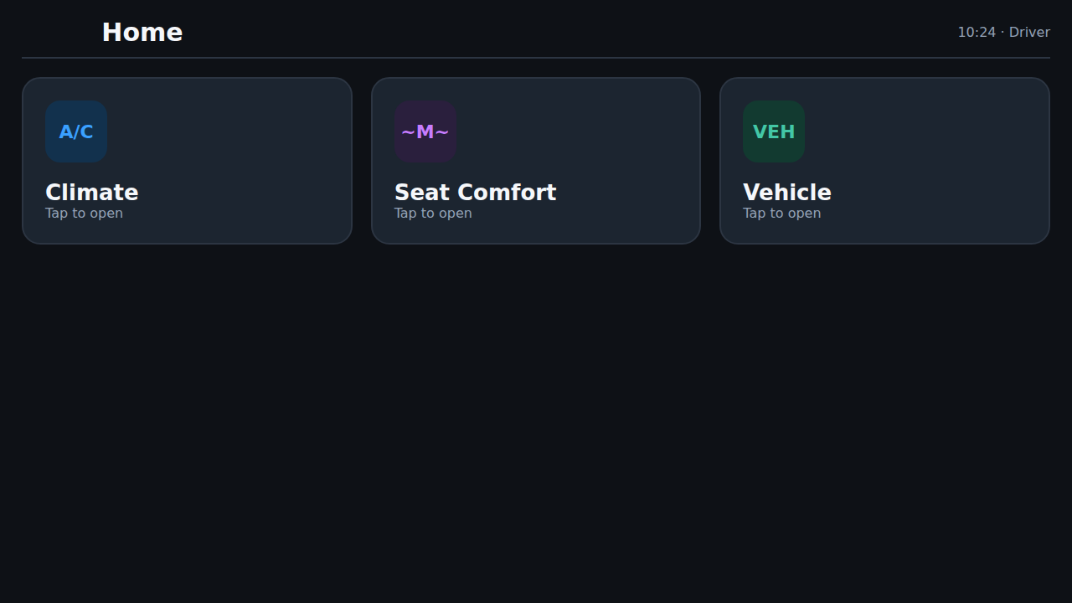
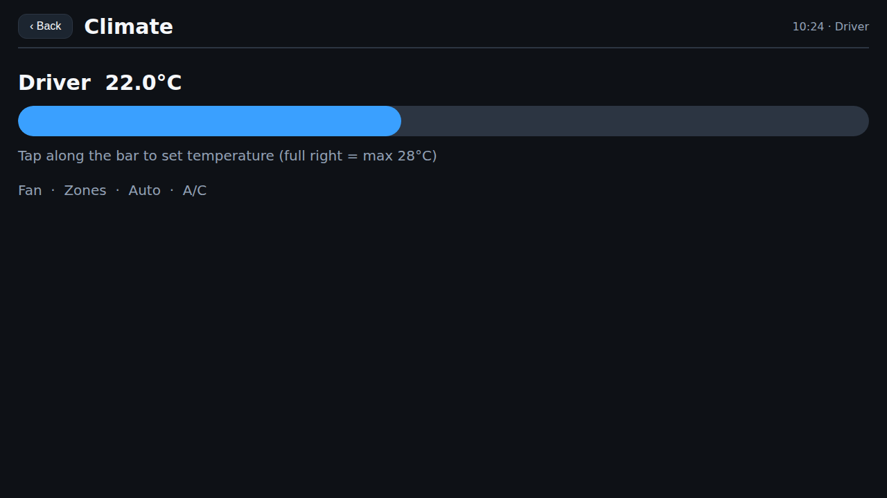
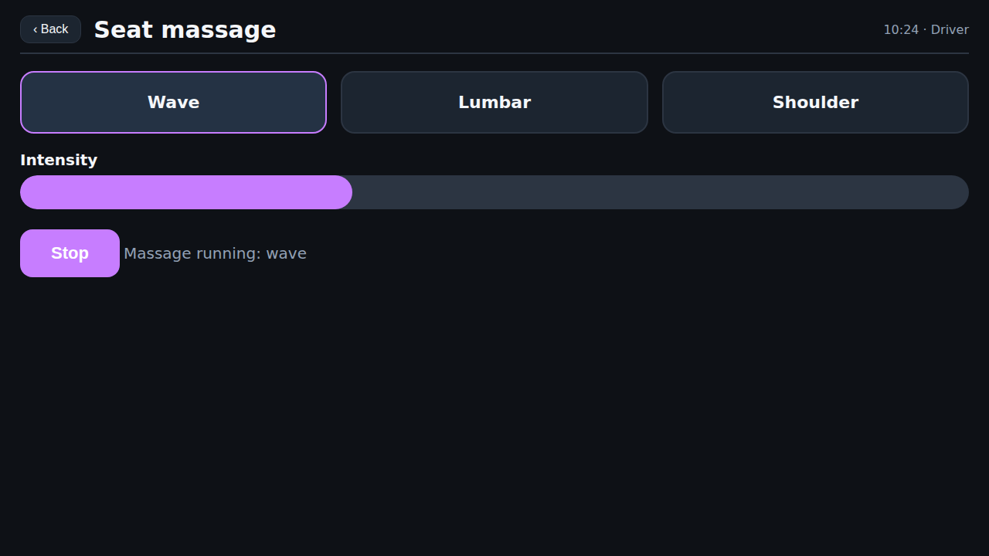
IT WORKS, END TO END — FULLY LOCAL
Custom IVI: two goals, zero fixed coordinates
Home
Climate
Seat massage
Starting screen
“Open the climate screen” ✓
“Start the seat massage” ✓
Local qwen3-vl:8b · guided only by the PDF-derived knowledge profile · native WebView app (Chrome drops synthetic ADB taps on web content)
Notes:
This is the money slide. Both goals pass on a custom, brand-styled IVI with no accessibility tree and proprietary icons. Mention the WebView detail: browsers drop synthetic taps, so we wrap the mock in a tiny native app.

Slide 8
PROOF IT'S NOT A TOY
AndroidWorld — a small local model in the cloud-SOTA band
Built-in-app subset · Android arm64 · offline
4 / 6
SystemWifiTurnOn
✓ PASS
SystemWifiTurnOff
✓ PASS
67% on this subset — fully offline
ContactsAddContact
✓ PASS
ClockStopWatchRunning
✓ PASS
~50–60%
SystemBrightnessMax
✗ FAIL
Cloud VLM agents (GPT-4o / Gemini class) on the full 116-task suite
SystemBrightnessMin
✗ FAIL
Honest caveats: a subset (not the full 116); the full suite needs an x86_64/KVM host; the two FAILs are the slider class — AndroidWorld's JSONAction has no precise drag. On a real device our agent does drag sliders.
Notes:
Volunteer the caveats — they make the number credible. The slider failures are a benchmark-API limitation, not an agent limitation: on a real device we issue a real adb swipe.

Slide 9
DEMO → UNATTENDED
Real bugs fixed getting it onto a physical-style surface
Landscape tap transposition
Progress read as “no progress”
Re-tapping a satisfied goal
SYMPTOM
SYMPTOM
SYMPTOM
wm size reports physical portrait (1080×2400) while the live landscape framebuffer is 2400×1080 — normalized taps landed transposed and missed.
A real state change with a tiny pixel delta (Start→Stop + “Massage running…”) looked static to a perceptual hash, so it looped.
A fine-grained subgoal tracker lagged after the overall goal was already met — the agent kept acting.
FIX
FIX
FIX
screen_size() reads the current screenshot's PNG header for true orientation; falls back to wm size.
screen_made_progress() also diffs visible UI text, not just pixels.
Recheck the overall goal before re-planning; finish the moment it verifies.
These are core-loop hardening, not demo hacks — they help on any rotated or custom surface. 119 tests cover the behavior.
Notes:
This slide earns engineering credibility: the unglamorous fixes that separate a one-off demo from something you can run unattended.

Slide 10
TRADE-OFFS, STATED PLAINLY
Why local — and where the edges are
Why local wins here
Honest limitations
Privacy / IP — unreleased head-unit screens never leave the bench
Cost — no per-call API bill across thousands of runs
Offline — works in a lab or vehicle with no connectivity
Reproducible — pinned local model, deterministic harness
Icon-only controls still depend on the local VLM's recognition
Visual verification proves the displayed UI, not the actuator — assert VHAL / CAN for real QA
A small model can pick a poor strategy; guards stop it safely but can't solve everything
Bench-test only — never a moving or production vehicle without safety review
Notes:
Say the limitations before they're asked. The actuator caveat is important: visual confirmation is necessary but not sufficient for real vehicle QA.

Slide 11
WHERE NEXT
A documentation-driven, offline IVI tester
Full 116-task AndroidWorld run on x86_64 / KVM
Real OEM manual + icon crops in place of the scaffold
Assert vehicle signal (VHAL / CAN) as ground truth alongside vision
Pilot on a real head unit — pick a target flow
You give it the goal. It reads the screen, reads the manual, and does the rest — offline.
Notes:
Close on the one-liner and your specific ask: pick a real head-unit flow to pilot.

