Slide 1

Predicting MLB Game Outcomes
By: Vince Purcell
Summer 2021 – Data Mining 2
Supervised by, Dr. Anthony Breitzman

Slide 2
Project Overview
1

Slide 3
Project Objectives
Collect Data using MLB’s Game Day API.
Perform Sentiment analysis to determine importance of various pitching and batting statistics.
Analyze various models for accuracy in predicting the winner of MLB game matchups.

Slide 4
Project Importance
MLB Teams would like to know the probability of their team winning based on different batting lineup and pitcher matchups
At this time of this presentation sports betting is legal in more than two dozen states.

Slide 5
What is Original
I decided to use MLB Season Stat predictions. Most research I investigated about this topic would use running averages.
I decided to include umpire statistics into the predictive model to see if there was an effect

Slide 6
Data Collection
2

Slide 7
Data Collection Approach
Collected Box Score, Game Summary, Player Data, and Player Stat Projections for each MLB matchup over past 4 years.
Used MLB-StatsAPI and the mlbgame API python packages to access MLB GameDay data.
Stored data into a MongoDB
API’s found at:
https://pypi.org/project/MLB-StatsAPI/
https://github.com/panzarino/mlbgame

Slide 8
Problems Encountered During Data Collection
MLB GameDay data was incomplete for a large portion of the games.
Python API’s had existing issues which was the reason for multiple data collection processes.

Slide 9
Database Choice
MongoDB synergizes well with the JSON outputs of the API’s.
The pymongo python package makes storing and accessing mongo documents immensely easy.
At the time of data collection I was unsure of what data specific data points.
Python Packages found at: https://pymongo.readthedocs.io/en/stable/

Slide 10
Data Analysis
3

Slide 11
Data Analysis Overview
Data Preparation
Predict Future Games
Sentiment Analysis on Regression Models
Analyze various models for accuracy

Slide 12
Data Preparation
Predict Future Games
Sentiment Analysis on Regression Models
Analyze various models for accuracy

Slide 13
Data Preparation
Read Mongo Collections for batting and pitching projections for both home and away teams.
Included home plate umpire to see if it had effect in prediction during sensitivity analysis
Target column will be whether home team won or lost the game

Slide 14
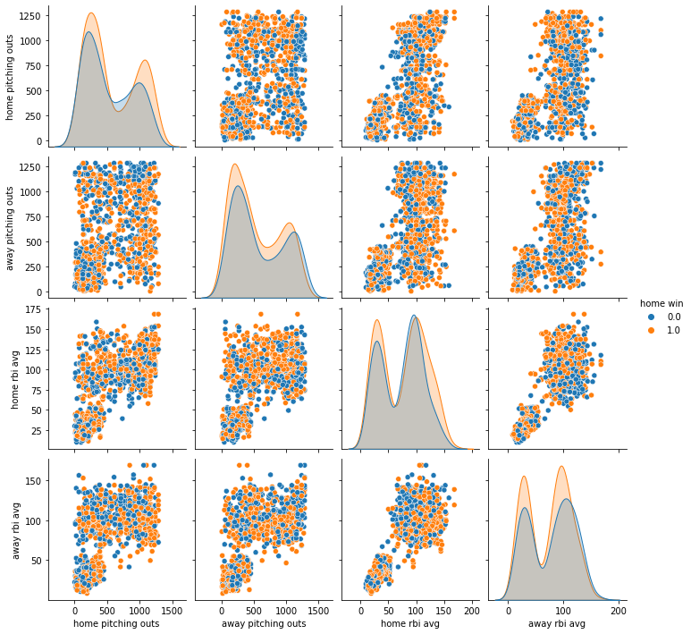
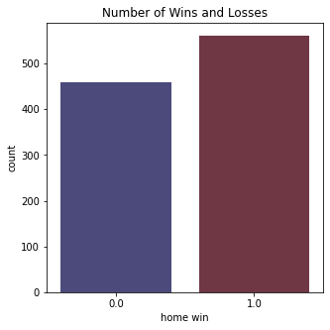
Data Preparation – Training Data Overview
Data Collection script collected data from 1,202 matchups and performed 85/15 training and test split
Data is not linearly separable
Plotting done using Seaborn python package
Python Packages found at:
https://seaborn.pydata.org/

Slide 15
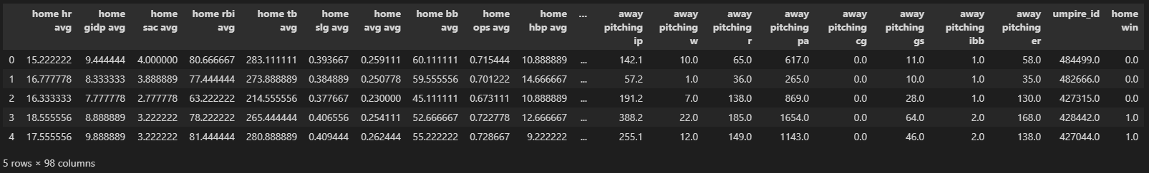
Data Preparation – Data Snippet
There were too many data features and all features may not prove to be influential.

Slide 16
Data Preparation
Predict Future Games
Sentiment Analysis on Regression Models
Analyze various models for accuracy

Slide 17
Sensitivity Analysis Overview
Sensitivity Analysis is done to quantify the relationship between model performance and dataset size or data features
Perform Sensitivity Analysis on Support Vector, Multilayer Perceptron, and Decision Tree Regression Models
Only included data features that prove to be more influential to cut down on dataset size

Slide 18
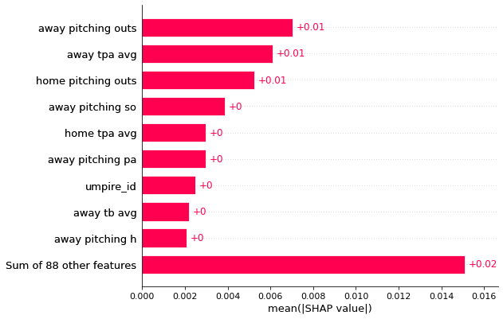
Sensitivity Analysis – Support Vector Regressor
TPA: Total Plate Appearances
PA: Pitches thrown per plate appearance
TB: Total Bases gained through hits
SO: Strike Outs
H: Total Hits

Slide 19
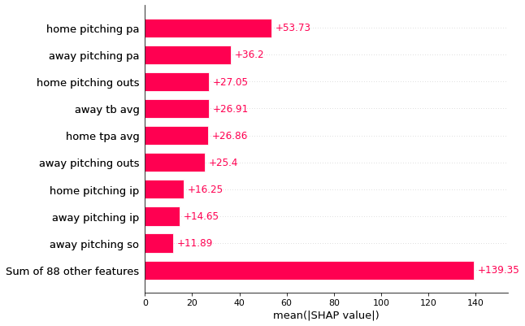
Sensitivity Analysis – MLP Regressor
PA: Pitches thrown per plate appearance
TB: Total Bases gained through hits
TPA: Total Plate Appearances
IP: Innings Pitched
SO: Strike Outs

Slide 20
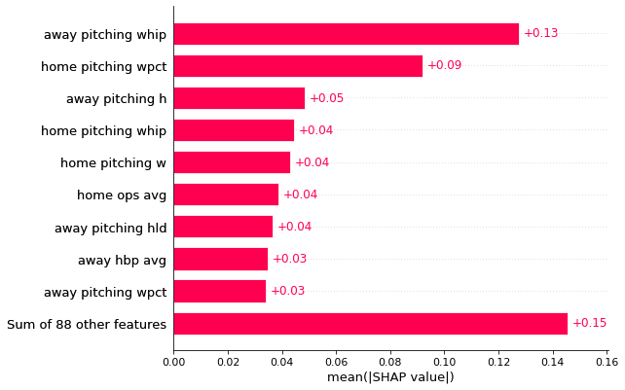
Sensitivity Analysis – Decision Tree Regressor
WHIP: Walks plus hits per inning
WPCT: Win percentage
H: Hits
OPS: Addition of on-base percentage and
slugging percentage
HLD: A Hold

Slide 21
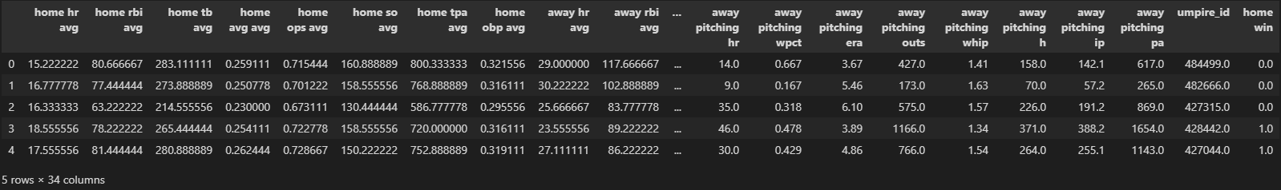
New Data Snippet
Data now cut down to 33 data features after sensitivity analysis

Slide 22
Data Preparation
Predict Future Games
Sentiment Analysis on Regression Models
Analyze various models for accuracy

Slide 23
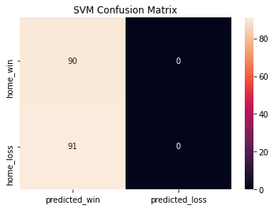

SVM and MLP
Both models either predicted all games as wins or losses
Data is not linearly separable, so this was expected

Slide 24
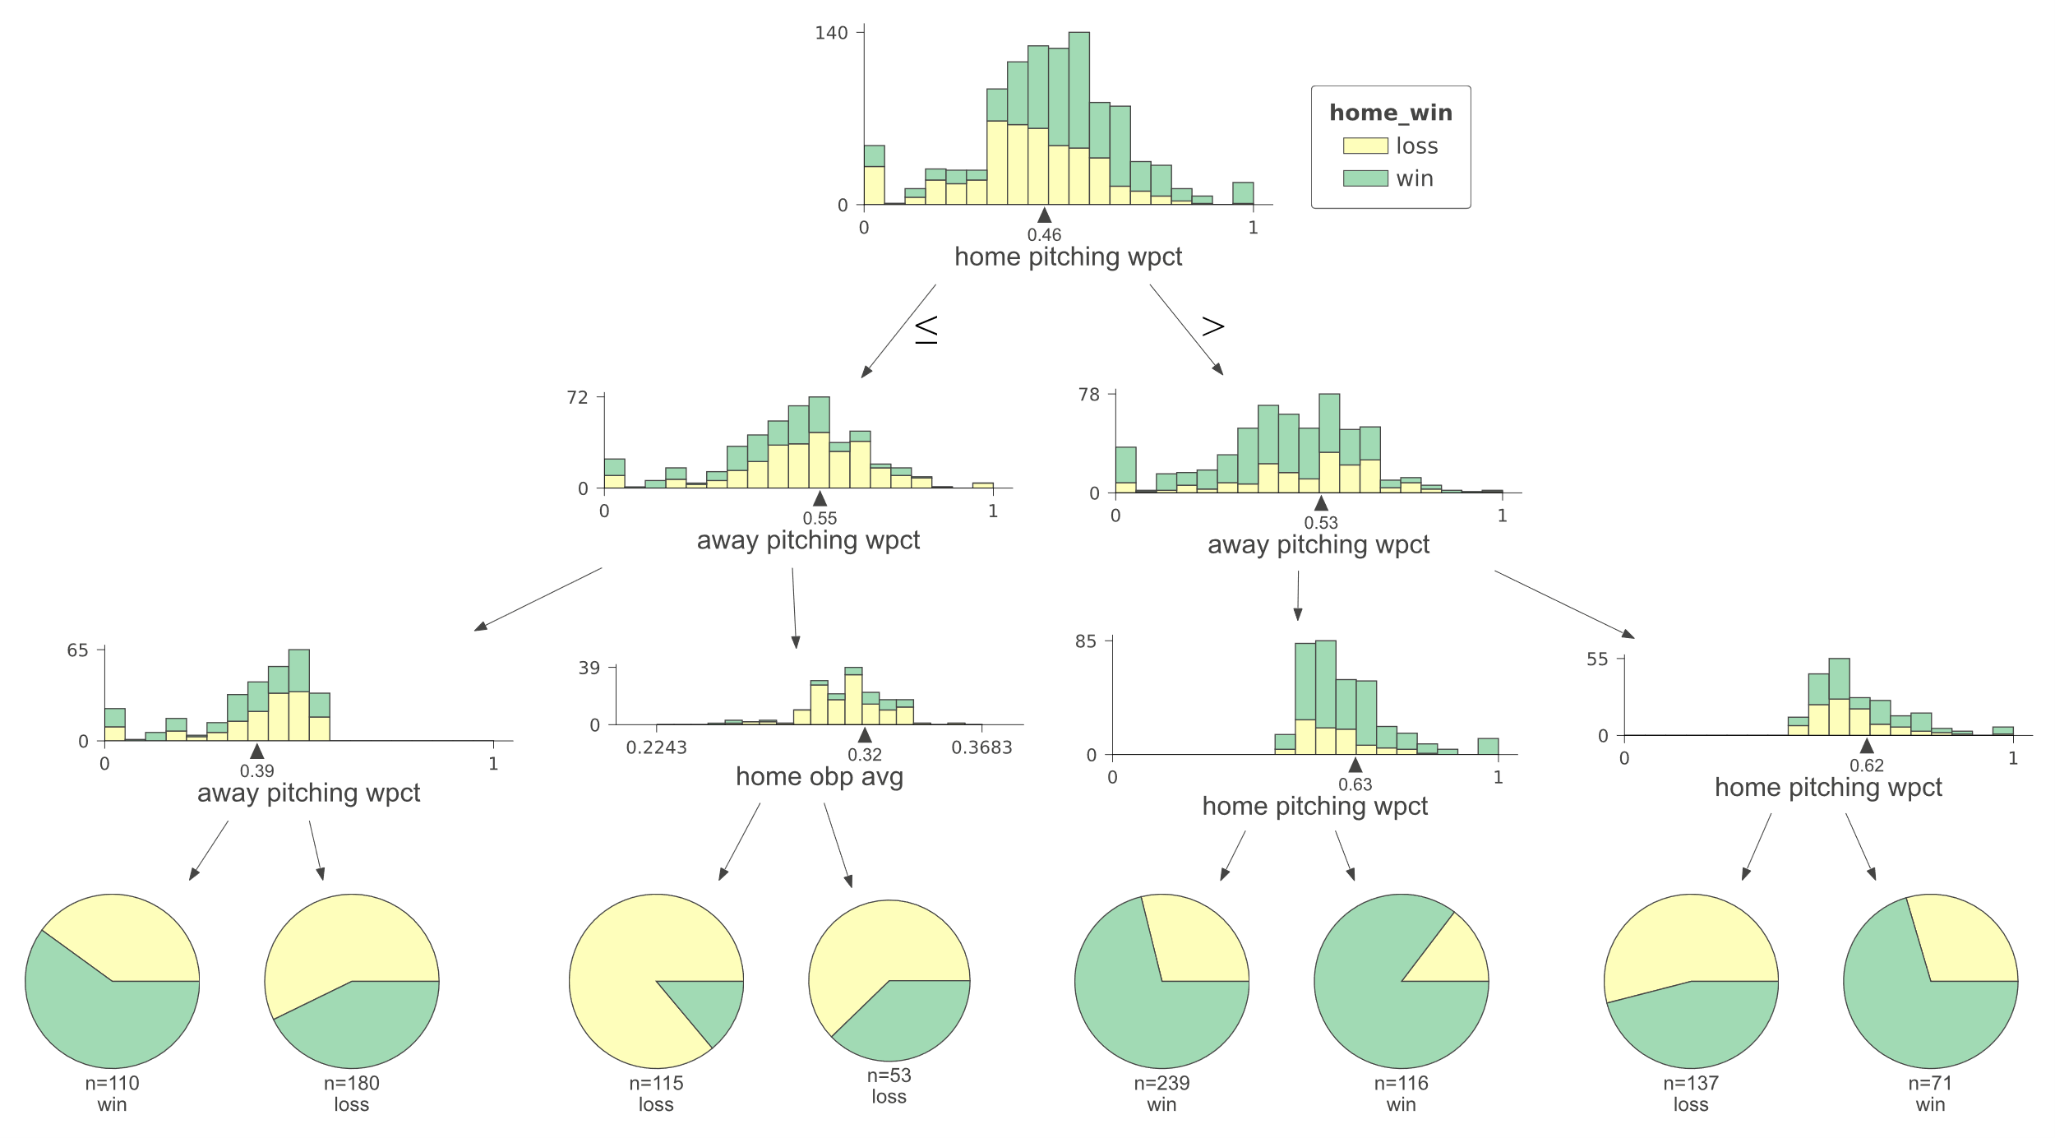

Decision Tree
Decision Trees are best suited for this data set
Decision Tree with a max depth of 3 performed at 69% accuracy
Great python package called dtreeviz for Decision Tree visualization
Python Packages found at:
https://github.com/parrt/dtreeviz

Slide 25
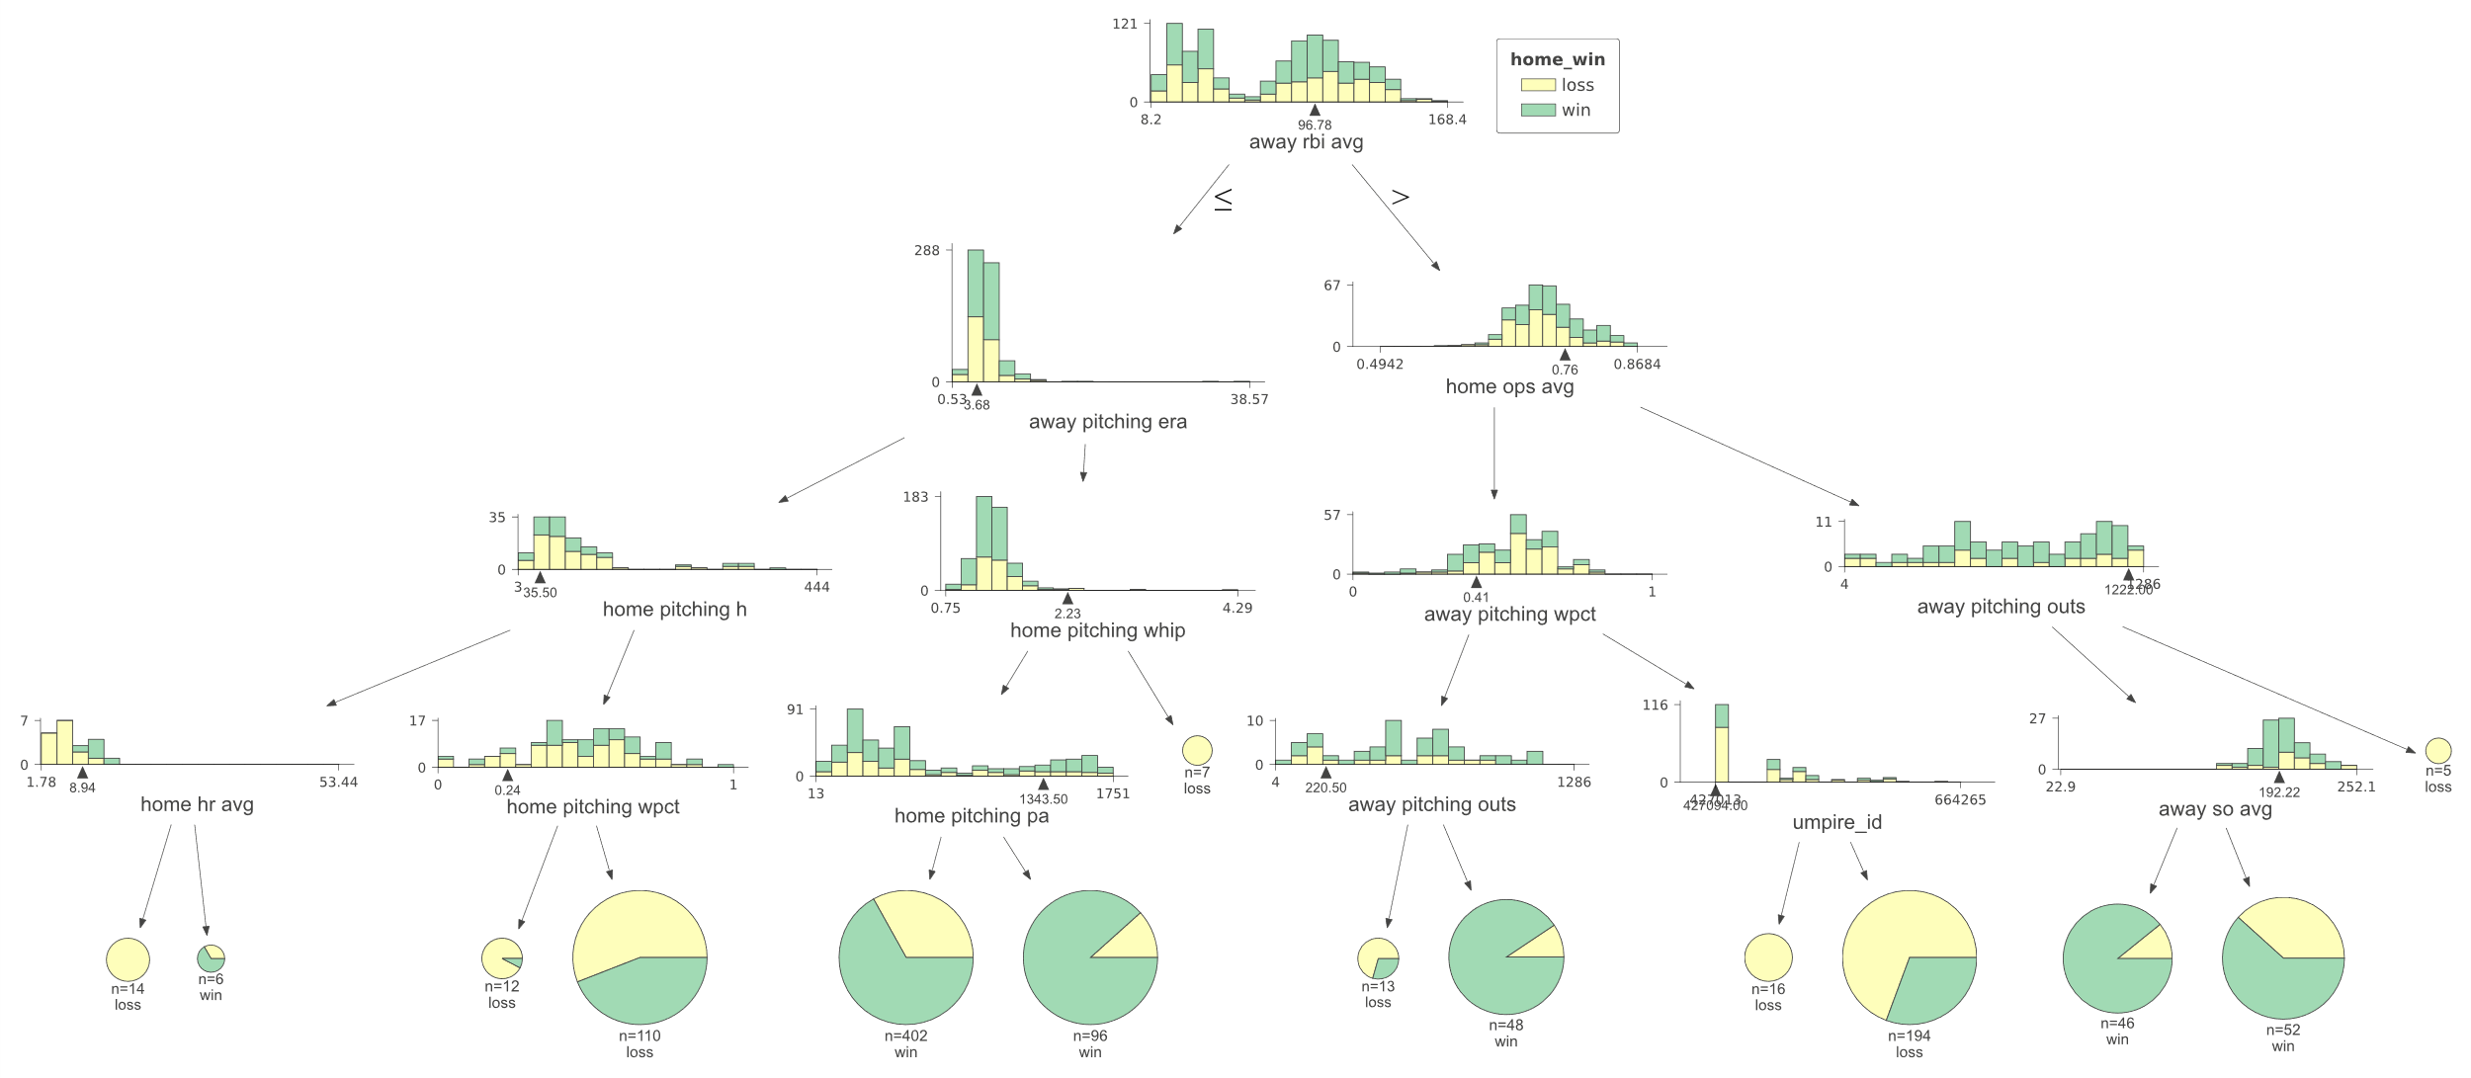

Random Forest
Random Forest with a max depth of 4 and an “entropy” criterion produced bests results
Over 70% accuracy for training data

Slide 26
Data Preparation
Predict Future Games
Sentiment Analysis on Regression Models
Analyze various models for accuracy

Slide 27
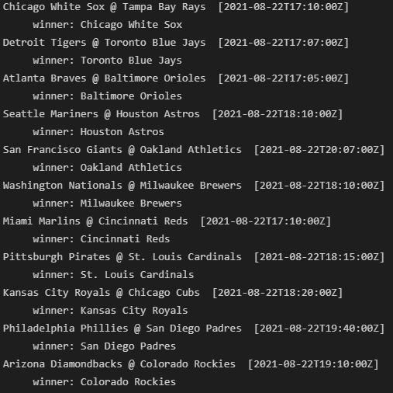
Predicting Future Games
Store data in MongoDB Collections separate from Training Data in order to not interfere with model training
MLB Game Day data is available for future games only at most 3 days out due to starting pitcher and lineup changes
After running this on a few days throughout the month of August I found it will get anywhere between 55-80%
Example output when given 08/22 as the date

Slide 28
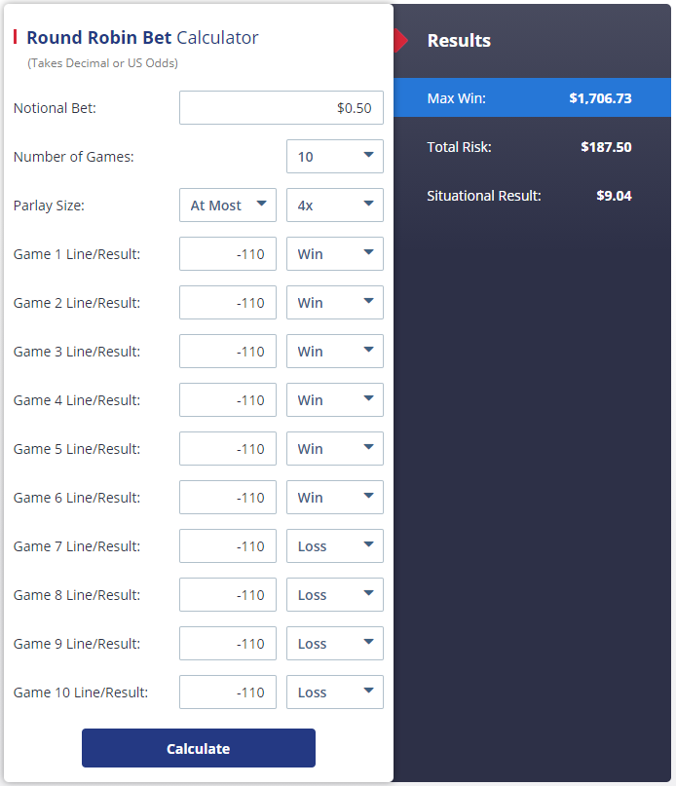


Predicting Future Games – Betting Scenarios
Best option would be to do Round Robin betting.
Round Robins are parlay bets that bet every combination that you specify
60% correct - $9 gain
70% correct - $205 gain
80% correct - $523 gain

Slide 29
Conclusion
3

Slide 30
Conclusion
For sports predictions, any model worth while will need to be at least 65% accurate.
Decision Trees and Random Forests are most likely the best solution for any data science problems that involve sports statistics.
My code found at:
https://github.com/VPurcell99/DataMining2/tree/main/MLBOutcomePrediction

Slide 31
Thanks for Watching!

