Slide 1
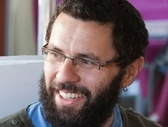
Relaxed Locally Correctable Codes with Improved Parameters
Vahid R. Asadi Simon Fraser University
Joint work with Igor Shinkar Simon Fraser University
November 2020

Slide 2







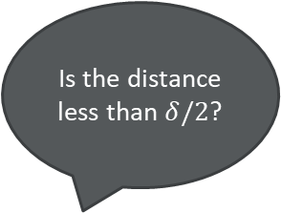
Error-correcting Codes
An encoding $C:Σ^{k}→Σ^{n}$ with rate $r$ and distance $δ$.
Is the distance less than $δ/2$?
Message $m$
$$Enc(m)$$
$$Dec(w)$$
Message $m$

Slide 3




Locally Decodable Codes (LDCs)
What if we want to decode only one bit of the message? Do we need to decode the entire message?
Definition 1. A code $C:Σ^{k}→Σ^{n}$ is said to be $(q, τ)$-locally decodable if for any coordinate $i∈[k]$ and any $w∈Σ^{n}$ such that $dist\left(w, C\left(m\right)\right)<τ$ we have
$\operatorname{Pr}{[Dec^{w}\left(i\right)=m_{i}]>\frac{2}{3}}$
$$i∈[k]$$
Local Decoder
$$m_{i}$$
$q$ queries
Corrupted Codeword

Slide 4
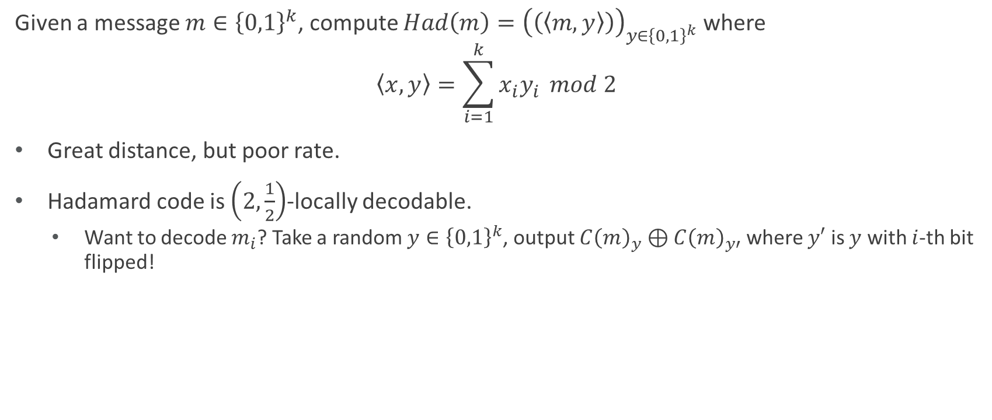
An example: Hadamard Code
Given a message $m∈{\left\{0,1\right\}}^{k}$, compute $Had\left(m\right)={\left(\left(\left\langle m,y\right\rangle \right)\right)}_{y∈{\left\{0,1\right\}}^{k}}$ where
$$\left\langle x,y\right\rangle =\sum_{i=1}^{k}{x_{i}y_{i}} mod 2$$
Great distance, but poor rate.
Hadamard code is $\left(2,\frac{1}{2}\right)$-locally decodable.
Want to decode $m_{i}$? Take a random $y∈{\left\{0,1\right\}}^{k}$, output $C{\left(m\right)}_{y}⊕C{\left(m\right)}_{y′}$ where $y′$ is $y$ with $i$-th bit flipped!

Slide 5

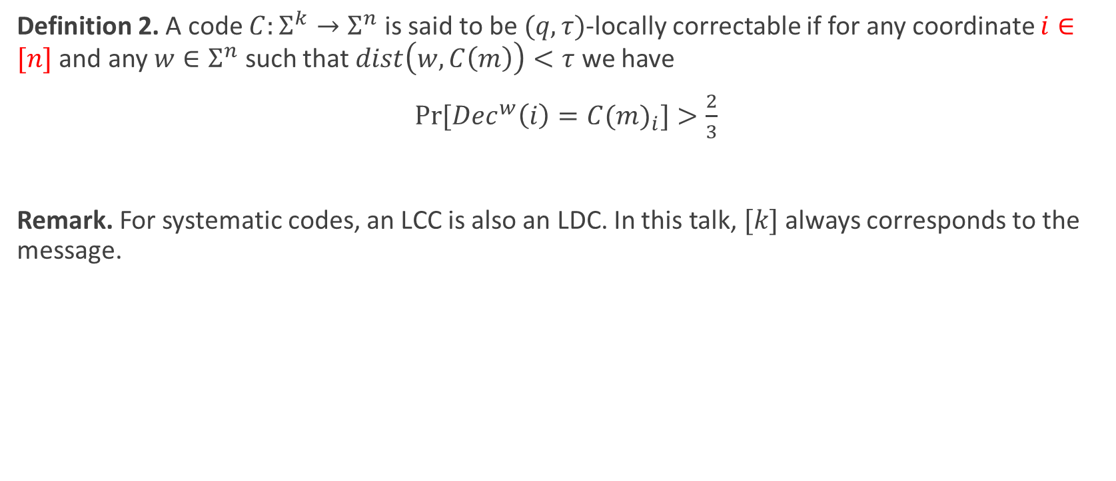

Locally Correctable Codes (LCCs)
Definition 2. A code $C:Σ^{k}→Σ^{n}$ is said to be $(q, τ)$-locally correctable if for any coordinate $i∈[n]$ and any $w∈Σ^{n}$ such that $dist\left(w, C\left(m\right)\right)<τ$ we have
$\operatorname{Pr}{[Dec^{w}\left(i\right)={C(m)}_{i}]>\frac{2}{3}}$
Remark. For systematic codes, an LCC is also an LDC. In this talk, $[k]$ always corresponds to the message.
$$i∈[n]$$
Local Decoder
$${C(m)}_{i}$$
$q$ queries
Corrupted Codeword

Slide 6
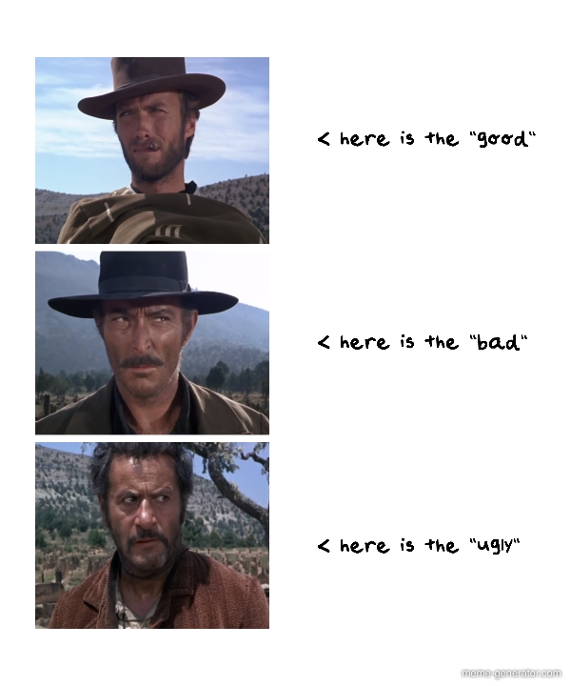
LDC Properties
The good: Many application! For instance, in cryptography, complexity, construction of PCPs, and …
The bad: Poor rate! The best known constructions have super-polynomial length [Yek08], [Efr12].
The ugly: Huge gap between constructions and lower bounds! Best known lower bounds are super-linear [KT00], [Woo07].

Slide 7
Relaxed Locally Decodable Codes (RLDCs)
Introduced by Ben-Sasson et al. [BGHSV06]
Key idea: Allow the decoder to say “Don’t know” if it detects that the input is noisy.
This suffices for many applications.

Slide 8


Relaxed Locally Decodable Codes
Definition 3. A code $C:Σ^{k}→Σ^{n}$ is said to be $(q, τ)$-relaxed locally decodable if for any coordinate $i∈[k]$
Completeness: If $w=C(m)$, we have $Dec^{w}\left(i\right)=m_{i}$.
Soundness: For any $w∈Σ^{n}$ such that $dist\left(w, C\left(m\right)\right)<τ$ we have
$\operatorname{Pr}{[Dec^{w}\left(i\right)∈\{m_{i}, ⊥\}]>\frac{2}{3}}$
$$i∈[k]$$
Relaxed Local Decoder
$$m_{i}/⊥$$
$q$ queries
Corrupted Codeword

Slide 9


Relaxed Locally Correctable Codes
Definition 4. A code $C:Σ^{k}→Σ^{n}$ is said to be $(q, τ)$-relaxed locally decodable if for any coordinate $i∈[n]$
Completeness: If $w=C(m)$, we have $Dec^{w}\left(i\right)={C(m)}_{i}$.
Soundness: For any $w∈Σ^{n}$ such that $dist\left(w, C\left(m\right)\right)<τ$ we have
$\operatorname{Pr}{[Dec^{w}\left(i\right)∈\{{C(m)}_{i}, ⊥\}]>\frac{2}{3}}$
$$i∈[n]$$
Relaxed Local Decoder
$${C\left(m\right)}_{i}/⊥$$
$q$ queries
Corrupted Codeword

Slide 10
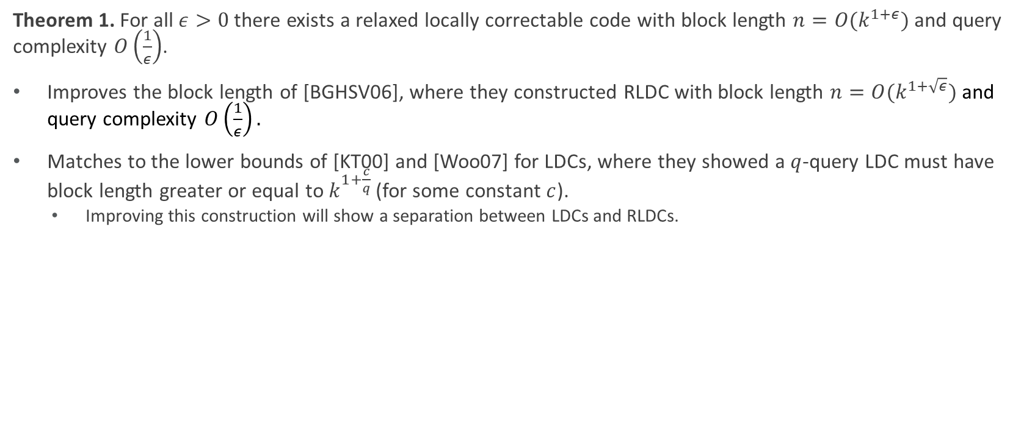
Main Result
Theorem 1. For all $ε>0$ there exists a relaxed locally correctable code with block length $n=O(k^{1+ε})$ and query complexity $O\left(\frac{1}{ε}\right)$.
Improves the block length of [BGHSV06], where they constructed RLDC with block length $n=O(k^{1+\sqrt{ε}})$ and query complexity $O\left(\frac{1}{ε}\right).$
Matches to the lower bounds of [KT00] and [Woo07] for LDCs, where they showed a $q$-query LDC must have block length greater or equal to $k^{1+\frac{c}{q}}$ (for some constant $c$).
Improving this construction will show a separation between LDCs and RLDCs.

Slide 11

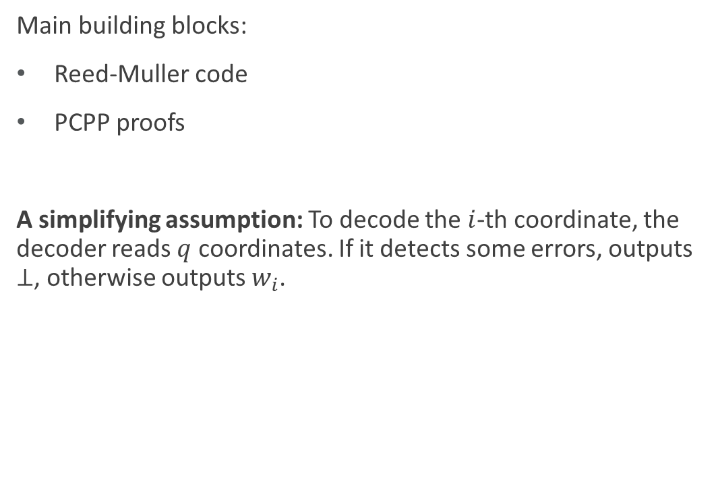
About Construction
Main building blocks:
Reed-Muller code
PCPP proofs
A simplifying assumption: To decode the $i$-th coordinate, the decoder reads $q$ coordinates. If it detects some errors, outputs $⊥$, otherwise outputs $w_{i}$.

Slide 12

Reed-Muller Codes
Definition 5: Given a field $F$ with size $n$, number of variables $m$, and a degree bound $d$, the code $RM_{F}[m,d]$ is the evaluation of all $m$-variate polynomials of degree at most $d$ over $F^{m}$.
Many applications in theoretical computer science and information theory.
We consider the setting of parameters where $d<n$.
In this case, the distance is $1−\frac{d}{n}$.
The rate is $>{\left(\frac{d}{mn}\right)}^{m}$.
Example: Think of a field big enough that we get $\left|F\right|>10d$.

Slide 13
How to check for errors?
An important property of Reed-Muller codes that we’ll use:
Restriction of Reed-Muller codes to planes and lines are also low-degree polynomials.
In other words, they’re codewords of smaller dimension.
So, we can use the planes and lines to do some local tests.

Slide 14
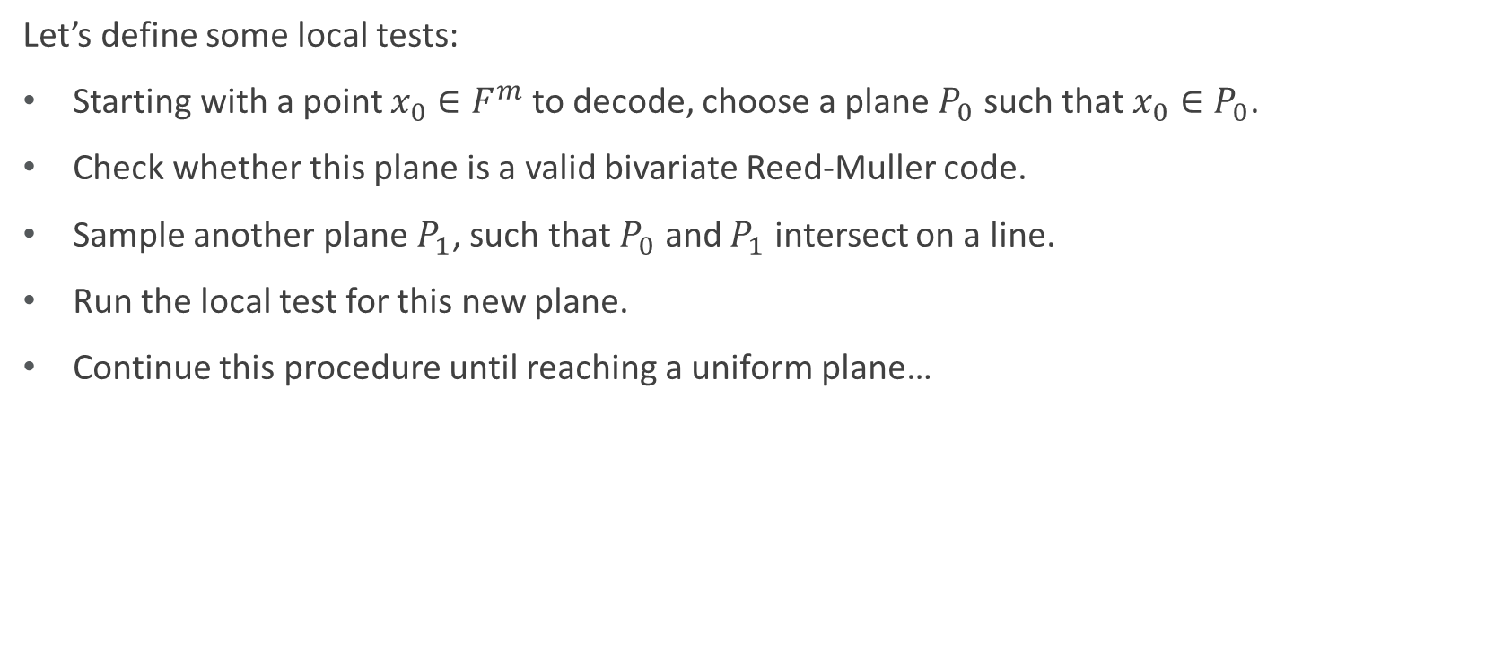
Local Tests
Let’s define some local tests:
Starting with a point $x_{0}∈F^{m}$ to decode, choose a plane $P_{0}$ such that $x_{0}∈P_{0}$.
Check whether this plane is a valid bivariate Reed-Muller code.
Sample another plane $P_{1}$, such that $P_{0}$ and $P_{1}$ intersect on a line.
Run the local test for this new plane.
Continue this procedure until reaching a uniform plane…

Slide 15
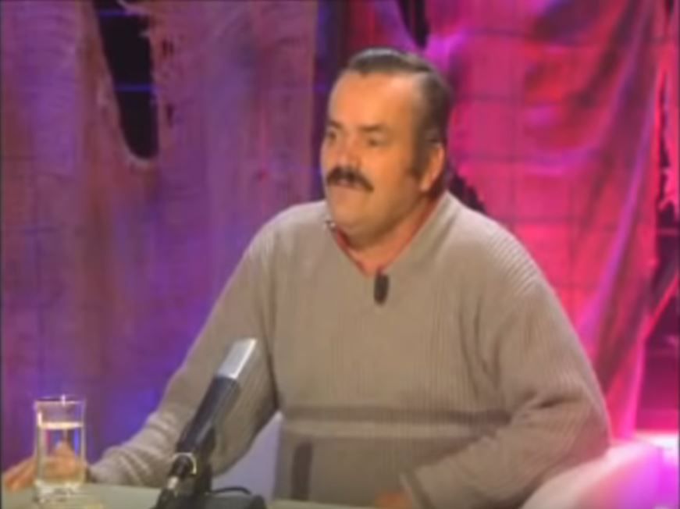
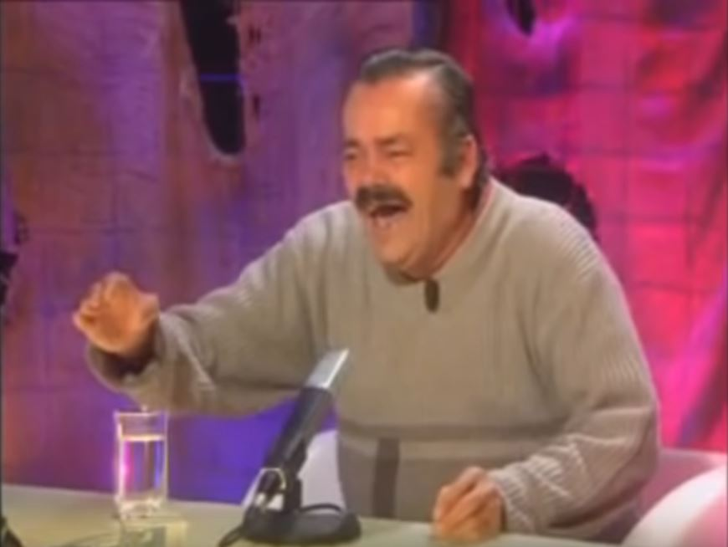
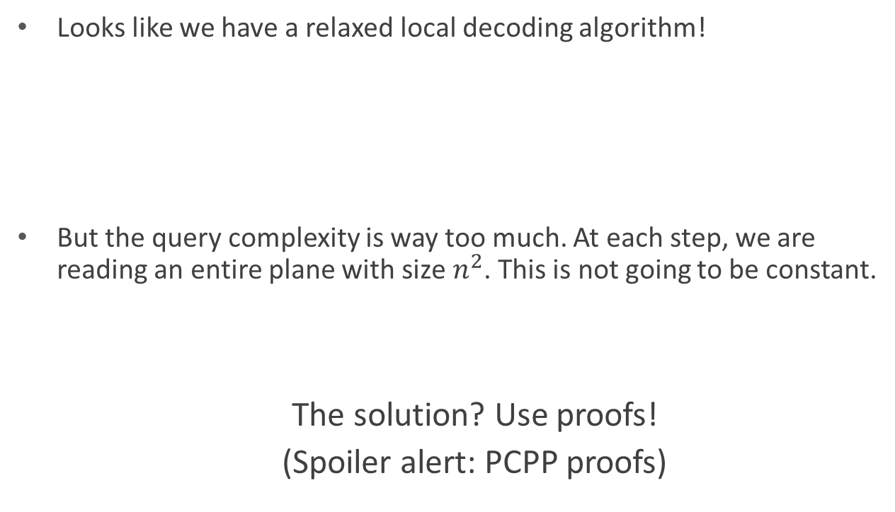
Everything looks good, but…
Looks like we have a relaxed local decoding algorithm!
But the query complexity is way too much. At each step, we are reading an entire plane with size $n^{2}$. This is not going to be constant.
The solution? Use proofs!
(Spoiler alert: PCPP proofs)

Slide 16

PCPPs
Definition 6 (PCPs of Proximity): For a language $L$, and a proximity parameter $ρ$, a $q$-query PCPP verifier receives oracle access to an input $x$ and proof $π$. It makes $q$ queries and has the following properties:
Completeness: For all $x∈ L$, there exists $π$ s.t. $\operatorname{Pr}\left[V^{x,π}=ACC\right]=1$.
Soundness: If $x$ is $ρ$-far from $L$, for any $π$, $\operatorname{Pr}\left[V^{x,π}=ACC\right]≤ε$.

Slide 17
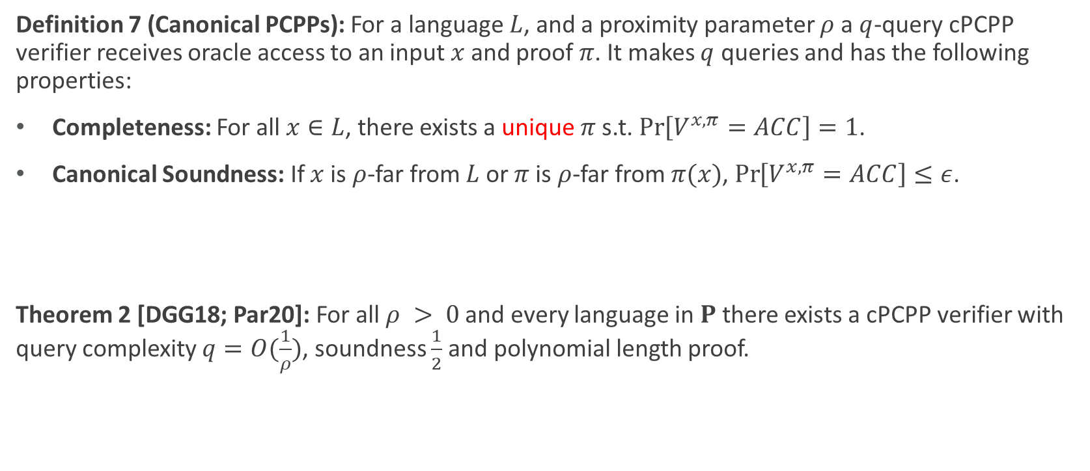
cPCPPs
Definition 7 (Canonical PCPPs): For a language $L$, and a proximity parameter $ρ$ a $q$-query cPCPP verifier receives oracle access to an input $x$ and proof $π$. It makes $q$ queries and has the following properties:
Completeness: For all $x∈L$, there exists a unique $π$s.t. $\operatorname{Pr}\left[V^{x,π}=ACC\right]=1$.
Canonical Soundness: If $x$ is $ρ$-far from $L$ or $π$ is $ρ$-far from $π(x)$, $\operatorname{Pr}\left[V^{x,π}=ACC\right]≤ε$.
Theorem 2 [DGG18; Par20]: For all $ρ > 0$and every language in $P$ there exists a cPCPP verifier with query complexity $q=O(\frac{1}{ρ})$, soundness $\frac{1}{2}$ and polynomial length proof.

Slide 18
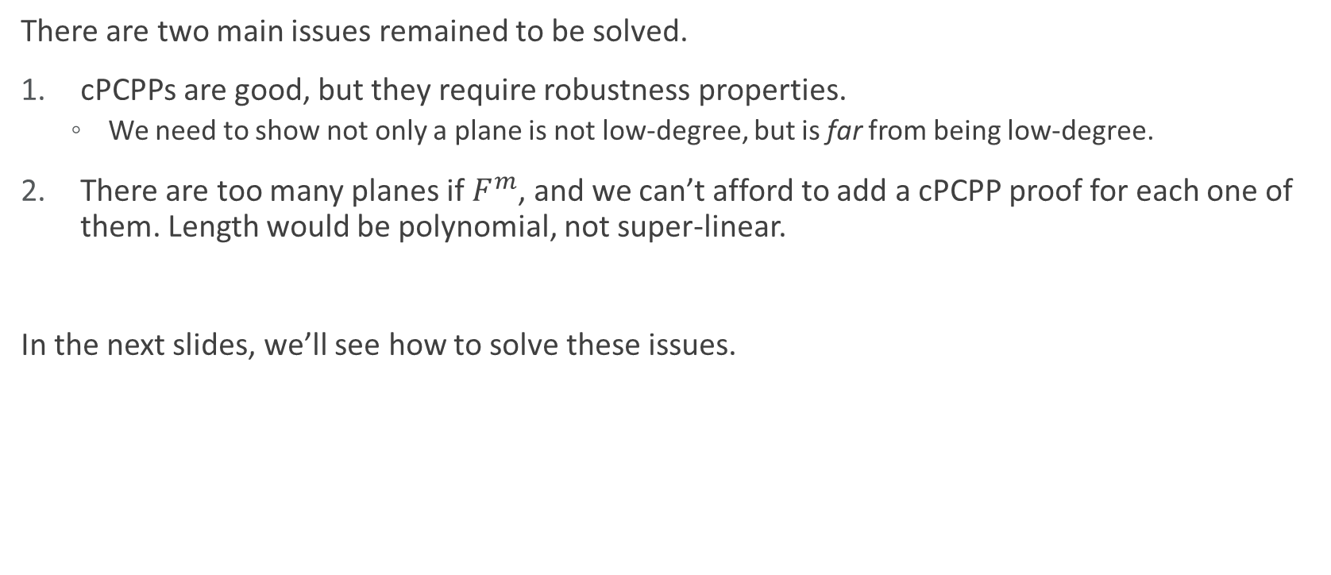
Some Issues…
There are two main issues remained to be solved.
cPCPPs are good, but they require robustness properties.
We need to show not only a plane is not low-degree, but is far from being low-degree.
There are too many planes if $F^{m}$, and we can’t afford to add a cPCPP proof for each one of them. Length would be polynomial, not super-linear.
In the next slides, we’ll see how to solve these issues.

Slide 19


Consistency Tests
We use two type of consistency tests:
Plane vs. point: check whether a point is consistent with the rest of the plane.
Plane vs. line: check whether a line is consistent with the rest of the plane
$$p$$
$$ℓ$$

Slide 20




Plane vs Point Test
We want to make sure that an adversary cannot change just one bit and we skip it.
Let’s copy the desired point $n^{2}$ times, so it contributes to half of the weight. Now define:
$RM_{P}^{\left(p\right)}=\{Q∘Q_{p}^{\left(n^{2}\right)}:Q is a low degree polynomial\}$
$$p$$
$$p^{n^{2}}$$
$$P$$

Slide 21
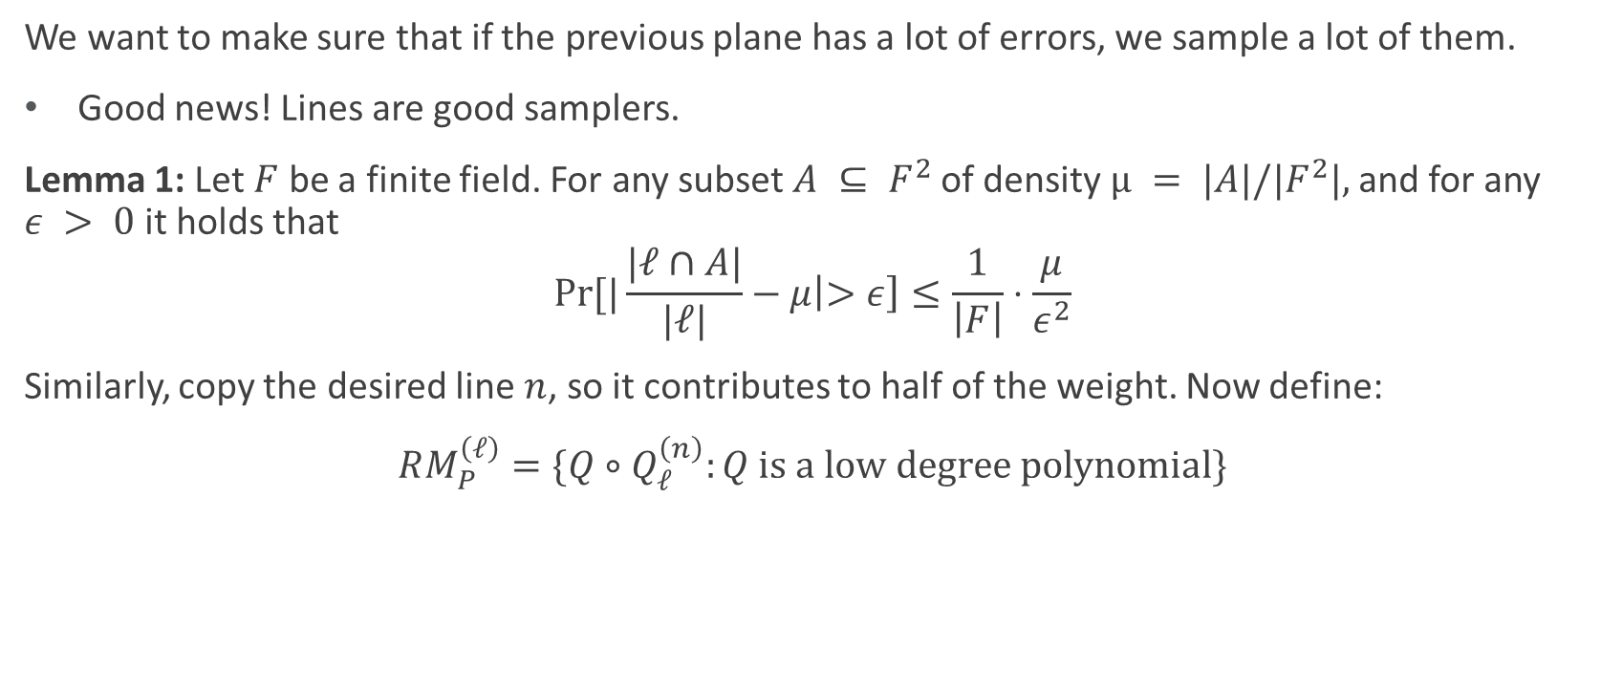
Plane vs Line Test
We want to make sure that if the previous plane has a lot of errors, we sample a lot of them.
Good news! Lines are good samplers.
Lemma 1: Let $F$ be a finite field. For any subset $A ⊆ F^{2}$of density $µ = |A|/|F^{2}|,$and for any $ε > 0$it holds that
$$\operatorname{Pr}{[|\frac{|ℓ∩A|}{|ℓ|}}−μ\left|>ε\right]≤\frac{1}{\left|F\right|}⋅\frac{μ}{ε^{2}}$$
Similarly, copy the desired line $n$, so it contributes to half of the weight. Now define:
$RM_{P}^{\left(ℓ\right)}=\{Q∘Q_{ℓ}^{\left(n\right)}:Q is a low degree polynomial\}$

Slide 22
Consistency Test using Random Walk
Defined in [CGS20] for tensored codes.
Here we modify it for Reed-Muller codes.
How the random walk works?
Start by picking a plane which contains the desired point.
At each step, sample a line from previous plane, then sample another plane that contains that line.
Do the above iteration until you reach a uniform plane.
Check whether all the planes are low-degree.

Slide 23
So far…
We have found a solution for the first issue.
We still need to reduce the number of planes we use.
Need two general properties from the planes:
Total number of planes is not very much!
Rapid mixing in the random walk.

Slide 24
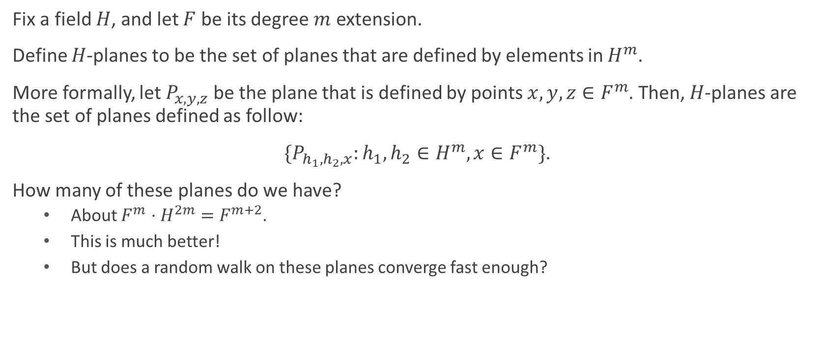
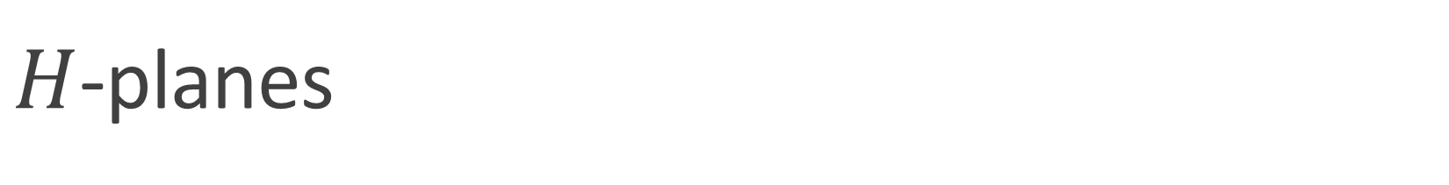
$H$-planes
Fix a field $H$, and let $F$ be its degree $m$ extension.
Define $H$-planes to be the set of planes that are defined by elements in $H^{m}$.
More formally, let $P_{x,y,z}$ be the plane that is defined by points $x,y,z∈F^{m}$. Then, $H$-planes are the set of planes defined as follow:
$\{P_{h_{1},h_{2},x}:h_{1},h_{2}∈H^{m},x∈F^{m}\}$.
How many of these planes do we have?
About $F^{m}⋅H^{2m}=F^{m+2}$.
This is much better!
But does a random walk on these planes converge fast enough?

Slide 25


Mixing Time for $H$-planes
Claim: Let $\vec{h_{1}}\text{, }\vec{h_{2}}\text{,}…\text{, }\vec{h_{m}}∈H^{m}$ be chosen uniformly at random, and $t_{1},t_{2},…,t_{m}∈F$ be chosen uniformly at random. Then $t_{1}\vec{h_{1}}\text{+}t_{2}\vec{h_{2}}\text{ +}…\text{+}t_{m}\vec{h_{m}}$ is $o(1)$-close to uniform in $F^{m}$.
This means after $m$ steps, a uniform point in the last plane is (close to) a uniform point in $F^{m}$.
From now on, we just consider $H$-planes, and we concatenate a cPCPP proof for all lines and points in $H$-planes.

Slide 26
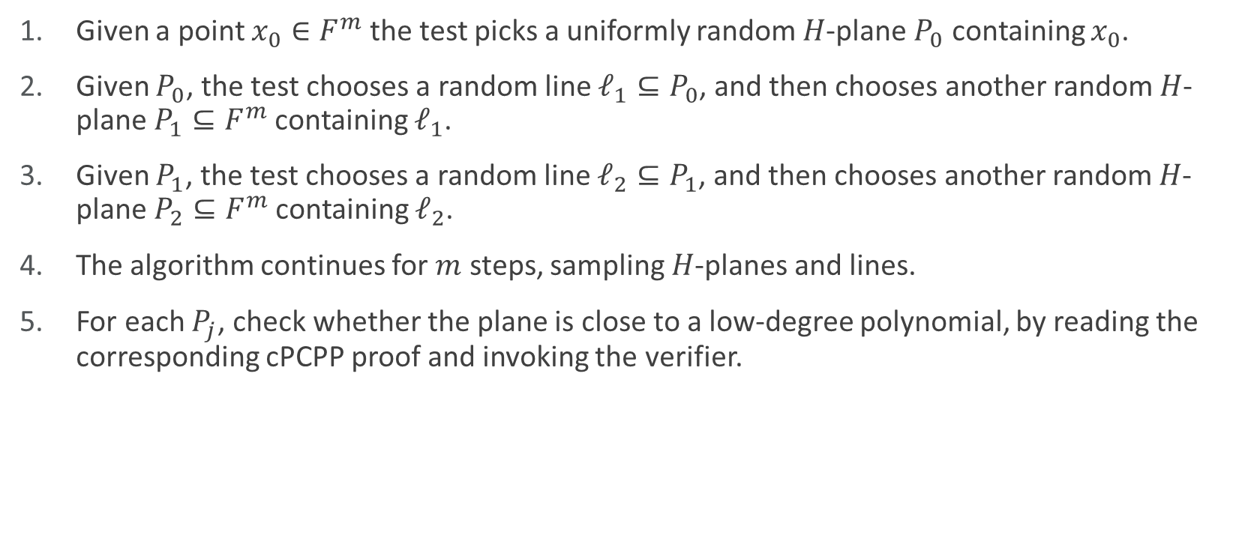
Relaxed Local Decoding Algorithm
Given a point $x_{0}∈F^{m}$ the test picks a uniformly random $H$-plane $P_{0}$ containing $x_{0}$.
Given $P_{0}$, the test chooses a random line $ℓ_{1}⊆P_{0}$, and then chooses another random $H$-plane $P_{1}⊆F^{m}$containing $ℓ_{1}$.
Given $P_{1}$, the test chooses a random line $ℓ_{2}⊆P_{1}$, and then chooses another random $H$-plane $P_{2}⊆F^{m}$containing $ℓ_{2}$.
The algorithm continues for $m$ steps, sampling $H$-planes and lines.
For each $P_{j}$, check whether the plane is close to a low-degree polynomial, by reading the corresponding cPCPP proof and invoking the verifier.

Slide 27

CTRW Theorem
Theorem 3 [A., Shinkar ‘20]: If $w$ is close to some codeword $c∈RM$ but $w_{x_{0}}≠c_{x_{0}}$, then with high probability
either $w_{|P_{0}}^{(x_{0})}$ is $Ω\left(1\right)$-far from bivariate $RM_{P}^{\left(x_{0}\right)}$
or $w_{|P_{j}}^{(ℓ_{j})}$ is $Ω(1)$-far from bivariate $RM_{P}^{\left(ℓ_{j}\right)}$.

Slide 28

Code Construction
The actual code consists of 3 parts. Given a message $m$
First, encode it using Reed-Muller encoding,
Next, add plane vs. point proofs for all points in $F^{m}$ and $H$-planes
Finally, concatenate all the plane vs. line tests for $H$-planes.

Slide 29

Composition Theorem
Theorem 4: Composing the Reed-Muller code with cPCPP proofs will result in a RLDC with block length
$$N=n^{m+O(1)}≤{\left(4m⋅2^{m}\right)}^{m+O\left(1\right)}⋅{\left(\frac{d}{m}\right)}^{m+O\left(1\right)}=2^{O\left(m^{2}\right)}⋅K^{1+O\left(\frac{1}{m}\right)},$$
And query complexity $O\left(m\right),$ $τ=Ω(1)$, and relative distance at least $\frac{1}{2}\left(1−\frac{d}{n}\right)≥\frac{3}{4}$.

Slide 30
What about RLCC?
The idea to make this code an RLCC is to encode the proofs with some systematic RLCC (i.e., [CGS20], [GRR18]).
So you can access the proof from the message part of the code.
Also, you are able to decode locally decode the proof, using the inner RLCC.
Be careful! First, you need to make sure that the cPCPP proof actually corresponds to the low-degree test.

Slide 31
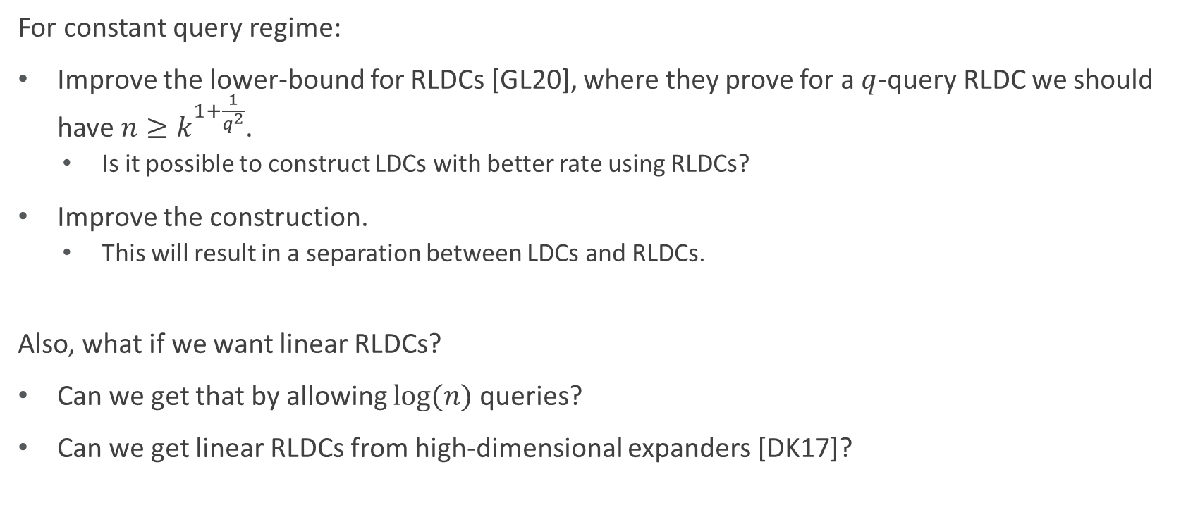
Open Problems
For constant query regime:
Improve the lower-bound for RLDCs [GL20], where they prove for a $q$-query RLDC we should have $n≥k^{1+\frac{1}{q^{2}}}$.
Is it possible to construct LDCs with better rate using RLDCs?
Improve the construction.
This will result in a separation between LDCs and RLDCs.
Also, what if we want linear RLDCs?
Can we get that by allowing $\log{(n)}$ queries?
Can we get linear RLDCs from high-dimensional expanders [DK17]?

Slide 32
Thanks! ☺ Stay safe, and stay relaxed!

