Slide 1
HACKWITHAMYPO 2026
Stage 2 Submission
TEAM INFY (AMY00107) • KPR Institute of Engineering and Technology
PS7 - LOCAL DATABASE QUESTION-ANSWERING SYSTEM (NO THIRD-PARTY API) PS2 - AI Hallucination Detection and Reliablity Scoring System.
Team Leader: Sanjai M S | Teammate: Reshekumar V

Slide 2
02 / 09 PROBLEM UNDERSTANDING
Restate the problem, in your own words
Who is affected? Students and staff members at the institution. What's broken today? The inability to safely query sensitive structured academic records and unstructured policies without relying on third-party cloud APIs that compromise privacy.
Why does it matter? Cloud-dependent solutions introduce data privacy risks, require constant internet access, and are prone to hallucinations when dealing with critical structured academic data. Evidence The project mandates a 100% offline, self-hosted architecture to guarantee complete institutional compliance and zero data hallucinations.
HackWithAMYPO 2026 — Stage 2

Slide 3
03 / 09 PROPOSED SOLUTION
Your idea, in one clear statement
A fully self-hosted, integration-ready Database Question-Answering System that processes structured records and unstructured documents entirely offline.
How it works
Key features
Boundaries
The system classifies a query's intent and routes it to either a ChromaDB vector index or parameterized SQL queries against SQLite, synthesizes a natural language answer using a local Qwen2.5 LLM, and then intercepts the output through an automated Trust Layer that fact-checks the answer against the local database before showing it to the user.
Role-Based Access Control (RBAC) for securing isolated data views.
Dual-way Speech-to-Text and Text-to-Speech voice interaction.
Interactive knowledge graphs for dynamic concept mapping and sprint milestones.
Enterprise Trust Layer & Reliability Scoring to automatically detect and flag hallucinations, providing a verifiable confidence score for every answer.
Deliberately excludes real-time integration with external third-party cloud Learning Management Systems (LMS) and public internet web scraping.
HackWithAMYPO 2026 — Stage 2

Slide 4
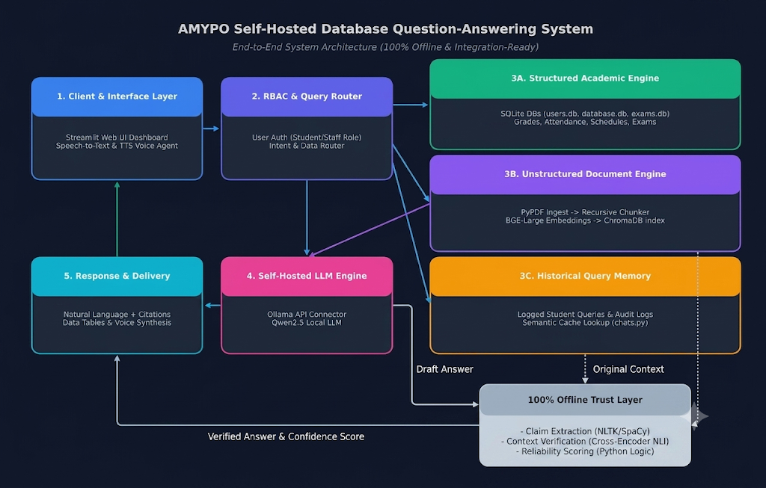
04 / 09 APPROACH & ARCHITECTURE
How the pieces fit together
HackWithAMYPO 2026 — Stage 2

Slide 5
05 / 09 TECH STACK
What you're building with, and why
Layer | Technology | Why this choice?
Front end | HTML/ CSS/ JS | Delivers an intuitive, responsive multi-page web dashboard with interactive elements and voice controls without webserver complexity.
Backend | Python 3.10 + Flask Engine | Offers seamless integration with ML libraries, database connectors, and asynchronous task execution.
AI / Model | BAAI/bge-large-en-v1.5 & Qwen2.5 (Quantized via Ollama API) | Provides state-of-the-art offline embeddings and exceptional multi-step reasoning with zero API costs and full data privacy.
Data / Storage | ChromaDB & SQLite | Manages lightweight vector storage for similarity searches and zero-configuration, ACID-compliant embedded databases for structured records locally.
Claim Extraction Engine | SpaCy / NLTK | High-speed, zero-compute sentence splitting (100% offline)
Fact-Checking / NLI Engine | sentence-transformers (cross-encoder/nli-deberta-v3-small) | Running locally to detect logical entailment or contradiction.
Orchestration | Pure Python | Calculating the mathematical Reliability Score.
HackWithAMYPO 2026 — Stage 1 Template

Slide 6
06 / 09 FEASIBILITY & PLAN
What's realistic to build in the hackathon window
Core Build
Integration
Polish & Demo
Setup
Connected UI, voice, RBAC, and real-time Cross-Encoder verification systems.
LLM initialization via Ollama, parameterizing SQL queries, and establishing the intent routing pipeline.
Edge-case testing, UI refinement, and recording a fallback demo video.
Local environment preparation, ChromaDB initialization, and SQLite schema deployment.
→
→
→
Biggest risk & fallback
What's already built vs. new
Risk: Running both the Qwen2.5 LLM and the Cross-Encoder verification model locally could strain host compute resources.
Fallback: Use ultra-lightweight NLP (NLTK) for extraction and smallest quantized models for verification to keep latency low.
Core SQLite schemas and basic document chunking logic. New: The multi-engine intent router, local LLM RAG synthesizer, and offline voice interaction modules.
HackWithAMYPO 2026 — Stage 1 Template

Slide 7
07 / 09 WHAT MAKES IT DIFFERENT
Your USP versus the obvious approach
The obvious way
Our approach
Cloud Dependency: Relying exclusively on third-party cloud APIs (like OpenAI or Claude) which transmits sensitive academic records over the public internet.
One-Size-Fits-All Retrieval: Shoving all institutional data—including structured grades and attendance—into a single vector database. This leads to severe hallucinations when the LLM attempts to answer exact numerical.
Static UI & Modality: Building basic text-in/text-out chat wrappers without addressing hands-free operational needs or accessibility for campus staff.
Input & Routing: The Streamlit Web UI captures queries, which the RBAC module authenticates and directs based on user intent.
Concurrent Retrieval: The system simultaneously pulls structured SQLite data, ChromaDB document vectors, and historical semantic caches.
LLM Drafting: The local Qwen2.5 model ingests the routed query and all retrieved context to formulate an initial draft answer.
Trust & Delivery: The 100% Offline Trust Layer runs NLI scoring on the draft against the original context before the UI delivers the validated response.
HackWithAMYPO 2026 — Stage 1 Template

Slide 8
08 / 09 EXPECTED IMPACT
Who benefits, and how you'd measure it
PRIMARY BENEFICIARY
SUCCESS METRIC
TARGET SCALE
Student and staff users.
100% offline data privacy compliance, an Average System Reliability Score of >95%, zero hallucinations on structured academic queries, and sub-3-second response times for cached FAQ lookups.
Deployment as a pilot within a single academic department for one semester, serving roughly 300 to 500 students and staff.
Longer-term vision
Decentralized Campus Network: Expand from a single-department pilot into a federated model across the campus, where each department hosts its own offline LLM node to completely eliminate recurring cloud SaaS costs.
Edge-Optimized Deployments: Evolve the system architecture to run on localized edge-computing devices, utilizing aggressive model quantization and system-level optimization to bypass the need for expensive, high-powered desktop GPUs.
Proactive Academic Analytics: Shift the engine from a reactive question-answering tool to a predictive system that analyzes historical student query patterns to automatically flag systemic bottlenecks in course syllabi or scheduling.
HackWithAMYPO 2026 — Stage 2

Slide 9
09 / 09 TEAM & ROLES
Who's building this, and with what
Sanjai M S
Reshekumar V
Qwen2.5 LLM inference and Streamlit frontend
ChromaDB/SQLite backend and RBAC query routing
CSE, III
CSE, III
Full tech stack summary
Streamlit, CSS | Python 3.10, Flask
BAAI/bge-large-en-v1.5 | Qwen2.5, Ollama API
ChromaDB, SQLite3 | PyPDF, LangChain
Sentence-Transformers, Pandas | SpeechRecognition, gTTS/pyttsx3, PyVis
HackWithAMYPO 2026 — Stage 2

