Slide 1


Talent Management Platform for Employee Performance and Career growth.
Accelerate workforce capability and career growth through intelligent performance tracking, automated skill assessments, structured 6-day study sprints, and instant semantic search across all internal training documentation.
Reshekumar V.
Notes:
1

Slide 2

Platform Architecture & Workflow
From Document Ingestion to Career Growth in Four Stages
An end-to-end, privacy-aware AI ecosystem powering enterprise training, semantic document search, automated assessments, and talent analytics.
Document Ingestion
Semantic Vector Engine
Policy & training PDF upload, SHA-256 deduplication, layout preservation, and OCR extraction.
BAAI bge-large 1024-dim embeddings indexed in ChromaDB for local RAG retrieval.
AI Exam & Sprint Generator
Talent Analytics & Voice AI
Automated exam synthesis, 6-day Sprint study plan creation, and instant score evaluation.
Executive KPI tracking, performance dashboards, and real-time Sphere Voice AI interactions.
Every stage operates within a secure environment, transforming raw corporate knowledge into measurable employee competency and career advancement.
Notes:
2

Slide 3
TECHNOLOGIES
Engineering the Enterprise Stack
A high-performance, modular stack combining local privacy-aware AI with enterprise talent analytics and interactive voice intelligence.
Flask MVC & Glassmorphism UI
SQLite Relational Database
Modern Flask backend with Jinja2 templates, Chart.js analytics, and custom Glassmorphism UI design system.
Multi-table relational database storing user credentials, facial descriptors, exam templates, and 6-day study sprints.
BAAI/bge-large-en-v1.5
ChromaDB Vector Database
High-density Sentence-Transformers model generating 1024-dimensional embeddings for semantic retrieval.
Embedded vector database for indexing dense document embeddings and metadata chunks.
Groq LLM Engine
Sphere Voice AI & Tool Engine
LLM engine powering local context-aware RAG, automated AI exam synthesis, and 6-day study plan generation.
Real-time Web Speech API assistant with TTS audio readout and dynamic backend tool calling for analytics.
Notes:
3

Slide 4

Milestone 1 — Robust Document Ingestion & Semantic Retrieval
Establish a production-ready foundation for document ingestion, vector indexing, and retrieval. This card summarizes core components and design choices that maximize accuracy, traceability, and retrieval relevance for downstream ML systems.
Notes:
4

Slide 5

Ingestion & Text Preparation
PDF Ingestion Pipeline
SHA-256 content hashing for deduplication (pre-store). Primary extraction with PyPDF to preserve logical layout; automatic OCR fallback for scanned or image-based pages. Store extracted metadata (filename, page, coordinates, timestamp).
Layout & Provenance
Preserve layout blocks (headings, paragraphs, tables) and per-chunk source pointers (file → page → bbox). Include extraction confidence score for each chunk to support downstream filtering and QA.
Sanitization & Normalization
Normalize whitespace, remove non-text artifacts, canonicalize Unicode, and tag language. Keep a short raw-text snapshot for auditing.
Notes:
5

Slide 6


ARCHITECTURE
RETRIEVAL
Chunking, Embeddings & Retrieval Architecture
Chunking Strategy
1000-character chunks with 200-character overlap, plus source pointers and SHA-256.
Embeddings
BAAI bge-large-en-v1.5 creates 1024-d, L2-normalized vectors with versioned metadata.
Vector Store & Retrieval
Local ChromaDB stores vectors and metadata. Top-K cosine search returns ranked chunks with provenance.
Notes:
6

Slide 7

Milestone 2 — RAG Chatbot, Talent Portal, Exams & Announcements
This milestone delivers an integrated learning platform: a Retrieval-Augmented Generation (RAG) conversational agent, a secure multi-role talent portal, an AI-driven exam engine, an announcement broadcaster, and executive analytics to measure trainee performance. The architecture prioritizes traceability, role-based access, automation, and data-driven insights.
Notes:
7

Slide 8

RAG AI Chatbot: Precise, Citable Answers
Implemented a conversational Q&A agent using Qwen LLM (via Ollama) plus vector retrieval for exact-document citations. Key capabilities:
Vector Retrieval
Contextual Prompting
Embeds PDFs and knowledge artifacts for fast semantic search and high-recall retrieval.
LLM conditioned on retrieved passages to ensure answers reference source text with provenance links.
Citation Transparency
Fail-Safes
Responses include exact citations and document excerpts to support auditability and compliance.
Fallback logic routes unknown queries to human review or suggests document uploads to expand coverage.
Notes:
8

Slide 9
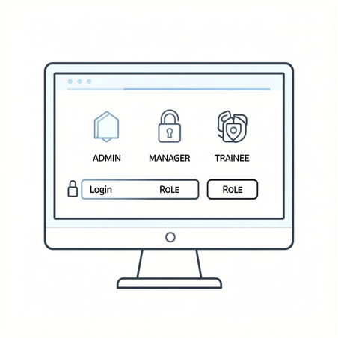

Multi-Role Talent Portal & Announcement System
A role-aware portal supports Admin, Manager, and Trainee accounts with SQLite-backed storage.
Admin: system setup, user management, analytics export
Manager: assign exams, view KPIs, publish announcements
Trainee: take exams, view results, receive announcements
Announcements can be broadcast or targeted by role, team, or cohort.
AI Exam Creation & Auto-Grading
The exam engine ingests PDFs, generates assessments, assigns them,
and grades automatically where possible.
01
02
Ingest & Extract:
Generate Questions:
Parse PDFs and embed content.
Create MCQs, short answers, and code prompts.
03
04
Assign & Proctor:
Grade & Review:
Schedule exams with time limits and logging.
Use rule-based scoring and human review for edge cases.
Notes:
9

Slide 10

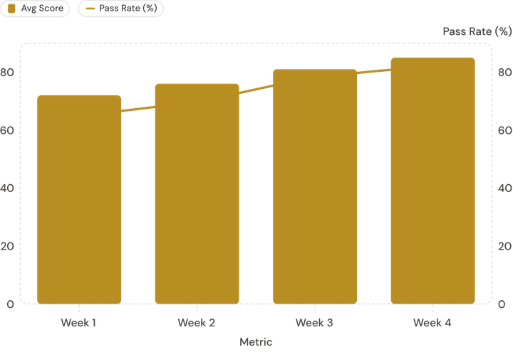
Executive Analytics: KPI Charts & Performance Insights
Score Distribution
Histogram and percentile bands to identify at-risk learners and high performers.
Engagement KPIs
Completion rate, time-on-task, and sequence adherence for predictive success modeling.
Dashboard visualizes trainee score trends (bars) with pass-rate overlay (line). Metrics support cohort filtering, drill-down to question-level item analysis, and export for enterprise reporting.
Operational Metrics
Exam throughput, auto-grade rate, and announcement reach for SLA and capacity planning.
Next steps: integrate A/B testing for exam variants, add anomaly detection on performance dips, and enable scheduled executive reports.
Notes:
10

Slide 11

Milestone 3 — Sphere Voice AI Assistant & AI Study Sprints
Delivering hands-free voice intelligence plus structured, AI-driven study workflows. This milestone combines a production-ready voice assistant (STT → intent → TTS), system automation via voice, and a reusable 6-day sprint generator optimized for trainee outcomes.
Notes:
11

Slide 12

Core Product: Sphere Voice AI Assistant
Capabilities
Real-time Speech-to-Text (low-latency, noise-robust) feeding NLU for intent & slot extraction
Context-aware Text-to-Speech answers with selectable voice personas and SSML support
Multilingual audio input and output — built to scale across languages (first release: 4 languages)
Design & Reliability Priorities
Deterministic handoffs: audio → transcript → intent → action with traceable context IDs
Fallbacks: confidence thresholds, clarification prompts, and server-side re-querying
Privacy-first: ephemeral audio storage, user opt-ins for analytics
Notes:
12

Slide 13



Voice-Driven Tool Execution — Actions You Can Say
Fetch Trainee Metrics
Trigger Exam Creation
Dispatch Announcements
“Hey Sphere, show Sam’s weekly mastery score.” Returns per-lesson metrics, recent activity, and flags for intervention.
“Create a Day-5 gateway exam for Module 3.” Generates question set, rubric, and schedules proctoring rules.
“Announce sprint kickoff to cohort B.” Sends multi-channel notice (in-app, email, voice summary) with delivery trace.
Actions are modeled as idempotent commands with audit logs and RBAC checks. Voice confirmations and undo flows reduce accidental operations.
Notes:
13

Slide 14

6-Day AI Study Sprint Orchestrator (with Multilingual Voice Support)
Multilingual Chat
4-language support with smart selection popups. Voice UI adapts phrasing and TTS voice per locale.
Adaptive Scheduling
Personalized daily task timing based on learner engagement signals and preferred study windows.
Day 1 Setup
Day 2 Micro-lessons
Day 3 Practice
Day 4 Deep Review
Day 5 Gateway
Configure sprint, establish baseline
Short focused lessons and materials
Apply skills with feedback loops
Consolidate concepts and weak spots
Timed exam to assess mastery
Assessment & Gates
Each sprint is auto-generated by the AI planner: curated daily tasks, prioritized reference materials, suggested time budgets, Day‑5 gateway exam creation, and a Day‑7 Voice Socratic interview for oral mastery checks.
Automated Day‑5 gating exam plus pass/fail criteria that feed the next sprint’s difficulty tuning.
Voice Socratic Interviews
Oral assessments that prompt reasoning, record responses, and provide targeted coach feedback.
Implementation notes: prioritize low-latency STT for live interviews, use speaker diarization for multi-learner sessions, and retain consented audio for quality review.
Notes:
14

Slide 15

Milestone 4 — Delivery Summary
Concise overview of Milestone 4: delivered automated email notification service, database-aware chatbot enhancements, ASGI server performance upgrades, SQLite WAL resilience fixes, and final UI/branding for the Talent Management Platform.
Scope
Audience
Goal
Notifications, chatbot DB integration, server performance, DB locking resilience, UI/brand finalization.
Enterprise engineering and product teams evaluating Milestone 4 deliverables.
Operational readiness, reliability under load, and polished user-facing experience for rollout.
Notes:
15

Slide 16



System Components & Engineering Highlights
Automated Email Notification Service
Templated SMTP notifications with retry, backoff, and audit logging.
DB-Aware Chatbot Intelligence
Provides controlled read access to trainee records and score tables for live lookups and summaries.
FastAPI + Uvicorn Architecture
Moved to FastAPI on Uvicorn, with CPU-heavy search isolated to keep requests responsive.
SQLite WAL Lock Resilience
Operational Controls
Health checks, circuit breakers, and graceful shutdowns improved runtime stability.
WAL mode and connection retry logic reduced Windows file-lock freezes.
Notes:
16

Slide 17
UX, Branding, Release & Next Steps
Finalized UI/UX with glassmorphism cards, accessible light/dark themes, and brand assets for "Talent Management Platform for Employee Performance and Career Growth." Design tokens and component library published.
Release checklist
1
QA signoff on notifications and chatbot responses
Load test p95 latency targets met for ASGI service
DB WAL monitoring in place with alerting
Brand assets and theme tokens merged into main repo
2
Risk & Mitigation
Risk: SMTP throttling → Mitigation: queued dispatch with rate limiter
Risk: DB read hotspots from chatbot → Mitigation: read replicas & caching for summaries
Risk: Vector search CPU spikes → Mitigation: dedicated workers via ThreadPoolExecutor
Recommended Next Steps
3
Run staged rollout to 10% of accounts and monitor delivery & latency
Enable read-replica for high-volume analytics queries
Hand off branding assets and component docs to product and marketing
Key takeaway: Milestone 4 delivers production-grade notifications, DB-integrated conversational intelligence, improved ASGI performance, and durable SQLite operations — ready for staged rollout under monitoring.
Notes:
17

