Slide 1

Milestone 2 — RAG Chatbot, Talent Portal, Exams & Announcements
This milestone delivers an integrated learning platform: a Retrieval-Augmented Generation (RAG) conversational agent, a secure multi-role talent portal, an AI-driven exam engine, an announcement broadcaster, and executive analytics to measure trainee performance. The architecture prioritizes traceability, role-based access, automation, and data-driven insights.

Slide 2

RAG AI Chatbot: Precise, Citable Answers
Implemented a conversational Q&A agent using Qwen LLM (via Ollama) plus vector retrieval for exact-document citations. Key capabilities:
Vector Retrieval
Contextual Prompting
Embeds PDFs and knowledge artifacts for fast semantic search and high-recall retrieval.
LLM conditioned on retrieved passages to ensure answers reference source text with provenance links.
Citation Transparency
Fail-Safes
Responses include exact citations and document excerpts to support auditability and compliance.
Fallback logic routes unknown queries to human review or suggests document uploads to expand coverage.

Slide 3
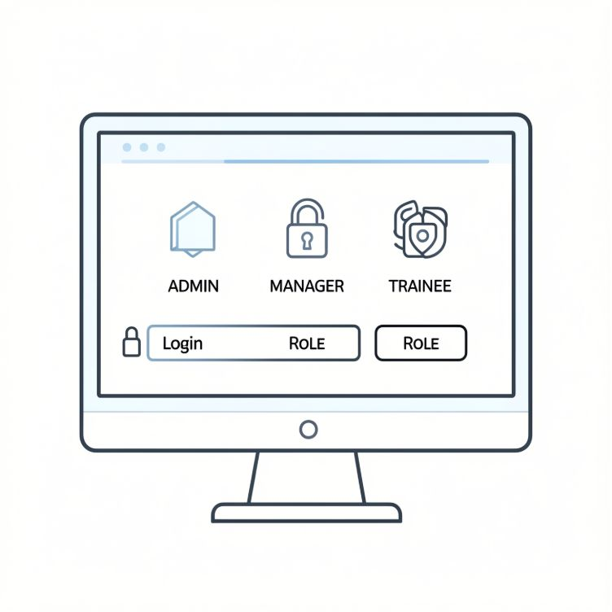

Multi-Role Talent Portal & Announcement System
A role-aware portal supports Admin, Manager, and Trainee accounts with SQLite-backed storage.
Admin: system setup, user management, analytics export
Manager: assign exams, view KPIs, publish announcements
Trainee: take exams, view results, receive announcements
Announcements can be broadcast or targeted by role, team, or cohort.
AI Exam Creation & Auto-Grading
The exam engine ingests PDFs, generates assessments, assigns them,
and grades automatically where possible.
01
02
Ingest & Extract:
Generate Questions:
Parse PDFs and embed content.
Create MCQs, short answers, and code prompts.
03
04
Assign & Proctor:
Grade & Review:
Schedule exams with time limits and logging.
Use rule-based scoring and human review for edge cases.

Slide 4

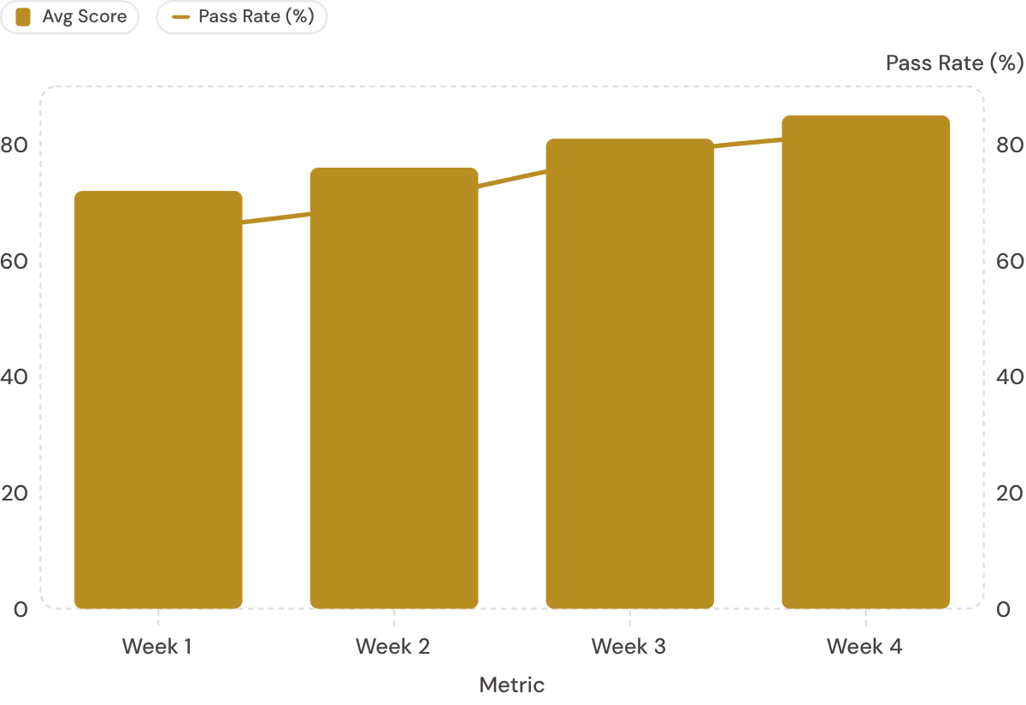

Executive Analytics: KPI Charts & Performance Insights
Score Distribution
Histogram and percentile bands to identify at-risk learners and high performers.
Engagement KPIs
Completion rate, time-on-task, and sequence adherence for predictive success modeling.
Dashboard visualizes trainee score trends (bars) with pass-rate overlay (line). Metrics support cohort filtering, drill-down to question-level item analysis, and export for enterprise reporting.
Operational Metrics
Exam throughput, auto-grade rate, and announcement reach for SLA and capacity planning.
Next steps: integrate A/B testing for exam variants, add anomaly detection on performance dips, and enable scheduled executive reports.

