Slide 1



MILESTONE 1
SECURE ON-PREM RAG
Talent Sphere Elevate
A high-end, secure, offline document intelligence and Retrieval-Augmented Generation dashboard. Upload private documents — training guides, company policy PDFs — and query them in natural language, all within a fully local environment.
Notes:
1

Slide 2

System Architecture & Lifecycle
From Upload to Answer in Four Stages
Every operation — text extraction, vector embedding, and LLM generation — runs locally on the host machine. No data ever leaves the network perimeter.
Document Ingestion
Chunking
1000-char chunks with 200-char overlap for continuity.
PDF upload, SHA-256 dedup, PyPDF parsing.
Vector Indexing
RAG & Generation
BAAI bge-large 1024-dim embeddings stored in ChromaDB.
Query embed, top-K cosine retrieval, Qwen via Ollama HTTP.
Each stage hands off structured data to the next, forming a deterministic, auditable pipeline from raw PDF to cited answer.
Notes:
2

Slide 3






TECHNOLOGIES
Engineering the Local Stack
Every layer was selected to guarantee zero external dependencies while maintaining production-grade performance.
Streamlit Frontend
ChromaDB Vector Store
Builds the interactive dashboard UI with rapid prototyping and live reload support.
Serverless local database at ./chroma_db for indexing dense embeddings and metadata.
BAAI/bge-large-en-v1.5
Ollama + Qwen LLM
Sentence-Transformers model producing 1024-dimensional embeddings for semantic retrieval.
Local API on port 11434 hosting Qwen for context-aware, cited answer generation.
PyPDF Parser
Pandas Data Layer
Handles digital PDF text extraction with cleaning and structural preservation.
Manages plotting, visual calculations, and tabular data structures.
Notes:
3

Slide 4
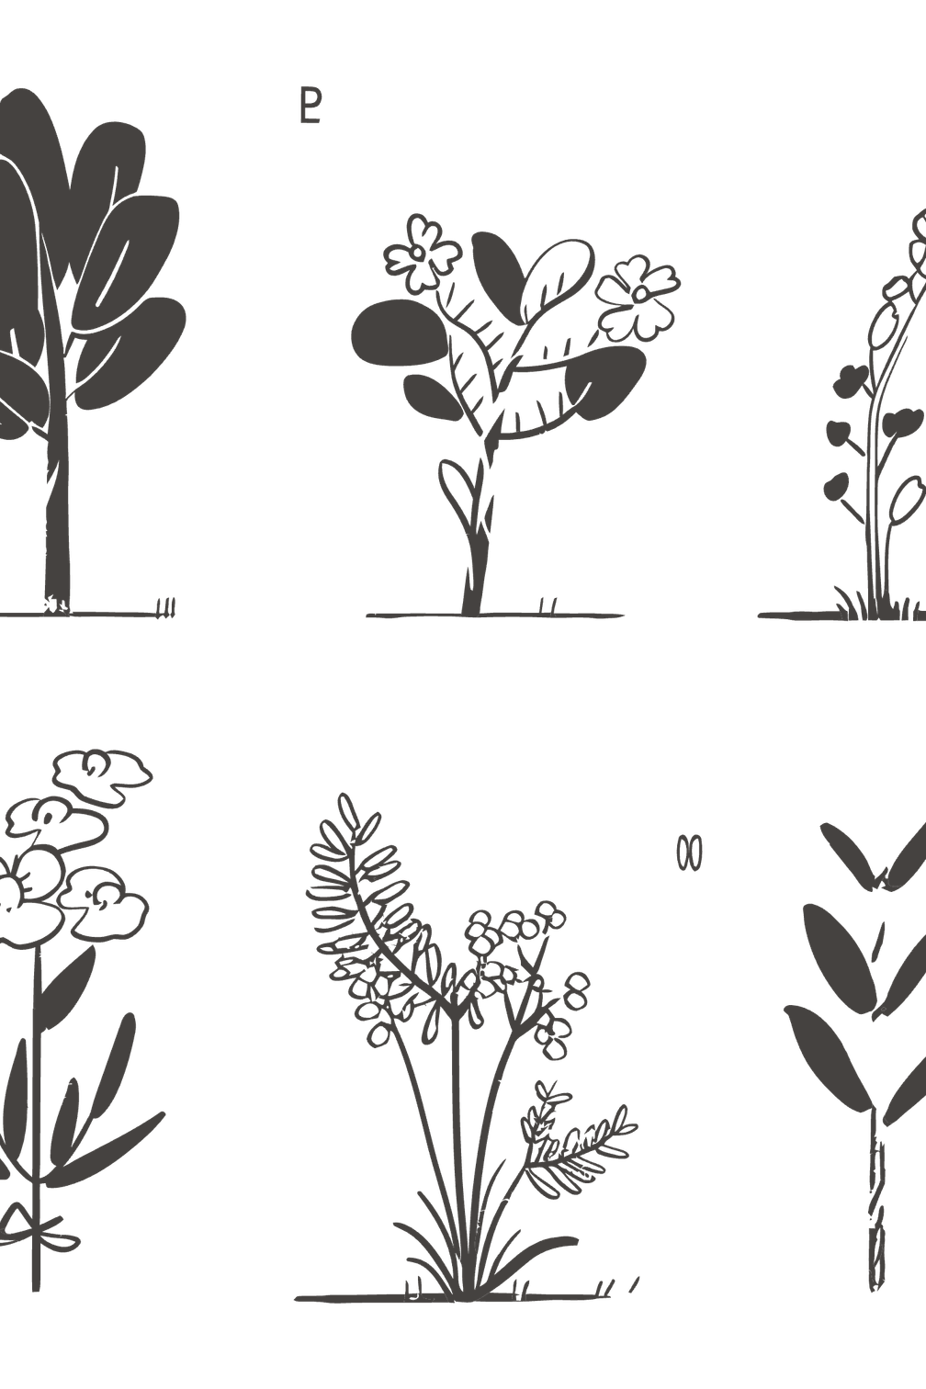
DASHBOARD OUTCOMES
A Cockpit for Document Intelligence
The main dashboard delivers hands-on control over every stage of the RAG pipeline — from theming to retrieval tuning to visual verification.
Notes:
4

Slide 5
Dashboard Capabilities
Built for Control and Transparency
Security Guarantee
Dynamic Theme System
Interactive Document Catalog
All operations — text extraction, vector embedding, and LLM generation — occur locally on the host machine.
Toggles between midnight dark glassmorphism and a clean Slate Light Mode for extended reading sessions.
Browse indexed documents, expand text chunks inline, or safely delete files from the local index.
Data Privacy
No data is sent to external cloud APIs, ensuring absolute confidentiality for sensitive enterprise documents.
Search Control Cockpit
Visual Verification
Custom regex highlighter for search terms and a horizontal relevance spectrum meter displaying similarity scores.
Adjust Top-K parameters, similarity thresholds, file multi-selects, and model lists directly on the main page.
Notes:
5

Slide 6

Milestone 1 Recap
What Ships in This Release
Cited RAG Answers
Fully Local Pipeline
Tunable Retrieval
Milestone 1 establishes the secure foundation: a complete, offline RAG pipeline with an interactive dashboard — ready for internal evaluation by technical teams.
Notes:
6

