Slide 1
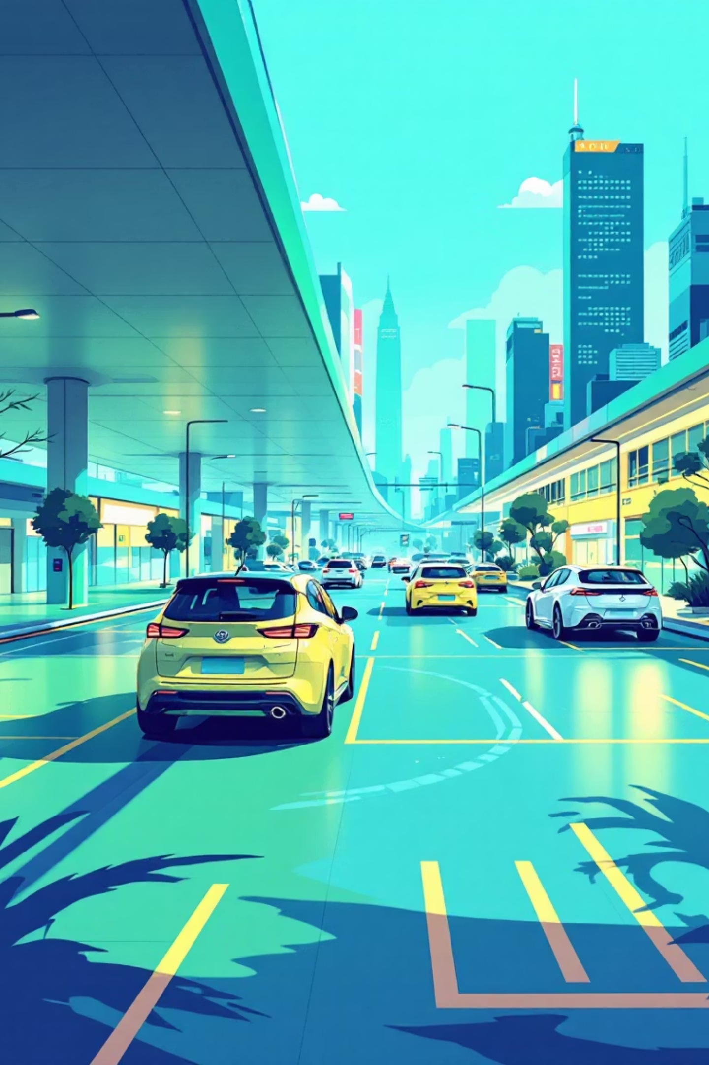
OptiSlot: Intelligent Infrastructure for Smart Cities
Moving Intelligence from the Slot to the Gate.
Presented by: [Your Name] | [Your Team Name] | [Event/Expo Name]

Slide 2
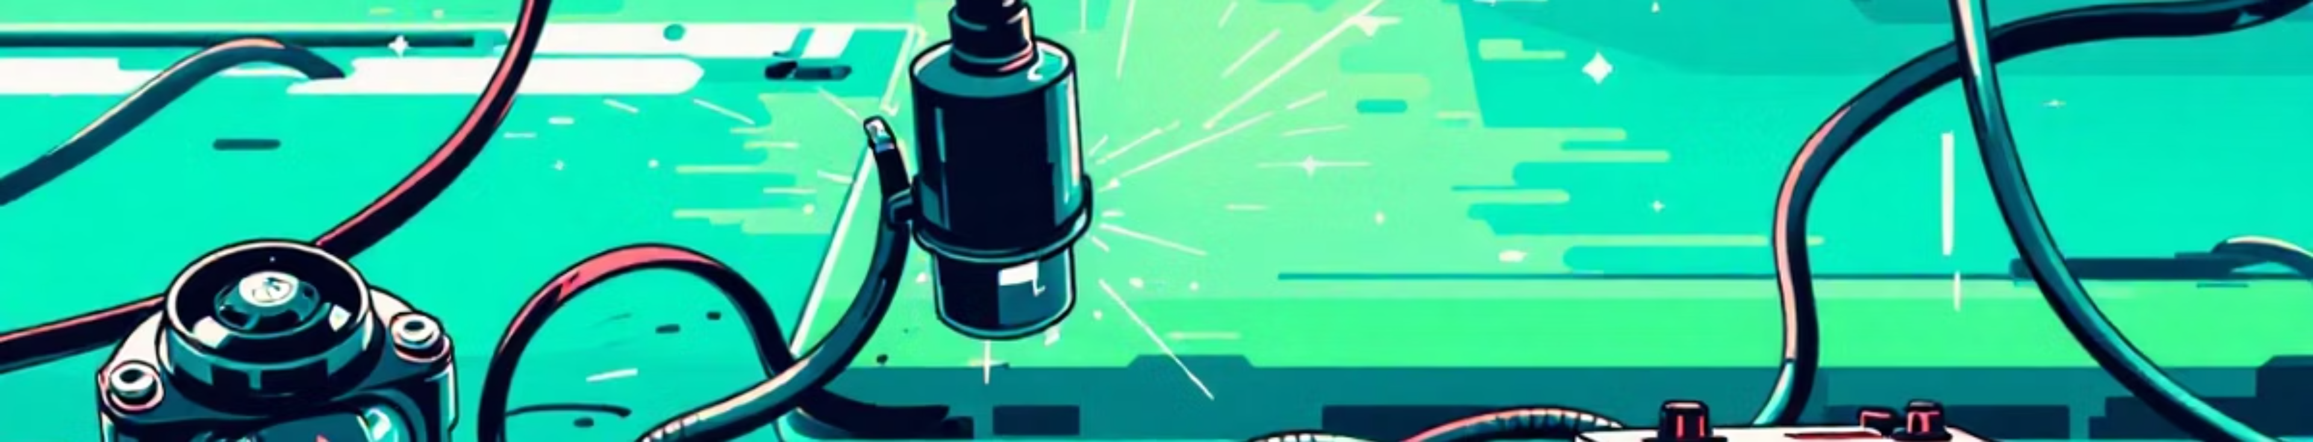

The Flaw in Traditional Smart Parking
High Cost
High Maintenance
Inefficiency
1 sensor per spot (500 spots = 500 sensors).
Batteries die, sensors break, networking fails.
Small car in large spot wastes space.
Most smart cities fail because they try to hardware-force the solution. Installing thousands of sensors is expensive and hard to maintain. We asked: Can we do it with zero slot sensors?

Slide 3

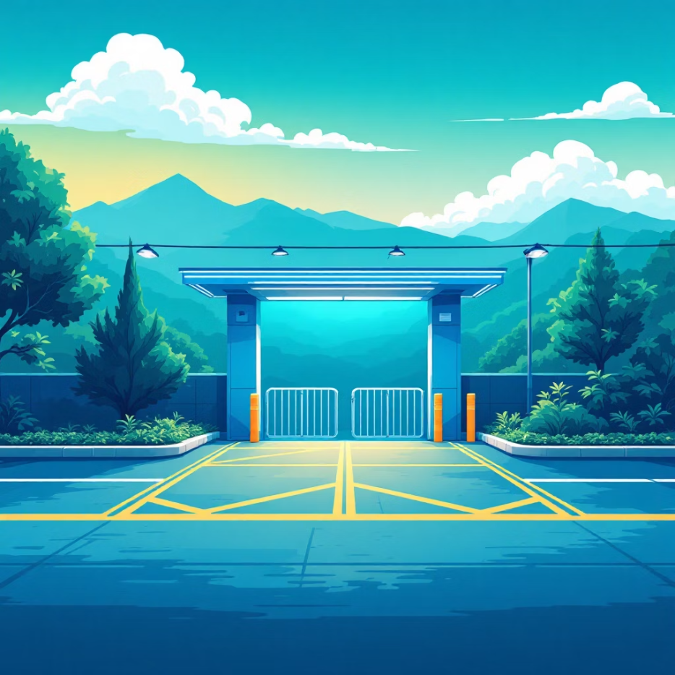

"Sensor-Less" Architecture: The Paradigm Shift
Old Way: Distributed Hardware
OptiSlot Way: Centralized Intelligence
Messy, unreliable, costly.
Clean, efficient, zero maintenance.
1
2
3
Shift Logic
One Node Control
Zero Maintenance
Intelligence moves from Parking Slot to Entry Gate.
2 Cameras + 2 Ultrasonic Sensors manage the entire lot.
No hardware at actual parking spots.
We replaced distributed hardware with centralized software. By profiling the car at the entry, we know exactly where it should go before it even enters.

Slide 4


Algorithmic Space Optimization: The Brain
Parking lots are like a game of Tetris. We don't just find a spot; we find the best spot.
01
Scan Vehicle Dimensions
Small / Medium / Large.
02
Check Grid State
Real-time database query.
03
Assign Optimal Slot
Smallest viable slot to maximize revenue per sq. ft.
Bin-Packing Algorithm
Utilizing a Best-Fit Heuristic.
We treat cars like items in a shipping container, ensuring a Mini Cooper doesn't waste a spot meant for a Cybertruck.

Slide 5
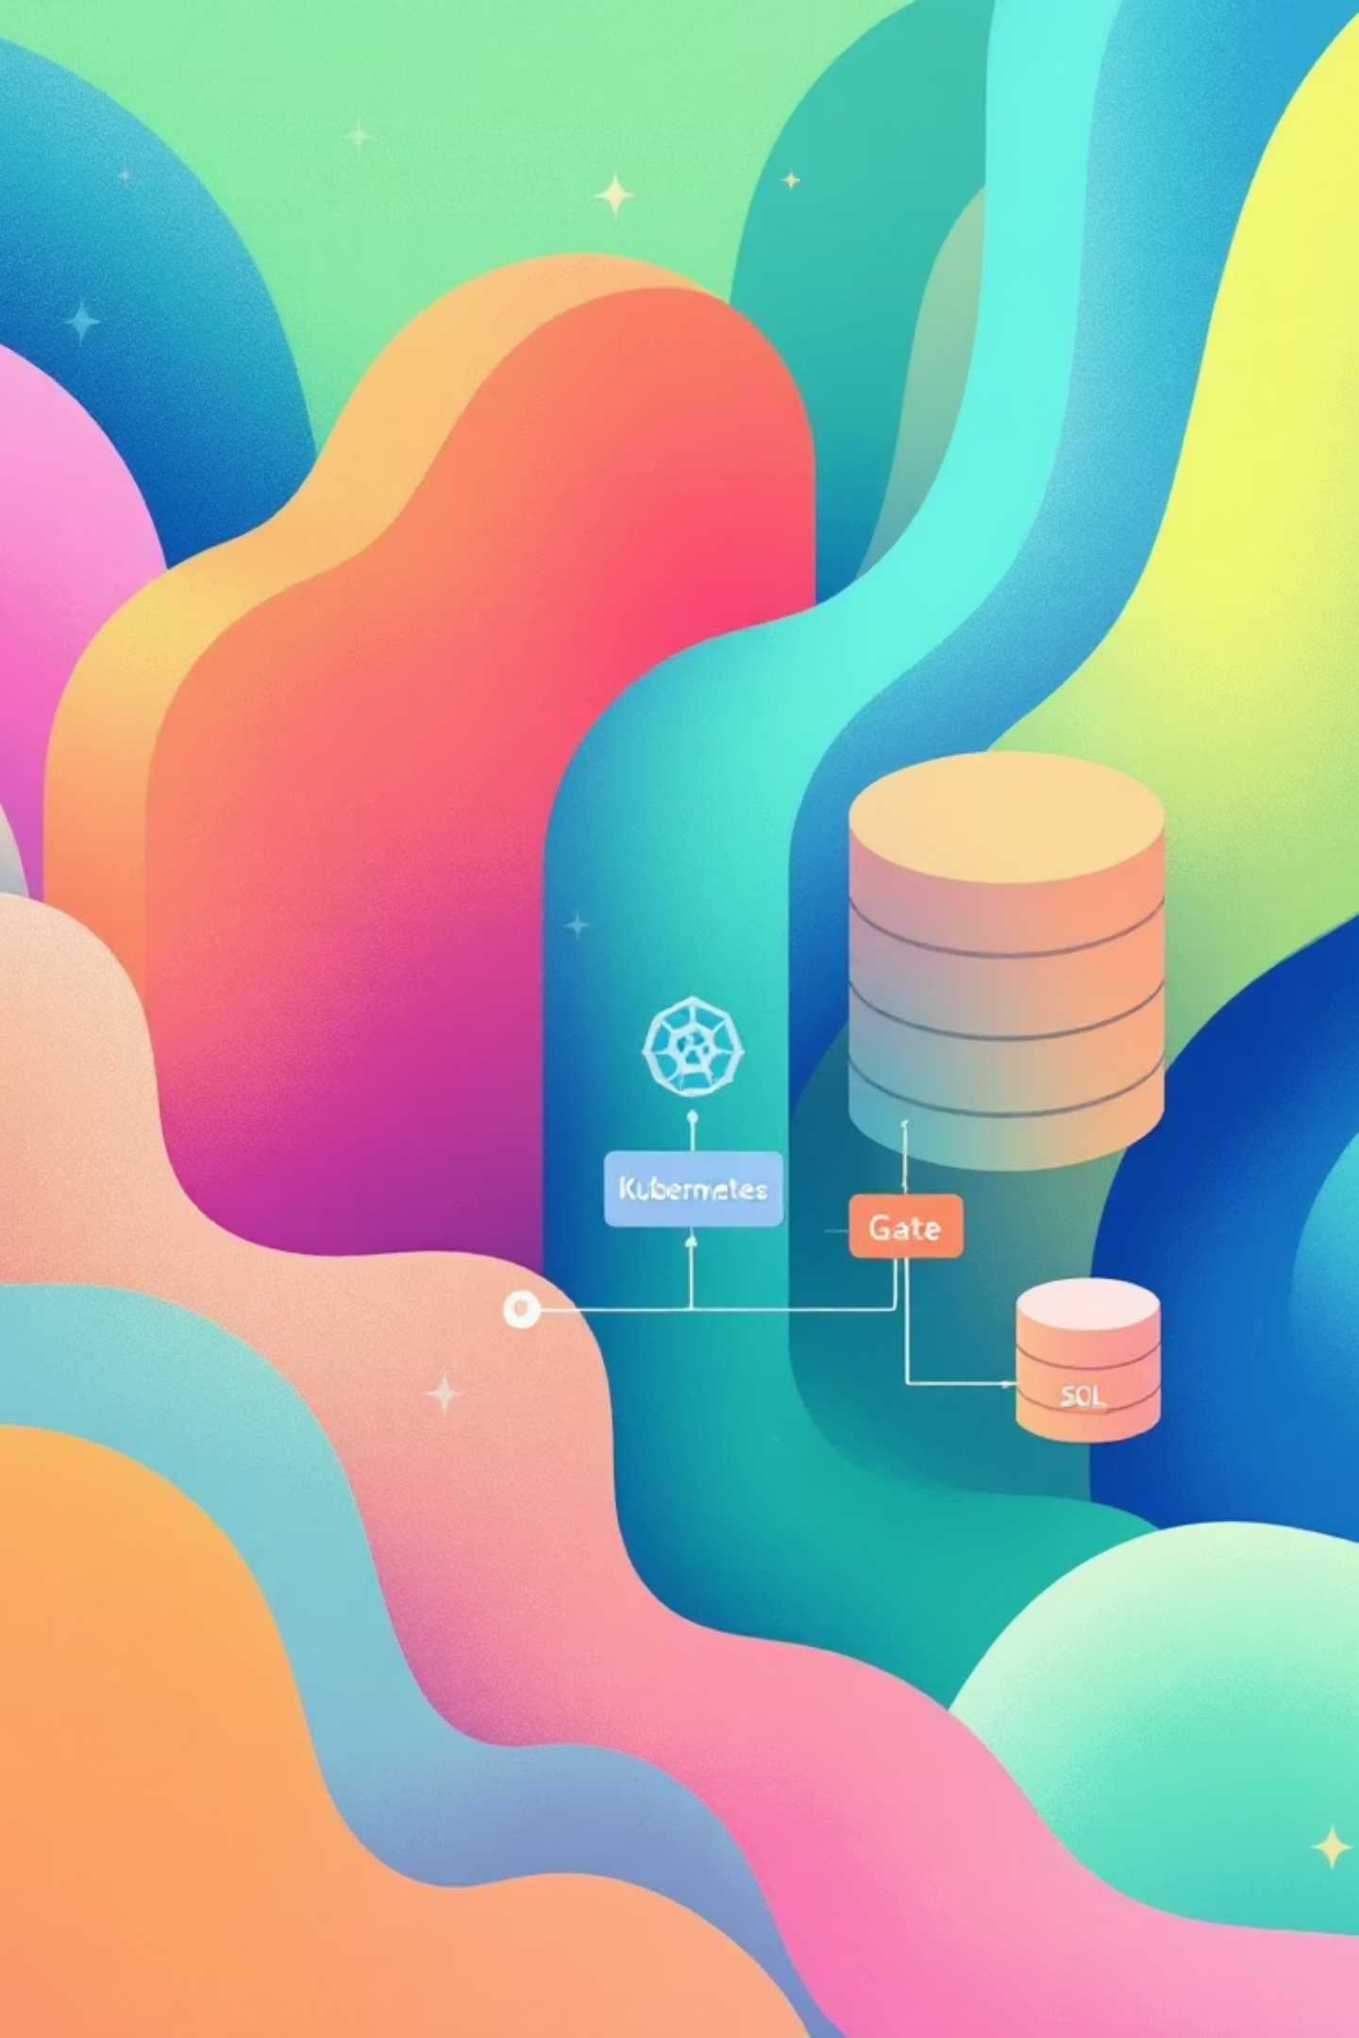

Cloud-Native & Scalable: System Architecture
Key Technologies
Compute
Vision
Docker Containers on Kubernetes (Auto-scaling).
OpenCV & EasyOCR (License Plate Recognition).
Connectivity
Secure Tunnels (No Static IP needed).
This isn't just a script; it's a distributed system. We use Kubernetes to ensure that even if the gate traffic spikes, our backend scales automatically.

Slide 6



Why This Makes Money: Business Impact & Viability
95%
20%
$95,000
CapEx Reduction
Revenue Increase
Installation Savings
No need to purchase hundreds of sensors.
Optimized packing = more cars per floor.
Difference between traditional and OptiSlot systems.
The Road Ahead
1
2
3
Dynamic Pricing
Predictive AI
Multi-Floor Routing
Charge more for "Premium" spots.
Anticipate fullness, guide drivers.
A* Pathfinding for efficient navigation.
OptiSlot
Frugal Engineering. Maximum Efficiency.
Let's reimagine infrastructure.

