Slide 1
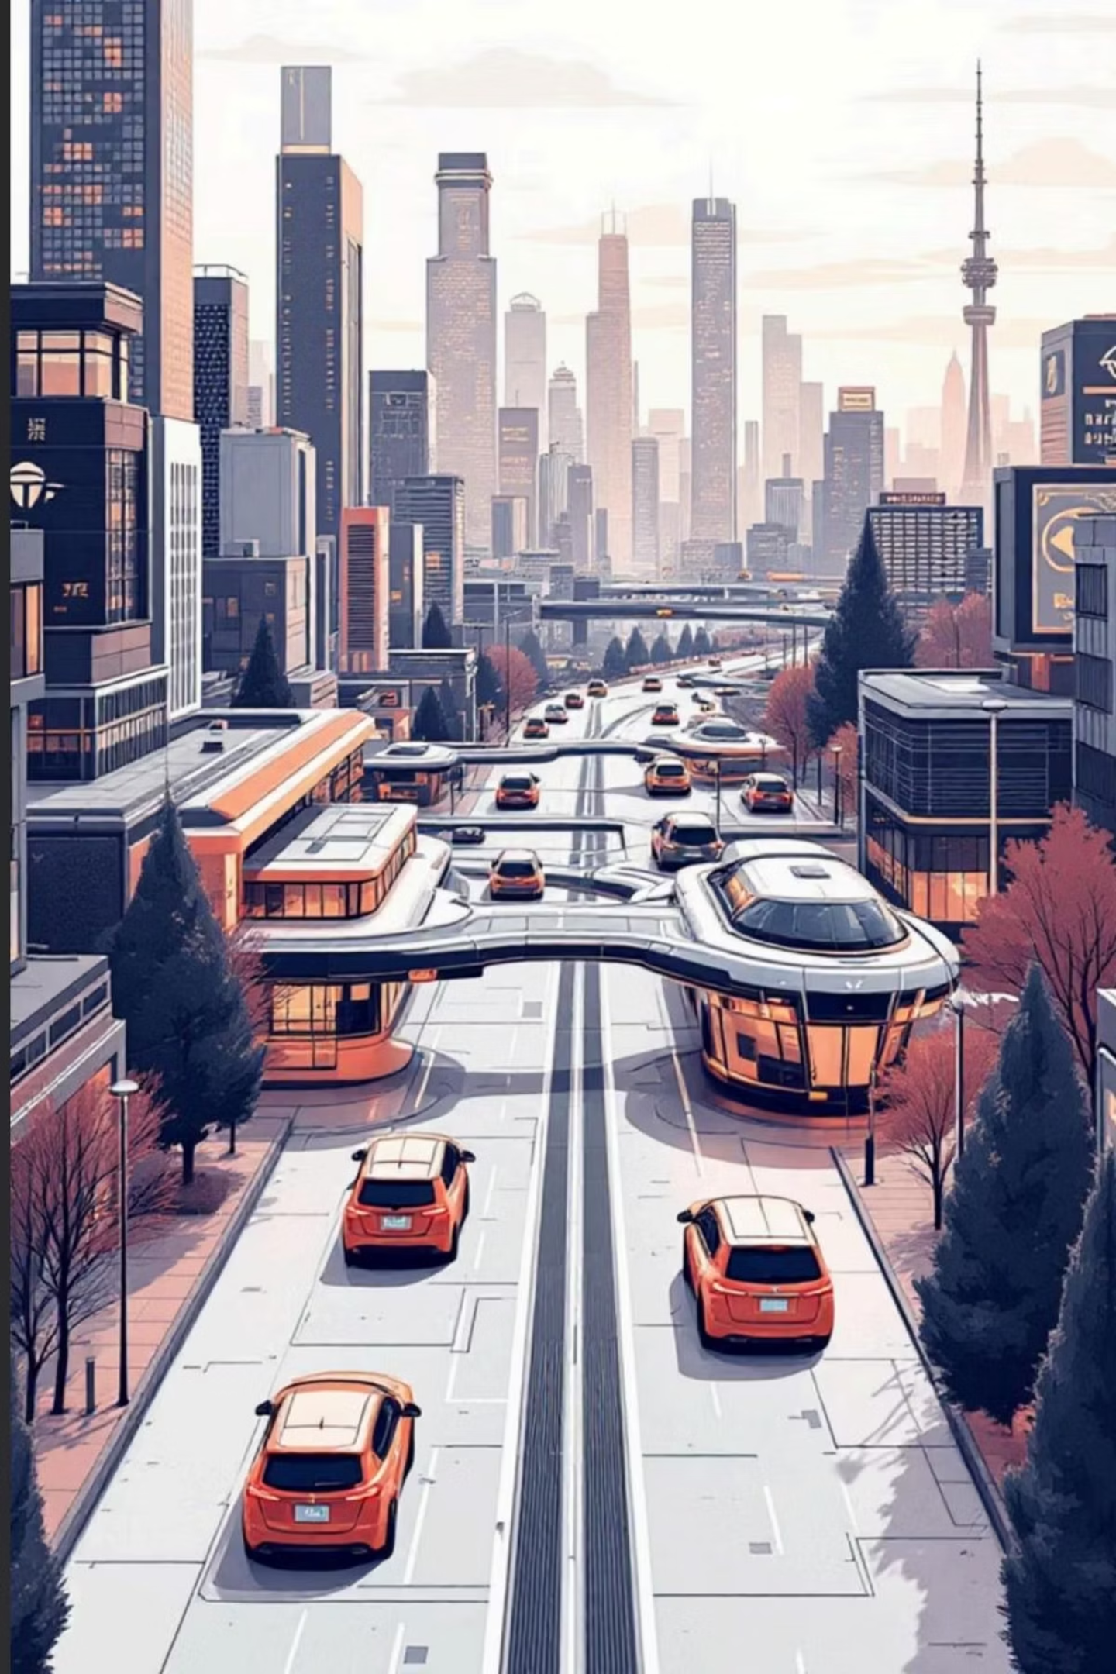
Optislot: Advanced Parking System
A smart solution for efficient urban transport.
By Reshekumar V, KPR Institute of Engineering and Technology

Slide 2

The Parking Predicament
Inefficiency
High Investment
Maintenance
Wasted search time
Traffic congestion
Fuel waste & pollution
Physical sensors per spot
Costly setup for municipalities
Scattered hardware issues
Increased complexity & costs
Addressing these issues cuts infrastructure costs, eases traffic, and lowers carbon emissions in urban areas.

Slide 3
Existing Scenario: The Status Quo
Current Methods
Drawbacks
Individual parking spot sensors: Limited data from entry gates.
Manual guidance: Inefficient and prone to human error.
High Expense: Significant installation and wiring costs.
Limited Scalability: Extensive physical construction needed for expansion.
These traditional hardware-reliant methods lack modern software efficiency.

Slide 4

Optislot: Software Parking
A single entry camera manages all parking, removing individual sensors.
01
02
03
License Plate Recognition
Smart Slot Allocation
Cloud Management
Entrance camera reads license plates.
Algorithm assigns best spots based on real-time availability and preferences.
Centralized cloud ensures real-time availability and access.

Slide 5
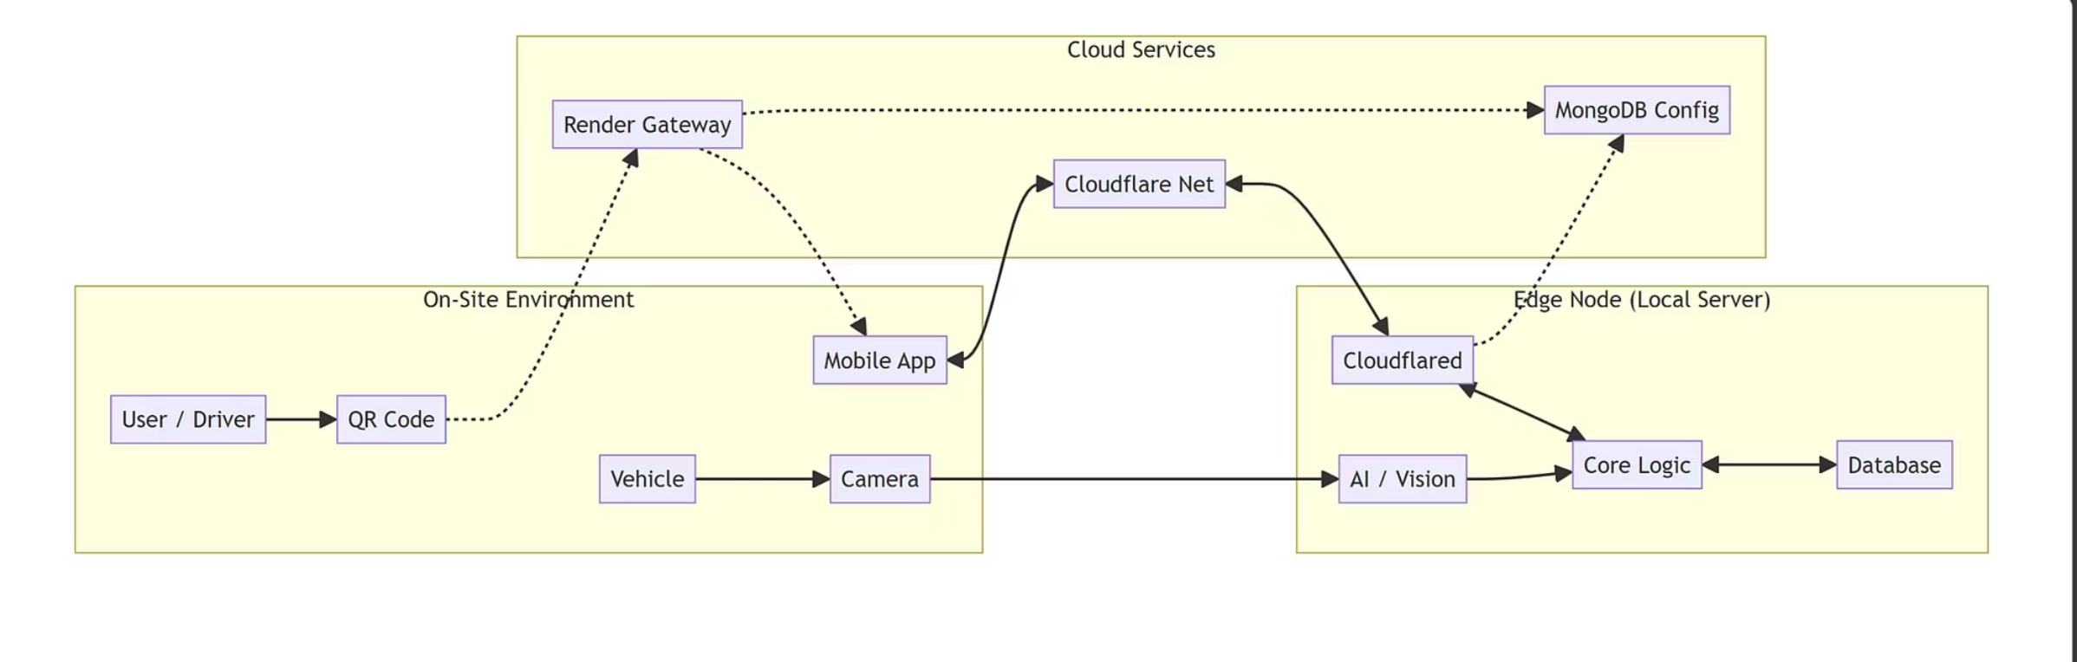
System Architecture: How it Works
Identifies incoming vehicles.
Processes information instantly, registers in central cloud.
Dynamic QR code guides drivers to assigned parking spot.
The Autonomous ParkingAgent
The system is driven by an autonomous ParkingAgent, operating on a Perceive-Decide-Act cycle:
Perceives: Processes live camera feeds (YOLOv8, EasyOCR) to identify vehicles.
Decides: Determines optimal response based on real-time slot availability and rules.
Acts: Updates database, reserves slots, grants entry, or triggers alerts.
This creates a self-managing infrastructure, reducing manual oversight.

Slide 6

Feasibility: A Practical Approach
Practicality
Cost & Scalability
Utilizes readily available, cost-effective hardware (webcams, laptops) and cloud services.
Scalable: Software updates expand capacity, avoiding costly physical construction or sensors.
Economical: Reduces installation costs versus traditional, hardware-intensive IoT systems.
Offline Capability
Cloud-based registration automatically manages dynamic IPs for seamless operation.
Edge-First: Ensures uninterrupted service; processes entry/exit even if cloud connection fails.

Slide 7
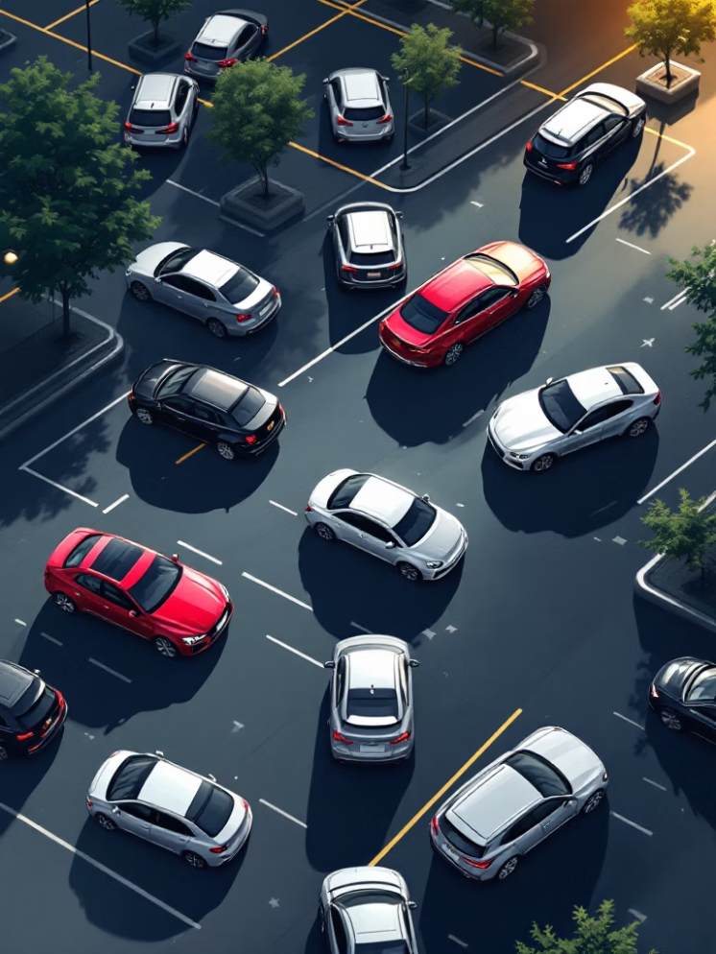
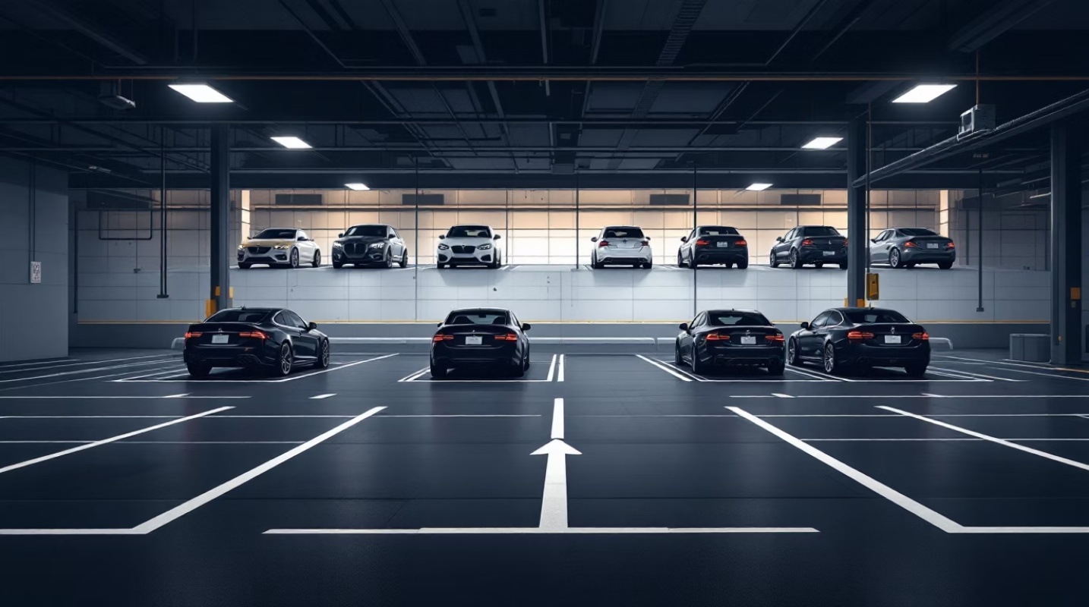
The OptiSlot Advantage: Optimized Space & Cost
OptiSlot Allocation
Traditional Lot
Fixed lines
Wastes space
Dynamic "bin packing"
Maximizes space
Up to 20% more capacity
Infrastructure Cost Comparison (500 Slots)
Traditional System
OptiSlot System
500 Sensors x ₹1,500 = ₹7,50,000
1 Camera + 1 Server = ₹50,000
Significant cost reduction.

Slide 8
Hybrid Verification Engine: 99% Accuracy
Our Hybrid Verification Engine achieves 99% accuracy with a dual-approach, sensor-free system.
User Verification (70% of cases)
Automated Anomaly Detection (30% non-compliance)
Users scan QR code at pillar.
Confirms exact parking spot.
Provides immediate, accurate occupancy data.
Algorithm analyzes CCTV images.
Identifies unauthorized vehicles in unbooked spaces.
Updates map to prevent double-booking.
Applications & Impact
Multi-level car parks
Automated toll systems
Gated communities

Slide 9
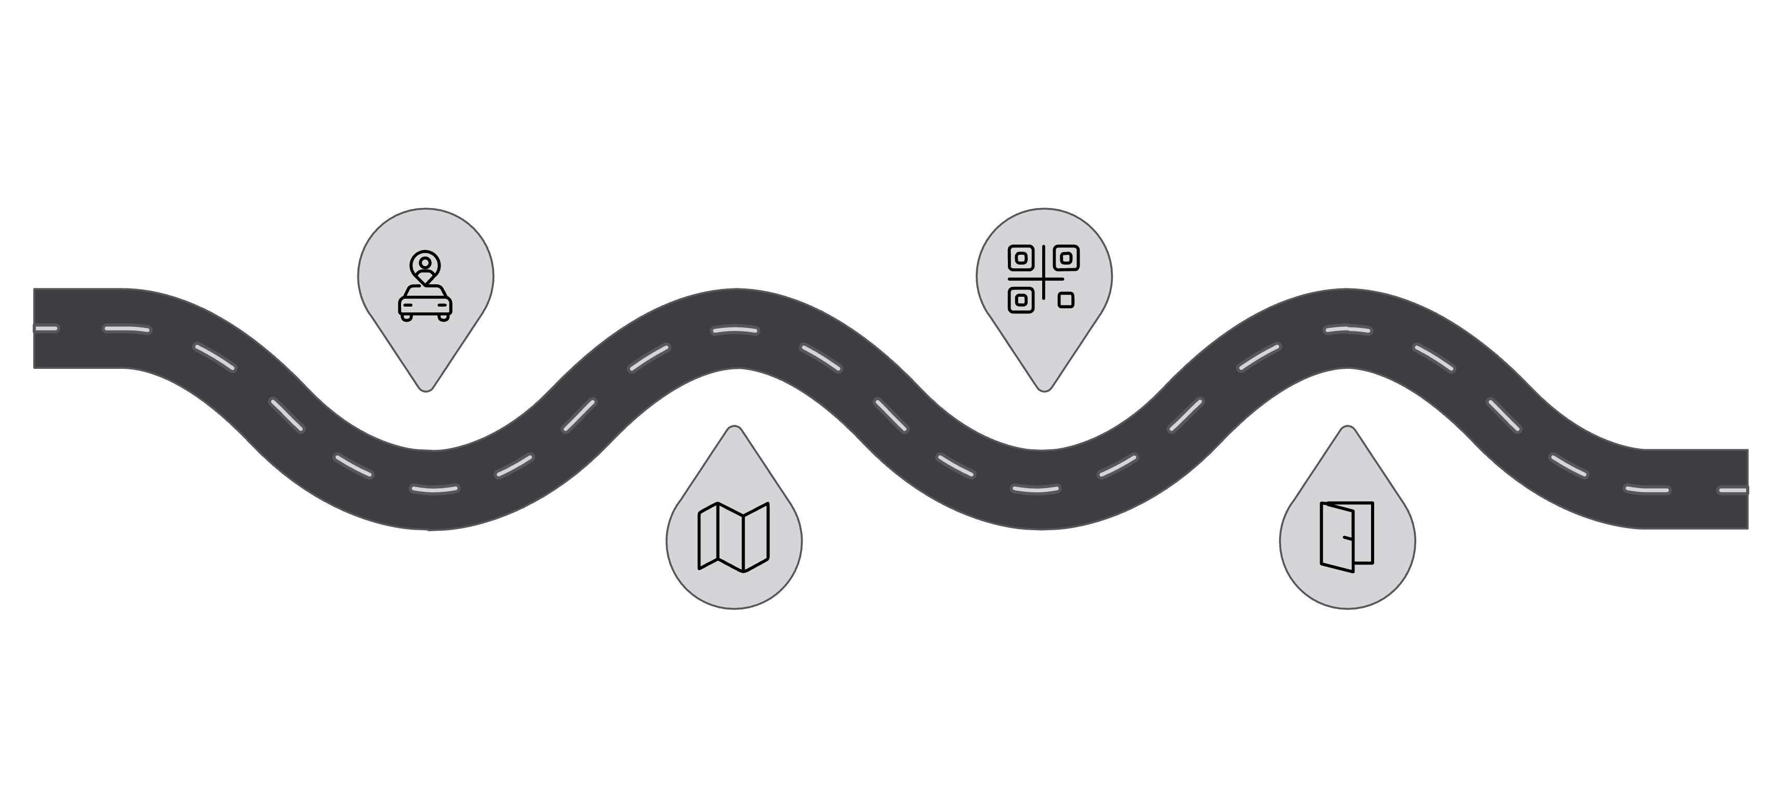
The OptiSlot Experience: Seamless Parking
Entry
Scan QR
Driver arrives
User registers stay
Guidance
Exit
App directs to spot
Driver leaves

Slide 10
Future Scope: Expanding Possibilities
Dynamic Pricing
Vehicle Locator
Adjusts fees by demand, optimizes revenue & space.
Guides drivers to parked vehicles, minimizing search time.
Optimized Energy Management
Predictive Availability
Uses live data for lighting/ventilation control, reducing energy.
Forecasts availability using data for proactive management.
Security Alert System
Automated Payment
Flags stolen/unauthorized vehicles via license plate recognition & law enforcement.
Seamless touchless payment upon exit (LPR/RFID).
Optislot: Advancing Smart Parking Solutions
Optislot's software-first architecture reduces hardware needs by 95%. This delivers cost efficiency, scalability, and environmental benefits.
We welcome collaboration to enhance and modernize parking infrastructure.
Reshekumar V
Project Lead and Developer
Connect
LinkedIn | vrk1711@gmail.com | Portfolio

