Slide 1
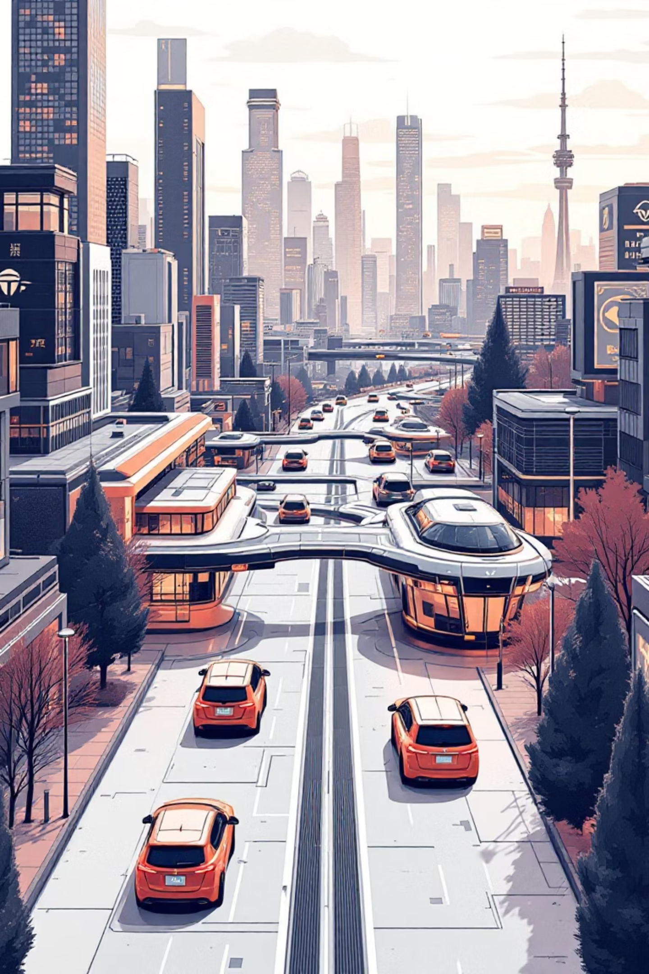
Optislot (Just Automated Real-time Intelligent Vehicle Parking System)
Smart Cities & Intelligent Transportation Systems
By Reshekumar V
Department of Computer Science and Engineering, KPR Institute of Engineering and Technology

Slide 2
Problem: The Parking Predicament
Inefficiency
High CAPEX
Maintenance
High search time for parking causes congestion and fuel waste.
Traditional systems need physical sensors at every slot (1:1 ratio).
Decentralized hardware increases failure points.
Location: Urban centers, malls, and corporate campuses.
Importance: Critical to reduce traffic, carbon emissions, and infrastructure costs.

Slide 3
Existing Scenario: The Status Quo
Current Methods:
Drawbacks:
Slot-Sensors: Ultrasonic/magnetic loops at every parking bay.
Manual: Security guards directing traffic.
Cost: Installing 100s of sensors is expensive.
Rigidity: Hard to scale; requires physical cabling for every new spot.
Insufficiency: Relies on "Brute Force Hardware" instead of scalable software logic.

Slide 4
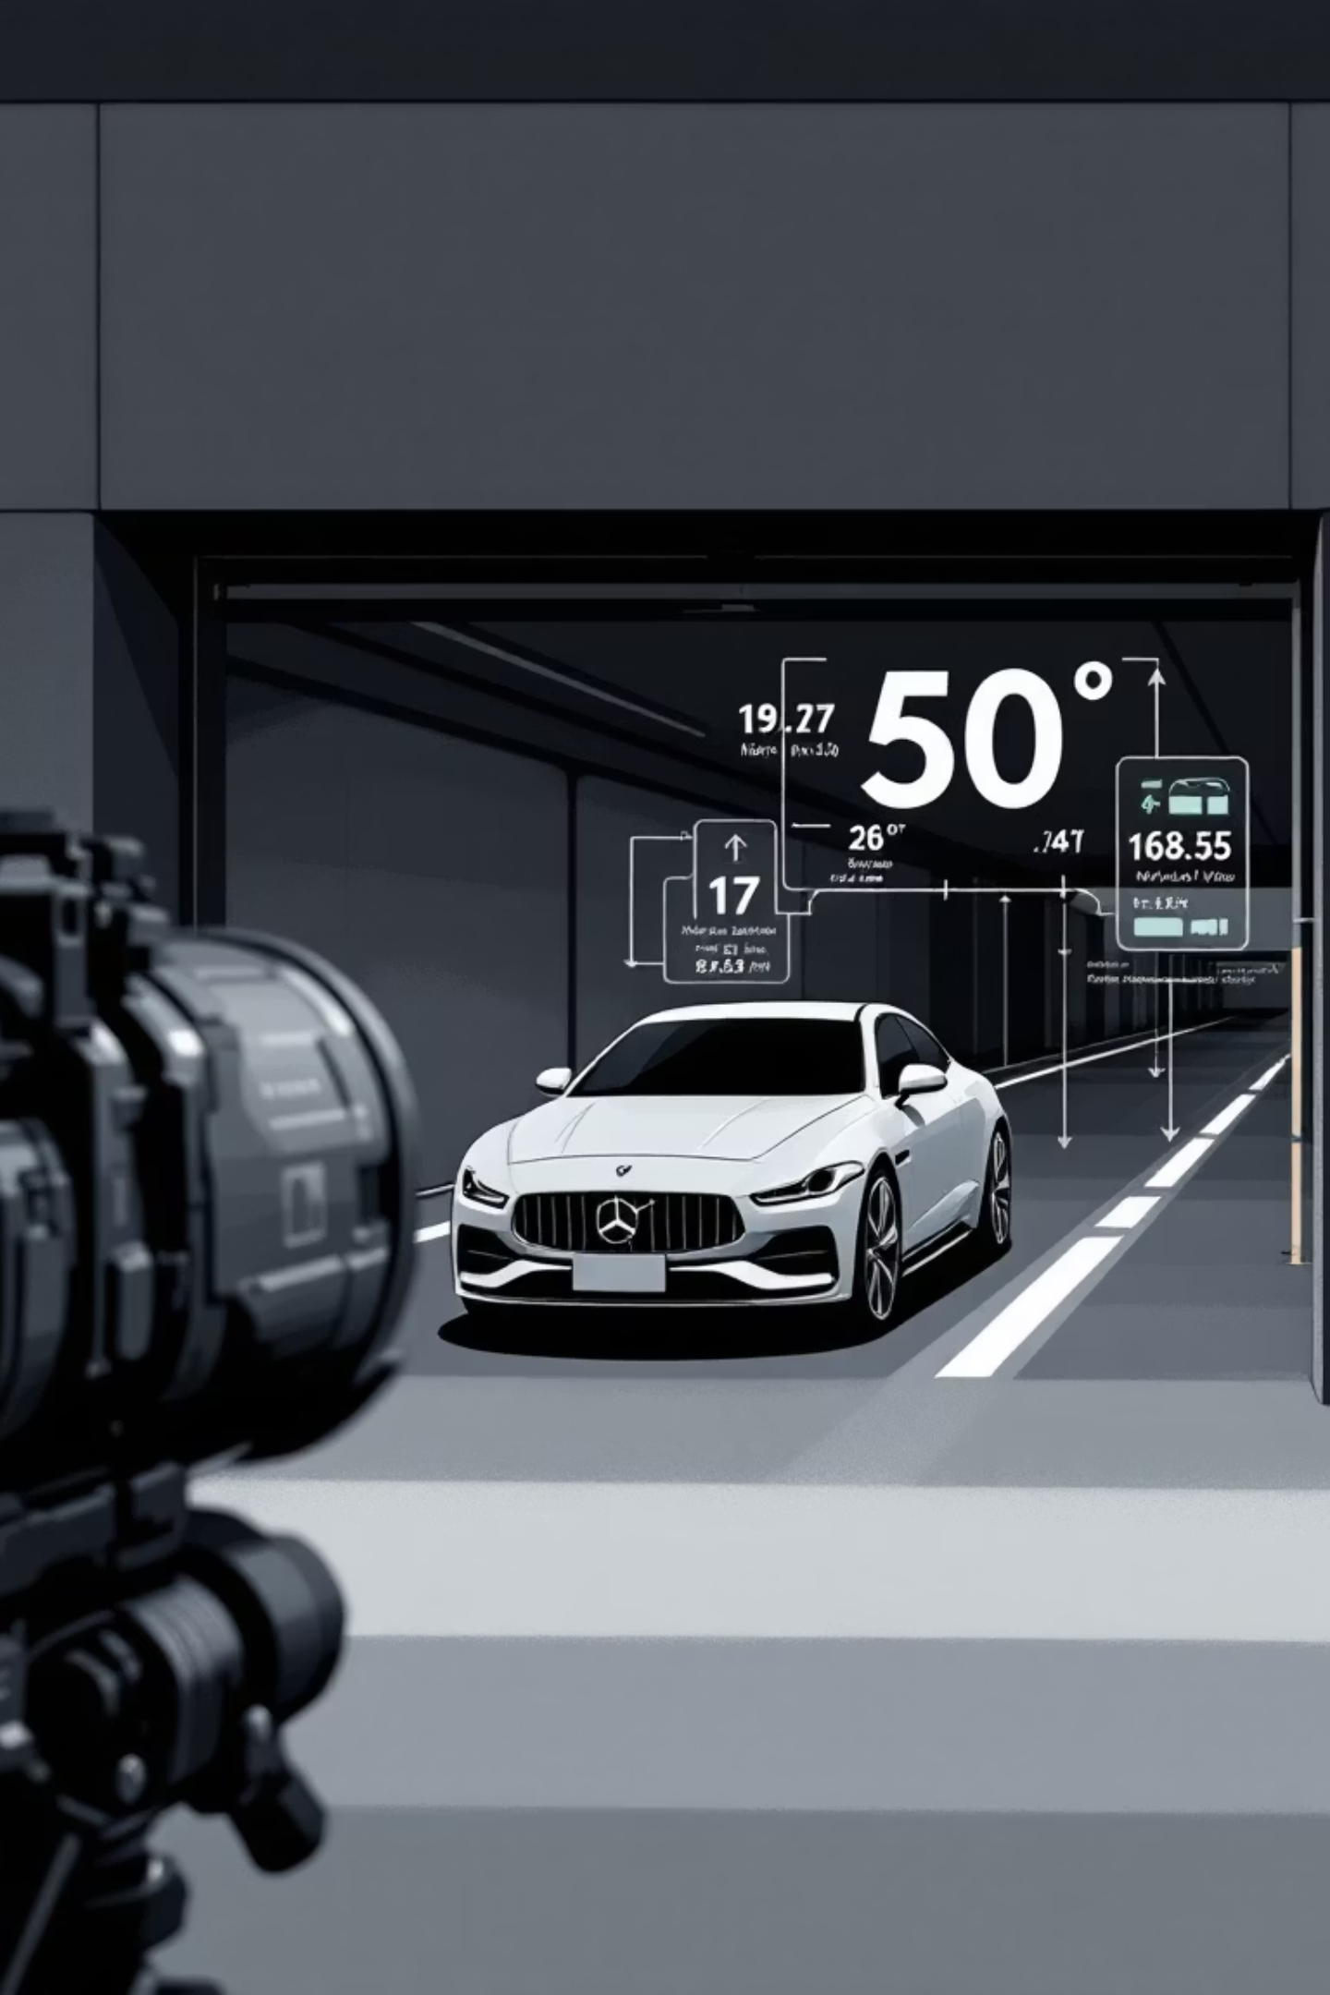
Proposed Solution: Optislot's Innovation
Core Idea: Centralized Sensor Fusion at the entry gate, removing slot-level sensors.
01
02
Optical Profiling
Logic
Camera determines vehicle size (SUV vs. Compact).
"Bin-Packing Algorithm" allocates the optimal slot.
03
Connectivity
Cloud Registry ensures access across changing networks.
Differentiation:
95% Hardware Reduction: Replaces hundreds of sensors with one camera.
Software-First: Infinite scalability without new wiring.

Slide 5

System Architecture: How it Works
Dynamic QR interface
Camera input
Outputs updated QR codes
Captures vehicle ID and dimensions
Camera → Python → MongoDB → QR
MongoDB cloud registry
Local Python server
Maps dynamic IPs to static endpoints
Runs allocation and processing
Workflow:
Input: Camera captures vehicle identity and dimensions.
Processing: Local Python server runs allocation algorithms.
Cloud Registry: MongoDB maps dynamic local IPs to static endpoints.
Interface: Dynamic QR code redirects users to their assigned slot.

Slide 6
Feasibility: A Practical Approach
Practicality:
Cost & Scalability:
High. Uses standard Webcams, Laptops, and Free-tier Cloud (MongoDB).
Scalable: Adding slots is a code update, not construction.
Economical: Drastically lower installation costs vs. traditional IoT.
Challenges:
Issue: Dynamic Network IPs.
Fix: Automated Service Discovery via Cloud Registry.

Slide 7
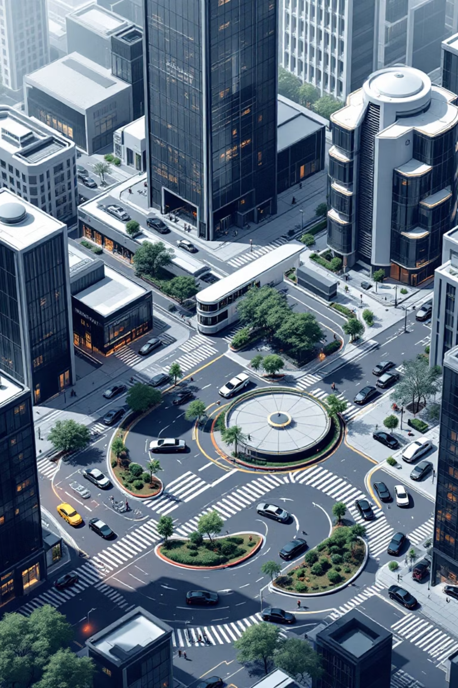


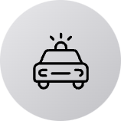
Applications & Impact
Use Cases: Multi-level car parks, automated tolls, gated communities.
Developers
Lower infrastructure overhead.
Drivers
Zero search time; guaranteed parking.
Impact:
Tech: Shifts industry from hardware-heavy to software-defined IoT.
Green: Direct reduction in vehicle idling emissions.

Slide 8
Future Scope: Expanding Possibilities
Improvements:
Advanced Features:
Mobile App: Remote slot pre-booking.
Auto-Billing: License plate-based payments (FastTag).
Indoor Guidance: AR or LED indicators to guide cars to slots.
Violation Detection: Automated overstay monitoring via exit cameras.

Slide 9
Optislot: Redefining Smart Parking for a Sustainable Future
Leveraging a revolutionary software-first approach, Optislot slashes hardware needs by 95%, delivering unmatched cost efficiency, effortless scalability, and profound environmental benefits. Gain a decisive competitive edge with a solution designed for tomorrow.
Partner with us to transform your parking infrastructure.
vrk1711@gmail.com

