Slide 1
Introduction: Addressing SDN Challenges in Smart Ecosystems

Slide 2
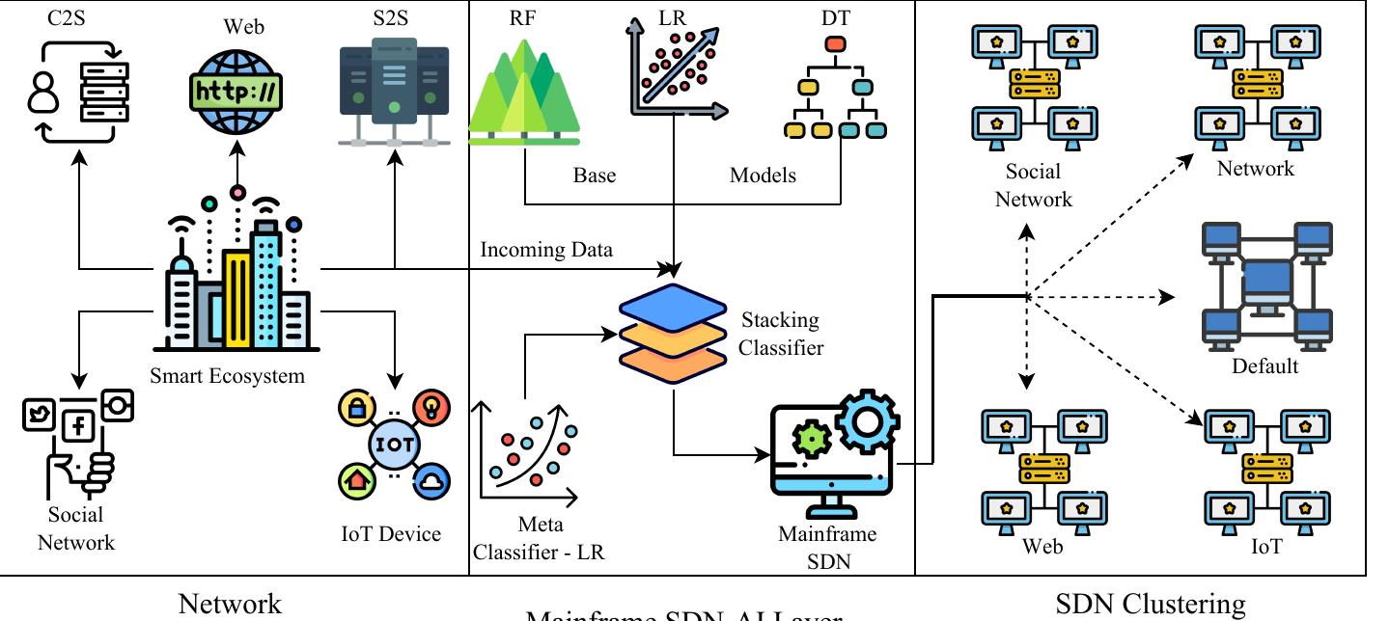
FAST Architecture: A Three-Layered Approach
• Network Communication Layer: Models diverse communication patterns (C-S, S2S, P2P, IoT, Social Network). Mathematical functions represent each type.
• Mainframe SDN-AI Layer: Houses the core intelligence. Mainframe SDN controller integrates the Ensemble Learning (EL) model. Trained on "Labeled Network Traffic Flows" dataset.
• SDN Clustering Layer: Specialized SDN controller clusters (Web, Network, IoT, Social Network, Default). Handles traffic based on category. Default cluster manages low-load scenarios.
• Improves scalability and fault tolerance by distributing control plane.
• Enables efficient resource utilization by directing traffic to specialized clusters.
• Provides a flexible and adaptable framework for managing diverse traffic types.

Slide 3
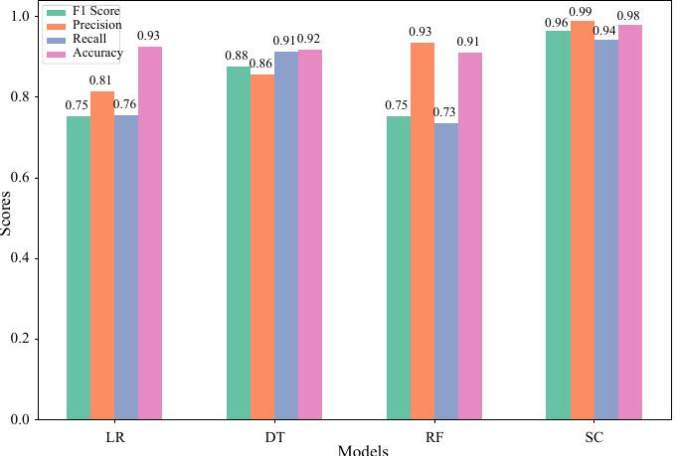
Intelligent Traffic Routing with Ensemble Learning
• Employs a stacking classifier as the EL model.
• Base Learners: Logistic Regression, Decision Trees, Random Forest.
• Meta-Learner: Logistic Regression.
• Leverages the strengths of multiple base learners for improved accuracy.
• Stacking combines predictions for a more robust classification.
• Outperforms traditional ML models in traffic classification tasks.

Slide 4
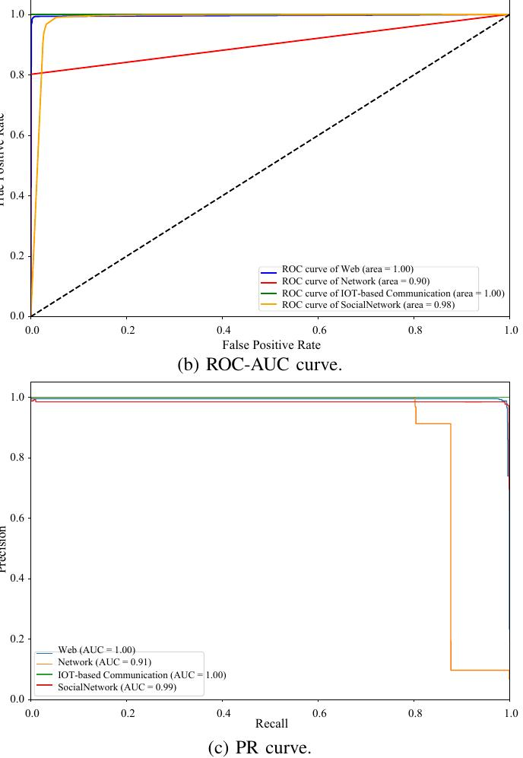
System Model and Problem Formulation
• Data (D) originates from network applications within a Smart Ecosystem (SE): D ← N ∈ SE
• Data is categorized: D = {Πweb, Πnetwork, Πiot, Πsocialnetwork}
• Mainframe SDN Controller (ΨSDN) uses the EL model (λEL) to predict the category (Θ): Θ = ΨSDN(λEL(D))
• Predicted category belongs to a cluster: Θ ∈ C
• Traffic is forwarded to the corresponding cluster: C = {Cweb, Cnetwork, Ciot, Csocialnetwork, Cdefault}
• This model ensures efficient routing and resource allocation based on traffic type.

Slide 5
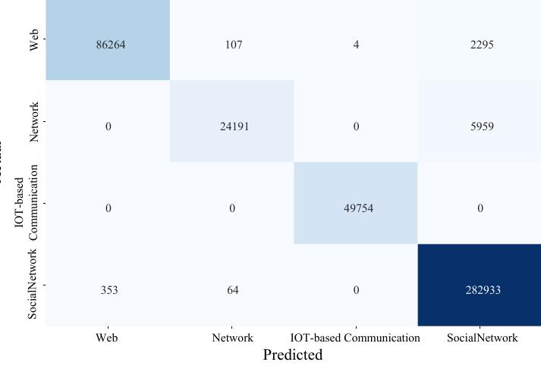
Performance Evaluation and Results
• Dataset: "Labeled Network Traffic Flows" (approx. 2.7 million flows, 50 features).
• Evaluation Metrics: Accuracy, F1-score, Precision, Recall.
• Confusion Matrix: High diagonal values demonstrate accurate classification.
• ROC Curve and PR Curve: Further validate the model's performance (details in paper).
• Comparison with other ML models: EL model achieves superior performance across all metrics.
• Results demonstrate the effectiveness of the EL model for accurate traffic classification.

Slide 6
Conclusion and Future Directions
• FAST enhances scalability, fault tolerance, and resource utilization in SDN-based smart ecosystems.
• Intelligent traffic routing via ensemble learning significantly improves performance.
• Future work includes optimizing resource management and security in 5G networks.
• Exploring applications in cloud computing resource utilization and blockchain security.
• Investigating federated learning for localized threat classification in SDN environments.
• FAST provides a foundation for building more robust and intelligent SDN solutions.
Image Here

