Slide 1
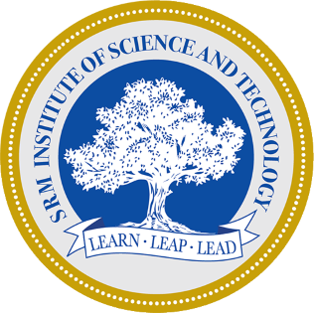
THIRD REVIEW Enhanced Diagnosis of Alzheimer's Disease through Predictive Progression Analysis of Neuro Imaging Sequences Project Category: RESEARCH
Guide Name Student Name & Registration Number
Dr. M. Karpagam V.R.Rishendra (RA2111026010221)
Rangineni Yukthamukhi (RA2111026010262)

Slide 2
Abstract
Alzheimer's disease (AD) is a progressive neurodegenerative disorder, often diagnosed too late for effective intervention with current techniques.​
This study proposes a deep learning framework combining Convolutional Neural Networks (CNNs) and Long Short-Term Memory (LSTM) networks for enhanced early AD diagnosis.​
CNNs extract spatial features from MRI neuroimaging data, identifying structural abnormalities linked to AD progression.​
LSTMs capture temporal patterns from sequential MRI scans, analyzing the progression of neurodegenerative changes over time.​
The hybrid CNN-LSTM and CNN-BiLSTM models provides a comprehensive approach, improving diagnostic accuracy and enabling earlier detection of AD.​
This work aims to contribute to AI-driven AD diagnosis, leading to better prediction, personalized treatment, and improved patient outcomes.​

Slide 3
Introduction
Alzheimer's disease causes memory loss and cognitive decline, with early diagnosis crucial for slowing progression and improving quality of life.​
Current diagnostic methods often detect the disease only at moderate or advanced stages, limiting their effectiveness.​
AI, particularly deep learning models like CNNs, shows promise in improving the accuracy and timeliness of Alzheimer’s diagnosis.​
CNNs extract spatial features from MRI scans, while LSTMs capture temporal patterns of disease progression.​
The hybrid CNN-LSTM and CNN-BiLSTM models combines spatial and temporal analysis to improve the accuracy of early diagnosis.​
This approach reduces false positives/negatives and can lead to AI-driven screening tools for better intervention and outcomes.​

Slide 4
Problem Statement
Alzheimer's Disease (AD) is a neurodegenerative disorder that causes cognitive decline and memory loss, impacting millions worldwide. Early detection is crucial for mitigating disease progression, but current diagnostic methods, including cognitive assessments and imaging analysis, can be time-consuming, expensive, and prone to variability. The increasing availability of brain imaging data, such as MRI scans, presents an opportunity to develop more efficient and accurate diagnostic tools using artificial
Utilizing deep learning algorithms, we aim to analyze brain MRI data to aid in the early detection and classification of different stages of Alzheimer's disease. Our project focuses on using convolutional neural networks (CNNs) and other deep learning techniques to automate and improve the diagnostic process. We will utilize a large, labeled dataset of brain images to develop and refine models that will surpass the accuracy and speed of traditional diagnostic methods.

Slide 5
Objectives
Developing a deep learning model for accurate Alzheimer's disease diagnosis.
To develop a hybrid deep learning model that combines Convolutional Neural Networks (CNNs) with both Long Short-Term Memory (LSTM) networks and Bidirectional Long Short-Term Memory (BiLSTM) networks for the early and accurate diagnosis of Alzheimer’s disease. ​
leveraging MRI neuroimaging data to improve diagnostic accuracy, predict disease progression, and support personalized treatment planning, ultimately enhancing patient outcomes.​Improving prediction accuracy and enhancing model interpretability.
Validating model performance on external datasets.

Slide 6
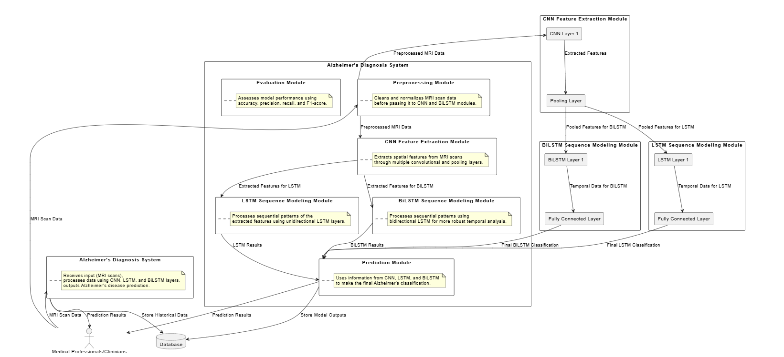
System Architecture

Slide 7
System Architecture
The architecture developed is for the Alzheimer's Diagnosis System such that the MRI scans analyzed would be used for more efficient prediction in Alzheimer's disease.
Preprocessing of the MRI scan data carried out by clinicians to ensure cleanliness and normalization before further analysis. The preprocessed data will then go through a CNN module, where spatial features are extracted from convolutional layers that critically capture imaging patterns.
This extracted feature is analyzed by the LSTM and the BiLSTM module. The LSTM module captures unidirectional patterns, whereas the BiLSTM module captures bidirectional patterns that make the analysis more comprehensive. Predictions made by different modules eventually combine in the Prediction module to generate a classification of Alzheimer's disease.
These predictions, along with historical data, are stored in a database to enable model evaluations over accuracy, precision, recall, and F1-score. Such architecture promises reliable Alzheimer's prediction accessible to clinicians for better decision-making.

Slide 8
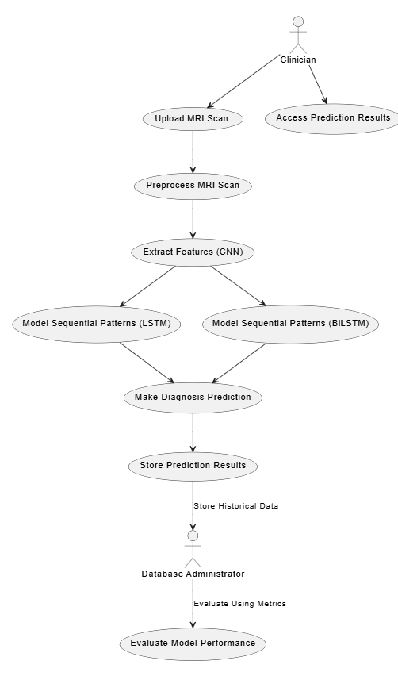
USECASE Diagram

Slide 9
USECASE Diagram
The use case diagram of Alzheimer's Diagnosis System represents the major interactions between the clinicians and the system. First, clinicians upload MRI scans followed by preprocessing for cleaning and normalization of data.
These data are next passed through a CNN module for identifying spatial features. Then, they are further processed through an LSTM module for capturing unidirectional sequential pattern and a BiLSTM module for bidirectional sequential pattern capturing.
These outputs are added up to make the final prediction for a diagnosis of Alzheimer's and are also put into the database.
Database administrators take care of the storage of historical data and might be able to check up on the model based on its accuracy, precision, and recall. Clinicians can find and view the result of predictions made by the prediction model, thus completing the diagnostic cycle.

Slide 10
Datasets
Huggingface.co
https://huggingface.co/datasets/Falah/Alzheimer_MRI
It discusses the different classes of Alzheimer’s disease and provides information on how to download and use the dataset. ​
This dataset focuses on the classification of Alzheimer's disease based on MRI scans. The dataset consists of brain MRI images labeled into four categories:​
'0': Mild_Demented​
'1': Moderate_Demented​
'2': Non_Demented​
'3': Very_Mild_Demented​

Slide 11
Literature Survey
https://docs.google.com/spreadsheets/d/1h88fofBdt7ulPmumsoEF6eZ4gotj3XamKbaNAe_3dFY/edit?gid=0#gid=0
The integration of Convolutional Neural Networks (CNNs) and Long Short-Term Memory (LSTM) networks proves effective in analyzing brain imaging data. CNNs capture structural features in the data, while LSTMs provide temporal sequence analysis, refining diagnostic tools and improving accuracy. Additionally, Generative Adversarial Networks (GANs) generate synthetic data to better train machine-based algorithms and enhance predictive usefulness in longitudinal studies of individuals with Dementia or Alzheimer's Disease. This combined approach can contribute to more precise and accurate diagnoses of dementia and its neurodegenerative forms. I am particularly interested in exploring how the complementary nature of CNN and LSTMs can provide more informative accounts of the changes to cognition resulting from Alzheimer's disease.

Slide 12
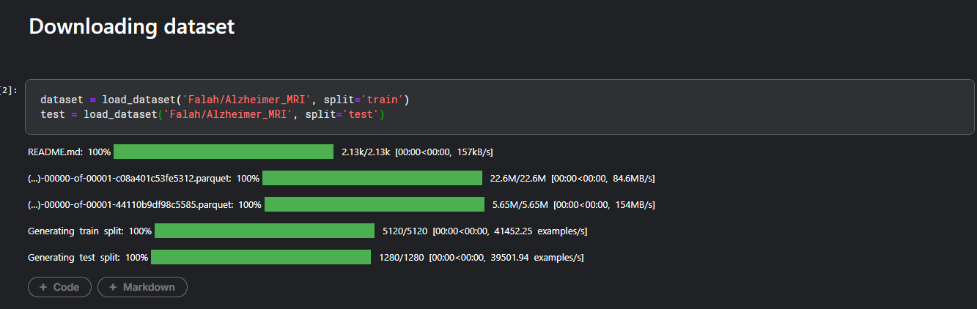
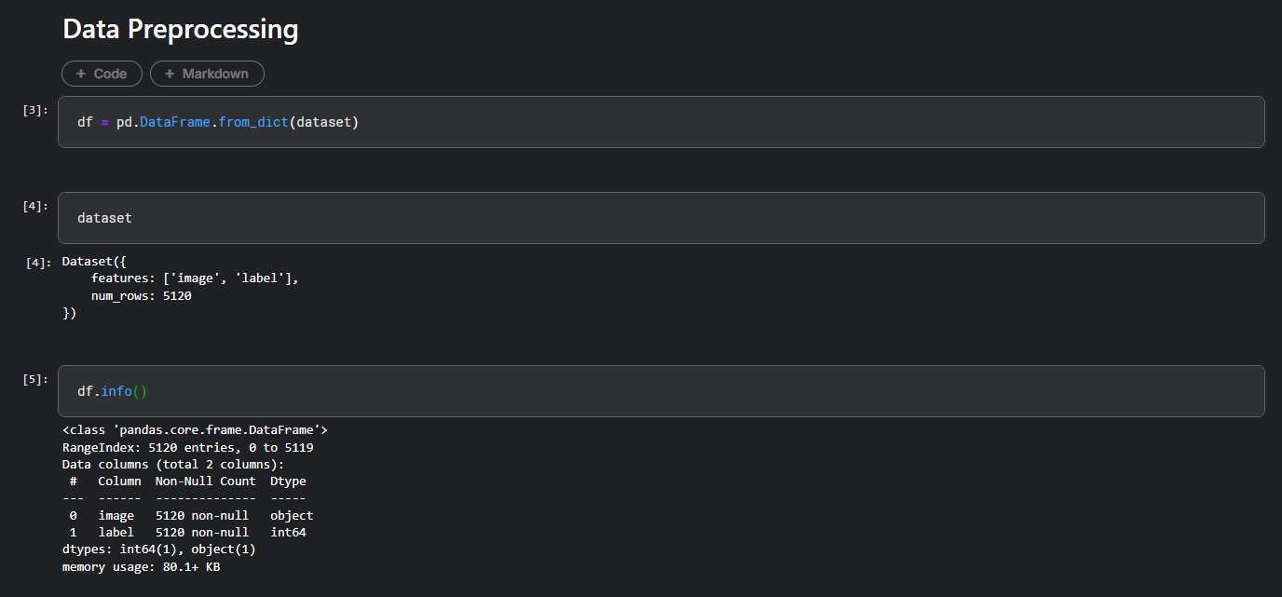
Implementation Screenshots

Slide 13
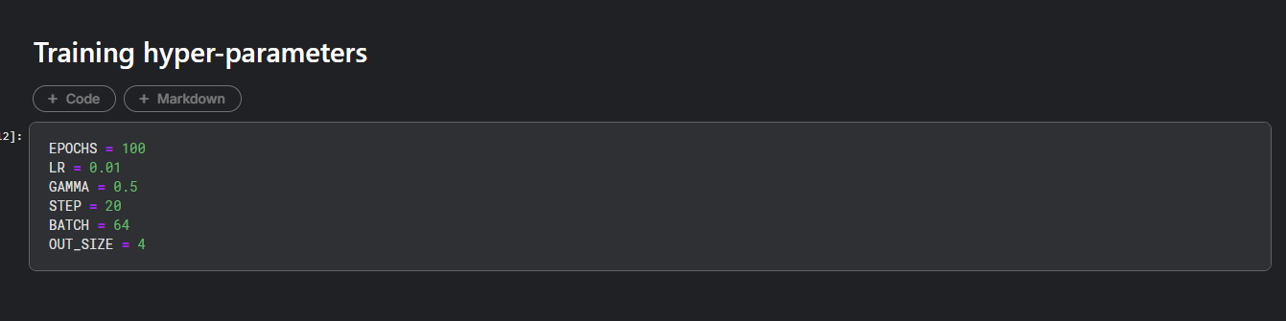
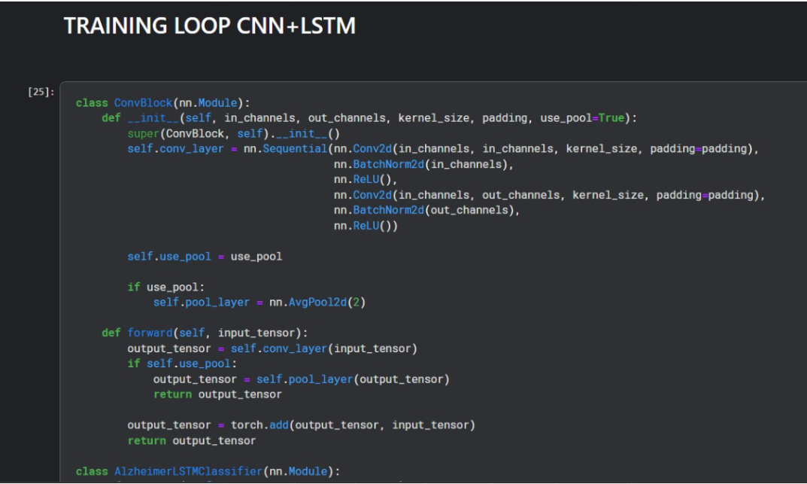

Slide 14
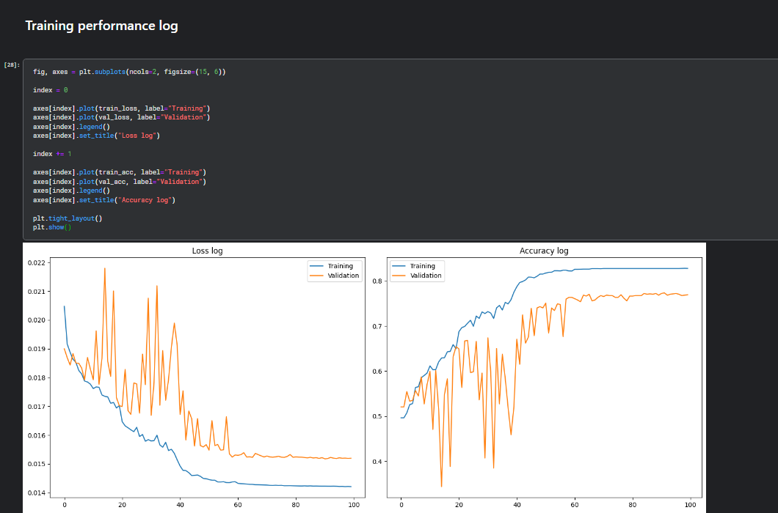

Slide 15
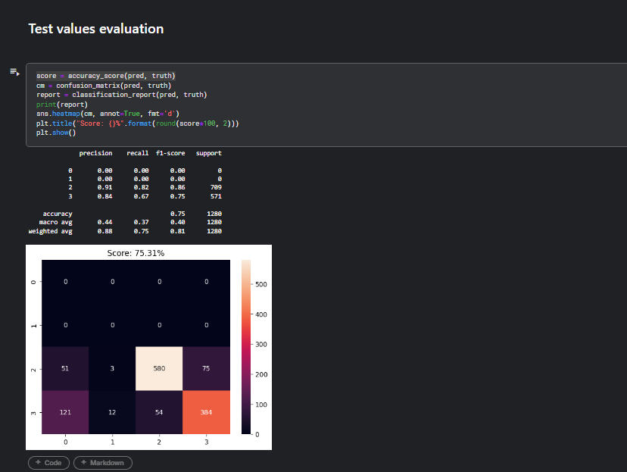

Slide 16
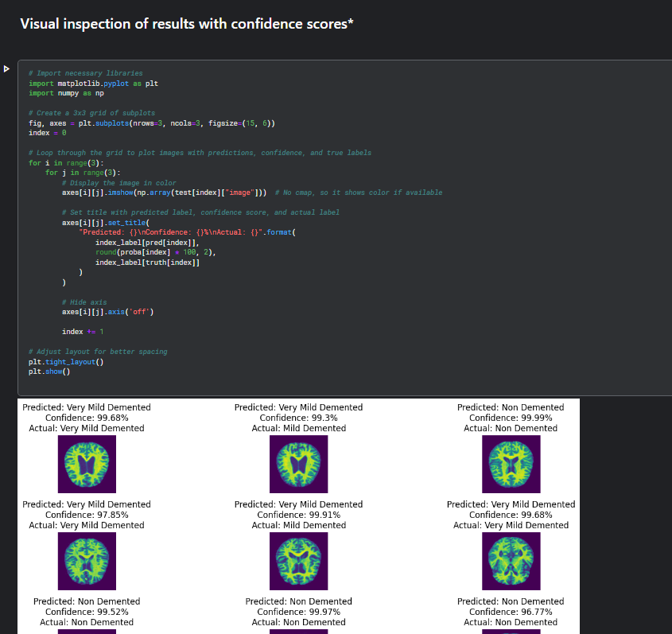

Slide 17
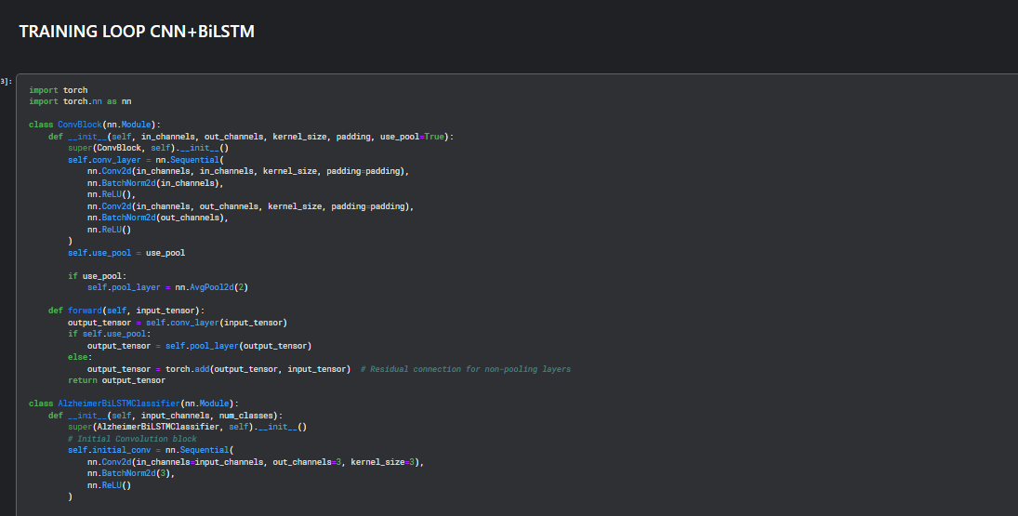

Slide 18
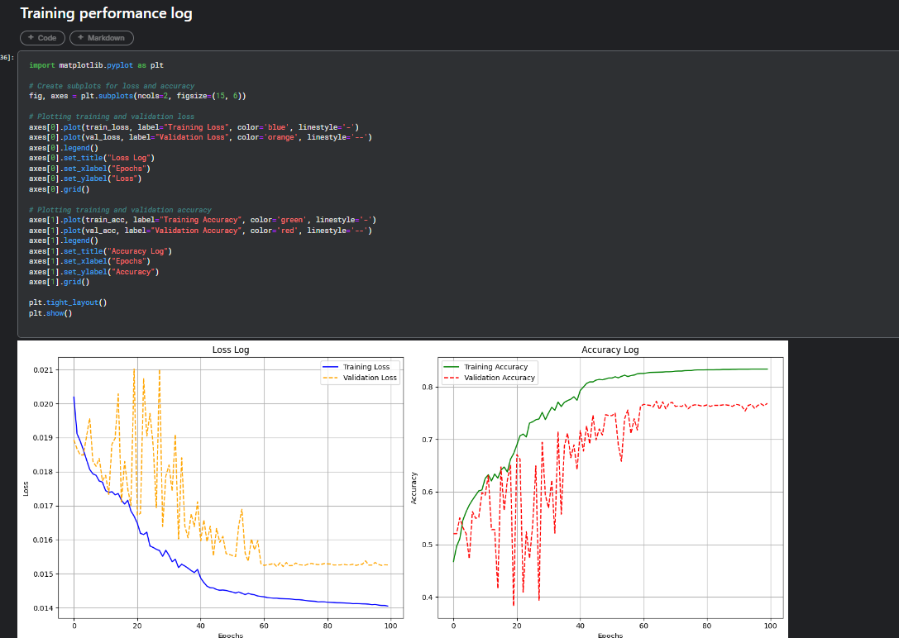

Slide 19
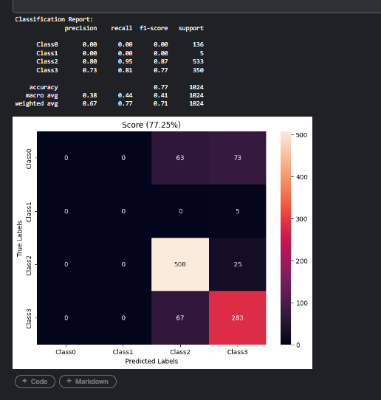

Slide 20
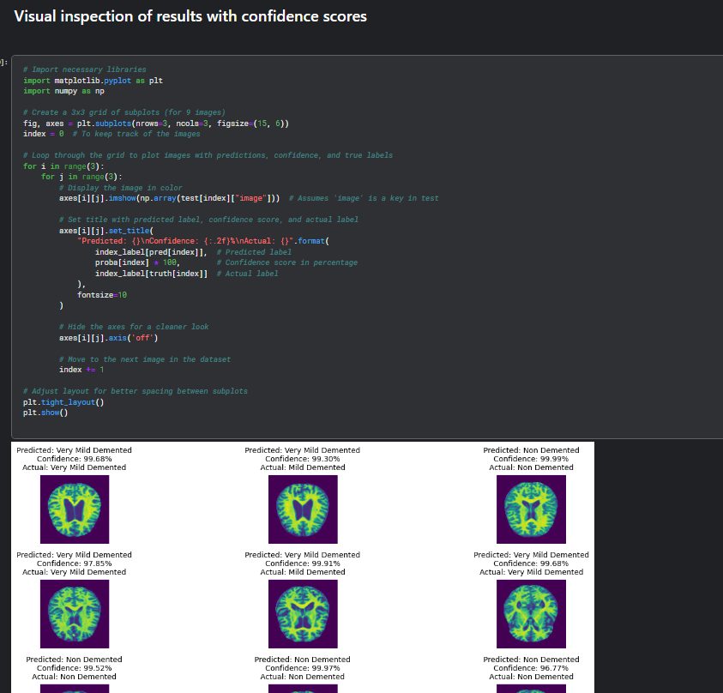

Slide 21
Limitations
Models may not consistently perform well across different populations and with various imaging technologies.
Deep learning models may lack transparency, making it difficult for clinicians to adopt them for clinical use.
Incomplete or inconsistent follow-up data can affect the analysis of disease progression.
Training and running complex models require significant computational resources.
Models may perform well on training data but struggle with new, unseen cases.
There are privacy and data security risks associated with handling sensitive medical data.
The real-world use of deep learning models may face a lengthy regulatory approval and integration process.

Slide 22
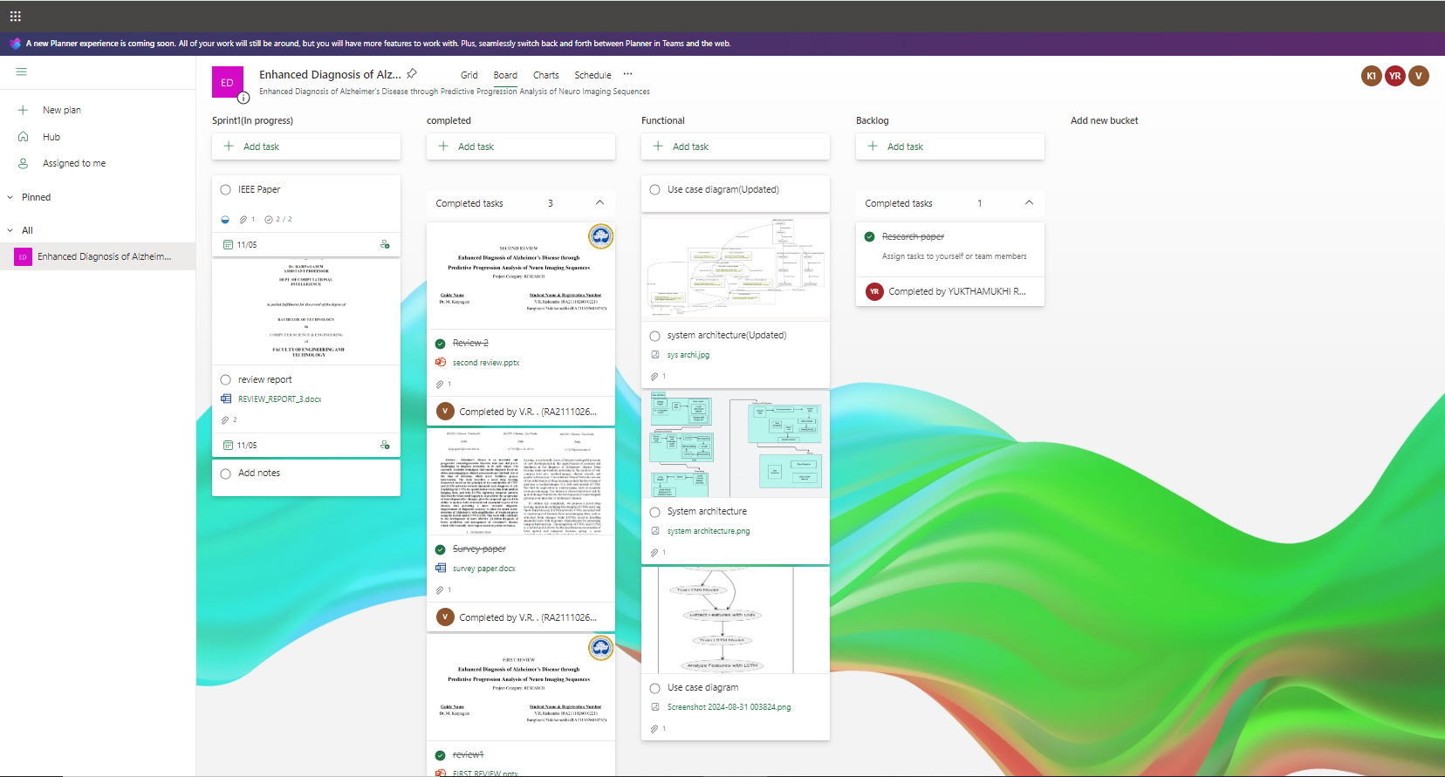
MS Planner Screenshots

Slide 23
References
https://ieeexplore.ieee.org/abstract/document/9521165?casa_token=8lyvdGTqEPUAAAAA:hvcmIjM_dEdgaLn1C_hcHWkhfbPwS783k29-Cqf7dts7UWJF-b5ngikgbthXfg4ZvWFIT-PsNA
https://onlinelibrary.wiley.com/doi/full/10.1155/2008/403896
https://ieeexplore.ieee.org/abstract/document/8737996
https://ieeexplore.ieee.org/abstract/document/8888197?casa_token=bwNZCA6RAUgAAAAA:UghnjruUU_7acMDSIEXLGnt5EZdMsvKbZKK5OYyFjziVuWUfgFhxOQLcSMIbgz3fEN_y7BMcog
https://www.ncbi.nlm.nih.gov/pmc/articles/PMC8249997/

