Slide 1
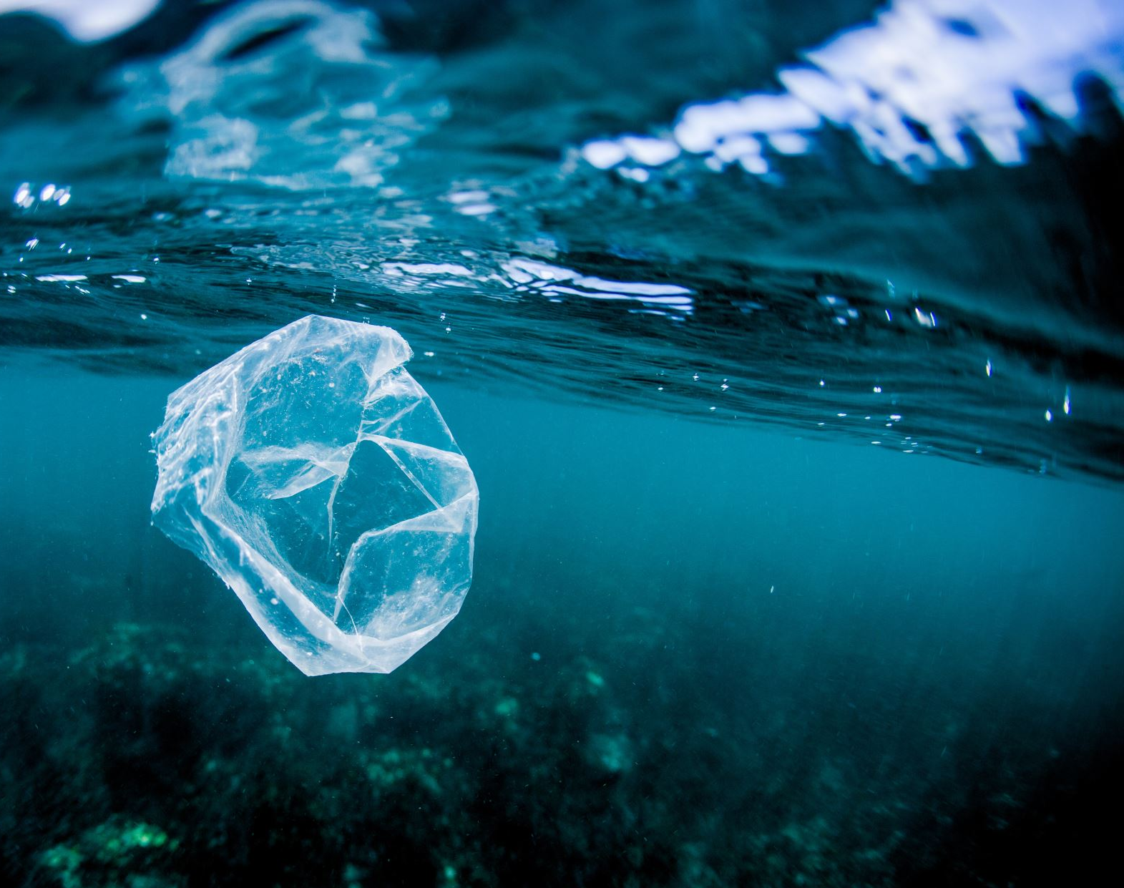
Accumulation of marine floating debris from coastal regions

Slide 2
What is your study question?
Which coastal region in which country has the most impact on which plastic gyre?

Slide 3
Which What If scenarios do you want to tackle with your twin?
What if this region reduce / increase their plastic input?
Which Method against plastic pollution works best?

Slide 4
Who could be interessted?
People
Researcher
Politicians

Slide 5
What do you need?
Satalite data (where and how is the plastic floating)
Data from waste faculties (how much they get in which region)
Data from ocean surveys (where do they find most plastic)
Hydrodynamic data (maybe from HYCOM?)

Slide 6
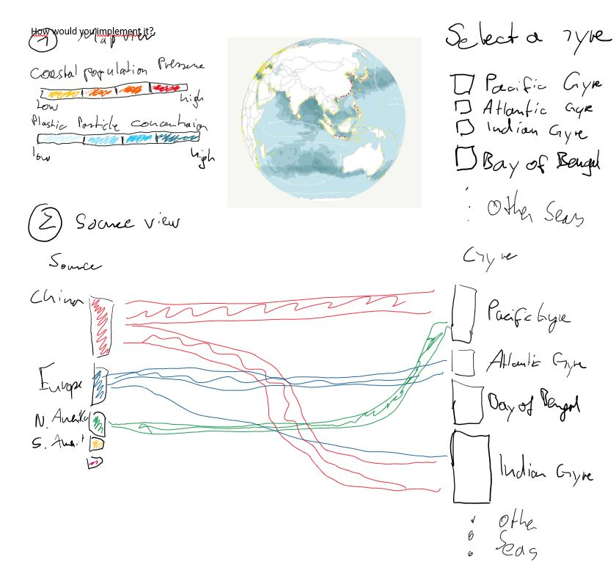
How do youn implement it?

