Slide 1

Portfolio
Report
My Client Name

Slide 2
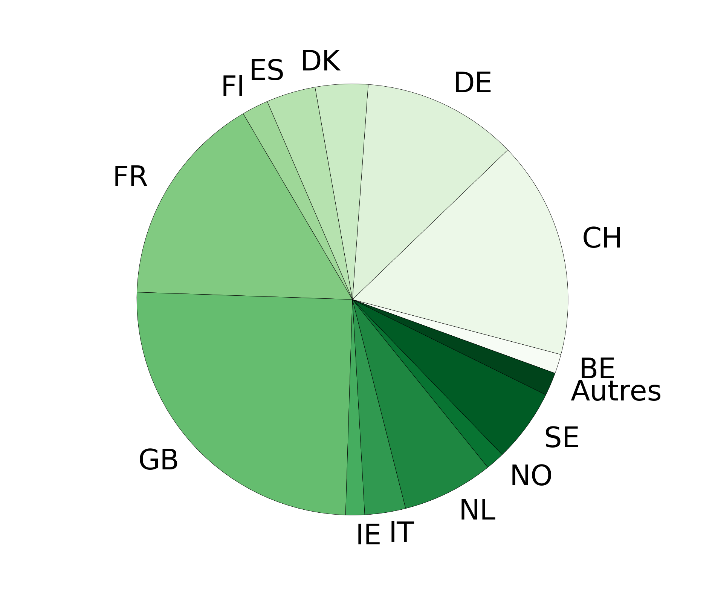
PORTFOLIO DESCRIPTION
KEY ELEMENTS
Asset management company | My Client Name |  | Number of components | 600
Name of the portfolio | My Client Portfolio |  | AUM (in € million) | Not Applicable
Benchmark | Stoxx600
TOP 10 PORTFOLIO POSITIONS
SECTORAL DISTRIBUTION
AUM in €M
AUM in €M
GEOGRAPHICAL DISTRIBUTION
PORTFOLIO DESCRIPTION
AUM in €M
General Description (manual or AI-generated input)
Description 1 (manual or AI-generated input)
Description 2 (manual or AI-generated input)

Slide 3
BIODIVERSITY ANALYSIS RESULTS
1
PORTFOLIO VARIABILITY
50% of stocks have a high (40%) or very high (10%) dependency on biodiversity
The 5 most nature dependent companies are:
Company A
Company B
Company C
Company D
Company E
The 5 ecosystem services on which the portfolio is most dependent are:
Groundwater
Forest products
Energy
Nutrient Cycling
Habitats for species
2
PORTFOLIO IMPACTS
60% of stocks have a high (40%) or very high (20%) impact on biodiversity
The 5 companies with the highest impact on nature are
Company F
Company G
Company H
Company I
Company J
The 5 natural capital assets which are the most impacted by the portfolio are
Water use
GHG emissions
Marine ecosystem
Freshwater ecosystem
Solid waste
3
BIODIVERSITY STRATEGY
Biodiversity Strategy (manual or AI-generated input).

