Slide 1
Comparison: Yocto ESDK VS Dockcross

Slide 2
dockcross
Dockcross/azure-app(1.504GB)
Dockcross/linux-arm64(1.247GB)
Dockcross/base(794.3MB)
* Here: 1GB = 1000MB

Slide 3
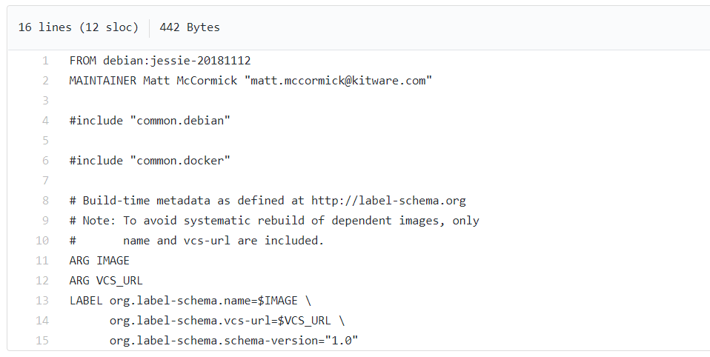
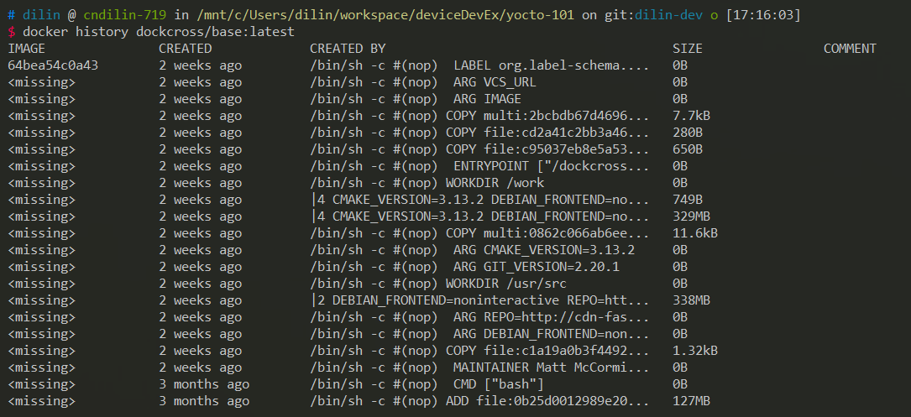
Dockcross/base (Dockerfile)

Slide 4
Dockcross/base (Dockerfile)
Install several packages
mainly for later toolchain build
Step | Size
FROM debian:jessie-20181112 | 126.9MB
|2 DEBIAN_FRONTEND=noninteractive REPO=http://cdn-fastly.deb.debian.org /bin/sh -c bash -c "echo \"deb $REPO/debian jessie main contrib non-free\" > /etc/apt/sources.list" && bash -c "echo \"deb $REPO/debian jessie-updates main contrib non-free\" >> /etc/apt/sources.list" && bash -c "echo \"deb $REPO/debian-security jessie/updates main\" >> /etc/apt/sources.list" && bash -c "echo \"deb http://ftp.debian.org/debian jessie-backports main\" >> /etc/apt/sources.list" && apt-get update --yes && apt-get install --no-install-recommends --yes automake autogen bash build-essential bc bzip2 ca-certificates curl file gettext gzip zip make ncurses-dev pkg-config libtool python python-pip rsync sed ssh bison flex tar pax vim wget xz-utils zlib1g-dev && apt-get clean --yes && /buildscripts/install-gosu-binary.sh && rm -rf /buildscripts | 338MB
|4 CMAKE_VERSION=3.13.2 DEBIAN_FRONTEND=noninteractive GIT_VERSION=2.20.1 REPO=http://cdn-fastly.deb.debian.org /bin/sh -c X86_FLAG=$([ "$DEFAULT_DOCKCROSS_IMAGE" = "dockcross/manylinux-x86" ] && echo "-32" || echo "") && /buildscripts/build-and-install-openssl.sh $X86_FLAG && /buildscripts/build-and-install-openssh.sh && /buildscripts/build-and-install-curl.sh && /buildscripts/build-and-install-git.sh && /buildscripts/install-cmake-binary.sh $X86_FLAG && /buildscripts/install-liquidprompt-binary.sh && PYTHON=$([ -e /opt/python/cp35-cp35m/bin/python ] && echo "/opt/python/cp35-cp35m/bin/python" || echo "python") && /buildscripts/install-python-packages.sh -python ${PYTHON} && /buildscripts/build-and-install-ninja.sh -python ${PYTHON} && rm -rf /buildscripts | 329MB

Slide 5
dockcross
Dockcross/azure-app(1.504GB)
Dockcross/linux-arm64(1.247GB)
Dockcross/base(794.3MB)
* Here: 1GB = 1000MB

Slide 6
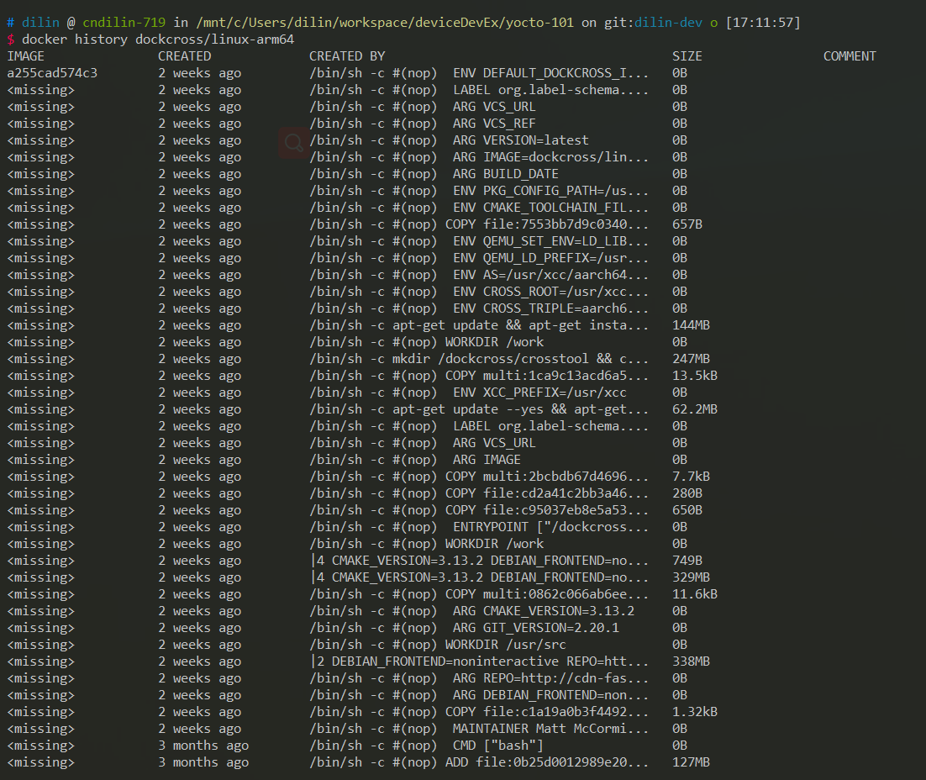
dockcross/linux-arm64(Dockerfile)

Slide 7
dockcross/linux-arm64(Dockerfile)
Step | Size
FROM dockcross/base:latest | 794.3MB
/bin/sh -c apt-get update --yes && apt-get install --no-install-recommends --yes gawk gperf help2man python-dev texinfo && apt-get clean --yes | 62.2MB
/bin/sh -c mkdir /dockcross/crosstool && cd /dockcross/crosstool && /dockcross/install-crosstool-ng-toolchain.sh -p "${XCC_PREFIX}" -c /dockcross/crosstool-ng.config && rm -rf /dockcross/crosstool /dockcross/install-crosstool-ng-toolchain.sh | 247MB
/bin/sh -c apt-get update && apt-get install -y qemu-user qemu-user-static && apt-get clean --yes | 144MB
Generate a toolchain folder for usage
Delete?
Qemu is for test
Notes:
The qemu-user-static emulator can run binaries for other architectures but with the same operating system as the current one.

Slide 8
dockcross
Dockcross/azure-app(1.504GB)
Dockcross/linux-arm64(1.247GB)
Dockcross/base(794.3MB)
* Here: 1GB = 1000MB

Slide 9
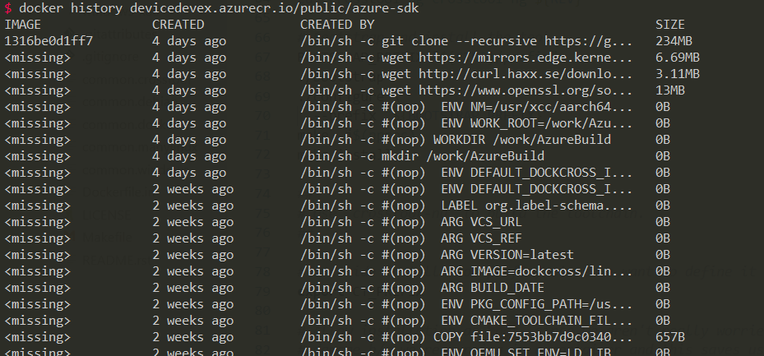
Dockcross/azure-app(Dockerfile)
/bin/sh -c git clone --recursive https://github.com/azure/azure-iot-sdk-c.git

Slide 10
Yocto ESDK
Yocto-azure-sdk(3.11GB + volume 1.243GB)
crops/yocto:ubuntu-16.04-base (739MB)
ubuntu:16.04 (117MB)
* Here: 1GB = 1000MB

Slide 11
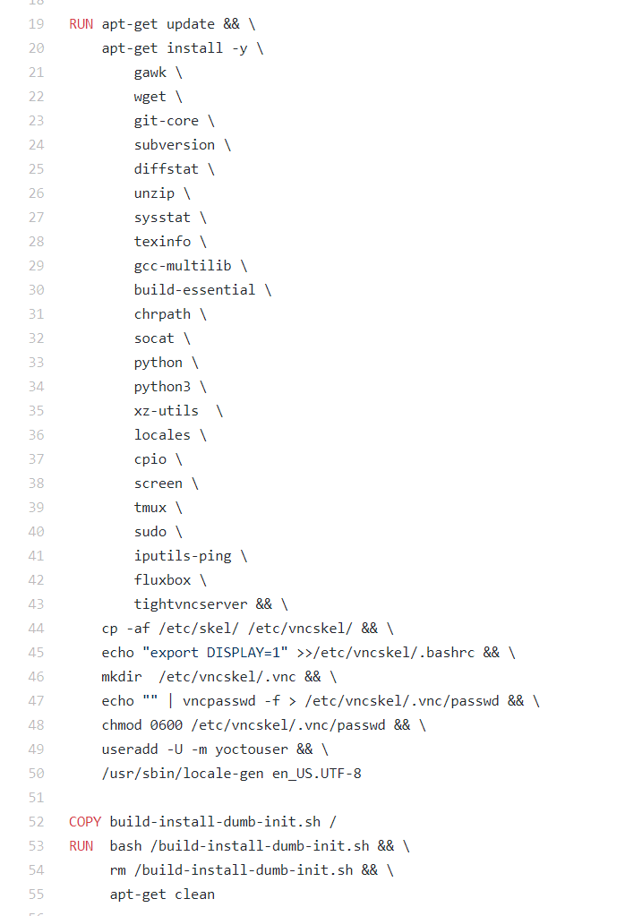
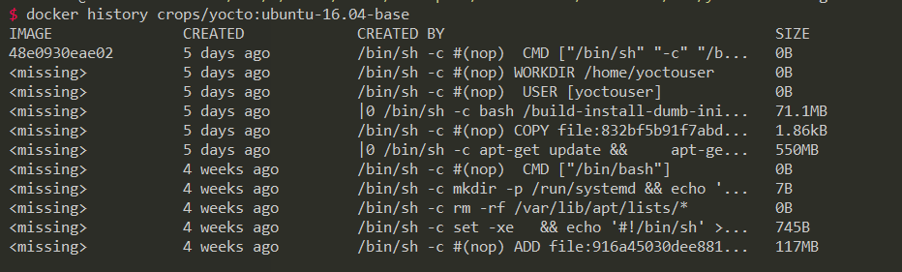
crops/yocto:ubuntu-16.04-base(Dockerfile)

Slide 12
Yocto ESDK
Yocto-azure-sdk(3.11GB + volume 1.243GB)
crops/yocto:ubuntu-16.04-base (739MB)
ubuntu:16.04 (117MB)
* Here: 1GB = 1000MB

Slide 13
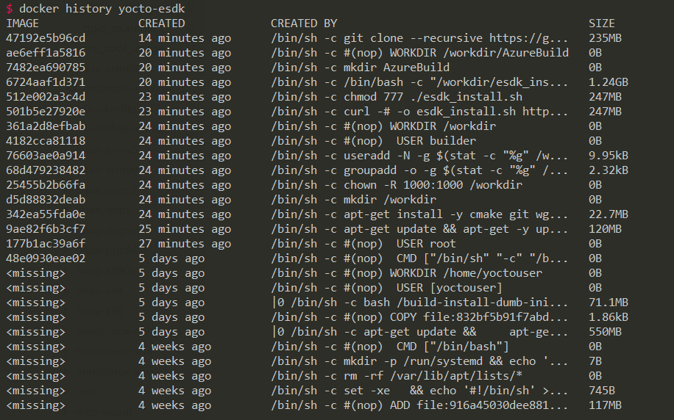
Yocto-azure-sdk
Hard to reduce
RUN curl -# -o esdk_install.sh http://downloads.yoctoproject.org/releases/yocto/yocto-2.6/toolchain/x86_64/poky-glibc-x86_64-core-image-minimal-aarch64-toolchain-ext-2.6.sh

Slide 14
Solution
Neither use yocto esdk nor dockcross directly.
Since we only needs toolchain in our scenario, we can flatten the structure to see how much size we could save.
azure-sdk(ideally 700MB)
toolchain-arm64(ideally around 300MB-400MB)
ubuntu:minimal(29MB)

Slide 15
Pros & Cons
Pros:
Reduce size, raise speed
Remove useless stuff, more sensible and elegant
Cons
Time and effort to maintain architecture specific docker image list
For device specific features, user should handle the features libraries themselves

Slide 16
Yocto toolchain
Devtool
Ext-container: http://downloads.yoctoproject.org/releases/yocto/yocto-2.6/toolchain/x86_64/ (architecture specific)

