Slide 1

Sardar Vallabhbhai National Institute of Technology, Surat
Natural Language Processing Project (MTech CSE - DS Sem 2)
QnA Bot using Google PaLM
Sarthak Jain (P23DS007)
Vaibhav Shinde (P23DS018)
Abhisek Naik (P23DS003)

Slide 2
QnA Bot
Question and Answering bot, is an application of machine learning and NLP techniques to understand and respond to questions posed in natural language. These bots are designed to interpret user queries, search for relevant information within a given knowledge base or corpus, and provide accurate answers in natural language.
These bots can be used for a variety of purposes, including customer support, providing information on products or services, assisting with troubleshooting, and more. They are a key component of conversational AI systems and play a significant role in enhancing user experience and automating interactions in various applications.

Slide 3
Objective
To build a virtual customer service agent that will assist customers with inquiries, provide support, and address issues through automated conversations.

Slide 4
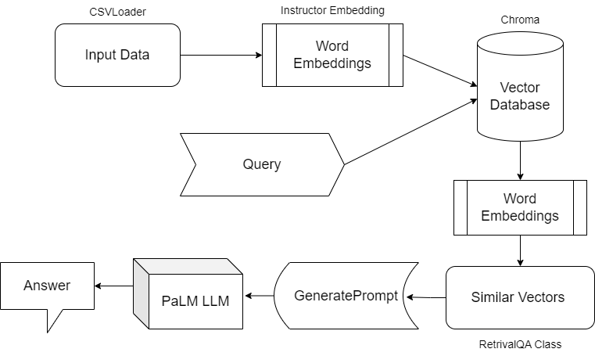
Project Architecture

Slide 5
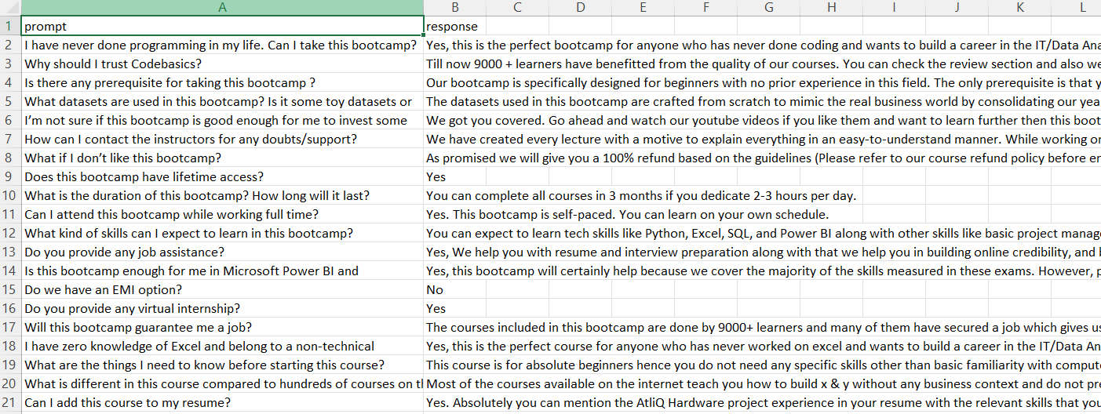
Components: Input Data
This is collection of mail received from customers with their query and corresponding responses given to those mails.

Slide 6
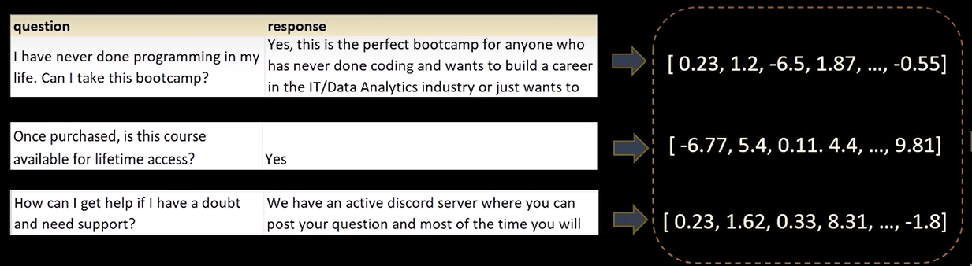
Components: Instructor Embedding
Very text input is embedded together with instructions explaining the use case (e.g., task and domain descriptions)
INSTRUCTOR is a single embedder that can generate text embeddings tailored to different downstream tasks and domains, without any further training.
INSTRUCTOR is robust to changes in instructions, and that instruction finetuning mitigates the challenge of training a single model on diverse datasets.

Slide 7
Components: Vector Database
VectorDB is a lightweight Python package for storing and retrieving text using chunking, embedding, and vector search techniques. It provides an easy-to-use interface for saving, searching, and managing textual data with associated metadata and is designed for use cases where low latency is essential.
We have used Chroma Vector Database for this project.
Chroma is a AI-native open-source vector database focused on developer productivity and happiness. Chroma is licensed under Apache 2.0.

Slide 8
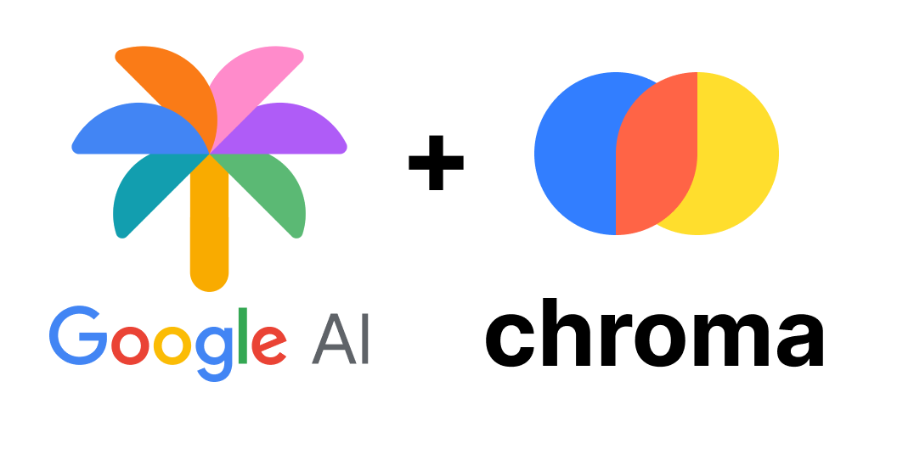
Components: Google PaLM LLM
PaLM 2 is our next generation large language model that builds on Google’s legacy of breakthrough research in machine learning and responsible AI.
It excels at advanced reasoning tasks, including code and math, classification and question answering, translation and multilingual proficiency, and natural language generation better than our previous state-of-the-art LLMs, including PaLM.
It can accomplish these tasks because of the way it was built – bringing together compute-optimal scaling, an improved dataset mixture, and model architecture improvements.
This can be simply be utilized by generating the free API from aistudio.google.com

Slide 9
Workflow
Initiate the Google PaLM LLM using your api key.
Load the data into workspace using LangChains’s CSVLoader.
Convert the input query answer data into a single vector using Instructor Embedding.
Store all the embeddings into a Vector Database.
Initiate a retriever object of the Vector Database that contains stored vectors.
Take query from the user.
From the vector database retrieve those vectors that are most similar to query.
Convert the query and similar prompts to appropriate prompt.
Pass it to Google PaLM LLM to convert it to a coherent ans.

Slide 10
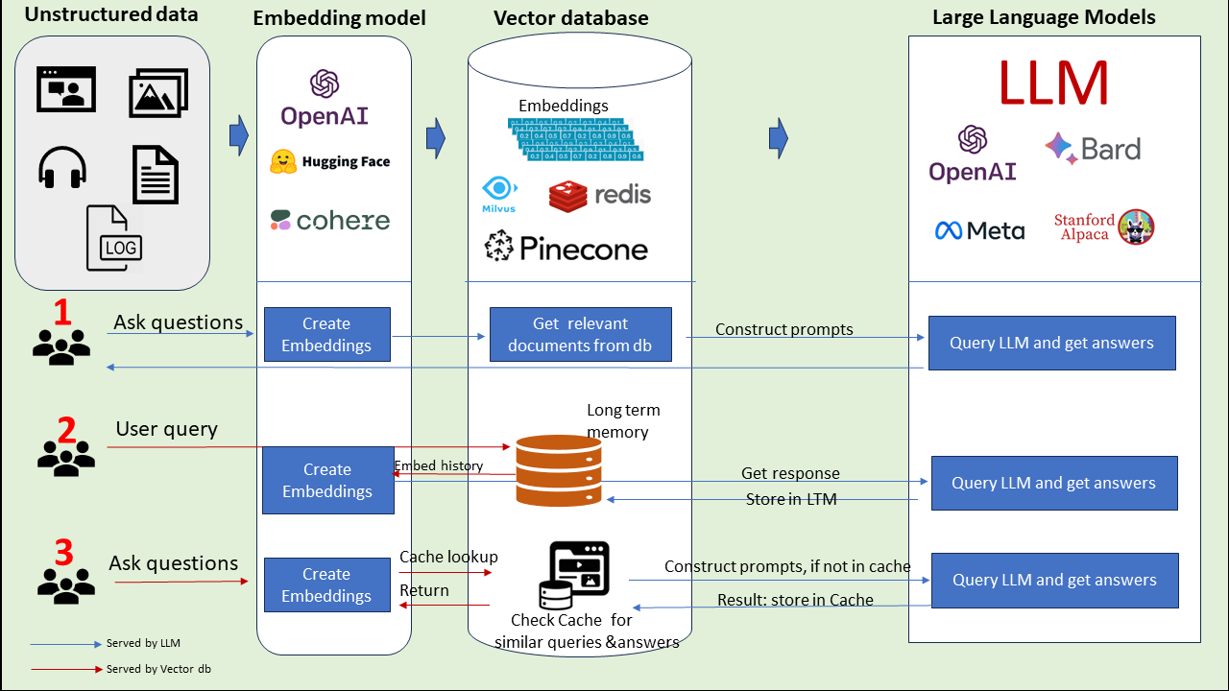
Workflow

Slide 11
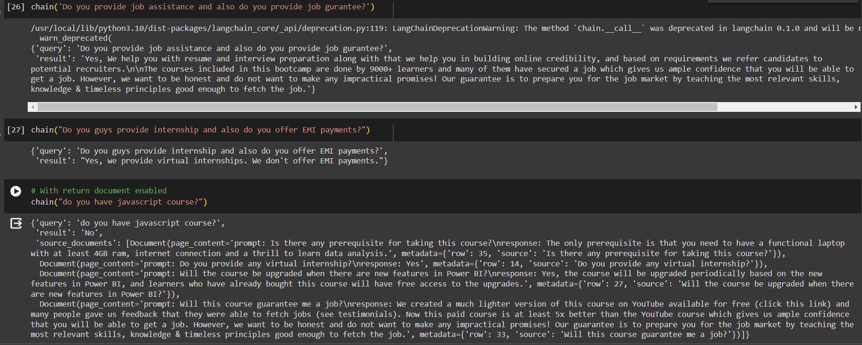
Results

Slide 12
Thankyou

