Slide 1

SMART INDIA HACKATHON 2026
TITLE PAGE
Problem Statement ID – [Enter PS ID]
Problem Statement Title- AI-Powered Hospital Appointment, Pre-Consultation & Documentation System
Theme- MedTech / BioTech / HealthTech
PS Category- Software
Team ID- 32
Team Name (Registered on portal)- Kaizen

Slide 2
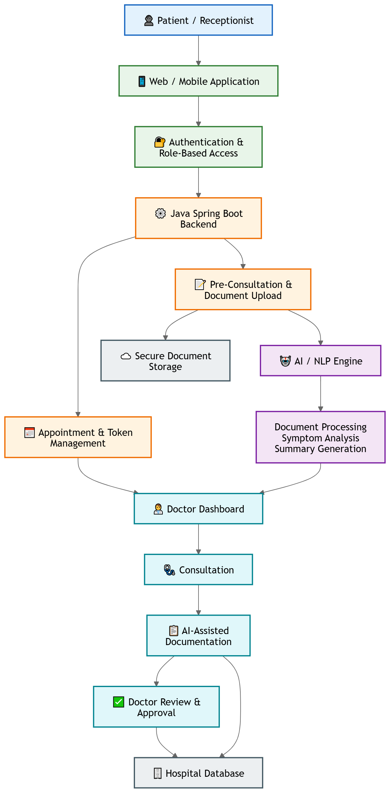
AI-Powered Hospital Appointment, Pre-Consultation & Documentation System
Kaizen
Proposed Solution (Describe your Idea/Solution/ Prototype)
Unified Access: Supports registration, online booking, and walk-in token generation on one platform.
AI Pre-Consultation: Collects medical history and symptoms automatically prior to doctor visit.
Doctor Dashboard: Centralizes real-time queues, records, and AI-synthesized patient summaries.
Smart Documentation: Generates structured drafts for doctor review and one-click approval.
Enterprise Infrastructure: Role-based access control, secure cloud storage, and automated alerts.

Slide 3
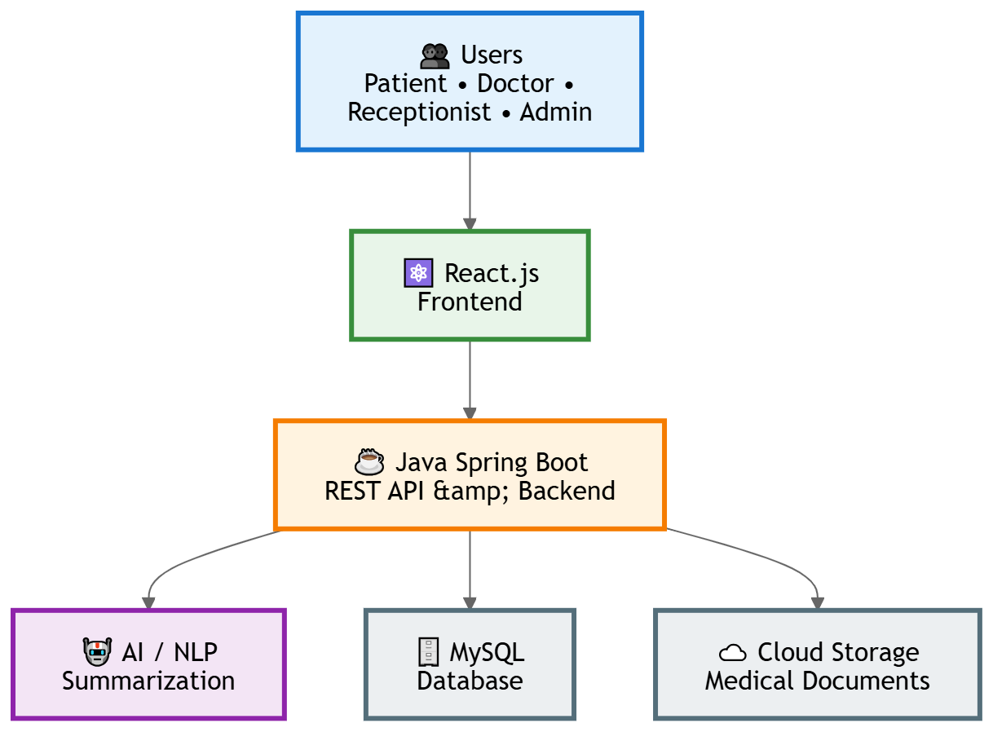
TECHNICAL APPROACH
Kaizen
Frontend: Responsive React.js application tailored for Patients, Doctors, Receptionists, and Admins.
Backend Core: Java Spring Boot REST API providing robust business logic and JWT/OTP security.
AI/NLP Engine: Extracts document metadata, summarizes symptoms, and automates report drafting.
Database & Cloud: Relational PostgreSQL database paired with encrypted cloud storage for clinical records.
Workflow:
Booking → Token → Pre-Consultation → AI Summary → Doctor Consultation → Documentation → Approval → Medical Record.
Security: Spring Security, RBAC, JWT/OTP, encryption, validation, and audit logging.

Slide 4
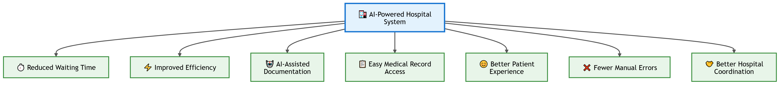
IMPACT AND BENEFITS
Kaizen
Reduced Wait Time: Optimized queueing and token system cuts lobby congestion.
Zero Paperwork: AI summaries & digital records replace physical clinical notes.
Enhanced Care: Doctors receive structured history before the consultation starts.
Improved Accuracy: Minimizes manual transcription errors across hospital operations.

Slide 5


FEASIBILITY AND VIABILITY
Kaizen
Feasibility
Technical Feasibility: Java stack, REST APIs, PostgreSQL, and existing AI APIs can support the system.
Operational Feasibility: Patients, receptionists, doctors, and administrators can use role-specific dashboards with simple workflows.
Economic Feasibility: The system can be developed using open-source technologies and cloud services with low initial infrastructure costs.
Implementation Feasibility: The system can be developed module-by-module, starting with appointment management and gradually adding AI features.
Scalability: The architecture can be expanded to support multiple departments, doctors, branches, and larger patient volumes.
Viability
The system has practical value because it addresses common hospital workflow problems.
Reduces manual appointment and registration work.
Helps manage both online and walk-in patients.
Reduces patient waiting and improves token/queue management.
Provides doctors with organized pre-consultation information.
Reduces the time required for medical documentation.

Slide 6
RESEARCH AND REFERENCES
Kaizen
Existing System vs Proposed System
Module / Feature | Existing System | Proposed Improvement
Pre-consultation | Patient enters Appointment ID, uploads reports, answers AI questions; summary saved under the Appointment ID. | Keep Appointment ID as the entry point; store the full session and summary against it, auto-available to the doctor — not tied to the changing daily token.
Walk-in / Receptionist | Receptionist books and runs pre-consultation for walk-ins; existing patient info can be reused. | Apply the same ID separation to walk-ins — reuse the patient record, but create a new Appointment ID for each new visit.
Doctor Dashboard & Consultation | Doctor views Patient Name, Appointment ID and Summary; enters diagnosis/prescription. | Doctor works from the daily Token ID; selecting a token auto-maps to Appointment ID → patient → pre-consultation summary, no manual searching.
References
WHO (2021) AI Health Ethics & ABDM (Govt. of India) interoperable digital health standards.

