Slide 1


Slide 2




Team Members
Taraka Raviteja peddi Hongyang Wang Yaswanth Yarram DurgaPrasadVSM

Slide 3
Contents
What is Splunk
Why Splunk
Components
Architecture
Features
Products
Best practices
Famous companies using Splunk
Alternatives
Use case

Slide 4
What is Splunk
Splunk is an advanced, scalable and efficient technology for indexing and searching log files stored on your system.
Log aggregation function - Quickly search dispersedly log files across the host
Search and extraction — Search easily and then group and aggregate
Visualization - Create charts with different operations, such as pie charts, histograms, row and column charts, and other complex charts
Email Alert - Splunk can be set to trigger email alerts based on different events
Hongyang Wang

Slide 5
Why is Splunk
Splunk is a digital platform that helps access machine-generated data, which is useful and valuable to everyone.
Splunk is that it does not require any database to store its data because it uses its indexes extensively to store data.
Multi-platform support - Currently Splunk supports Windows XP, Vista, 7, and 8 (32-bit/64-bit)/Windows Server 2003, 2003 R2, 2008, and 2008 R2 (32-bit/64-bit) 2.6+ kernel Linux distributions (32-bit/64-bit), Solaris (8, 9, 10, 11), OSX (10.5, 10.6, 10.7), FreeBSD 7, 8 (32-bit/64-bit), AIX (5.3, 6.1, 7.1), HP-UX (11i v2, 11i v3).
Hongyang Wang
Hongyang Wang
Notes:
Multi-platform support - Makes processing data easier. It is not necessary to be limited to the operating platform.
Index arbitrary data from any source - Splunk can index all of your machine data without having to purchase, write, or maintain any particular analyzer or adapter.

Slide 6
Why is Splunk
Index arbitrary data from any source - Splunk can index any type of computer data from any source in real time
Splunk Forwarder - Splunk Forwarder can be deployed if the required data is not available over the network, or if the required data is not visible on the server where Splunk is installed.
Security - Splunk is a powerful security model.
Hongyang Wang
Notes:
Index arbitrary data from any source - Splunk can index all of your machine data without having to purchase, write, or maintain any particular analyzer or adapter.
Splunk forwarder provides secure, distributed, real-time global data collection for thousands of endpoints. They can monitor local application log files, capture status command output about schedules, get performance metrics from virtual or non-virtual sources, or file systems that monitor configuration, permissions, and attribute changes.
Each Splunk transaction is verified, including user activities performed through the web user interface and command line interface, and system activities performed through the Splunk API.

Slide 7

Components of splunk
Yaswanth Yarram

Slide 8
Components of splunk
Forwarder:
Forwarder gather data from remote devices and passes data in real time to the database.
Indexer:
Incoming data is handled in real time by indexers. It stores and indexes the data on the disk as well.
Search Head:
End users interact with Splunk through Search Head. It allows users to do search, analysis & Visualization. Yaswanth Yarram

Slide 9
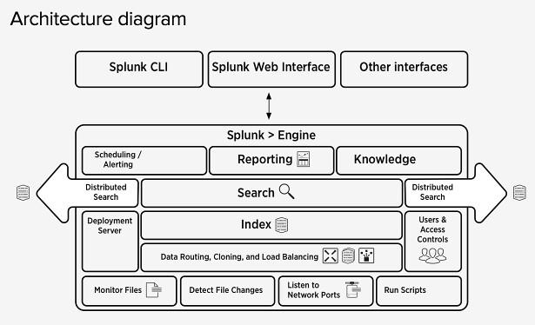
Splunk Architecture
Yaswanth Yarram

Slide 10
Features Of Splunk
Accelerate Development & Testing
Monitor and alert.
Collect and index any data
Real-time search, analysis and visualization
Yaswanth Yarram

Slide 11
Splunk Products
Splunk Enterprise
Splunk Light
Splunk Cloud
DurgaPrasadVSM

Slide 12
Splunk Products
Splunk Enterprise:
The large IT company uses Splunk Enterprise Edition. It helps you to collect and analysis information apps , websites ,applications, etc.
Splunk Cloud:
It has the same features as the enterprise version.Splunk Cloud is a hosted platform. It can be availed from AWS cloud platform or splunk
Splunk Light:
Splunk Light is a free version. It allows search, report and alter your log data. It has limited functionalities and feature compared to other versions.
DurgaPrasadVSM

Slide 13
Best Practices of using Splunk
You should test the index so you can quickly perform the test.
There are specific fields you must get right at index time. Everything else you can create/modify only after indexing.
The time stamp may be identified by Splunk automatically. If you have a different timeline in your log file, you have to change the time timeline.
DurgaPrasadVSM

Slide 14
Famous companies using Splunk
Cisco
Bosch
IBM
Motorola
PepsiCo
Dominos
Facebook
DurgaPrasadVSM

Slide 15
Alternative to Splunk
Loggly:
It enables you to analyze logs and quickly search. The tool helps you collect system data with compatibility with Syslog.
LogFaces:
Logfaces are another spunk alternative to send your queries via e-mail. This tool maintains log information in the building. A simple desktop application is included in the tool.
DurgaPrasadVSM

Slide 16
Dominos - Use case
Difficulties & Challenges :
Unstructured data, manual searches and maintaining preferences.
Splunk to Dominos :
Search the data faster, monitor the performance,interactive apps, real-time feedback and get better insights.
DurgaPrasadVSM

Slide 17

Demo Started
Taraka Raviteja Peddi

Slide 18
References
https://www.guru99.com/splunk-tutorial.html#6
https://www.google.com/search?q=what+is+a+splunk&rlz=1C1GCEB_enUS811US811&oq=what+is+a+splunk&aqs=chrome..69i57j0l5.3715j1j7&sourceid=chrome&ie=UTF-8

Slide 19
Any Questions ?
Taraka Raviteja peddi Hongyang Wang Yaswanth Yarram DurgaPrasadVSM

