Slide 1
Electronics Industry In Brief
Section 1
P V S Phaneendra
09.07.2019

Slide 2
Physics – The Need to Understand
History of Physics
Ancient Astronomy
Natural Philosophy
Classical Physics
Modern Physics
Advancements in Physics
Astronomy
Electro-magnetism
Solid State Physics
Nuclear Physics

Slide 3
Evolution of Electronics prior to 1900s
600 B.C. – Static Electricity Discovery
1785 – Coulomb’s Law formulation by Charles-Augustin de Coulomb
1752 – B Franklin proved that electricity and lightning are the same
1800 – Alessandro Volta invented battery
1808 – Atomic Theory by John Dalton
1816 – Sir Francis Ronalds built first electric telegraph
1827 – George Ohm introduced concept of electrical resistance
1831 – Michael Faraday published Law of Induction
1836 – Nicholas Callan invented transformer
1844 – Samuel Morse developed telegraph and the Morse Code
1845 – Kirchoff Circuit Laws by Gustav Kirchoff
1876 – Axelander Graham Bell patented telephone
1877 – Thomas Alva Edison invented phonograph
1880 – Curie(s) discovered piezoelectricity
1883 – J J Thompson invented waveguides
1888 – Hertz proves existence of E M waves
1895 – Discovery of X-ray by Wihelm Rongten
1897 – Ferdinand Braun invented CRT

Slide 4
Evolution of Electronics post 1900s
1900 – Guglielmo Radio builds first radio communication system
1904 – John Ambrose invented diode
1912 – E H Armstrong developed Electronic Oscillator
1919 – E H Armstrong developed standard AM radio receiver
1925 – Lilienfeld patented first FET
1928 – First experimental TV broadcast in US
1936 – Paul Eisler invented PCB
1939 – E H Armstrong invented FM radio receiver
1939 – First Klystron tube built
1941 – Konrad Zuse developed first programmable computer
1944 – J L Baird developed first color picture tube
1948 – Dennis Gabor invented holography
1951 – First nuclear plant in US
1958 – Jack Kibly invented IC
1960 – T H Maiman invented LASER
1966 – Optical fiber communication
1969 – Unix operating system
1970 – First microprocessor

Slide 5
Modern Electronics is closely associated to …
Electricals
Physics
Metallurgical Sciences
Choice of materials going into preparation of transistors, RF material, resisters and other components etc.
Mathematics
Software
Flow of electrons – current, voltage differences, etc.
Atoms, Electrons, Neutrons, Protons, Electromagnetic Waves, etc.
That helps you realize the digital and analog logic to be programmed with the help of simulations (latest trend)

Slide 6
Today’s Electronics Industry
Semiconductor Industry
Consumer Electronics Industry

Slide 7
Design to Fab
Section 2
P V S Phaneendra

Slide 8
Realization of A Chip
Architecture & Design on Paper
Architect(s)
Softcore Creation (HDL programming)
FPGA Prototyping(before ASICs design)
Logic Synthesis
Realization of corresponding ASICs
Digital Design by RTL engineers
Analog Design by Analog / Mixed Signal engneers
Circuit Designers, Planners
Floor Planning & Routing to meet timing latencies
Design details translates to xm technology based lambda rules
Technology dependent fabrication process
Hours-days
Days-Weeks
Weeks-Month(s)
Months
Think about design cost for any re-spin at various phases of the design

Slide 9
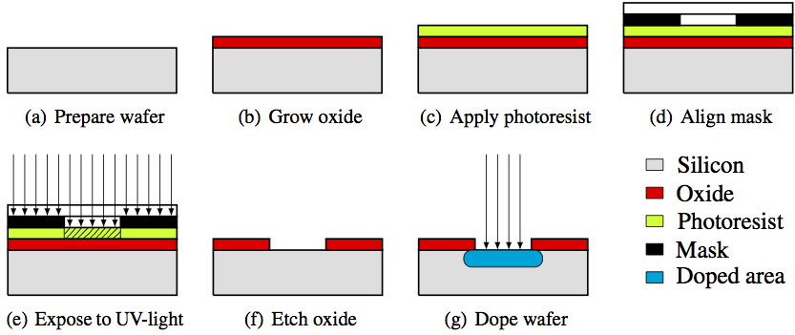
Fabrication of An IC – A Tedious Process
Wafer Production
Water Fabrication
Thermal Oxidation or Deposition
Masking
Etching
Doping
Dielectric Deposition and Metallization
Passivation
Wafer Test
Electrical Test (Device Test)
Assembly

Slide 10
Testing the Samples
Die Packaging
Preparation of Reference Boards
Reference / Evaluation / Development Boards
Components selection
PCB Layout Design
Given to prospective clients / customers for evaluation
FAE / AE support
DIP
QFP
Ball mounted, etc. and many more variations are available

Slide 11
Concerns to Address
How to bring down the cost incurred because of design re-spins (re-work) ?
Each design re-spin could lead to any of the following
Fix in the implementation or process – costly affair since the sample ICs have already been manufactured
Increased development efforts since this might require fixes at the software level too to cover up for the hardware limitations/bugs
Final prototype requires actual software working on the final hardware
Fabrication of ICs is in itself a time-consuming process (10+ days to months)
Fabs / Foundries set up assembly lines in order to manufacture these Silicon
Missing deadlines is a costly affair

Slide 12
EDA & It’s Eco-System
Section 3
P V S Phaneendra

Slide 13
EDA Companies – Creating End-to-End Eco-System
EDA is an acronym for “Electronics Design Automation” Tools
For over a decade now, EDA companies have been offering the to-go solutions, products to meet the requirements of the semiconductor industries and eco-system
EDA industry is going through a big transformation
Semiconductor companies are using EDA tools in order to innovate IC / SoC designs with trade-offs between the famous triad, namely,
AREA
TIMING (PERFORMANCE)
POWER

Slide 14
EDA Companies Building Stronger Eco-System
EDA companies are also increasingly expanding their portfolio to cater to the design-to-fab needs of the semiconductor industry
System design and verification
Digital design and sign-off
Custom IC / Analog / RF design
IC Package design and analysis
System Analysis
PCB design and analysis
The tools are so proficient that the sign-offs from these tools are foundries compliant too

Slide 15
Methodologies Defined to Speed up Time-to-Market of ICs / SoCs
Simulation
Emulation
IP/Model/SoC behavior is modelled (mimicked) at the Software level
Modelled at a higher abstraction and hence, software running on them, boots faster
Usually dependent on mathematical models of the various components within the device
Mainly for analysis, debugging and performance
IP/Model/SoC behavior is not just modelled but also each and every feature of the device is supposed to be replicated
Generally, pretty slow since every inner aspect is tried to be duplicated
Emulators are, generally, hardware based, and hence, the more closer to the actual REAL device
More about functional correctness, apps that work on the emulator are supposed to work right away on the real device(s) too

Slide 16
Virtual Platforms
Section 4
P V S Phaneendra

Slide 17
How does a Simulated System Look Like ?
uC
uC
Virtual Platform
L1 Cache
L1 Cache
BUS
Monitor
RAM
ROM
FLASH
UART
Trace Tools
Application
Execute
OS / RTOS
Event Recorder

Slide 18
Virtual Platforms - Simulator
Mostly modelled in Software ONLY
Simulator mimics the TARGET’s behavior
Granularity of the modelling is limited by the features of the hardware sought by the use-cases
Aids in debugging complex scenario since simulators provided the much-needed determinism while testing
Helps in analyzing SoC behavioral changes by adding newer components using plug-and-play
Aids in early software development, driver development
Lessens Time-To-Market of a product since software is available much early compared to the traditional timelines

Slide 19
VP Use-Cases
Software Development
Aids in driver’s and other software development
Architectural Exploration
By modelling at more finer granular level, capabilities and capacity of a system could be explored
Helps in analyzing bottlenecks in a system
Aids in development and testing of new component(s), IP(s) in a SoC
Also helps in verification of SoC with the help of verification libraries
EDA tools that now support Co-simulation can easily integrate software models along with hardware block in order to realize a system
Open-source VPs are available that enable academic and industry collaboration(s) bridging the gap between industry and academia

Slide 20
Few Notable Open-Source Simulators
Accellera’s SystemC

