Slide 1
Understanding CMake
P V S Phaneendra

Slide 2
Agenda
Overview on Build Process
Build Files / Scripts
Build Systems
CMake - The Quintessential Build Tools Generator
Getting Started with CMake
CMake Language Constructs Overview
Few Important CMake Commands
Few Important CMake Variables
Illustrations By Examples
And More In Future
Interesting Reads or Links
References

Slide 3


Overview on Build Process
Why does a programmer require a build system ?
To execute one’s code on a hardware
And, hardware understands ONLY machine code
And, programmers generally would be coding at a much higher abstraction level (C, C++, Python, etc.)
Now, how does the programmer transform the source at higher abstraction level to the machine code (host code) ?

Slide 4
Overview on Build Process (contd.. 1)
Build process is tightly coupled with the language design and decisions of the language committee
No one rule for all languages
Each language has it’s own build process in place for transforming the high level language to the machine code
Build process consists of varying number of build steps for each language
Hence, the need for understanding the build process arises !

Slide 5
Overview on Build Process (contd.. 2)
Classification of languages
based on abstraction levels closer to machine code
Low level languages (C, C++)
Interpreter languages (JavaScript, Python, etc.)
Virtual machine based languages (Java - JVM)
Why do you think above classification is important and relevant in the current discussion ?
Heard about pre-processor, compiler, assembler and linker ?

Slide 6
Build Files / Scripts
Build files usually are written to build a given source code for limited number of
Compilers
Platforms
Few well known scripts : Makefile, npm scripts, runjs
Executing Makefile
Build commands ‘make’ (Unix flavours) or ‘nmake’ (Win) use these build scripts in order to build the final executable
Build scripts, for instance, contain list of dependencies and rules
The rules within a build script contains
rules that determine the order in which the intermittent targets are built, finally resolving into generation of the final target file, and
the correct sequence of the rules

Slide 7
Build Files / Scripts (contd.. 1)
Sample #2
package \
|__ include \
| abcInteface.h, abcDetails.h
|__ src \
| abcInterface.cpp, abcDetails.cpp
CXX = g++
CFLAGS = -g -Wall –static
AR = ar
PCKG_NAME := package
INC_DIR := -I${CWD_PATH}/$(PCKG_NAME)/include
SRC_DIR := ${CWD_PATH}/$(PCKG_NAME)/src
OBJ_DIR := ${CWD_PATH}/$(PCKG_NAME)/obj SRCS := $(foreach s_dir, $(SRC_DIR), $(wildcard $(s_dir)/*.cpp)) OBJS := $(patsubst $(SRC_DIR)/%.cpp, $(OBJ_DIR)/%.o, $(SRCS)) LIBRARY := $(addprefix lib, $(PCKG_NAME)) LIBRARY := $(addsuffix .a, $(LIBRARY)) LIBRARY := $(addprefix lib/, $(LIBRARY)) vpath %.cpp $(SRC_DIR) vpath %.o $(OBJ_DIR) all : createDir $(LIBRARY) @echo
@echo "Creating $(PCKG_NAME) library ..."
-include (OBJS:.o=.d)
createDir :
@echo
@echo "Creating 'obj', 'lib' - required directories ..."
@mkdir -p obj
@mkdir -p lib
define make-object
$1/%.o : %.cpp
@echo "..." $(CXX) -MMD -MP $(CFLAGS) $(INC_DIR) -c $$< -o $$@
endef
$(LIBRARY) : $(OBJS)
@echo
$(AR) -r $@ $^
$(foreach b_dir, $(OBJ_DIR), $(eval $(call make-object, $(b_dir))))
clean :
@echo
@echo "Cleaning $(PCKG_NAME) ...“
@rm $(OBJ_DIR) -rf
@rm lib -rf
Sample #1
all : g++ -o exec main.cpp -I${CWD_PATH}/package/include -L${CWD_PATH}/package/lib –lpackage
clean :
@rm exec

Slide 8
Build Systems
Build Systems are far more generic than to build Scripts
Few of these tools have their own language
Far more flexible than build files alone
User scripting becomes easier (Eg. User need not remember more obscure make variables like $@, $^, $+, etc.)
Build systems could be the build script generators as well
Popular Build Tools
SCons (Sconstruct)
GNU Autotools
CMake
Jam
qmake
Ant
Maven
Gradle
Rake
Makepp

Slide 9
Cmake – The quintessential build TOOLs generator
CMake supports
Command-line build tool generators
IDE build tool generators
Extra build tool generators
Companies / Users
Netflix
The HDF Group
Inria
Biicode
ReactOS
KDE
Apache QPid
Second Life
and many other prominent users …

Slide 10
Cmake – The quintessential build TOOLs generator (contd.. 1)
Command-line Generators
Borland Makefiles
MSYS Makefiles
MinGW Makefiles
NMake Makefiles
NMake Makefiles JOM
Ninja
Unix Makefiles
Watcom Wmake
IDE build tool generators
Visual Studio xx 20xx
Xcode
Extra build tool generators
CodeBlocks
CodeLite
Eclipse CDT4
KDevelop3
Kate
Sublime Text 2

Slide 11
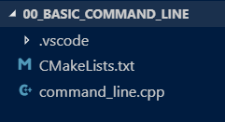
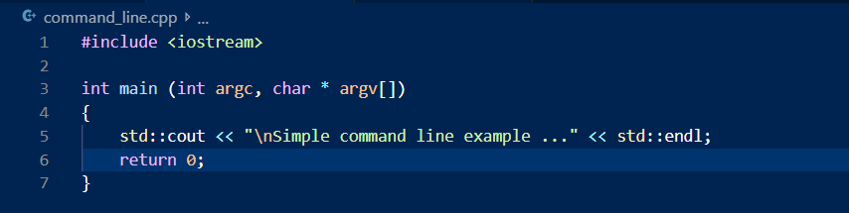
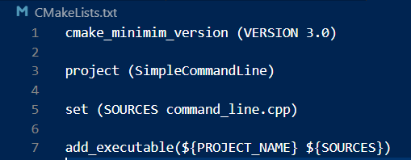
Sample illustration
Session targeted towards C++ source code

Slide 12
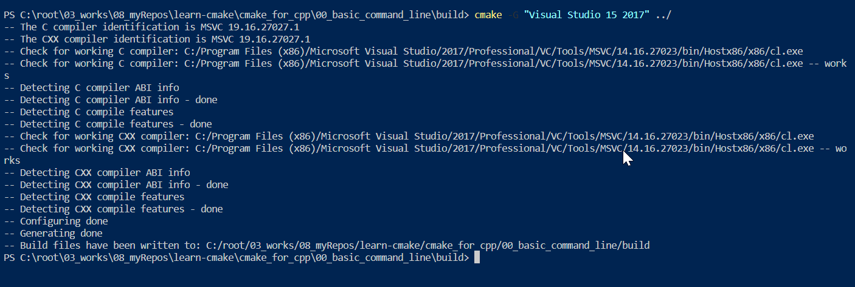
sample illustration (Contd.. 1)
Create a ‘build’ directory within the project and change current directory to that
The below snapshot shows how to create the solution and generate the relevant build files using CMake

Slide 13
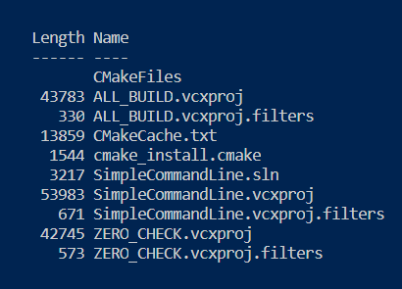
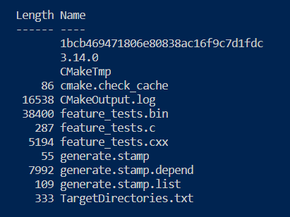
Sample illustration (Contd.. 2)
Build Directory Contents
Cmakefiles contents

Slide 14
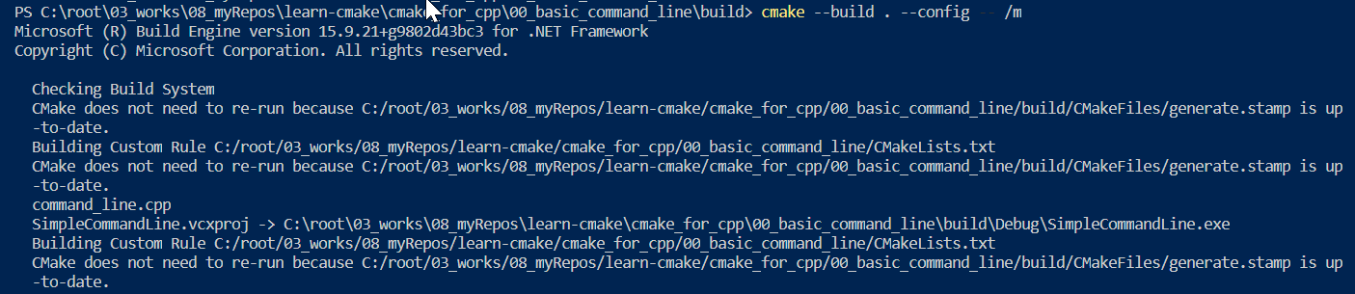
Sample illustration (Contd.. 3)
Next step is to build the executable
This would lead to generation of the object files and building of the final executable

Slide 15
Sample illustration (Contd.. 4)
Traverse to the directory listing the final executable and let’s run it

Slide 16
Cmake language constructs overview
CMake language construct can be classified into the following
CMake Commands
CMake Variables
CMake (cmake.exe) Commands are necessary
CMake is a scripting language, and
It understands it’s commands ONLY
CMake variables are necessary since they help in locating paths, positioning of the to-be created artefacts (build directories, binary directories, etc.), etcetera.

Slide 17
Few Important Cmake commands
Basic Commands
cmake_minimum_required
project
set
message
Working With Libraries
include_directories
target_include_directories
link_library
target_link_libraries
add_executable
Multi-Project Workspace
add_subdirectory
Adding Targets
add_library
add_executable
Playing with Macros
target_compile_definitions
target_compile_options
Find / locate
find_file
find_path
find_package
find_library
find_program
Configurations & Customizations
configure_file
configure_command
Testing
Include(Ctest)
add_test
enable_testing
add_custom_command
add_custom_target
set_project_properties
add_dependencies

Slide 18
Few important cmake variables
Project Locations
CMAKE_ROOT
PROJECT_NAME
CMAKE_CURRENT_LIST_DIR
CMAKE_CURRENT_SOURCE_DIR
CMAKE_CURRENT_BINARY_DIR
CMAKE_BINARY_DIR
PROJECT_SOURCE_DIR
PROJECT_BINARY_DIR
Environmental Variables
CMAKE_INCLUDE_PATH
CMAKE_LIBRARY_PTH
CMAKE_PREFIX_PATH
Compilers & Tools
CMAKE_BUILD_TYPE
BUILD_SHARED_LIBS
CMAKE_C_FLAGS
CMAKE_CXX_FLAGS
Compiler/System Info
CMAKE_MAJOR_VERSION
CMAKE_MINOR_VERSION
CMAKE_PATCH_VERSION
Link Dependences & Interfaces
PUBLIC
PRIVATE
INTERFACE

Slide 19
Illustrations by examples
Few often used CPP project templates have been created that illustrate some recommended ways of using CMake listfiles
They range from:
Simple project creation (say, Hello-World program)
Adding multi-project workspace
Creating Libraries (static and dynamic)
Using NuGet packages
These are just to name a few
Modern-CMake rules/recommendations are not yet fully demonstrated

Slide 20
AND MORE IN FUTURE
Setting up properties for CPP project properties that enable strict language checking
Demonstrating different build types supported by CMake
More modern way of exporting DLL interfaces and consuming them
Importance of CMake functions and their usage
Using CMake – the ‘config’ way
Demonstrating CMake integration with Conan

Slide 21
Interesting READs and links
https://softwareengineering.stackexchange.com/questions/297847/why-do-build-tools-use-a-scripting-language-different-than-underlying-programmin
https://www.cs.virginia.edu/~dww4s/articles/build_systems.html
https://stackoverflow.com/questions/3209517/why-should-one-use-a-build-system-over-that-which-is-included-as-part-of-an-ide

Slide 22
References
https://cmake.org/documentation/
https://cmake.org/cmake-tutorial/
https://linux.die.net/man/1/cmakecommands
https://gitlab.kitware.com/cmake/community/wikis/doc/cmake/Useful-Variables

Slide 23
THANK YOU

