Slide 1
Python Testing Strategies
P V S Phaneendra

Slide 2
Agenda
To share my assorted learnings put together in a more structured format
To prepare a launch pad to the first-timers doing testing in Python
For already knowledgeable and experts, may be a small brush up ? ☺

Slide 3
Introduction
Testing Ground Ups …

Slide 4
Types of Test Cases
Unit Tests (function-level)
Component Tests (DLL, lib, interface level)
System Tests
Performance Tests (benchmarking, fine-tuning)

Slide 5
Types of Test Cases (contd.. 1)

Slide 6
Unit tests
Presenting an Overview

Slide 7
Usual Test Practice Demo
Test Script 1 (Func1)
Object Under Test (OUT)
Func1()
….
Class abc:
Func2()
….
Test Script 2 (Class abc)
Test Script 3 (Func2)
This presentations scope is being limited to Unittest’ing in Python
More specifics are detailed in the slides to follow ☺

Slide 8
Expectations from Unit Tests
Tests should be repeatable
Tests should be deterministic in nature
Tests should get executed in isolation
Tests should execute fast
Tests should test functionality/responsibility of function(s)
Tests should mimic external dependencies, if required
Tests should be able to verify internal dependencies

Slide 9
Test Doubles
Is a generic terminology that is used for testing purposes replacing the production code by an alternative
Known by different names too
Test Dummy objects
Test Fake objects
Test Stub objects
Test Spy objects
Test Mock objects

Slide 10
Test Doubles (contd.. 1)
Test Dummy
Objects are just passed around as placeholders, but never used
Test Fake
Objects perform some implementations but using some shortcuts (not suitable for production setup). Eg. Memory implementation
Test Stub
Objects provide canned (pre-determined) responses
Test Spy
Objects that ‘spy’ or record information based on how they were called
Test Mock
Most sophisticated of all, work with pre-determined expect calls,
can throw exceptions (side-effect behaviors),
work with assertions on how they were called, how many times they were called, what order were they called, et cetera
NOTE: Mock aren’t Stubs !

Slide 11
Testing with Mocks
Presenting An Analogy

Slide 12
Mocking In Cpp (An Analogy)
GMock is one of the open-source mocking libraries
Steps involved
Select an interface for Object Under Test for mocking
Create a class for that interface by inheriting from GMock class
Use this mock in the test framework
In test-fixtures,
Setup expectations for the testing objects
Perform actions
Validate the assertions

Slide 13
Ease of Mocking In Python
Import a mocking library
No need for creating an explicit interface (higher abstract language)
Setup expectations for the Objects Under Test (OUT)
Do actions
Validate the assertions
Here, let’s explore mocking using Python unittest library

Slide 14
Mocking in python
Using ‘unittest’ Test Framework

Slide 15
Installing mock library
For Python version > 3.3, mock is inbuilt into the standard unittest framework
For Python version < 3.3, it can be pip installed
>$ pip install mock

Slide 16
unittest Methods & Properties
>>> import unittest
>>> dir(unittest)
['BaseTestSuite', 'FunctionTestCase', 'SkipTest', 'TestCase', 'TestLoader', 'TestProgram', 'TestResult', 'TestSuite', 'TextTestResult', 'TextTestRunner', '_TextTestResult', '__all__', '__builtins__', '__cached__', '__doc__', '__file__', '__loader__', '__name__', '__package__', '__path__', '__spec__', '__unittest', 'case', 'defaultTestLoader', 'expectedFailure', 'findTestCases', 'getTestCaseNames', 'installHandler', 'load_tests', 'loader', 'main', 'makeSuite', 'registerResult', 'removeHandler', 'removeResult', 'result', 'runner', 'signals', 'skip', 'skipIf', 'skipUnless', 'suite', 'util']

Slide 17
mock Module Methods & Properties
>>> from unittest import mock
>>> dir(mock)
['ANY', 'Base', 'BaseExceptions', 'CallableMixin', 'DEFAULT', 'FILTER_DIR', 'FunctionTypes', 'MagicMixin', 'MagicMock', 'MagicProxy', 'MethodWrapperTypes', 'Mock', 'ModuleType', 'NonCallableMagicMock', 'NonCallableMock', 'PropertyMock', '_ANY', '_Call', '_CallList', '_MockIter', '_Sentinel', '_SentinelObject', '_SpecState', '__all__', '__builtins__', '__cached__', '__doc__', '__file__', '__loader__', '__name__', '__package__', '__spec__', '__version__', '_all_magics', '_allowed_names', '_builtins', '_calculate_return_value', '_callable', '_check_and_set_parent', '_check_signature', '_clear_dict', '_copy', '_copy_func_details', '_delegating_property', '_deleted', '_dot_lookup', '_format_call_signature', '_get_class', '_get_eq', '_get_iter', '_get_method', '_get_ne', '_get_signature_object', '_get_target', '_importer', '_instance_callable', '_is_exception', '_is_instance_mock', '_is_list', '_is_magic', '_is_started', '_iterate_read_data', '_magics', '_missing', '_must_skip', '_non_defaults', '_patch', '_patch_dict', '_patch_multiple', '_patch_object', '_patch_stopall', '_return_values', '_safe_super', '_set_return_value', '_set_signature', '_setup_func', '_side_effect_methods', '_try_iter', '_unsupported_magics', 'builtins', 'call', 'create_autospec', 'file_spec', 'inplace', 'inspect', 'magic_methods', 'mock_open', 'numerics', 'partial', 'patch', 'pprint', 'right', 'seal', 'sentinel', 'sys', 'wraps']

Slide 18
Mock Class Methods & Properties
>>> from unittest.mock import Mock
>>> dir(Mock())
['assert_any_call', 'assert_called', 'assert_called_once', 'assert_called_once_with', 'assert_called_with', 'assert_has_calls', 'assert_not_called', 'attach_mock', 'call_args', 'call_args_list', 'call_count', 'called', 'configure_mock', 'method_calls', 'mock_add_spec', 'mock_calls', 'reset_mock', 'return_value', 'side_effect']

Slide 19
MagicMock Class Methods & Properties
>>> from unittest.mock import MagicMock
>>> dir(MagicMock())
['assert_any_call', 'assert_called', 'assert_called_once', 'assert_called_once_with', 'assert_called_with', 'assert_has_calls', 'assert_not_called', 'attach_mock', 'call_args', 'call_args_list', 'call_count', 'called', 'configure_mock', 'method_calls', 'mock_add_spec', 'mock_calls', 'reset_mock', 'return_value', 'side_effect']

Slide 20
Mock versus MagicMock
Mock and MagicMock offer same set of the interfaces
Why two different mock objects are supported by unittest framework ?
MagicMock subclasses (inherits) from Mock class and provides default implementations for all of the magic methods
Wait! What are these magic methods ?
Dunder (Magic, Special) methods
Any function that starts with ‘__’ (double underscore) and ends in ‘__’ (double underscore)

Slide 21
MagicMock: Dunder Methods Impl’
__lt__: NotImplemented __gt__: NotImplemented __le__: NotImplemented __ge__: NotImplemented __int__: 1 __contains__: False __len__: 0 __iter__: iter([])
__exit__: False __complex__: 1j __float__: 1.0 __bool__: True __index__: 1 __hash__: default hash for the mock __str__: default str for the mock __sizeof__: default sizeof for the mock
Mock class would not have implemented the following methods. Querying them might result in errors.

Slide 22
Installing mock library
For Python version > 3.3, mock is inbuilt into the standard unittest framework
For Python version < 3.3, it can be pip installed
>$ pip install mock
Sometimes, the implementation might not yet be complete, but still the developer would want to test the existing code. Mocks are an extremely useful non-invasive instrumentation for these scenario.

Slide 23
Example: MagicMock
>>> from unittest.mock import MagicMock
>>> mm_object = MagicMock()
>>> print(mm_object)
<MagicMock id='2961226316432'>
>>> print(mm_object.__len__)
<MagicMock name='mock.__len__' id='2961231951912'>
>>> print(mm_object.__len__())
0
>>> print(mm_object.__index__())
1
>>> print(mm_object.__le__())
NotImplemented

Slide 24
Example: Mock
>>> from unittest.mock import Mock
>>> m_object = Mock()
>>> print(m_object)
<Mock id='1626288732872'>
>>> print(m_object.__len__)
Traceback (most recent call last):
File "<stdin>", line 1, in <module>
File "C:\Users\Paluri\AppData\Local\Programs\Python\Python37\lib\unittest\mock.py", line 592, in __getattr__
raise AttributeError(name)
AttributeError: __len__
>>> print(m_object.__index__)
Traceback (most recent call last):
File "<stdin>", line 1, in <module>
File "C:\Users\Paluri\AppData\Local\Programs\Python\Python37\lib\unittest\mock.py", line 592, in __getattr__
raise AttributeError(name)
AttributeError: __index__

Slide 25
Example: Implementing Magic Methods for Mock
>>> m_object.__len__ = Mock(return_value=3)
>>> print(m_object.__len__)
<Mock name='mock.__len__' id='1626288732928'>
>>> print(m_object.__len__())
3
>>>
>>> m_object.__index__ = Mock(return_value=10)
>>> print(m_object.__index__)
<Mock name='mock.__index__' id='1626288733096'>
>>> print(m_object.__index__())
10

Slide 26
mock.Mock Arguments
spec
side_effect
return_value
wraps
name
spec_set
Unsafe
**kwargs (keyword arguments)

Slide 27
mock.Mock Create & Set Attributes
>>> m_object = Mock()
>>> print(m_object)
<Mock id='1626324995824'>
>>> m_object.x_attr = 10
>>> m_object.y_attr = 'new attribute'
>>> print(m_object.x_attr)
10
>>> print(m_object.y_attr)
new attribute

Slide 28
mock.Mock Create & Set Attributes
>>> m_object = Mock(x=10, y=20)
>>> print(m_object)
<Mock id='1626324995264'>
>>> print(m_object.x)
10
>>> print(m_object.y)
20
>>> print(m_object.z)
<Mock name='mock.z' id='1626324995376'>
>>> m_object.z = 30
>>> print(m_object.z)
30

Slide 29
mock.Mock().return_value
>>> class MyClass(object):
... def get(self):
... return 3
...
>>> class_obj = MyClass()
>>> print(class_obj, class_obj.get)
<__main__.MyClass object at 0x0000017AA887C198> <bound method MyClass.get of <__main__.MyClass object at 0x0000017AA887C198>>
>>> class_obj.get()
3

Slide 30
mock.Mock().return_value
>>> class_obj.get = Mock(return_value=10)
>>> print(class_obj, class_obj.get)
<__main__.MyClass object at 0x0000017AA887C198> <Mock id='1626325106984'>
>>> print(class_obj.get())
10
>>> class_obj.get.return_value = 'new value'
>>> print(class_obj.get())
new value

Slide 31
mock.Mock().side_effect
Let’s say you want to use a random function’s outcome in a test. How would you use it ?
How to mock multiple values in a test ?
How to mock and simulate exceptions ?
>>> class random_number_gen(object):
... def get(self):
... return 11
...
>>> obj = random_number_gen()
>>> obj.get()
11

Slide 32
mock.Mock().side_effect
>>> obj.get = Mock(side_effect=[11, 22, 33])
>>> obj.get()
11
>>> obj.get()
22
>>> obj.get()
33
>>> obj.get()
Traceback (most recent call last):
File "<stdin>", line 1, in <module>
File "C:\Users\Paluri\AppData\Local\Programs\Python\Python37\lib\unittest\mock.py", line 960, in __call__
return _mock_self._mock_call(*args, **kwargs)
File "C:\Users\Paluri\AppData\Local\Programs\Python\Python37\lib\unittest\mock.py", line 1022, in _mock_call
result = next(effect)
StopIteration

Slide 33
mock.Mock().side_effect
>>> obj.get = Mock(side_effect=[11, 22, 33, StopIteration('Iteration Error.')])
>>> obj.get()
11
>>> obj.get()
22
>>> obj.get()
33
>>> obj.get()
Traceback (most recent call last):
File "<stdin>", line 1, in <module>
File "C:\Users\Paluri\AppData\Local\Programs\Python\Python37\lib\unittest\mock.py", line 960, in __call__
return _mock_self._mock_call(*args, **kwargs)
File "C:\Users\Paluri\AppData\Local\Programs\Python\Python37\lib\unittest\mock.py", line 1024, in _mock_call
raise result
StopIteration: Iteration Error.

Slide 34
Sample Test Class Setup
>>> class MyClass(object):
... def method1(self):
... return 1
... def method2(self):
... return 2
... def method3(self):
... return 3
...
>>> obj = MyClass()
>>> obj.method1 = Mock()
>>> obj.method2 = Mock()
>>> obj.method3 = Mock()

Slide 35
mock.Mock().assert_called()
>>> obj.method1()
<Mock name='mock()' id='1308656385664'>
>>> obj.method2()
<Mock name='mock()' id='1308659648160'>
>>> obj.method1.assert_called()
>>> obj.method2.assert_called()
>>> obj.method3.assert_called()
Traceback (most recent call last):
File "<stdin>", line 1, in <module>
File "C:\Users\Paluri\AppData\Local\Programs\Python\Python37\lib\unittest\mock.py", line 801, in assert_called
raise AssertionError(msg)
AssertionError: Expected 'None' to have been called.
Asserts True for all mocks that have been called at least once

Slide 36
mock.Mock().assert_called_once()
>>> obj.method1()
<Mock name='mock()' id='1308662022552'>
>>> obj.method2()
<Mock name='mock()' id='1308662022776'>
>>> obj.method2()
<Mock name='mock()' id='1308662022776'>
>>> obj.method1.assert_called_once()
>>> obj.method2.assert_called_once()
Traceback (most recent call last):
File "<stdin>", line 1, in <module>
File "C:\Users\Paluri\AppData\Local\Programs\Python\Python37\lib\unittest\mock.py", line 810, in assert_called_once
raise AssertionError(msg)
AssertionError: Expected 'mock' to have been called once. Called 2 times.
Asserts True for all mocks that have been called EXACTLY once

Slide 37
mock.Mock().assert_called_once()
>>> obj.method3.assert_called_once()
Traceback (most recent call last):
File "<stdin>", line 1, in <module>
File "C:\Users\Paluri\AppData\Local\Programs\Python\Python37\lib\unittest\mock.py", line 810, in assert_called_once
raise AssertionError(msg)
AssertionError: Expected 'mock' to have been called once. Called 0 times.

Slide 38
New Test Class Setup
>>> class NewClass(object):
... def method(self, a, b, c):
... pass
...
>>> obj = NewClass()
>>>
>>> obj.method = Mock()

Slide 39
mock.Mock().assert_called_with(*)
>>> obj.method(10, 20, 30)
<Mock name='mock()' id='1308662025128'>
>>> obj.method(11, 22, 33)
<Mock name='mock()' id='1308662025128'>
>>> >>> obj.method.assert_called_with(11, 22, 33)
>>> >>> obj.method.assert_called_with(10, 20, 30)
Traceback (most recent call last):
File "<stdin>", line 1, in <module>
File "C:\Users\Paluri\AppData\Local\Programs\Python\Python37\lib\unittest\mock.py", line 829, in assert_called_with
raise AssertionError(_error_message()) from cause
AssertionError: Expected call: mock(10, 20, 30)
Actual call: mock(11, 22, 33)
Assert consumes all generic arguments – positional & keyword
Asserts True for LAST call with CORRECT arguments

Slide 40
mock.Mock().assert_called_once_with(*)
Assert consumes all generic arguments – positional & keyword
>>> obj.method(1, 2, 3)
<Mock name='mock()' id='1308662025016'>
>>> obj.method.assert_called_once_with(1, 2, 3)
>>>
>>> obj.method(10, 20, 30)
<Mock name='mock()' id='1308662025016'>
>>> obj.method.assert_called_once_with(10, 20, 30)
Traceback (most recent call last):
File "<stdin>", line 1, in <module>
File "C:\Users\Paluri\AppData\Local\Programs\Python\Python37\lib\unittest\mock.py", line 839, in assert_called_once_with
raise AssertionError(msg)
AssertionError: Expected 'mock' to be called once. Called 2 times.
Asserts True for mock called EXACTLY once with the correct arguments

Slide 41
mock.Mock().assert_any_call(*)
Assert consumes all generic arguments – positional & keyword
>>> obj.method(1, 2, 3)
<Mock name='mock()' id='1308662023840'>
>>> obj.method(4, 5, 6)
<Mock name='mock()' id='1308662023840'>
>>>
>>> obj.method.assert_any_call(1, 2, 3)
>>> obj.method.assert_any_call(4, 5, 6)
>>>
>>> obj.method.assert_any_call(7, 8, 9)
Traceback (most recent call last):
File "<stdin>", line 1, in <module>
File "C:\Users\Paluri\AppData\Local\Programs\Python\Python37\lib\unittest\mock.py", line 891, in assert_any_call
) from cause
AssertionError: mock(7, 8, 9) call not found
Asserts True for mock called with CORRECT arguments (order doesn’t matter)

Slide 42
mock.Mock().assert_not_called()
Asserts TRUE for mock function that never got called
>>>
>>>
>>> obj.method.assert_not_called()
>>>
>>> obj.method(1, 2, 3)
<Mock name='mock()' id='1308662046392'>
>>> obj.method.assert_not_called()
Traceback (most recent call last):
File "<stdin>", line 1, in <module>
File "C:\Users\Paluri\AppData\Local\Programs\Python\Python37\lib\unittest\mock.py", line 792, in assert_not_called
raise AssertionError(msg)
AssertionError: Expected 'mock' to not have been called. Called 1 times.

Slide 43
mock.Mock().reset_mock(*)
Resets the mock function
>>> obj.method(1, 2, 3)
<Mock name='mock()' id='1308662046616'>
>>> obj.method(4, 5, 6)
<Mock name='mock()' id='1308662046616'>
>>>
>>> obj.method.reset_mock()
>>> obj.method.assert_called()
Traceback (most recent call last):
File "<stdin>", line 1, in <module>
File "C:\Users\Paluri\AppData\Local\Programs\Python\Python37\lib\unittest\mock.py", line 801, in assert_called
raise AssertionError(msg)
AssertionError: Expected 'None' to have been called.
return_value, side_effect, assert calls are reset/clear/set to defaults

Slide 44
mock.Mock().called | call_count
>>>
>>> obj.method.called
False
>>> obj.method.call_count
0
>>> obj.method(1, 2, 3)
<Mock name='mock()' id='1308662153344'>
>>> obj.method(4, 5, 6)
<Mock name='mock()' id='1308662153344'>
>>>
>>> obj.method.called
True
>>> obj.method.call_count
2
called → returns TRUE if mock is called
call_count → returns number of times a mock is called

Slide 45
Other mock.Mock().functions
assert_has_calls (call, any_order=False)
mock_add_spec (spec, spec_set=False)
attach_mock (mock, attribute)
configure_mock (**kwargs)
call_args
call_args_list
method_calls
mock_calls

Slide 46
mock.Mock().NonCallableMock
A non-callable version of the mock
return_value and side_effect have no meaning for this type of mock
Well, I’ve not used this yet, so can’t comment for now ☺

Slide 47
Mocking: Points to Note
>>> obj = NewClass()
>>>
>>> obj.method = Mock()
>>>
>>> obj.method.caled
<Mock name='mock.caled' id='1308662153960'>
>>>
>>> obj.method.astert_called()
<Mock name='mock.astert_called()' id='1308662154128'>
Any new attribute or method assigned on the mock object to which error is NOT reported
How to solve this ?
Keep your questions alive & open ! ☺

Slide 48
Benefits of mocking
Testing becomes simple with mock (ofcourse, one needs to understand mocking. Nothing comes for free!)
I don’t want to spend my time writing tests for my testbench
Mocking helps us avoid writing methods for testing and more importantly – ‘test those testbench methods’
Makes our tests writing faster
Dealing with exceptions, errors

Slide 49
Patching in Python
Let’s do some Patching

Slide 50
What’s this Patching ?
unittest.mock.Mock and unittest.mock.MagicMock are for the mocking of a function, it’s return value, it’s side-effects, performing assert operations on the mocked object.
Patch supports this under-lying behavior of mocking just that now it allows applying this powerful mocking mechanism onto the OUT and replaces OUT with a mock object
Patch works on the importing of a module

Slide 51
More on Patching
Available as:
context managers
decorators
manually apply patch (use with caution!)
Scope of patching
Use as context manager if the scope is limited to some duration within a function
Decorate a class method if a function is to be patched for the entire duration of that function call
Decorate at class level if the function is to be patched for the entire duration of that function call within that class

Slide 52
Still More on Patching …
DO NOT apply Patch where it downloaded from
Apply Patch where it is used
In short, what all one can do ?
Patch a class (public) method
Patch a class (private) method ☺
Patch an object that is (public/private) attribute of a class ☺
Patch a dict

Slide 53
Scope for Patching
Use of patch decorator takes care of setup and cleanup of the patch/mock objects by itself
Manual invocation of patch objects using ‘start’ and ‘stopxxx’ methods, the developer has to take care of the setup and cleanup of these mocked/patched objects
Context Manager
Function-level patch
Patch at class scope
Manual patching

Slide 54
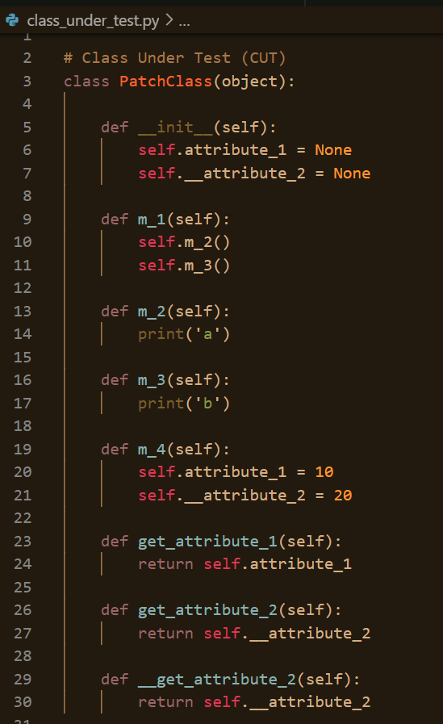
Sample Test Class Setup
Intent is to test the dependency calls between m_1 and m_2 methods
Observe that both m_1 and m_2 methods don’t return anything

Slide 55
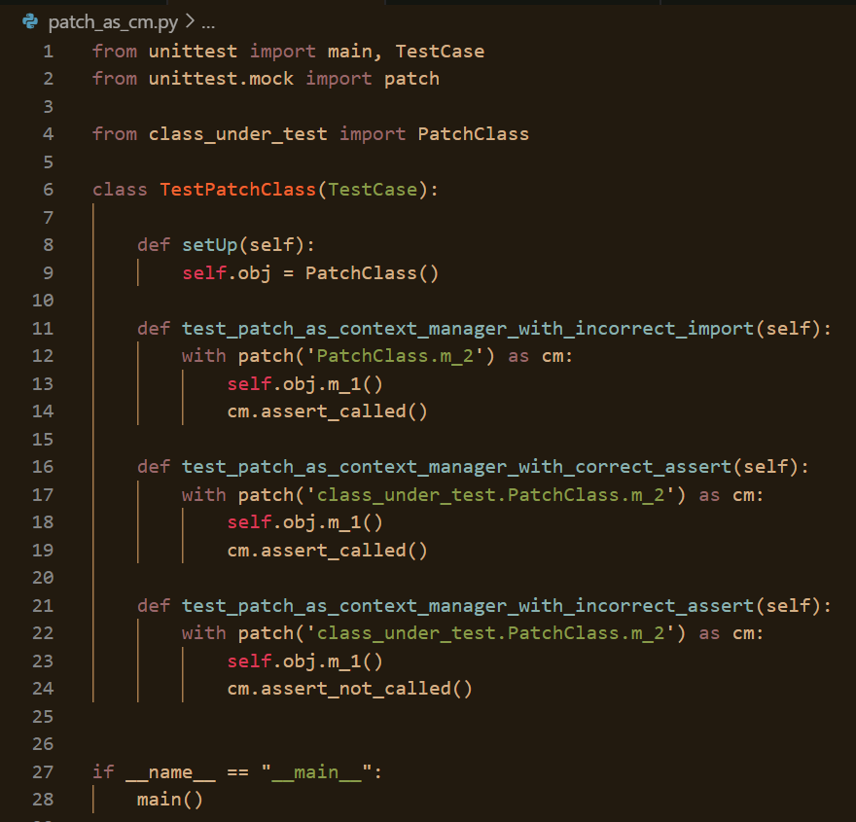
patch as context manager (cm)
So, how to execute and verify our tests now ?
Using unittest.main() ?
python <test_file.py> -v
python –m unittest <test_file.py> -v
Not using unittest.main() ?

Slide 56
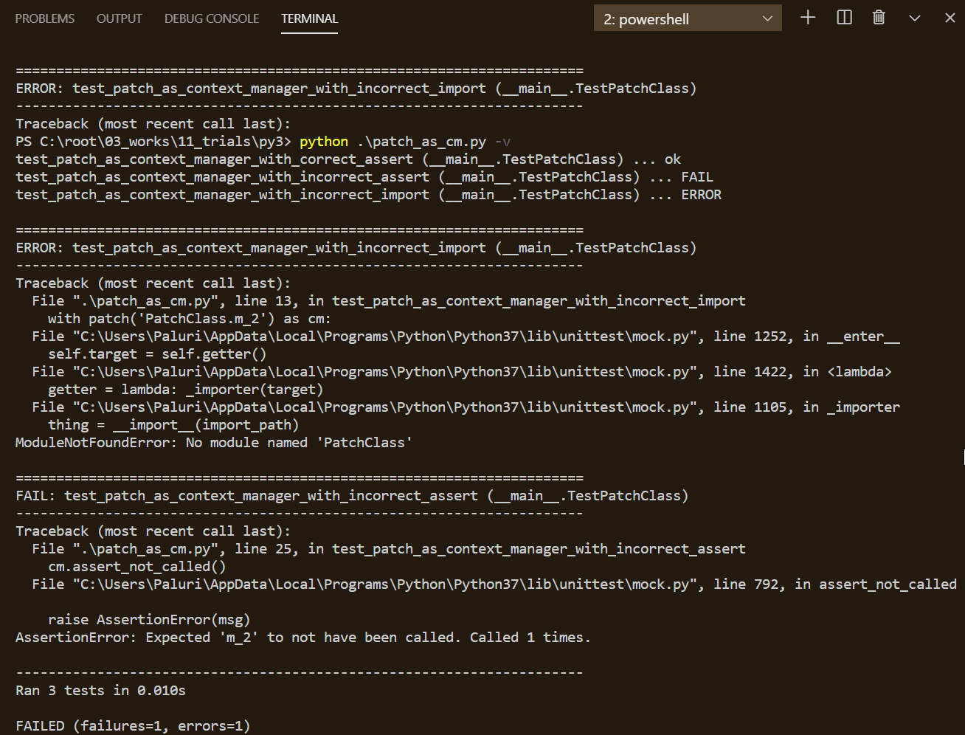
patch as context manager (cm)

Slide 57
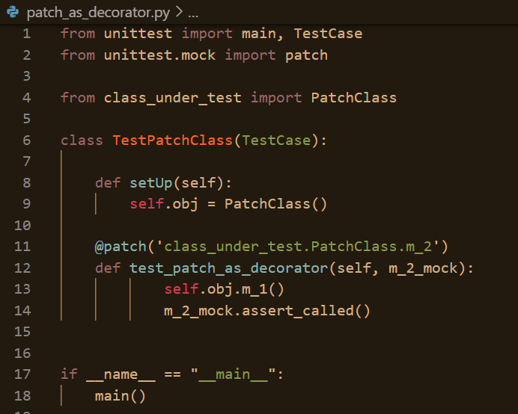
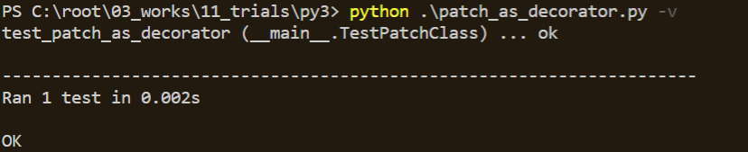
patch function as decorator

Slide 58
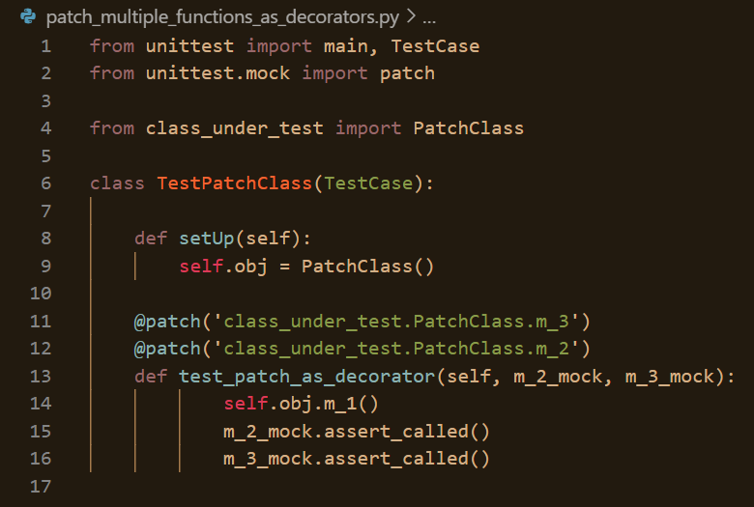
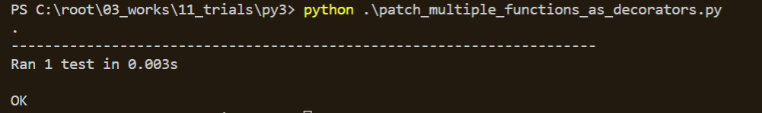
patch multiple functions as decorator
Order of the patch decorators is important w.r.t. the mock objects passed as arguments to the test fixture

Slide 59
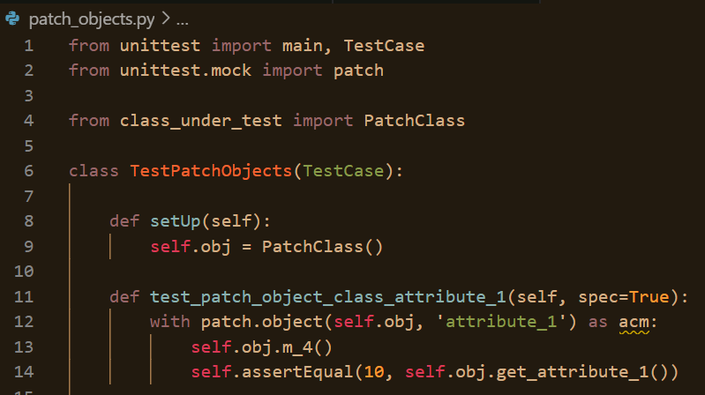
patch.object as context manager
Provide the actual instance of the class/object to the patch.object call

Slide 60
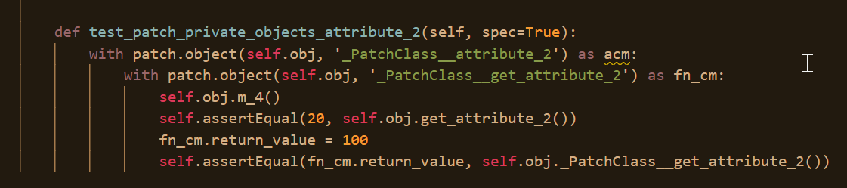
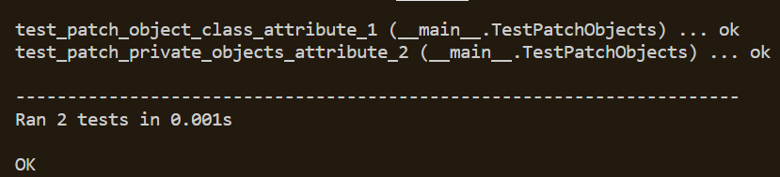
patch.object as context manager
Remember how to retrieve the class attributes ?
Just print using ‘dir(<OUT>)’ ☺

Slide 61
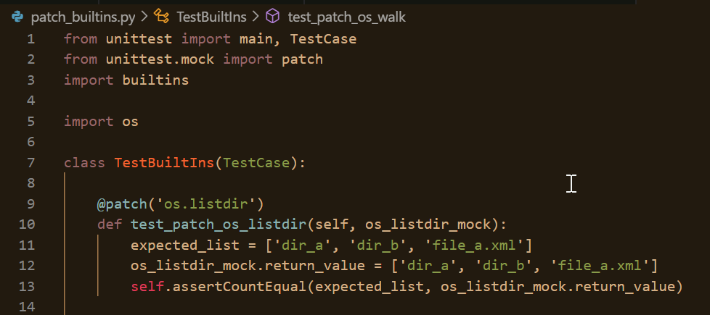
patch builtins: ‘os.listdir’
mock / patch ‘os.listdir’

Slide 62
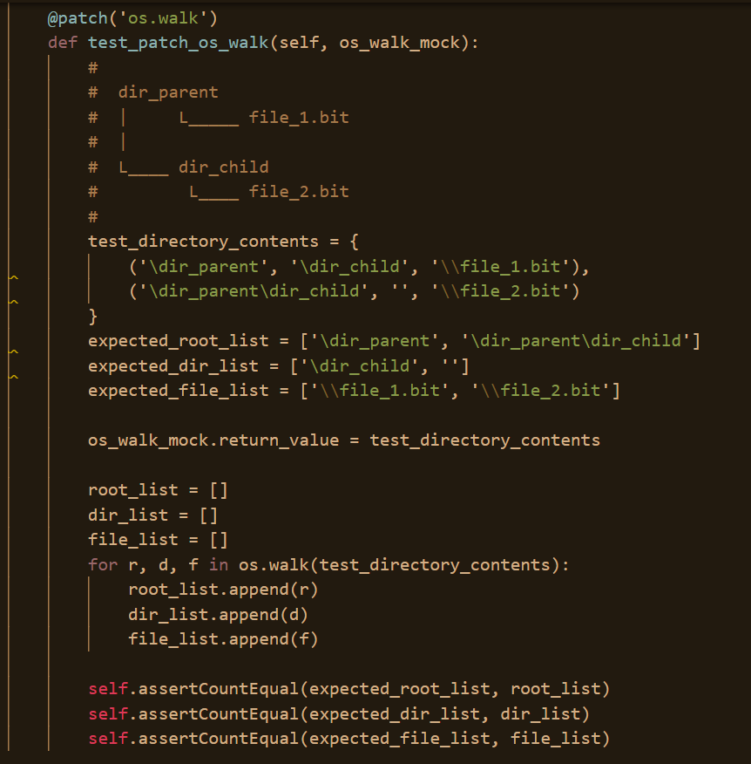
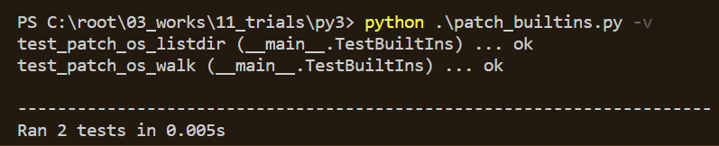
patch builtins: ‘os.walk’
mock / patch ‘os.walk’
Likewise, patch many other builtins
as well

Slide 63
Other patch stuff not yet discussed
Lambda
Create
Patching dicts
Patching PropertyMock
Manual patch

Slide 64
Spec’ing in Python
Advanced Topic - I

Slide 65
AUTOSpec’ing in Python
Advanced Topic - II

Slide 66
Q&A Break

Slide 67
OK, I’ve few (more) ☺
Why spec=True is not made default for the patch ?
When spec should be preferred over autospec ?

Slide 68
Ok – Now that you know stuff Call yourself
Mocker
Patcher
Spec’er
Autospec’er

Slide 69
Thank You !!

