Slide 1
Learning python
P V S Phaneendra

Slide 2
Why python ?
Guido Van Rossum – author for Python programming language
Conceived in 1980s
Scripting cum Programming language
Simple, productive and readable
Ever increasing 3rd party libraries support
Limitations of being an interpreter and GIL haven’t curbed Python’s popularity

Slide 3
Python scripting components
Sys module
Os module
Subprocess
Math
Random
Date Time
JSON

Slide 4
Python language constructs
Like any other language, Python supports many a constructs
Function
OOPs
Command-line parse
List
Tuple
Set
Dictionary
Loop
Comprehension Expressions
Metaclasses
If-ElseIf-Else

Slide 5
few VERy well-known libraries
Requsets
Scrapy
wxPython
Pillow
SQLAlchemy
BeautifulSoup
Twisted
Numpy
Scipy
Matploblib
Pygame
Pyglet
pyQT
pyGTK
Scapy
pywin32
nltk
nose
Sympy
IPython

Slide 6
Tutorial objectives
To make learning Python in an interactive way
To present newer concepts introduced in Python3
To introduce few of the primarily used Python testing frameworks
Doctest
Unittest
Pytest
To understand the programming errors / trace the call-stack

Slide 7
Tutorial contents overview
learn-py3 \
pvs-labs …….………………….. Contains the practice tutorials
pvs-solutions …………………... Contains the possible solutions
slide-deck ……………………... Contains few notes and presentations
test_objects …………………… Contains the test-objects used within tutorials
ReadMe.txt ……………………. You are expected to START HERE !

Slide 8
Getting started …
Go to directory listing the ‘doctest’ tutorials
>$ cd learn-py3/pvs-labs/01_test_using_doctest
Run the example
>$ python 00_introduction.py
Once the above example is run, the example is expected to fail. These are self-testing tests.

Slide 9
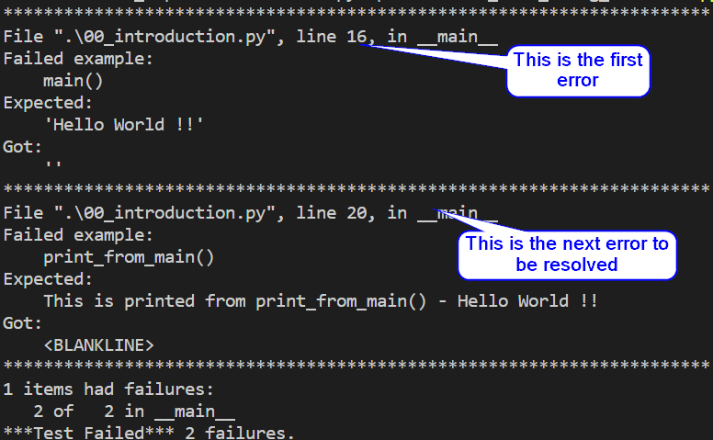
Understanding TEST RUN LOG
Start resolving errors from the top of the run log
In this test run, first go to line#16 of the source code
Inspect the error
It got ‘’ (empty string) while ‘Hello World !!’ was expected
Resolve and run test again
Check possible solutions under ‘pvs-solutions’ directory

Slide 10
Now, Before you start …
The user is expected to pay some attention to the questions listed within the interactive console session comments
In few cases, the questions are the bridging gap between the successive tests
The tutorial contains the basic elements to get started using Python(3)
It is to be noted that the tutorials refinements and updates are still in progress, hence not yet fully completed

Slide 11
Python testing frameworks
Listed below are few of the Python Testing Frameworks
Doctest
Unittest
Pytest
Nosetest
Pytest is the more recommended Python Testing Framework from the above listed frameworks

Slide 12
Pytest’s tutorials tests
Assert feature
Tests run selection based on Mark Decorators of type
simple
Skip / SkipIf (conditional and non-conditional)
Parametrized
Fixture Types
Classical Type xUnit-styled
Pytest fixtures at Module-level
Fixtures Scope
Module scope
Session scope
Function scope
Class scope

Slide 13
Future works
Pytest has many features and supports high customizations
Refine and extend tutorials to demonstrate further usage of Pytest
Demonstrate importance and use of ‘conftest.py’ file
Exercise various Pytest supported hooks
Converting from Unittest to Pytest (unittest2pytest)
Pytest support for running nose test framework
Pytest support for plugins (Django, twisted, cov, xdist, bdd, pep-8, flakes, etc.)

Slide 14
References
https://www.python.org/
https://docs.pytest.org/en/latest/
http://plugincompat.herokuapp.com/

Slide 15
Thank You !!

