Slide 1
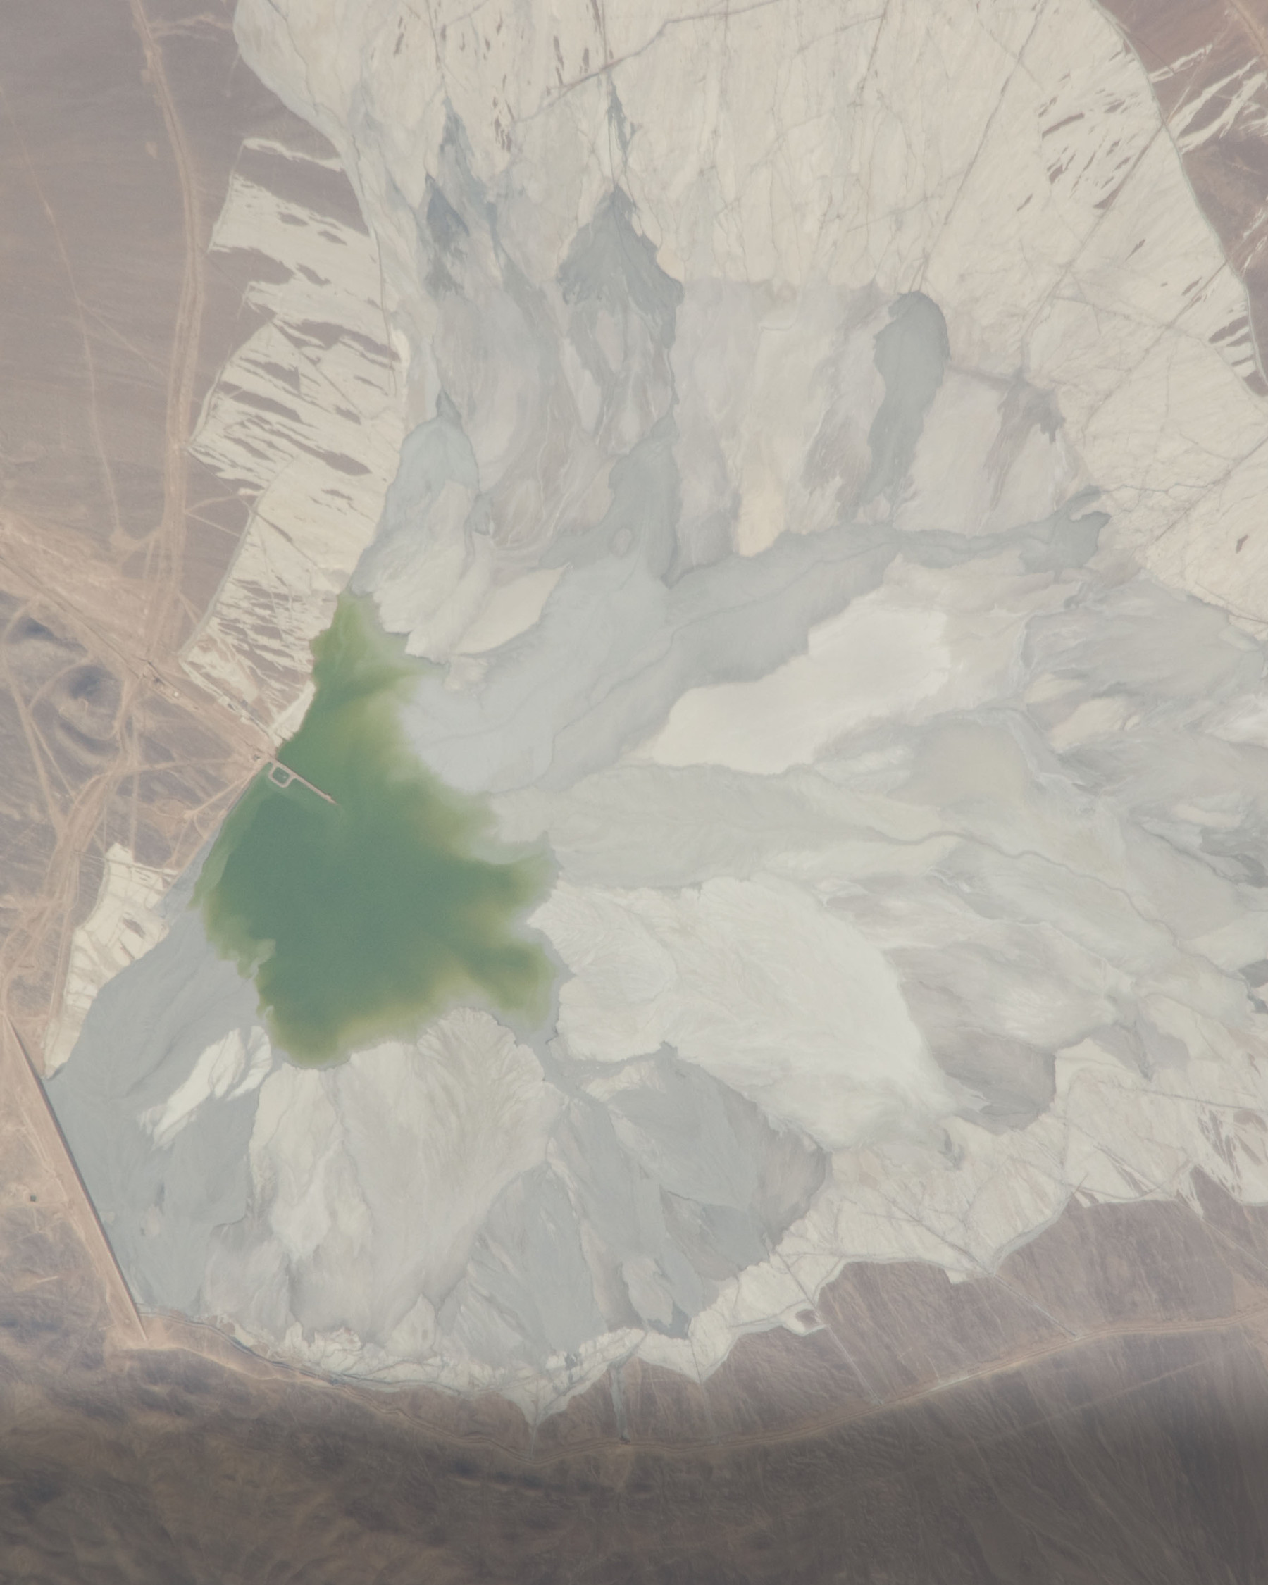
Goldman Sachs’
Copper Outlook and
BHP’s $6 Billion
Escondida Decision
Near-term earnings exposure
and the economics of replacement
Goldman Sachs’ higher copper outlook implies a large near-term earnings sensitivity for BHP, while the proposed Escondida concentrator will be judged on the mine output and cash flow it preserves over a much longer period.
$2.83bn
FY2026-static EBITDA sensitivity to Goldman’s reported $1,600/t copper revision
An illustration, not a 2027 forecast
Benjamin Yang · Strategic Materials Policy Tracker · Research cutoff 5 November 2026
Notes:
Cover.
Thesis wording: Condensed from the lede of the published FI002 article (app/research/escondida-copper/page.tsx). The qualifiers kept are: sensitivity rather than forecast, proposed concentrator, and the longer judgement period.
$2.83bn FY2026-static EBITDA sensitivity to Goldman’s reported $1,600/t copper revision. An illustration, not a 2027 forecast. Basis: SMPT FI002 model, tab 04 Operating Sensitivity, cell D45 (2,830.4 US$m); BHP’s disclosed FY2026 copper price sensitivity applied to the $1,600/t revision as publicly reported. Same figure as slide 2.
BHP results for the year ended 30 June 2026, presentation. https://www.bhp.com/-/media/documents/media/reports-and-presentations/2026/260818_bhpresultsfortheyearended30june2026_presentation.pdf · slides 19-22, 28, 35-36, 40, 48, 50
FinancialJuice report of the Goldman Sachs copper revision, 20 October 2026. https://www.financialjuice.com/News/9812752/Goldman-Sachs-Copper---FJElite.aspx?xy=rss · article
SMPT FI002 methodology and calculation CSVs. https://github.com/VSSpowerlifting/strategic-materials-policy-tracker/blob/main/docs/research/fi002-bhp-copper/output/SMPT_FI002_Methodology.md · Methodology; Price_Sensitivity, Threshold_Sensitivities CSVs
Cover image: Image courtesy of the Earth Science and Remote Sensing Unit, NASA Johnson Space Center. Astronaut photograph ISS022-E-8282, taken 9 December 2009 at 20:56:50 GMT by the Expedition 22 crew (Nikon D2Xs, 800 mm), https://eol.jsc.nasa.gov/SearchPhotos/photo.pl?mission=ISS022&roll=E&frame=8282. NASA material, not protected by copyright. Shows the tailings impoundment in 2009, not the open pits or the proposed New Concentrator. Cropped to 4:5 and resized; the bottom of the frame is darkened by a gradient; no other edits. Provenance: assets/fi002-cover-escondida-iss022-e-8282.jpg.provenance.json. SHA-256 a1ea806791fa14fb45a1ea521c196a9a49cbb53d7097276a32464f118cb17a83.

Slide 2
2
Goldman's $1,600/t revision implies a $2.83bn FY2026-static EBITDA sensitivity
Static copper EBITDA differential, US$bn, from BHP's disclosed FY2026 sensitivity
# | Item | Differential
1 | GS revised vs previous | 2.83
2 | GS revised vs World Bank | 4.25
1
$15,400/t against $13,800/t, applied to BHP's $39m per US¢1/lb sensitivity; linear.
2
$15,400/t against the World Bank's $13,000/t for the 2027 annual average, on the same basis.
US$bn, FY2026-static
Both figures are sensitivities, not forecasts. The replacement concentrator needs about 199ktpa to clear a 10% return in SMPT's hypothetical base case, rising to 333ktpa when benefits are shorter and start later. Funded pre-FID readiness is the supported position; ranking construction timing needs an operating counterfactual BHP has not published.
Source: BHP FY2026 results presentation and Annual Report 2026; World Bank CMO October 2026; Goldman Sachs revision as publicly reported; SMPT calculations
Notes:
Evidence: S01; S03; S12; S18; SMPT. S01: BHP results for the year ended 30 June 2026, presentation. https://www.bhp.com/-/media/documents/media/reports-and-presentations/2026/260818_bhpresultsfortheyearended30june2026_presentation.pdf · slides 19-22, 28, 35-36, 40, 48, 50 S03: BHP Annual Report 2026. https://www.bhp.com/-/media/documents/investors/annual-reports/2026/260818_bhpannualreport2026.pdf · PDF pp. 22, 30, 36-37, 132, 136, 153, 163-165 S12: World Bank Commodity Markets Outlook, October 2026. https://thedocs.worldbank.org/en/doc/2ac43f46629cf90c2ea5b8929a343593-0050012026/original/CMO-October-2026.pdf · Table 1, PDF p. 21 S18: FinancialJuice report of the Goldman Sachs copper revision, 20 October 2026. https://www.financialjuice.com/News/9812752/Goldman-Sachs-Copper---FJElite.aspx?xy=rss · article SMPT: SMPT FI002 methodology and calculation CSVs. https://github.com/VSSpowerlifting/strategic-materials-policy-tracker/blob/main/docs/research/fi002-bhp-copper/output/SMPT_FI002_Methodology.md · Methodology; Price_Sensitivity, Threshold_Sensitivities CSVs

Slide 3
3
Goldman's revised 2027 average sits 18.5% above the World Bank
Calendar-2027 copper price references, US$/t
The $15,400/t annual average comes from public reporting; the original 19 October note was not obtained. Goldman's $15,600/t end-2027 view is a different measure and is not charted. The $14,405/t forward is a dated 19 October snapshot, not a tradable curve.
Source: World Bank CMO October 2026, Table 1; FinancialJuice and Reuters via Business Recorder reporting of Goldman Sachs; Goldman Sachs Exchanges, 23 October 2026
Notes:
Evidence: S12; S18; S20; S16. S12: World Bank Commodity Markets Outlook, October 2026. https://thedocs.worldbank.org/en/doc/2ac43f46629cf90c2ea5b8929a343593-0050012026/original/CMO-October-2026.pdf · Table 1, PDF p. 21 S16: Goldman Sachs Exchanges transcript, 23 October 2026. https://www.goldmansachs.com/insights/goldman-sachs-exchanges/why-oil-prices-are-surging-despite-recovering-supply · transcript S18: FinancialJuice report of the Goldman Sachs copper revision, 20 October 2026. https://www.financialjuice.com/News/9812752/Goldman-Sachs-Copper---FJElite.aspx?xy=rss · article S20: Reuters via Business Recorder, Goldman copper upgrade. https://www.brecorder.com/news/40445090/copper-flat-as-china-caution-outweighs-us-stockpiling-goldman-upgrade · article

Slide 4
4
Copper EBITDA rose to $18.2bn in FY2026 as production slipped
BHP reported results, US$bn unless labelled, fiscal years to 30 June
# | Item | FY2025 | FY2026
1 | Copper revenue | 22.530 | 29.031
2 | Copper underlying EBITDA | 12.326 | 18.187
3 | Group underlying EBITDA | 25.978 | 32.947
4 | Copper production, Mt | 2.017 | 1.953
2
Copper is 55.2% of group EBITDA by simple division; BHP's stated 54% share excludes Group and unallocated items.
4
Group copper production on the mixed basis BHP reports.
US$bn unless labelled
EBITDA rose by $5.861bn while group production fell, as the average realized price moved from $4.25/lb to $5.74/lb. The figures show the size of the exposure; they do not attribute the whole increase to price.
Source: BHP FY2026 results presentation and exchange release; BHP Annual Report 2026
Notes:
Evidence: S01; S02; S03. S01: BHP results for the year ended 30 June 2026, presentation. https://www.bhp.com/-/media/documents/media/reports-and-presentations/2026/260818_bhpresultsfortheyearended30june2026_presentation.pdf · slides 19-22, 28, 35-36, 40, 48, 50 S02: BHP results for the year ended 30 June 2026, exchange release. https://www.bhp.com/-/media/documents/media/reports-and-presentations/2026/260818_bhpresultsfortheyearended30june2026_exchangerelease.pdf · full release S03: BHP Annual Report 2026. https://www.bhp.com/-/media/documents/investors/annual-reports/2026/260818_bhpannualreport2026.pdf · PDF pp. 22, 30, 36-37, 132, 136, 153, 163-165

Slide 5
5
Each price comparison scales BHP's $39m sensitivity in a straight line
Static FY2026 copper EBITDA differential against Goldman's revised $15,400/t, US$m
Differential = price gap ÷ 2,204.6226 × 100 × $39m. The results equal about 9% and 13% of FY2026 group EBITDA for the previous-Goldman and World Bank comparisons. BHP realized $7.01/lb (about $15,454/t) in Q1 FY2027. Linear sensitivities, not forecasts.
Source: BHP FY2026 results presentation; BHP Q1 FY2027 operational review; SMPT Price_Sensitivity calculations
Notes:
Evidence: S01; S05; SMPT. S01: BHP results for the year ended 30 June 2026, presentation. https://www.bhp.com/-/media/documents/media/reports-and-presentations/2026/260818_bhpresultsfortheyearended30june2026_presentation.pdf · slides 19-22, 28, 35-36, 40, 48, 50 S05: BHP operational review for the quarter ended 30 September 2026. https://www.bhp.com/-/media/documents/media/reports-and-presentations/2026/261020_bhpoperationalreviewforthequarterended30september2026-pdf.pdf · PDF pp. 1-2, 5 SMPT: SMPT FI002 methodology and calculation CSVs. https://github.com/VSSpowerlifting/strategic-materials-policy-tracker/blob/main/docs/research/fi002-bhp-copper/output/SMPT_FI002_Methodology.md · Methodology; Price_Sensitivity, Threshold_Sensitivities CSVs

Slide 6
6
A FY2027-volume proxy yields a smaller $2.27bn EBITDA illustration
Illustrative FY2027 EBITDA effect of the $1,600/t revision, US$m
Level
Increase
Decrease
US$m
2,394.0
−119.7
2,274.3
1.575Mt guidance midpoints × 95% assumed payable factor = 1.496Mt; × $1,600/t = $2,394m; less 5% assumed leakage = $2,274.3m, about 19.6% below the $2,830m issuer-static figure. The two measures use different periods and volume scopes. Neither is a forecast or a measure of funding capacity.
Source: BHP Q1 FY2027 operational review guidance; SMPT methodology proxy calculation
Notes:
Evidence: S05; SMPT. S05: BHP operational review for the quarter ended 30 September 2026. https://www.bhp.com/-/media/documents/media/reports-and-presentations/2026/261020_bhpoperationalreviewforthequarterended30september2026-pdf.pdf · PDF pp. 1-2, 5 SMPT: SMPT FI002 methodology and calculation CSVs. https://github.com/VSSpowerlifting/strategic-materials-policy-tracker/blob/main/docs/research/fi002-bhp-copper/output/SMPT_FI002_Methodology.md · Methodology; Price_Sensitivity, Threshold_Sensitivities CSVs

Slide 7
7
BHP raised the concentrator capex range to $5.4–6.3bn in August
Escondida replacement concentrator capital cost, US$bn nominal; points are range midpoints
Stated range
Point estimate
US$bn, nominal
The August midpoint is 13.6% above March, and the output midpoint 4.2% higher (230–270ktpa against 220–260ktpa, FY34–43 average). The change is a plan revision, not a reported overrun. Output replaces Los Colorados rather than adding capacity. Permit submitted 17 March 2026; RCA pending; FID CY2027–28; first production CY2031–32.
5.85
August 2026 plan
5.40
6.30
5.15
March 2026 plan
4.40
5.90
3.36
BHP 57.5% share, August
3.10
3.62
0.00
1.40
2.80
4.20
5.60
7.00
Source: BHP FY2026 results presentation; BHP Escondida permit submission, March 2026; SEIA index, retrieved 5 November 2026
Notes:
Evidence: S01; S07; S17. S01: BHP results for the year ended 30 June 2026, presentation. https://www.bhp.com/-/media/documents/media/reports-and-presentations/2026/260818_bhpresultsfortheyearended30june2026_presentation.pdf · slides 19-22, 28, 35-36, 40, 48, 50 S07: BHP, Escondida environmental permit submission for a new concentrator. https://www.bhp.com/news/articles/03/escondida--bhp-submits-environmental-permit-to-build-a-new-concentrator-plant · article S17: SEIA project index entry. https://ambihub.cl/seia/proyecto/2167965265 · retrieved 2026-11-05

Slide 8
8
The midpoint capex needs $839m a year of after-tax benefit at 10%
SMPT hypothetical reverse appraisal, US$m nominal
# | Item | Value
1 | Capex midpoint | 5,850
2 | Present value of capex | 4,435
3 | Required annual benefit | 839
2
Five equal year-end draws, 2027–31, discounted at 10% nominal.
3
Twenty years from 2032. At $10,494/t, a $4,000/t assumed burden (not C1) and 35% tax, this needs 198.8ktpa.
US$m, nominal
This is SMPT's hypothetical calculation against a no-build baseline. BHP discloses a 16–18% IRR at $4.76/lb (about $10,494/t); these calculations do not reproduce it.
Source: BHP FY2026 results presentation; SMPT methodology and Threshold_Sensitivities calculations
Notes:
Evidence: S01; SMPT. S01: BHP results for the year ended 30 June 2026, presentation. https://www.bhp.com/-/media/documents/media/reports-and-presentations/2026/260818_bhpresultsfortheyearended30june2026_presentation.pdf · slides 19-22, 28, 35-36, 40, 48, 50 SMPT: SMPT FI002 methodology and calculation CSVs. https://github.com/VSSpowerlifting/strategic-materials-policy-tracker/blob/main/docs/research/fi002-bhp-copper/output/SMPT_FI002_Methodology.md · Methodology; Price_Sensitivity, Threshold_Sensitivities CSVs

Slide 9
9
Shorter or later benefits raise the threshold from 199ktpa to 333ktpa
Annual output needed for a 10% nominal return, SMPT hypothetical cases, ktpa
BHP's 230–270ktpa guidance is an FY34–43 average and does not establish twenty flat years. Combined stress applies $8,500/t, +20% capital and a two-year delay. Each case changes one input from the base unless labelled.
Source: SMPT Threshold_Sensitivities calculations; BHP FY2026 results presentation for the output guidance
Notes:
Evidence: SMPT; S01. S01: BHP results for the year ended 30 June 2026, presentation. https://www.bhp.com/-/media/documents/media/reports-and-presentations/2026/260818_bhpresultsfortheyearended30june2026_presentation.pdf · slides 19-22, 28, 35-36, 40, 48, 50 SMPT: SMPT FI002 methodology and calculation CSVs. https://github.com/VSSpowerlifting/strategic-materials-policy-tracker/blob/main/docs/research/fi002-bhp-copper/output/SMPT_FI002_Methodology.md · Methodology; Price_Sensitivity, Threshold_Sensitivities CSVs

Slide 10
10
Dividends and minority payouts absorbed almost all FY2026 free cash flow
BHP group cash flow, FY2026, US$m
Level
Increase
Decrease
US$m
21,778
−12,011
−6,756
−2,355
656
21,778 − 12,011 = 9,767 free cash flow; less 6,756 dividends and 2,355 to non-controlling interests leaves 656. The $4.3bn silver stream is a financing inflow and is excluded. Copper free cash flow of $12bn (FY27–31) and $24bn (FY32–35) are management scenarios. Group capex runs about $11bn a year; net debt $8.694bn, cash $18.532bn, undrawn RCF $5.5bn.
Source: BHP Annual Report 2026, cash flow statement and capital management; BHP FY2026 results presentation
Notes:
Evidence: S03; S01. S01: BHP results for the year ended 30 June 2026, presentation. https://www.bhp.com/-/media/documents/media/reports-and-presentations/2026/260818_bhpresultsfortheyearended30june2026_presentation.pdf · slides 19-22, 28, 35-36, 40, 48, 50 S03: BHP Annual Report 2026. https://www.bhp.com/-/media/documents/investors/annual-reports/2026/260818_bhpannualreport2026.pdf · PDF pp. 22, 30, 36-37, 132, 136, 153, 163-165

Slide 11
11
Public evidence supports funded readiness ahead of a construction decision
Timing actions and the evidence each would need; the first is the supported position
Maintain funded pre-FID readiness | Supported now. The replacement need is credible and no costed avoided loss has been shown; each preparatory commitment needs a defined purpose, through permit, engineering and return gates.
Stage, re-scope or defer | If alternative circuits protect production cheaply, the mature cost or recovery profile weakens returns, or irreversible works face material redesign risk.
Accelerate major construction | Needs an annual operating plan showing unavoidable retirement losses worth more than the acceleration premium and added execution risk, plus approved permits, safe interfaces, supplier availability and a costed schedule.
Accelerate selected preparatory work | Where the information or schedule protection is worth its cost, such as avoiding a costed schedule bottleneck.
Ranking the actions needs annual with-build and no-build output, alternative processing, capital draws, ramp-up, costs, tax and closure obligations, none of which BHP has published. Equal schedule shifts cancel in the discount factor, so timing alone does not rank them.
Source: SMPT analysis of BHP FY2026 results presentation and Annual Report 2026; SMPT methodology
Notes:
Evidence: S01; S03; SMPT. S01: BHP results for the year ended 30 June 2026, presentation. https://www.bhp.com/-/media/documents/media/reports-and-presentations/2026/260818_bhpresultsfortheyearended30june2026_presentation.pdf · slides 19-22, 28, 35-36, 40, 48, 50 S03: BHP Annual Report 2026. https://www.bhp.com/-/media/documents/investors/annual-reports/2026/260818_bhpannualreport2026.pdf · PDF pp. 22, 30, 36-37, 132, 136, 153, 163-165 SMPT: SMPT FI002 methodology and calculation CSVs. https://github.com/VSSpowerlifting/strategic-materials-policy-tracker/blob/main/docs/research/fi002-bhp-copper/output/SMPT_FI002_Methodology.md · Methodology; Price_Sensitivity, Threshold_Sensitivities CSVs

