Slide 1

Hotel Management System (HMS)
Software Engineering (19CSE314)
Presented by
Bommagani Sai Teja Goud – AV.EN.U4CSE22007
V Sai Sruthi Reddy – AV.EN.U4CSE22046
Velmula Premchander Reddy – AV.EN.U4CSE22048
Department of Computer Science
Amrita Vishwa Vidyapeetham, Amaravati

Slide 2
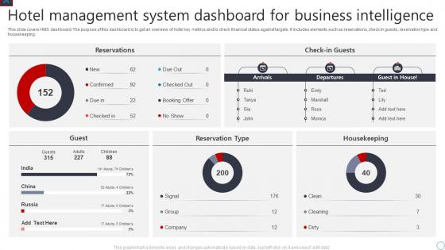
Introduction
A Hotel Management System (HMS) is software designed to automate hotel operations, including room booking, check-in/check out, payments, and customer management.
This project follows an Incremental Model, where development occurs in phases, ensuring early testing, client feedback, and efficient feature integration.
Hotels face several challenges in managing operations manually, such as:
Slow and inefficient booking processes
Errors in reservations and billing
Difficulty in tracking room availability
Lack of centralized customer records
To resolve the above challenges a fully digital hotel management system is under development that automates operations for improved efficiency and customer experience.

Slide 3
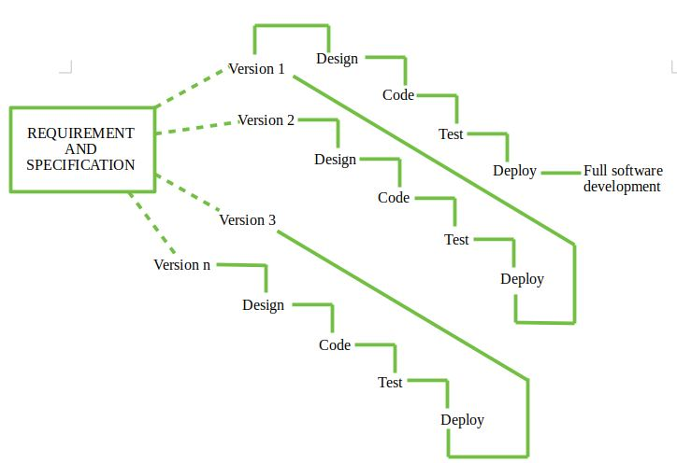
Objective
Streamline reservations & automate booking processes.
Enable secure & hassle-free online payments.
Simplify check-in & check-out for both staff and guests.
Provide real-time reports for better decision-making.
Enhance overall guest experience with improved services.
Why the Incremental Model?
Step-by-step implementation ensures stability.
Early testing allows identification of issues before full deployment.
Faster delivery of core functionalities for client feedback.
Scalability – Additional features can be integrated later.

Slide 4
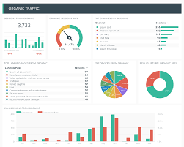




Requirement Gathering
Stakeholders & Their Needs
Hotel Manager/ Admin – Centralized control for bookings, reports, and staff management.
Receptionist – Handles check-ins, check-outs, and guest records.
Customers – Easy room booking, secure payments, and feedback options.
Housekeeping Staff – Room cleaning schedule, status updates.
Functional Requirements
Room Booking – Real-time availability, seamless reservations.
Check-in/Check-out – Digital process, automated billing.
Payments – Secure transactions and invoicing.
Customer Management – Guest history and preferences.
Room Cleaning Management – Assign housekeeping tasks, track room status.
Reports & Analytics – Revenue, occupancy trends, and performance insights.
Non-Functional Requirements
Scalable – Supports multiple hotel branches.
Secure – Encrypted data and compliance with standards.
Efficient – Fast processing and real-time updates.
User-friendly – Intuitive interface for all users.

Slide 5
Incremental Model:
Increment 1
Key Features:
Increment 2
Key Features:
Increment 3
Key Features:
Increment 4
Key Features:
Core Room Booking System (Week 1-4)
Payment Processing & Check-in/Check-out (Week 5-8)
Customer Management & Reports (Week 8-10)
Final Testing & Deployment
User Authentication & Role Management (Admin, Staff, Customer)
Real-time Room Availability & Booking Confirmation
Automated Email/SMS Booking Notifications
Secure Payment Gateway Integration (Stripe/PayPal)
Automated Invoicing & Transaction Tracking
Digital Check-in & Check-out System
Customer Profile Creation & Visit History Tracking
Feedback & Rating System for Service Improvement
Business Reports (Bookings, Revenue, Customer Trends)
UI/UX Enhancements & Bug Fixes
Comprehensive Security Testing & Data Encryption
System Deployment & Training for Hotel Staff

Slide 6
Iteration 1: Core Booking System (Week 1-4)
Iteration 2: Payment & Check-in/Check-out System (Week 5-8)
Objective:
Develop the basic hotel booking system with user authentication and room reservation.
Phases:
Planning & Requirement Analysis (Week 1-2)
Identify core booking system needs (room selection, availability check, user registration).
Define roles: Admin, Receptionist, Customer.
Create a database schema for users, rooms, and bookings.
System Design (Week 2-3)
Design UI mock-ups for login and room booking pages.
Set up system architecture (backend, database design, frontend wireframes).
Development (Week 3-4)
Implement User Authentication (Login, Register).
Develop Room Booking feature (check availability, select room, confirm booking).
Create database tables for users, rooms, and reservations.
Testing & Deployment (Week 4)
Unit testing: Validate login, room selection, and booking functionalities.
Deploy the first working module with limited features.
Outcome:
Users can log in and book rooms.
Admins can manage room availability.
Objective:
Add payment processing and check-in/check-out functionalities to improve booking management.
Phases:
Requirement Analysis (Week 5)
Identify payment methods (Credit/Debit Card, UPI, PayPal, Cash).
Define workflows for Check-in and Check-out (room key assignment, invoice generation).
System Design (Week 6)
Design UI for payment processing and check-in/out pages.
Update database schema to include transaction details.
Development (Week 7-8)
Integrate payment gateway (Stripe, PayPal, etc.).
Implement Check-in/Check-out Process (Room assignment, invoice generation).
Testing & Integration (Week 8)
Test payment success/failure scenarios.
Validate check-in/check-out functionalities.
Outcome:
Guests can pay online and confirm their booking.
Receptionists can check guests in and out, ensuring a seamless process.

Slide 7
Iteration 3: Reports & Customer Management (Week 9-10)
Final Testing & Deployment (Week 11-12)
Objective:
Enhance customer management, reporting, and housekeeping tracking for efficient hotel operations.
Phases:
Requirement Analysis (Week 9)
Identify required reports (Revenue, Bookings, Customer History, Room Status).
Define customer data storage for better service tracking.
Establish room cleaning status updates for housekeeping.
System Design (Week 9-10)
Design Admin Dashboard UI for reports, customer history, and room status tracking.
Update database schema to store customer visit history and room cleaning status.
Development (Week 10)
Implement Customer Management System (View/Edit customer history).
Develop report generation for revenue, occupancy, and housekeeping status.
Enable housekeeping staff to update room cleaning status after service.
Testing & Integration (Week 10)
Validate report accuracy (financial, occupancy, and housekeeping reports).
Test customer history retrieval and room cleaning status updates.
Outcome:
Admins can track hotel performance, revenue, and room availability more efficiently.
Customer service improves with history tracking and better personalization.
Housekeeping staff can update room cleaning status, ensuring real-time availability updates.
Objective:
Optimize, test, and deploy the final version of the system.
Phases:
UI Enhancements & Bug Fixes (Week 11)
Improve UI consistency across all modules.
Fix bugs from previous iterations.
Final System Testing & Security Checks (Week 11-12)
Perform penetration testing for security vulnerabilities.
Ensure system stability under high user load.
Deployment & User Training (Week 12)
Deploy the final version on the production server.
Conduct training sessions for hotel staff.
Outcome:
The Hotel Management System is fully operational and ready for use.
Users, receptionists, and admins can use the system without major issues.

Slide 8
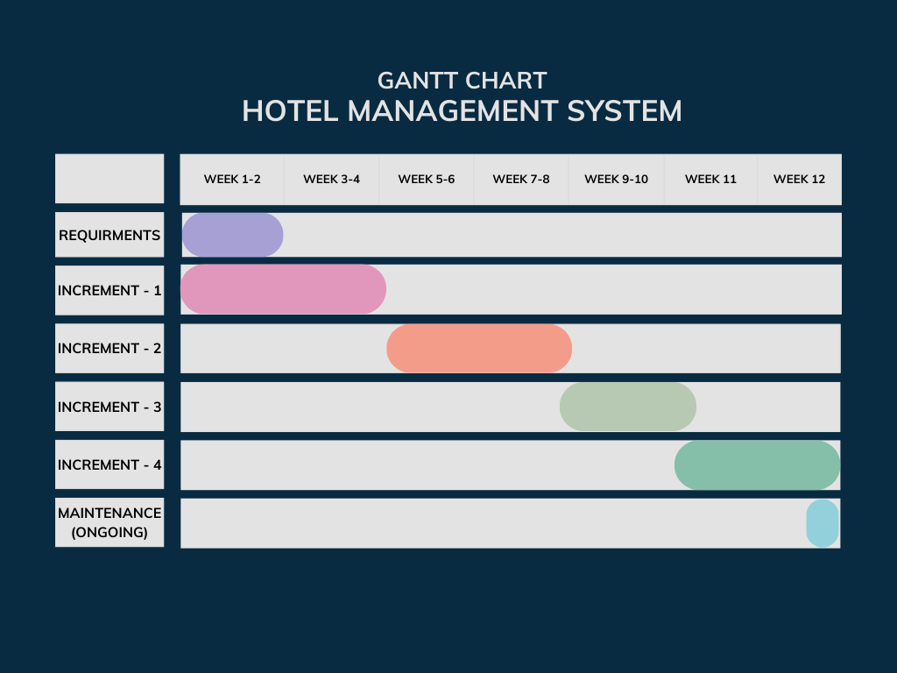

Slide 9
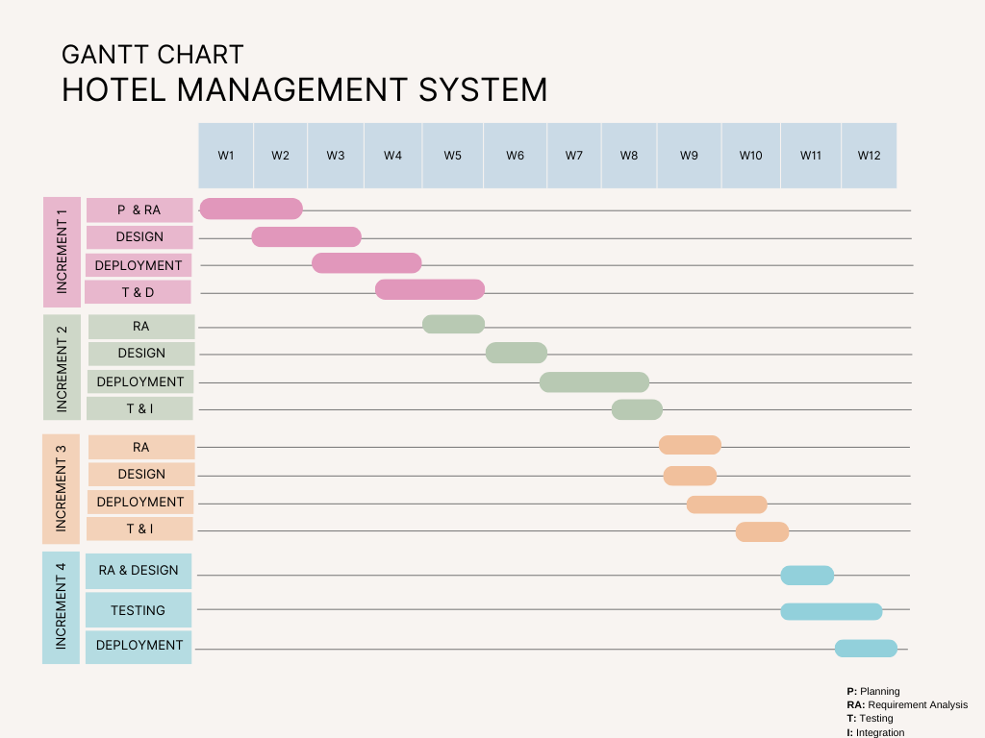

Slide 10
Technologies Used
Software Requirements
Operating System: Windows, macOS, or Linux Database: MySQL / PostgreSQL Backend: Java (Spring Boot) / Python (Django) / Node.js Frontend: React.js / Angular Development Tools: VS Code, Eclipse or PyCharm Version Control: Git (GitHub/GitLab)
Hardware Requirements
Server: Cloud-based (AWS, Azure, or Google Cloud) or Dedicated Server Processor: Intel Core i5/i7 (or equivalent) for local development RAM: Minimum 8GB (16GB recommended) Storage: SSD (512GB or more) Network: High-speed internet for cloud/server communication

Slide 11
Conclusion
The Hotel Management System enhances efficiency by automating core hotel operations such as bookings, check-ins, payments, and customer management.
It reduces manual workload, minimizes errors, and ensures a seamless experience for both guests and staff. With robust security and scalable architecture, it adapts to hotels of all sizes while safeguarding critical data.

Slide 12
THANK YOU!!

