Slide 1







Singapore Public Healthcare
Sustainability

Slide 2

Introduction
Demographic Projections
Ageing Population
2030: 1 in 4 Singaporeans will be elderly
Hospital Admissions Forecasting
2035
Increase Hospital Demand
Healthcare Expenditure
2023: 62.7% of total hospital admissions were elderly
2025: SGD 20.9 billion
2030: > SGD 30 billion
Increase Healthcare Expenditure
Financing Adequacy Analysis

Slide 3

Data Sources
Data |  | Purpose
Singapore Population Structure |  | Analyse growth trends and project future population by age
Hospital Admissions (Age, Sex) |  | Establish hospital admission patterns for forecasting
Bed Occupancy Rates |  | To determine hospital capacity utilisation and constraints
Government Healthcare Expenditure |  | Establish spending trend and calculate cost per admission
Household Expenditure Survey |  | Establish household healthcare expenditure

Slide 4
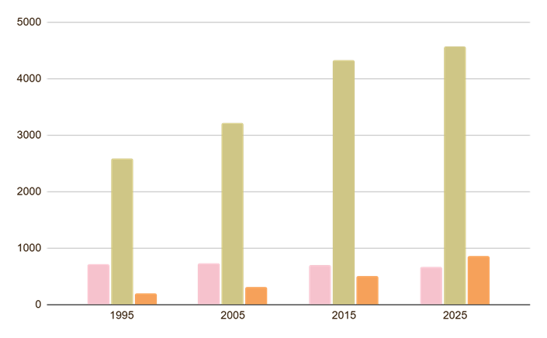

1. Demographic Projection
Project Singapore’s population structure up to 2035 using historical data with life expectancy trends, mortality and fertility rates.
Population 4.20M (2025) → 4.10M (2035)
Resident population declining
Resident pop: 4.20M → 4.10M
Net decline of ~107K by 2035
The Elderly
Elderly 25.9% in 2035 (18.8% in 2025)
> 80 years old doubles to 316K+ by 2035
0–14 years: declining to 12.1%
15–64 years: shrinking to 63.3%
65+ years: rising to 25.9%
Source: https://www.population.gov.sg/ & https://www.singstat.gov.sg/

Slide 5
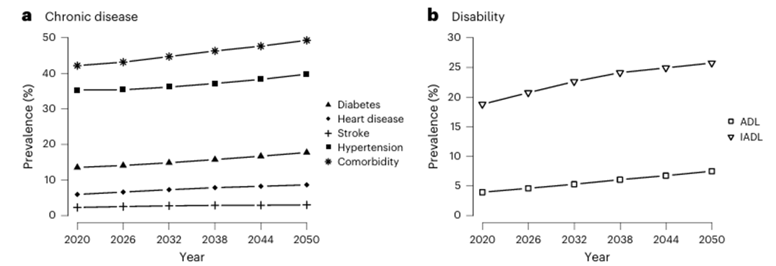
2. Hospital Demand & Admission Forecasting
Project demand for hospital beds using age-specific hospital admission rates to assess if projected demand aligns with planned hospital capacity.
Bed-day demand: 3.79M days → 4.45M days (+17%)
BOR 2025: 89.6% — exceeds 85% red line
Total admissions grow: 601K (2025) → 685K (2035)
Elderly (65+) admissions: 266K → 349K (+31%)
Source: Disease burden, lifetime healthcare cost and long-term intervention impact projections among older adults in Singapore

Slide 6
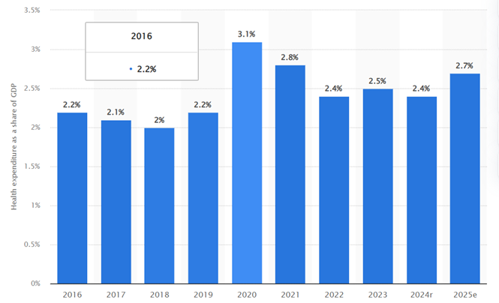

3. Healthcare Costs Projection
Healthcare expenditure is driven by changes in demand and medical cost inflation.
Govt Hospital Opex
2025: SGD 7.52B → 2035: SGD 14.10B (+88%)
Medical Inflation
Rising 2.7% (2025) to 6.1% by 2035
Cost Per Admission
SGD 12,490 (2025) → SGD 17,644 (2035)
Elderly cost multiplier drives accelerating expenditure
Projected Govt Healthcare Cost 2026–2035
Source: https://www.statista.com/statistics/780864/health-expenditure-share-of-gdp-singapore/?srsltid=AfmBOoqpsV1btn4QtflX8Df7KMcrAC3aeXlv6s5cn_Tu8sxLEbKW_q0W
https://isomer-user-content.by.gov.sg/153/b25a4bb9-db1b-428d-ab48-4528e0ee0d37/fy2026_analysis_of_revenue_and_expenditure_2026.pdf

Slide 7
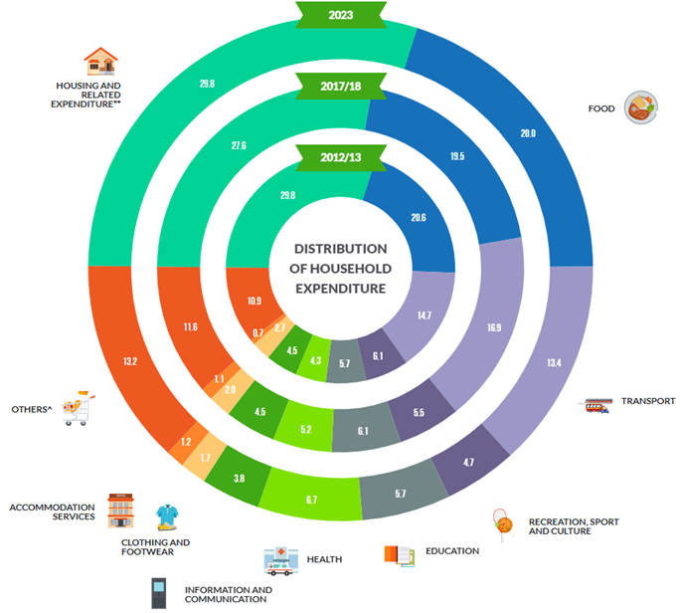
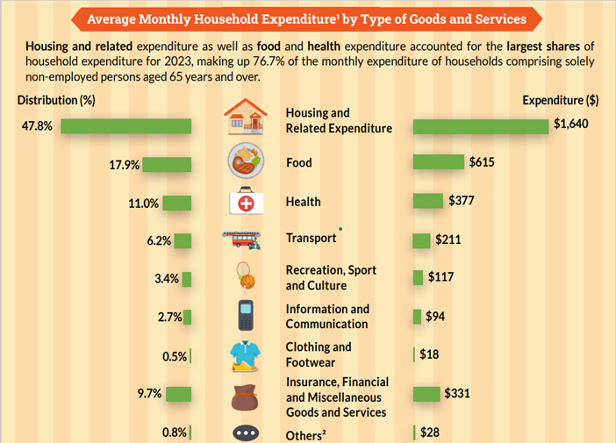
4. Financing & Subsidy Sustainability
Financing gap emerges; surplus until 2030, deficit from 2031 Deficit reaches SGD 951M by 2035 (7.2% of govt budget) Household OOP burden: SGD 1,760/yr (2026) → SGD 2,698/yr (2035)
Source: https://www.singstat.gov.sg/find-data/search-by-theme/households/household-expenditure/latest-data

Slide 8

Trade Off Analysis
Subsidy Level vs Fiscal Sustainability
Capacity Expansion vs Fiscal Sustainability
Trade-off between household protection and fiscal sustainability
65% subsidy: financing deficit SGD 951M by 2035; OOP SGD 4,358/yr per household
55% subsidy: deficit eliminated; but OOP jumps to SGD 5,603/yr (+29%)
Optimal zone: 60% subsidy — deficit SGD 134M, OOP SGD 4,980/yr (21.6% of income)
Balances operational capacity needs with fiscal constraints
Baseline 3.53% expansion rate: BOR falls from 89.6% (2025) to 74.2% (2035)
2% expansion rate: BOR stays above 86.8% through 2035, breaching safety threshold
3.53% expansion rate (MOH plan) keeps BOR within 85% threshold by 2032

Slide 9
Sensitivity Analysis
Medical Cost Inflation vs Government Health Subsidies
Elderly Population Growth Rate vs Projected Hospital Admissions
At 2.7% inflation (base): deficit SGD 951M by 2035
At 5% inflation: deficit balloons to SGD 3.6B by 2035
At 8% inflation: deficit reaches SGD 9.6B — fiscal crisis threshold
Each 1% rise in inflation adds ~SGD 700M to 2035 deficit
Bed expansion rate is the #1 BOR driver: 3.53%→2% raises BOR by 12.7pp
ALOS reduction: 10% ALOS cut reduces BOR by ~5.5pp — policy lever
65+ population growth: 1.5% faster growth adds only 0.68pp to BOR
Healthier SG policy factor: -0.6% efficiency gain reduces BOR by 3.3pp

Slide 10
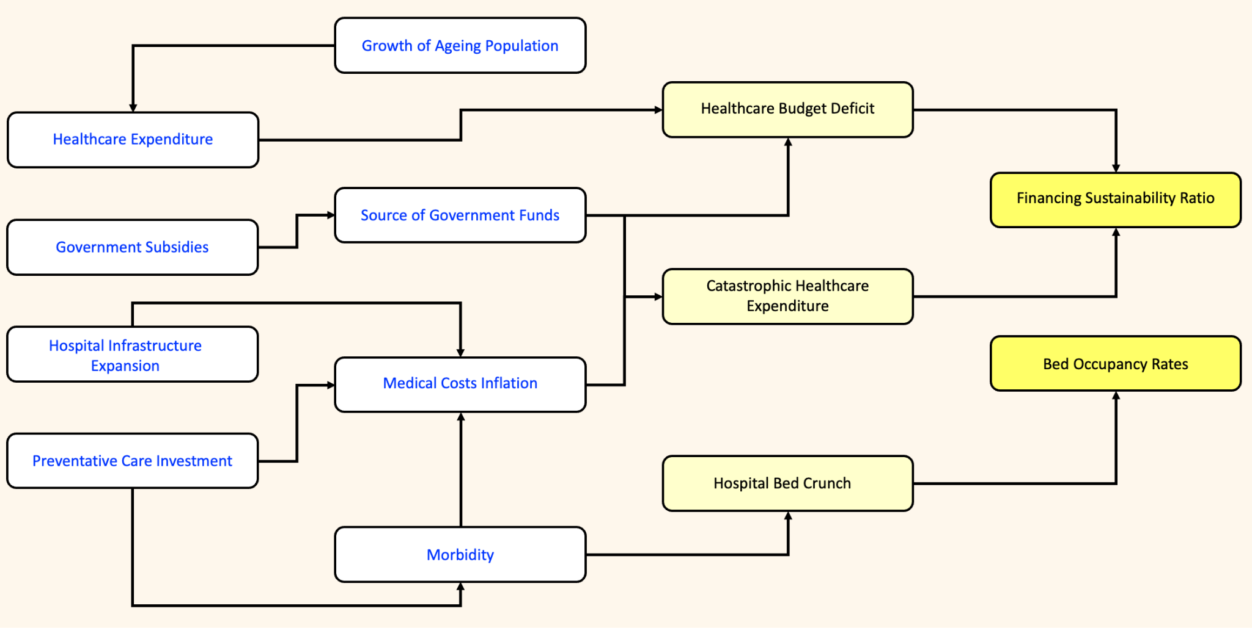

Influence Diagram

Slide 11
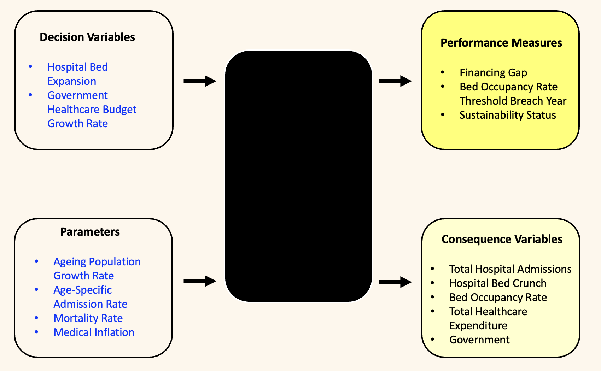
Black Box Model

Slide 12

Key Findings & Recommendations
Hospital Capacity
Subsidy Optimisation
Demographics → admissions → BOR → expenditure (2026–2035)
60% subsidy rate balances household burden and govt fiscal position
Fiscal Sustainability
Policy Priority
Deficit of SGD 951M by 2035; sustain budget growth at 5.75% p.a.
Prioritise Healthier SG, ALOS reduction, and 3.53% bed expansion plan

Slide 13
Thank you!

