Slide 1
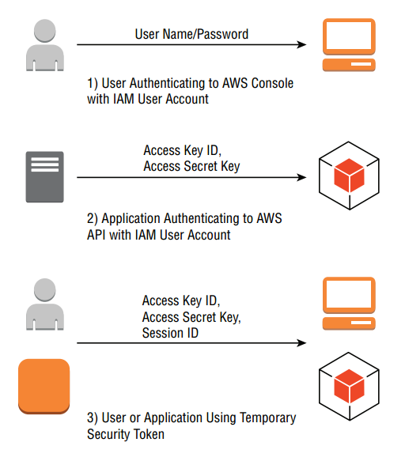

Slide 2
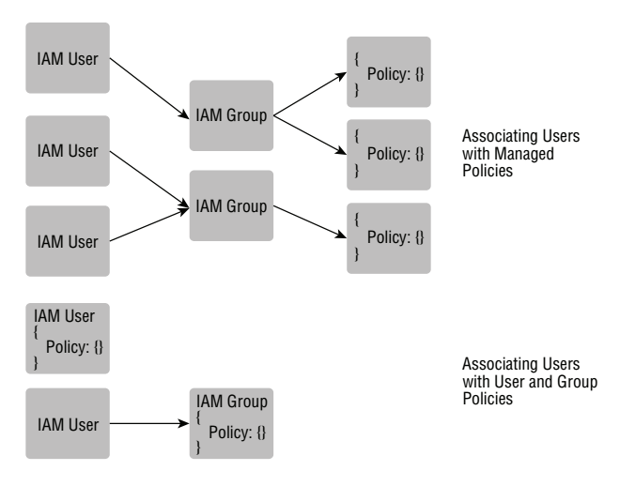

Slide 3
Sample Policy
{
"Version": "2012–10–17",
"Statement": [
{
"Sid": "Stmt1441716043000",
"Effect": "Allow",
"Action": [
"s3:GetObject",
"s3:ListBucket"
],
"Condition": {
"IpAddress": {
"aws:SourceIp": "192.168.0.1"
}
},
"Resource": [
"arn:aws:s3:::my_public_bucket/*"
]
}
]
}

Slide 4
Amazon Resource Names (ARN)
arn:aws:service:region:account-id:resource
arn:aws:s3:us-east-1:123456789012:my_corporate_bucket/*
arn:aws:iam:us-east-1:123456789012:user/David
arn:aws:dynamodb:us-east-1:123456789012:table/tablename

