Slide 1
Generative Adversarial Networks (GANs)
CSCI 4425/5425: Introduction to Deep Learning
Paras Khanal, Shokhina Jalilova, Vincent Sanchez

Slide 2
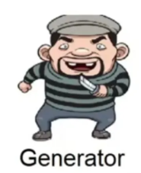
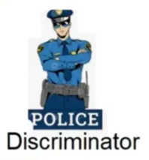
Introduction
A Generative Adversarial Network (GAN) is a deep learning framework designed to learn the underlying distribution of real data and generate new, realistic samples.
It consists of two neural networks:
Generator (G): creates synthetic data from random noise, producing a learned distribution pg(x)
Discriminator (D): evaluates whether a given sample is real or generated
Adversarial setting / Competitive
The Generator learns to produce increasingly realistic data
The Discriminator learns to better distinguish real from fake images

Slide 3
Why ?
GAN is not a classification or prediction model.
It is a generative model. The generator learns the real data distribution.
It generates the data for specific purposes.
Data Augmentation
Generating additional training samples
Medical image, biology or rare datasets
Image generation
Realistic images
Art, design, simulation
Image to Image translation; super resolution
Color, format, sketch -> photo
Low resolution -> high resolution
Synthetic Data creation
Healthcare
Autonomous Driving
Simulation environments

Slide 4
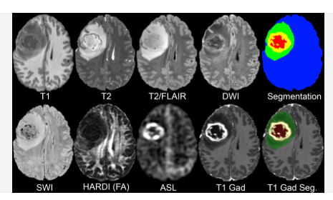
Real world challenge– small dataset problem
Limited labeled medical images for rare disease
Some disease are rare. Examples include specific variants of pneumonia, different COVID-19 variants,brain tumor, etc.
Medical data is highly sensitive and restricted (HIPAA regulation and others)
Data collection is very slow and expensive
Deep learning model typically require thousands or millions of sample images
Rare disease have few hundred images usually

Slide 5
GAN is the solution
GAN solves this by learning data distribution and generating additional samples like magic.
GANs can generate synthetic medical images – very similar to real images
Example workflow:
Train a GAN on real medical images (e.g. MRI, CT Scans)
Generator creates synthetic images -> added to dataset
A disease detection model is trained with more data, improving accuracy.
GAN
Train on real image
Generator
Synthetic image
Model
Train Disease detection

Slide 6
How GAN compares to other models: GAN vs VAE
Both models generate new samples but differ in training.
GAN
Uses adversarial training
Training can be unstable
Produces sharper images
Optimizes distribution difference
VAE
Uses probabilistic latent variables
Easier to train
Generated samples are often blurrier
VAE optimizes a likelihood-based objective

Slide 7
GAN vs Diffusion Models
GAN
Fast image generation
Hard to train
Risk of mode collapse (repeating one pattern only)
GAN start from random noise, learns to transform into realistic data
Diffusion
Slower generation due to iterative steps
Stable training
Higher image quality
Diffusion models gradually remove noise from data.

Slide 8
GAN vs GNN
GAN
Generates new data (continuous)
Focuses on continuous data generation
Use case: medical image generation, simulation
GNN
Learn relationships in data (Graph)
Focuses on learning relationships through nodes
Use case: Social networks, recommendation

Slide 9
How does this magic happen: Basic Training process - outline
Component | Role (What it does)
Generator (G) | Creates synthetic images from random noise ( z )
Discriminator (D) | Distinguishes between real images and generated images
Loss Calculation | Measures how well D detects and how well G fools D
Generator Update | Improves G to produce more realistic images
Discriminator Update | Improves D to better detect fake images
Iterative Training | Repeats the process through multiple training cycles
Optimization Goal | Minimax game: G minimizes, D maximizes the objective
Final Outcome | Generated data distribution ≈ real data distribution

Slide 10
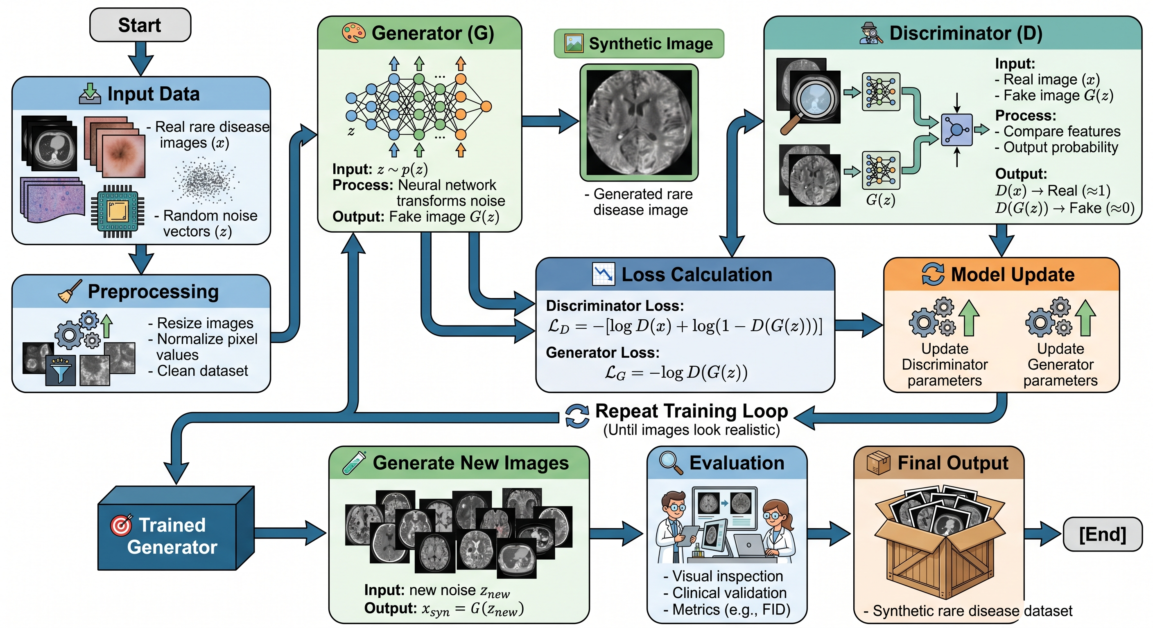
GAN Architecture for Rare disease

Slide 11
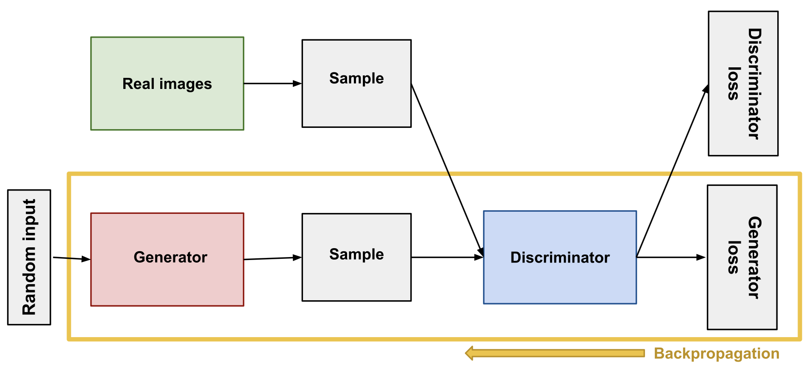
The Generator
Goal: find parameters θ so that generated samples are indistinguishable from real data
A new sample x* is generated in two steps:
Sample a latent noise vector z from a simple base distribution
z ~ N(0, I) — standard normal, easy to sample from
Pass z through the generator network to get a fake sample:
x* = g[z, θ]
The generator never sees real images directly — it only learns from the gradient signal fed back by the discriminator
After training: discriminator is discarded; only g[z, θ] is kept for generating new samples
Why z ~ N(0, I)?
• Simple to sample from — any random number generator • Low-dimensional (e.g., 100D) — the generator learns to warp this into the high-dimensional image space • Continuous and smooth — nearby z values produce
similar images (latent space interpolation)

Slide 12
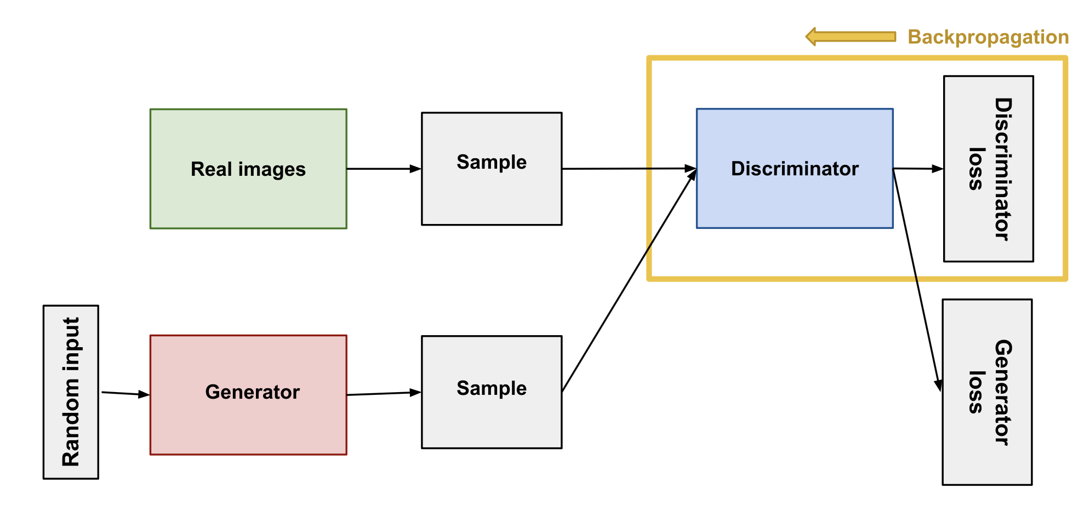
The Discriminator
The discriminator f[x, ϕ] takes any image x (real or fake) and outputs a single scalar
Output passed through sigmoid to get a probability:
sig[f[x, ϕ]] ∈ [0, 1]
High output (≈ 1) → D believes the input is real
Low output (≈ 0) → D believes the input is fake
Why sigmoid? It maps any real number to a probability — essential for binary classification
GAN labeling convention:
Real images: label y = 1 → D should output ≈ 1
Generated samples: label y = 0 → D should output ≈ 0
At convergence: sig[f[x, ϕ]] = 0.5 for all x — D is at chance (perfect uncertainty)
Why discard the discriminator after training?
• It is only a training signal — not the end product • At convergence it outputs 0.5 everywhere, so it carries no useful information • We only ever needed it to teach the generator

Slide 13
Notation
Symbol | Meaning
x | A real data sample (e.g., an image)
x* | Generated (fake) sample
z | Latent noise vector (input to generator)
Pr(x) | True data distribution
Pr(x*) | Generated sample distribution
g[z, θ] | Generator network with parameters θ
f[x, ϕ] | Discriminator network with parameters ϕ
L[ϕ], L[θ] | Discriminator and generator loss functions
𝔼[·] | Expectation (average over a distribution)
D_JS | Jensen–Shannon divergence
D_W | Wasserstein distance

Slide 14
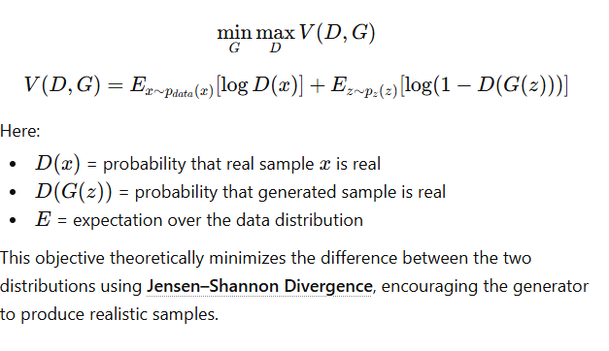
Loss Function — overview
The loss function in GAN measures how well the generator and discriminator perform their competing tasks.
The discriminator’s objective is to correctly classify real images as real and generated images as fake, while the generator’s objective is to fool the discriminator into labeling fake images as real.
This adversarial objective is typically expressed as a minimax function, where the discriminator maximizes the probability of correct classification and the generator minimizes the discriminator’s ability to detect fake samples.

Slide 15

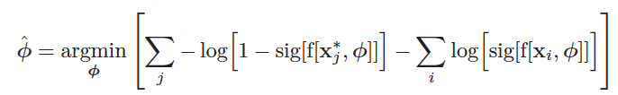
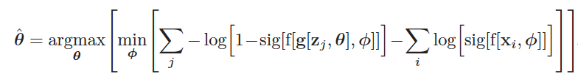
GAN loss function — setup
Start from binary cross-entropy loss (section 5.4):
Assign real examples y = 1, generated samples y = 0:
Substitute generator x*ⱼ = g[zⱼ, θ] (note: generator must maximize this loss to fool D):
Equation 15.4 — the minimax GAN objective

Slide 16
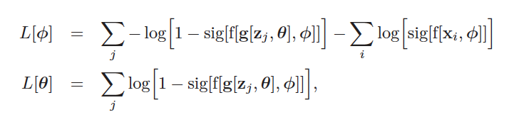

GAN loss function — training the two networks
Equation 15.4 is split into two loss functions for practical training:
Discriminator loss (minimize to update ϕ):
Generator loss (minimize to update θ):
Minimizing L[ϕ] trains the discriminator to correctly classify real vs. fake
Minimizing L[θ] trains the generator to fool the discriminator
At each step: draw batch of z, pass through G to get x*, draw batch of real xi, then update both

Slide 17
Training Process:
In a Generative Adversarial Network (GAN), training involves two neural networks learning simultaneously in an adversarial setup.
The generator takes a random noise vector and produces synthetic (fake) images that resemble the training data, while the discriminator receives both real images from the dataset and fake images from the generator and attempts to classify them as real or fake.
During each training iteration, the discriminator first learns to better distinguish real from generated images. Then the generator is updated based on the discriminator’s feedback so it can produce more realistic outputs.
This alternating process continues repeatedly until the generated data becomes increasingly difficult for the discriminator to distinguish from real data.

Slide 18
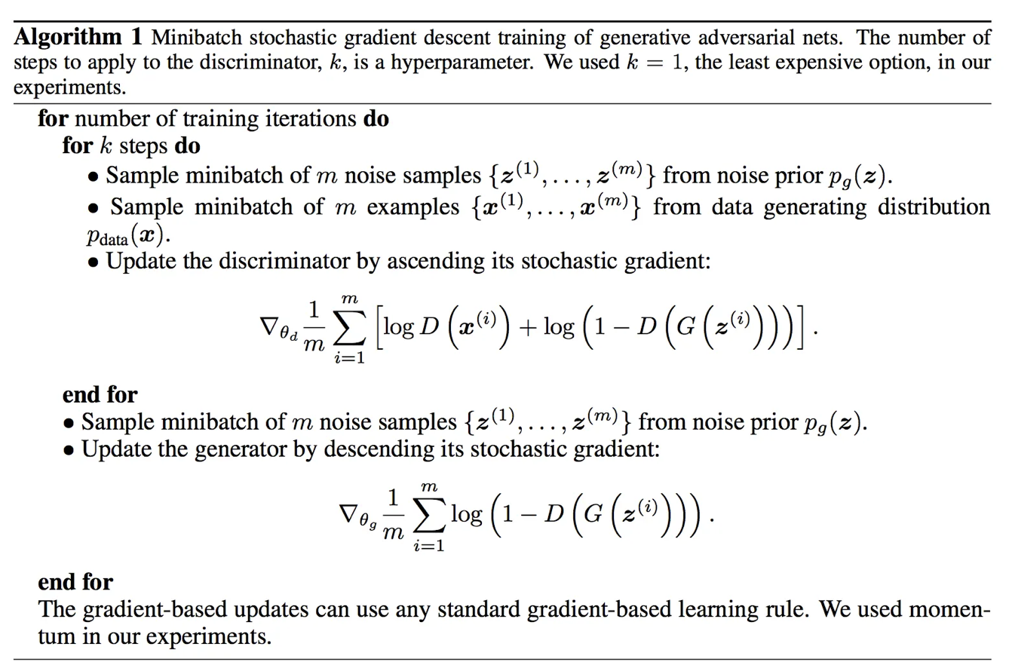
Training process - pseudocode
Training loop:
Generator →
Fake Image →
Discriminator →
Real/Fake →
Loss →
Backpropagation →
Update weights

Slide 19
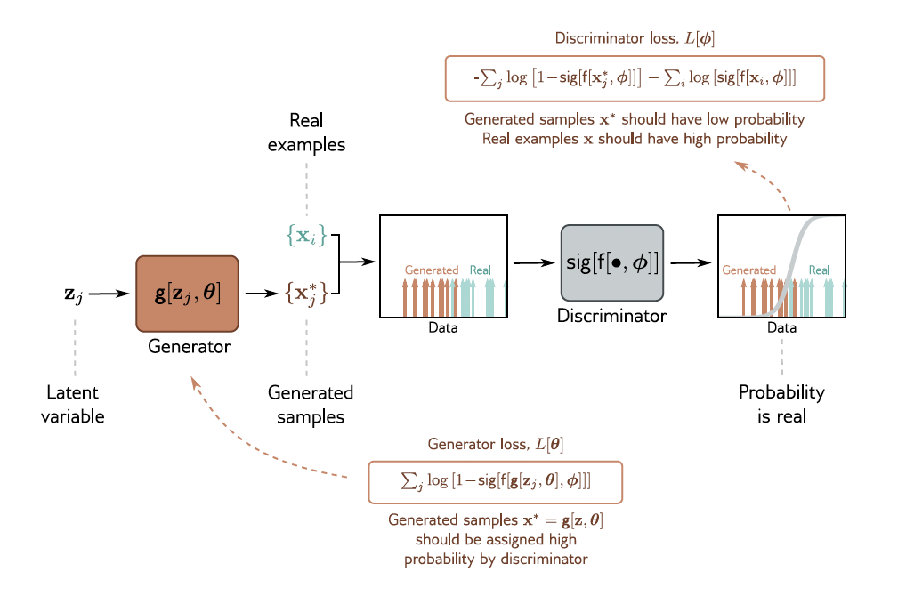
GAN training loop
Alternate: update D for one or more steps, then update G for one step
Goal: Nash equilibrium — neither player can unilaterally improve
Convergence: D(x) = ½ for all x — perfect uncertainty

Slide 20
Nash equilibrium in GAN training
Technically, the solution to GAN training is a Nash equilibrium
The optimization algorithm searches for a position that is simultaneously:
A minimum of L[ϕ] — discriminator cannot improve further
A maximum of the generator objective — generator cannot improve further
Upon convergence: g[z, θ] generates samples from the same distribution as the data
Upon convergence: sig[f[•, ϕ]] = 0.5 everywhere — discriminator is at chance
In practice: true Nash equilibria are hard to find; GAN training can be unstable

Slide 21
Improving Stability
Section 15.2 — Analysis, Vanishing Gradients

Slide 22
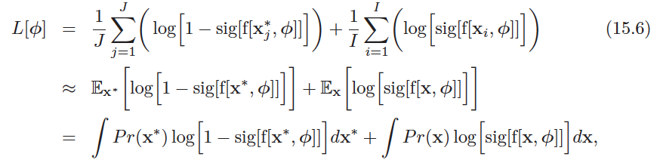

Analysis of GAN loss — expectation form
Dividing the sums in eq. 15.3 by I, J (number of samples) gives an expectation form:
The optimal discriminator for any fixed generator is:
Equation 15.7 — optimal discriminator as a function of the two distributions
This means: the discriminator tells us the relative probability of x being real vs. generated

Slide 23

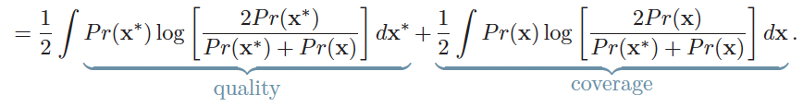
Jensen–Shannon divergence
Substituting the optimal discriminator into L[ϕ] and simplifying:
L[ϕ]
Ignoring additive/multiplicative constants, this is the Jensen–Shannon divergence:
The two KL terms have interpretations:
First term (quality): penalizes generated samples in regions with no real data
Second term (coverage): penalizes real data regions with no generated samples
The second term does not depend on the generator — GAN does not enforce coverage → mode dropping

Slide 24
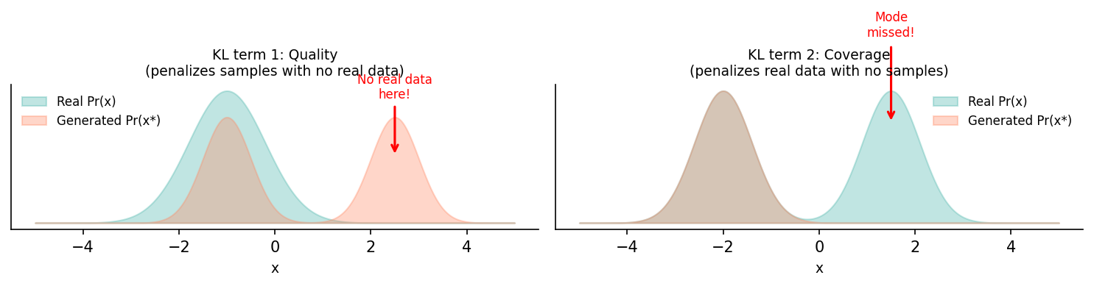
Quality vs. coverage in the GAN loss
The generator is trained on the quality term only — coverage is not penalized
This explains why GANs are prone to mode dropping: they can "get away with" missing modes

Slide 25
Vanishing gradients
Problem: if the two distributions Pr(x*) and Pr(x) are disjoint, the JSD is log 2 (a constant)
Any small change to the generator will not decrease the loss — gradient is zero
Why distributions may be disjoint:
Generated samples lie in a low-dimensional subspace (size of latent z)
Real examples also lie in a low-dimensional subspace (natural image manifold)
These subspaces may have little or no overlap
Empirical evidence: if discriminator is trained further without updating generator, generator gradients vanish
If the discriminator becomes too good — training of generator stalls

Slide 26
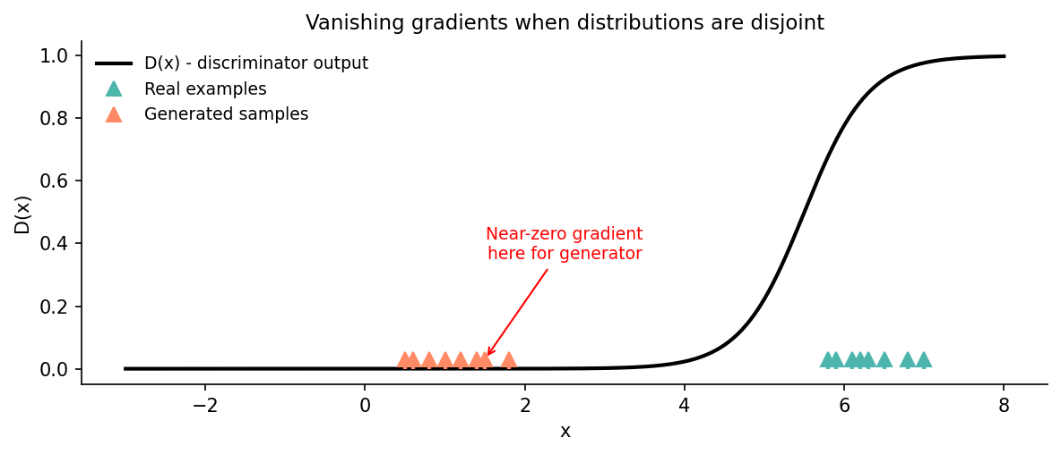
Vanishing gradients — illustration
When samples are well-separated, the sigmoid discriminator is flat at generated sample positions
Gradient to update generator parameters is near zero — training stalls

Slide 27
Code Example

Slide 28
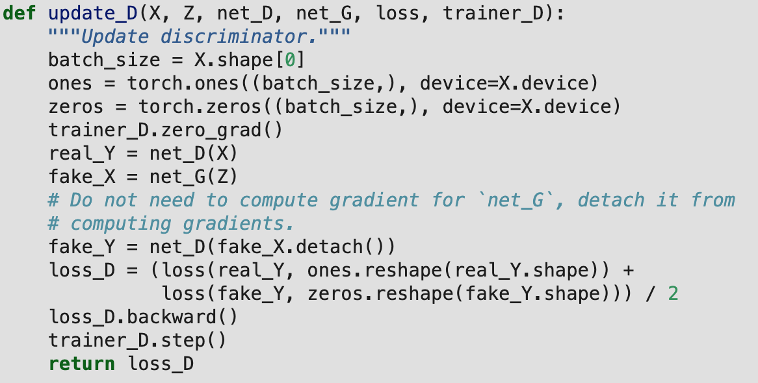
Discriminator Update
X -> real images
Z -> random noise
net_D ->discriminator
net_G -> generator
loss -> loss function
trainer_D -> optimizer
Ref: Zhang, A., Lipton, Z. C., Li, M., & Smola, A. J. (2023). Dive into deep learning. Cambridge University Press.
Notes:
This function updates the discriminator by training it to assign high scores to real data and low scores to generated data. It computes the loss on both real and fake samples, then updates the discriminator’s weights to improve its ability to distinguish between them.
Batch_size – number of samples in this batch
Ones – real images
Zero – fake images
Real_Y – distriminator predicts how real are the images
Fake_X – generator creates fake images from noise
Loss_D – computes discriminator loss, calculates average between real and fake images

Slide 29
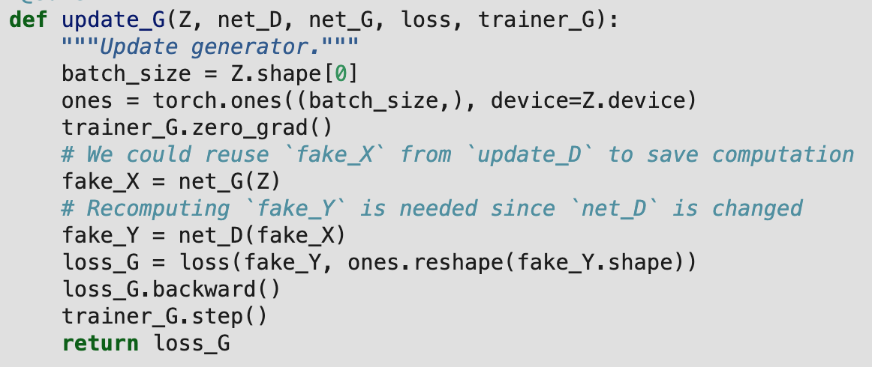
Generator Update
Z -> random noise
net_G -> generator
net_D ->discriminator
loss -> loss function
trainer_G -> optimizer
Key Difference:
Generator wants fake images labeled as 1
Ref: Zhang, A., Lipton, Z. C., Li, M., & Smola, A. J. (2023). Dive into deep learning. Cambridge University Press.
Notes:
This function updates the generator by training it to produce fake data that the discriminator classifies as real. It computes the loss by comparing the discriminator’s output on fake images to real labels, then updates the generator to better fool the discriminator.

Slide 30
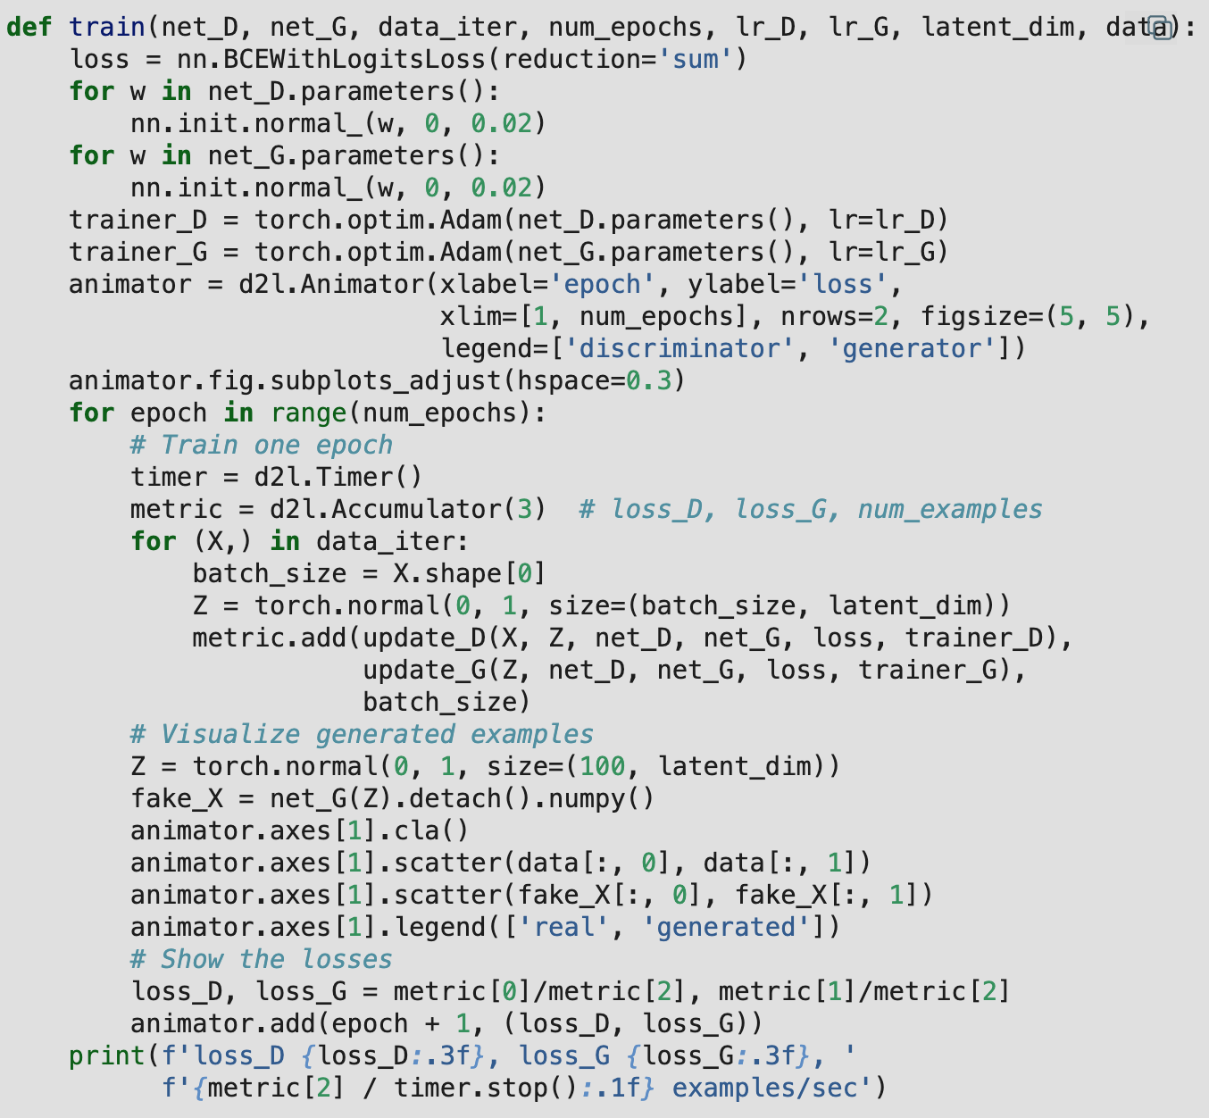
Training
net_D -> discriminator
net_G -> generator
data_iter -> dataset iterator (training data)
lr_D -> learning rate for discriminator
lr_G -> learning rate for generator
latent_dim -> size of the noise vector
Ref: Zhang, A., Lipton, Z. C., Li, M., & Smola, A. J. (2023). Dive into deep learning. Cambridge University Press.
Notes:
This function runs the full GAN training loop by repeatedly generating noise, updating the discriminator, then updating the generator. After each epoch it tracks the loss of both the generator and discriminator
Data_iterator – provides batches of real data to the model during training
Latent_dimension – determines how much info the generator has to create images
Too small: not enough information, generator can’t create diverse outputs
Too large: harder to train, model may overcomplicate things

Slide 31
Applications of GANs
Image Generation
Image-to-Image Translation
Sketch -> photo
Day -> night
Style Transfer
Photo -> Van Gogh style painting
Medical Imaging
Generate or enhance MRI/CT scans
Assist diagnosis with limited data

Slide 32
Downsides of GANs
Unbalanced “Game”
If Discriminator gets too good: spots fakes too easily and Generator gets no useful feedback
If Generator gets too good: Discriminator can’t learn and the model collapses
Mode Collapse
Generator finds one good output and repeats it over and over again
Vanishing Gradients
When the Discriminator is confident, gradient becomes very small and Generator stops learning
Poor architecture for images
Ignores pixels, edges, and shapes
Produces blurry or unrealistic images

Slide 33
GAN Family
Year | Model | Key Contribution
2014 | GAN (Goodfellow et al.) | Introduced adversarial training (Generator vs Discriminator)
2015 | DCGAN (Radford et al.) | Stable image generation with CNNs
2017 | WGAN (Arjovsky et al.) | Improved stability using Wasserstein loss
2017 | CycleGAN (Zhu et al.) | Image-to-image translation without paired data
2019 | StyleGAN (Karras et al.) | Style-based generator for highly realistic images
2022+ | GANs + Diffusion | Hybrid generative approaches combining GAN speed with diffusion quality

Slide 34
DCGAN (Deep Convolutional GAN)
Before DCGAN
Standard GAN uses fully connected layers
Very unstable with poor image quality
What Changed?
Replaced fully connected layers with CNNs
Why it matters
GANs become stable enough to train on more complex images
GANs were originally trained on simple datasets or even toy datasets
Key design rules for stable training
No pooling -> uses stride convolutions instead
Uses Batch Normalization to stabilize training
Activations
Generator ->ReLU (same as original)
Discriminator -> LeakyReLU (from sigmoid)
Introduction of LeakyReLU prevents dead neurons by allowing small gradients even for negative inputs
Notes:
CNN – uses filters that scan over the image to learn spatial patterns (edges, shapes)
Dead neurons – Always output 0 and stops learning
LeakyReLU – introduces an alpha to values that values less than or equal to zero. Makes negative inputs not zero anymore
Pooling – reduce the size of an image based on max or average value
Strided convolutions – also shrinks the image, but uses learned filters instead of fixed rules
Batch Normalization – keeps outputs of layers in a consistent range to stabilize gradients. Allows both networks to learn at similar speeds

Slide 35
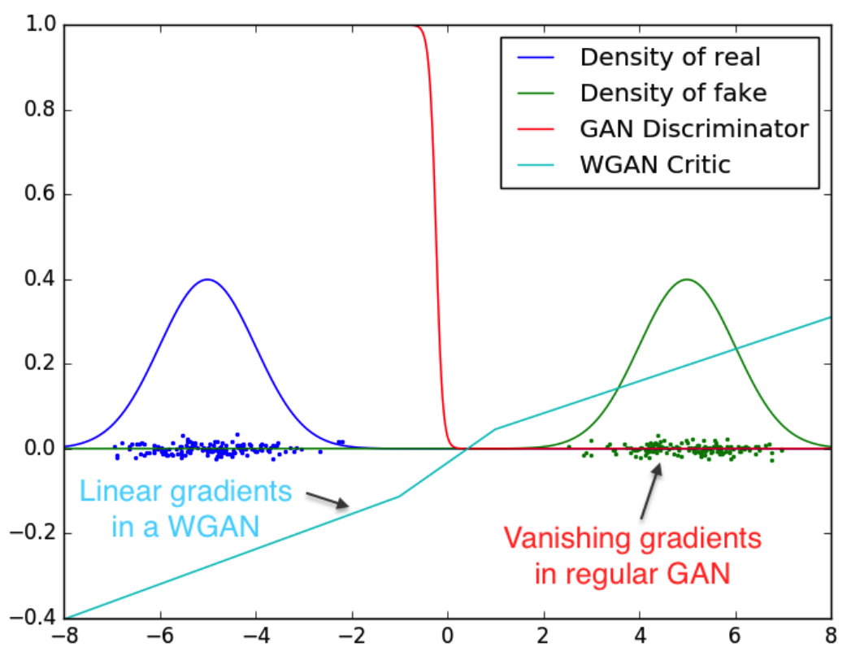

WGAN (Wasserstein GAN)
Key Changes
Uses Wasserstein loss instead of cross-entropy
Removes sigmoid output from discriminator and changes to a “critic”
Why it matters
Fixes the issue of vanishing gradients that occurred in original GAN
Generator receives useful gradients even when discriminator is strong
Loss now correlates with actual image quality
Simplified Wasserstein Loss
$$L=𝔼\left[\text{critic}\text{(}\text{real}\text{)}\right]−𝔼\left[\text{critic}\text{(}\text{fake}\text{)}\right]$$
Ref: Arjovsky, M., Chintala, S., & Bottou, L. (2017, July). Wasserstein generative adversarial networks.
Notes:
Critic – Outputs any real number instead of 0 to 1. A score of how real something looks. A CNN
Wasserstein Loss – Calculates the distance between the real data distribution and the generated data distribution.
Original GAN – loss can go down even when images are bad or vice versa

Slide 36
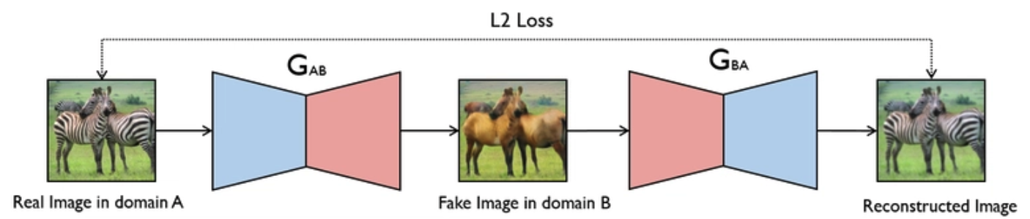
CycleGAN
Key Ideas
Learns translation WITHOUT paired data
Uses two GANs for forward (A->B) and backward (B->A) mapping
Doesn’t create from noise but instead modifies an existing image
Benefits
No need for paired data
Works on many domains
Preserves structure using Cycle Consistency Loss
Ref: https://dev.to/aditi_baheti_f4a40487a091/from-day-to-night-building-a-cyclegan-for-image-translation-3pjd
Notes:
Cycle Consistency Loss – difference between original and reconstructed image
CycleGAN loss is a combination of GAN loss (realism) and Cycle consistency loss (structure)

Slide 37
StyleGAN
What Changed?
Traditional GANs generated images from noise
StyleGAN introduces a style-based generator architecture
Layer-by-Layer Control:
Early layers -> coarse features (shape, pose)
Middle layers -> structure (facial features)
Late layers -> fine details (texture, color)
Why it matters
Produces highly realistic images
Can modify specific features without affecting others
Notes:
Style-based generator – Uses style information to control different parts of the image at each layer

Slide 38
References
Zhang, A., Lipton, Z. C., Li, M., & Smola, A. J. (2023). Dive into deep learning. Cambridge University Press.
Goodfellow, I., Pouget-Abadie, J., Mirza, M., Xu, B., Warde-Farley, D., Ozair, S., ... & Bengio, Y. (2020). Generative adversarial networks. Communications of the ACM, 63(11), 139-144.
Radford, A., Metz, L., & Chintala, S. (2015). Unsupervised representation learning with deep convolutional generative adversarial networks. arXiv preprint arXiv:1511.06434.
Arjovsky, M., Chintala, S., & Bottou, L. (2017, July). Wasserstein generative adversarial networks. In International conference on machine learning (pp. 214-223). Pmlr.
Zhu, J. Y., Park, T., Isola, P., & Efros, A. A. (2017). Unpaired image-to-image translation using cycle-consistent adversarial networks. In Proceedings of the IEEE international conference on computer vision (pp. 2223-2232).
Karras, T., Laine, S., & Aila, T. (2019). A style-based generator architecture for generative adversarial networks. In Proceedings of the IEEE/CVF conference on computer vision and pattern recognition (pp. 4401-4410).

