Slide 1
Exploring Airbnb Dataset
Exploratory Data Analysis with Python

Slide 2
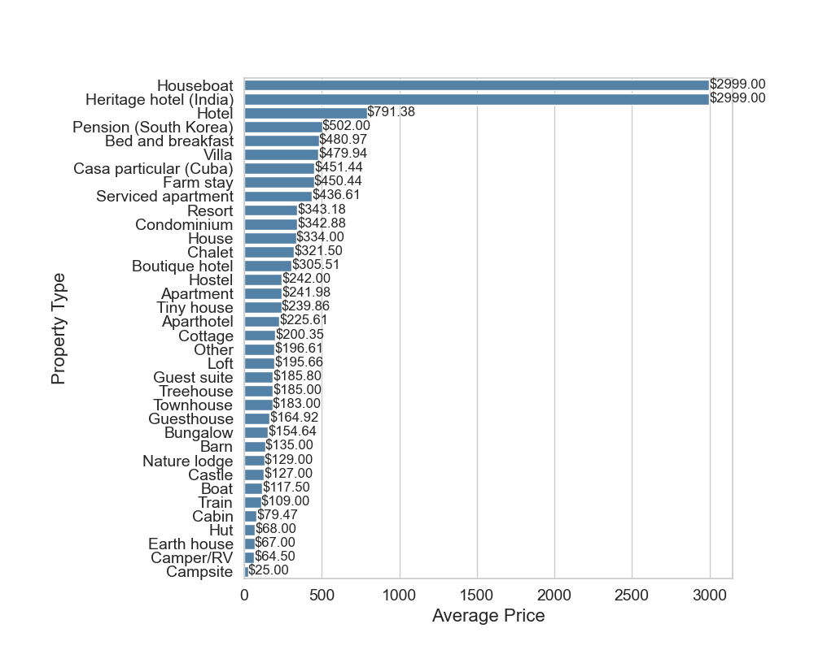
Average Price by Property Type

Slide 3
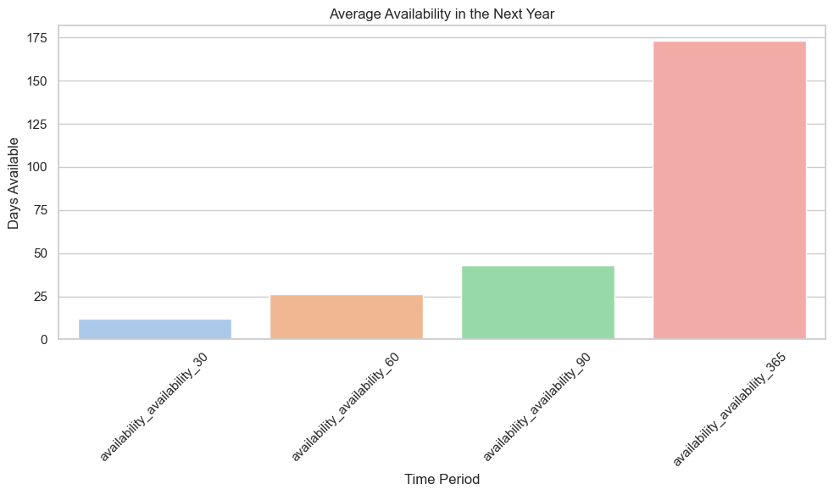
Average Price by Property Type

Slide 4
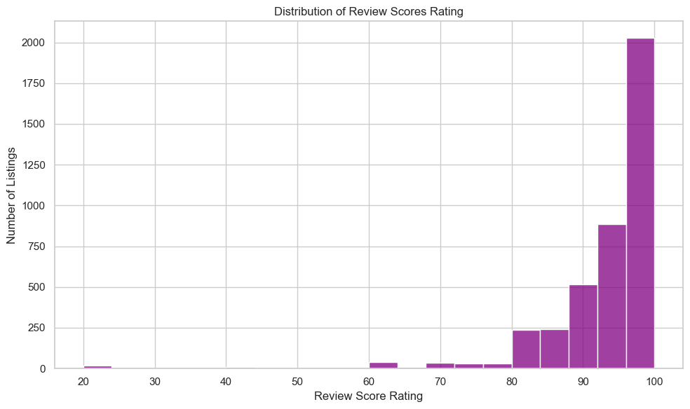
Distribution of Review Scores Rating

Slide 5
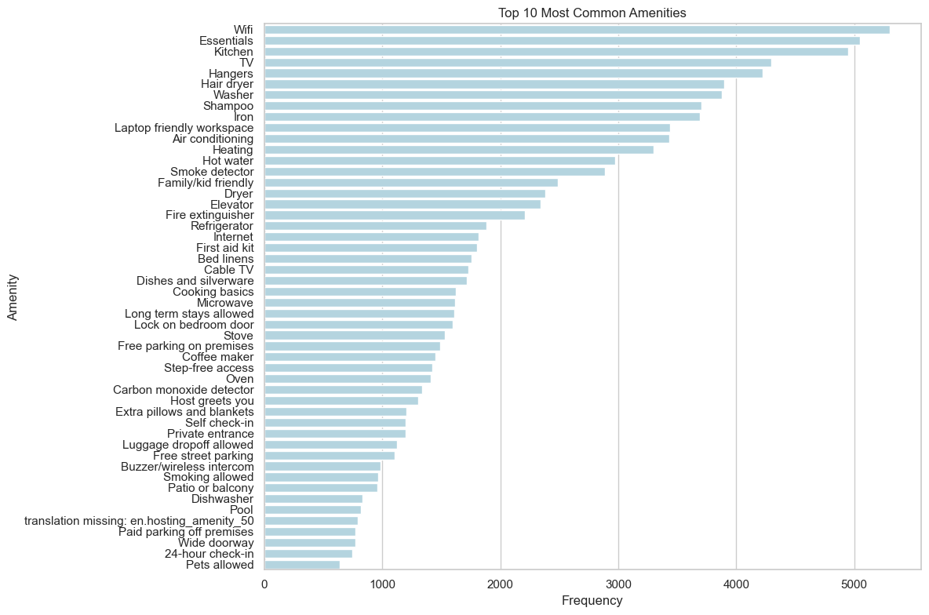
Top Common Amenities

Slide 6
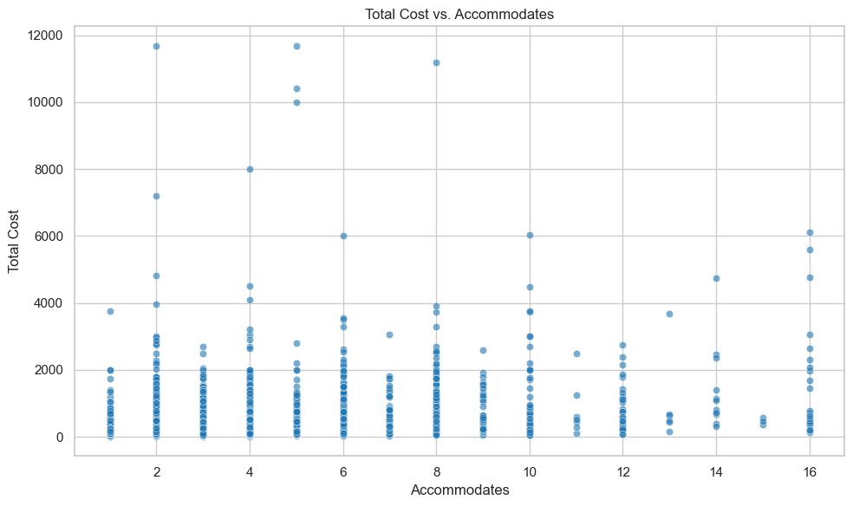
Total Cost Vs. Accommodates

Slide 7
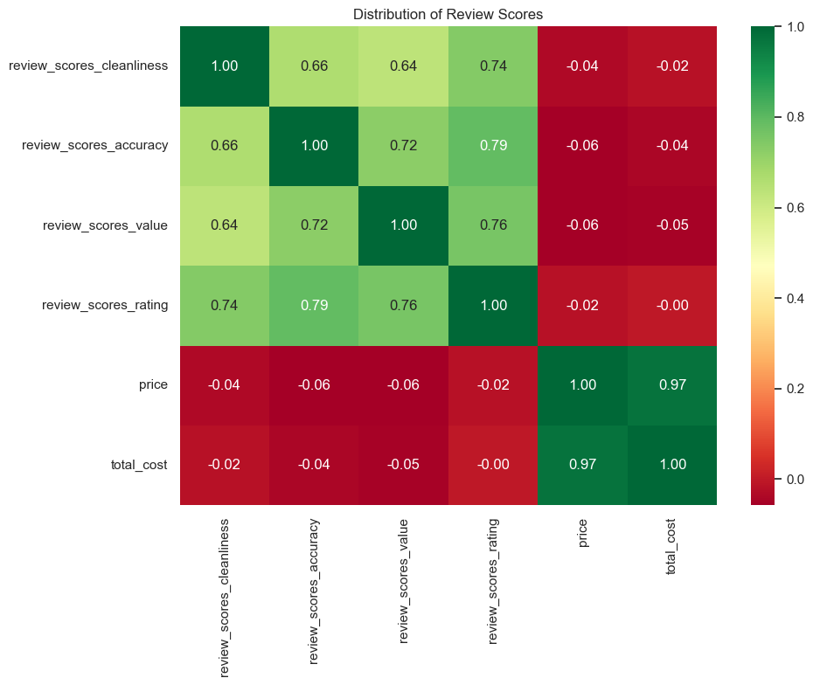
Distribution of Review Scores

Slide 8
Variance Analysis of Numeric Columns
Variance Analysis of Numeric Columns
- Accommodates Variance: 5.28
- Bedrooms Variance: 0.91
- Beds Variance: 2.62
- Number Of Reviews Variance: 2480.19
- Bathrooms Variance: 0.49
- Price Variance: 284673.12
- Security Deposit Variance: 1650179.96
- Cleaning Fee Variance: 10565.33
- Extra People Variance: 4807.63
- Availability Availability 30 Variance: 136.56
- Availability Availability 60 Variance: 551.10
- Availability Availability 90 Variance: 1240.83
- Availability Availability 365 Variance: 19553.88
- Review Scores Accuracy Variance: 0.81
- Review Scores Cleanliness Variance: 1.18
- Review Scores Checkin Variance: 0.62
- Review Scores Communication Variance: 0.65
- Review Scores Location Variance: 0.58
- Review Scores Value Variance: 0.88
- Review Scores Rating Variance: 81.42
- Host Listings Count Variance: 4336.82
- Host Total Listings Count Variance: 4336.82
- Host Response Rate Variance: 0.19
- Verification Count Variance: 4.74
- Total Cost Variance: 339515.46

Slide 9
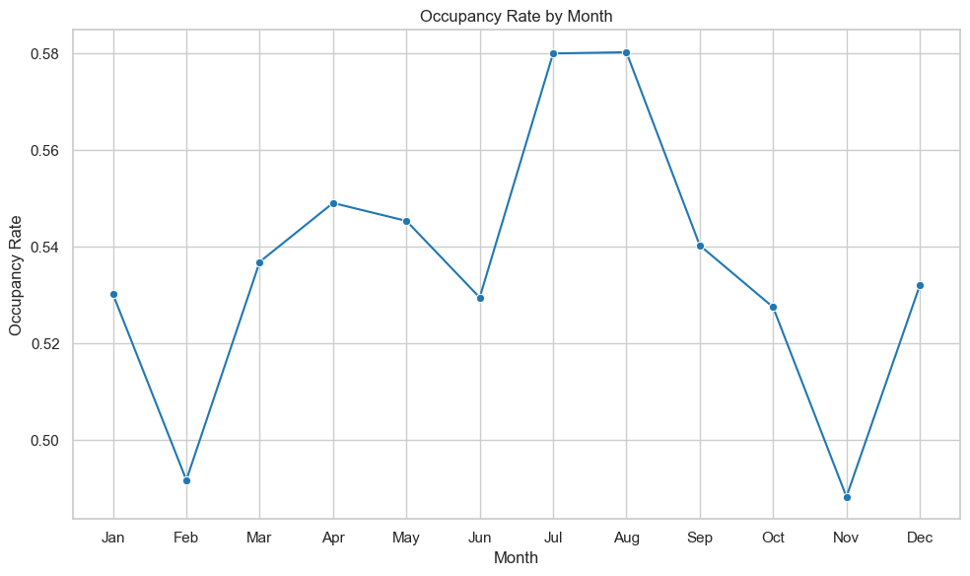
Occupancy Rate by Month (First and Last Reviews

Slide 10
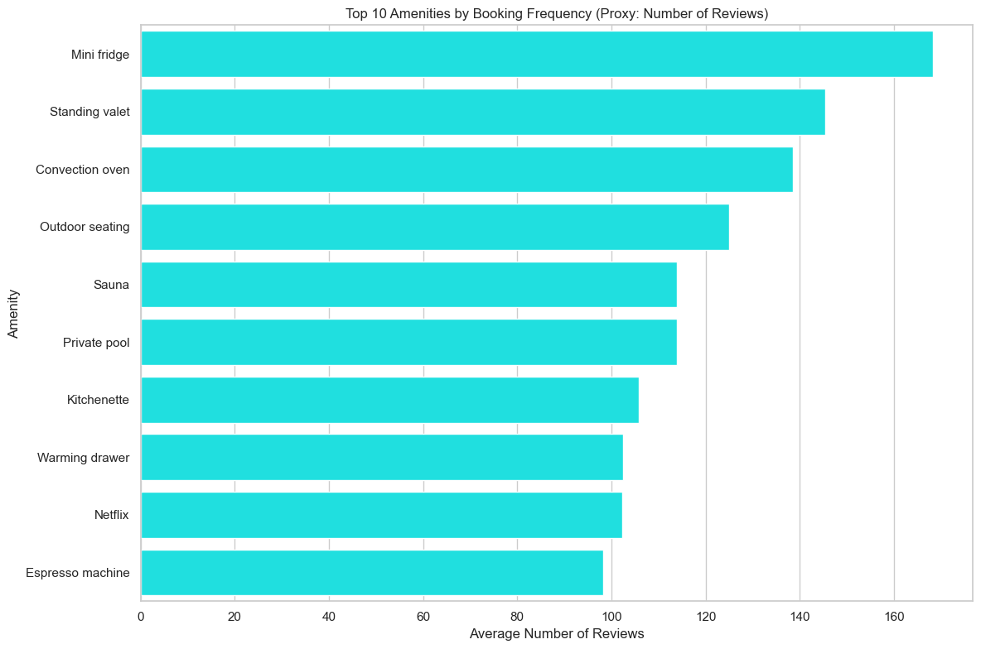
Top ten Amenities by Booking Frequency

Slide 11
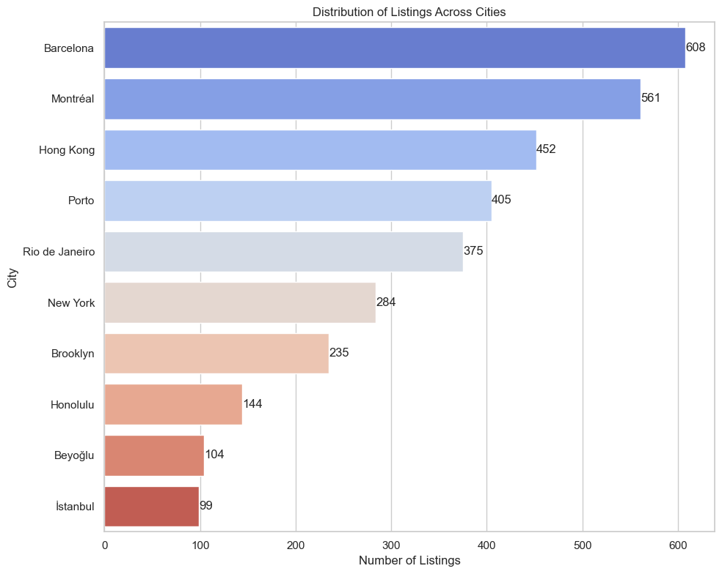
Distribution of Listings Across Cities

Slide 12
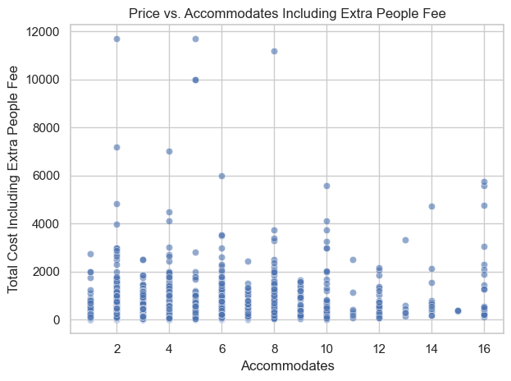
Price vs. Accommodates Including Extra People Fee

Slide 13
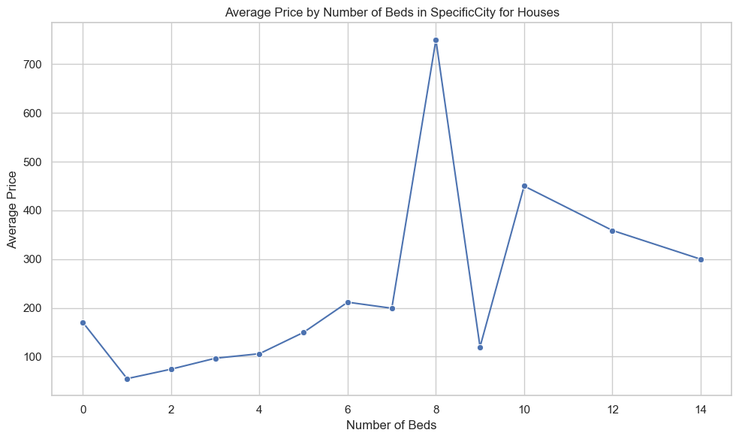
Average Price by Number of Beds in Houses

Slide 14
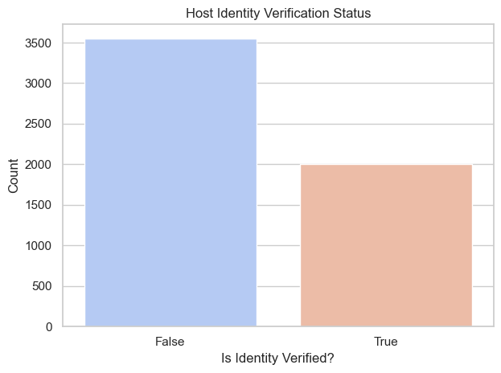
Host Identity Verification Report

Slide 15
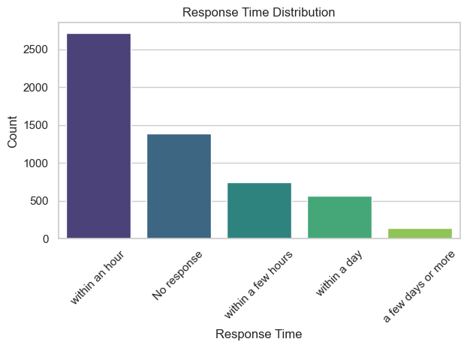
Response Time From Host

Slide 16
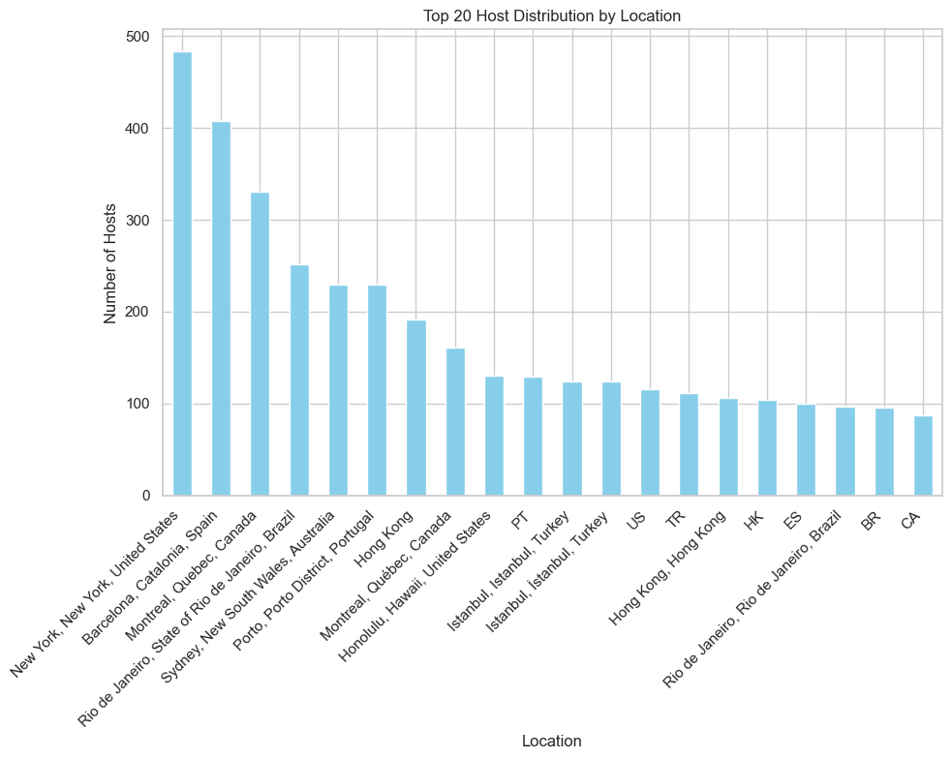
Host Distribution By Location

Slide 17
Review Scores and Beds Analysis
Review Scores Analysis
Review Scores Breakdown:
- Review Scores Accuracy:
More than 8.0: 3770
Less than 5.0: 30
- Review Scores Cleanliness:
More than 8.0: 3490
Less than 5.0: 38
- Review Scores Checkin:
More than 8.0: 3876
Less than 5.0: 16
- Review Scores Communication:
More than 8.0: 3870
Less than 5.0: 20
- Review Scores Location:
More than 8.0: 3811
Less than 5.0: 11
- Review Scores Value:
More than 8.0: 3603
Less than 5.0: 24
Beds Score Analysis:
- Beds:
More than 7.0: 72
Less than 9.0: 5510

Slide 18
Data Observations
Numeric data has different formats like dictionary.
Several data elements like datetime need to be transformed.
There are several numeric fields have null or NaN values in it.
Flattening is required in some cases.

Slide 19
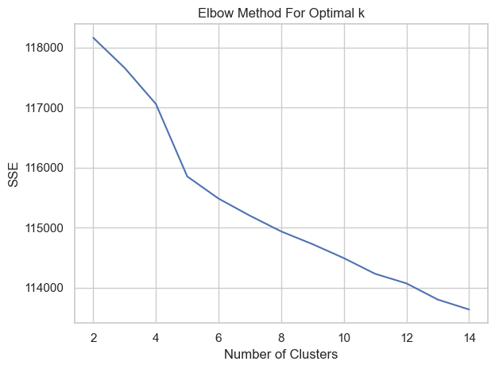
Elbow Method For Optimal k

Slide 20
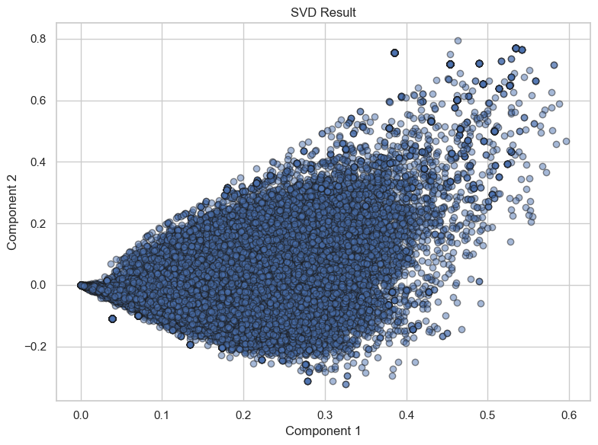
SVD Result

Slide 21
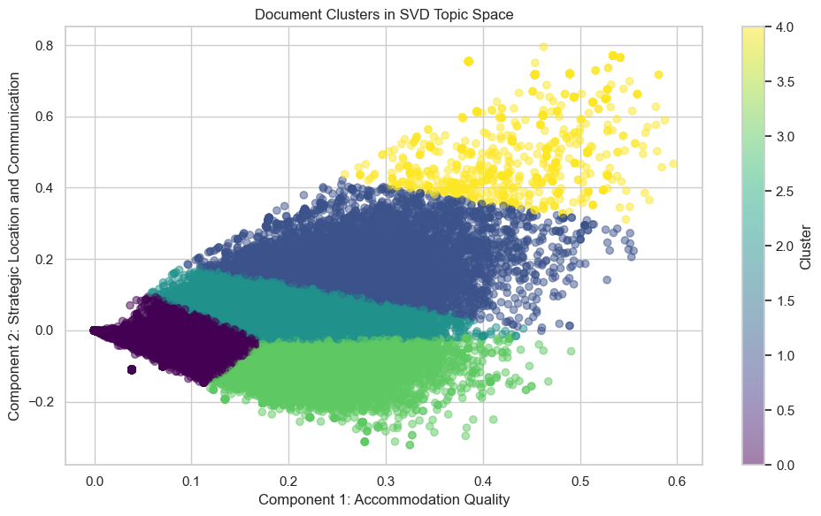
Clusters in SVD Topic Space

Slide 22
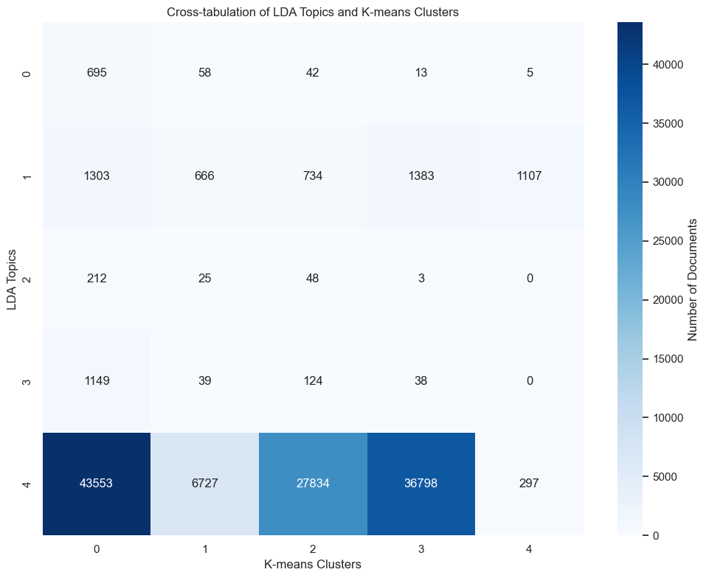
K-Means Clusters

Slide 23
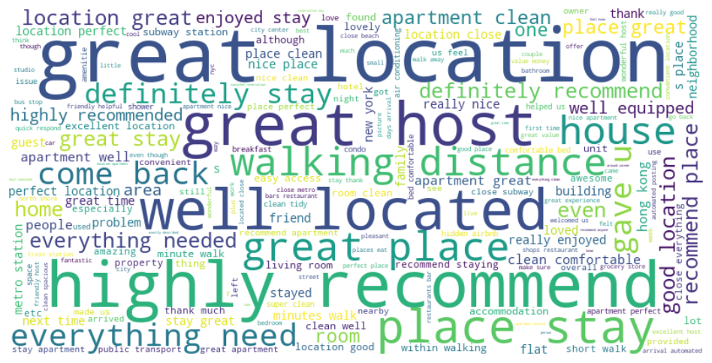
Word Cloud

Slide 24
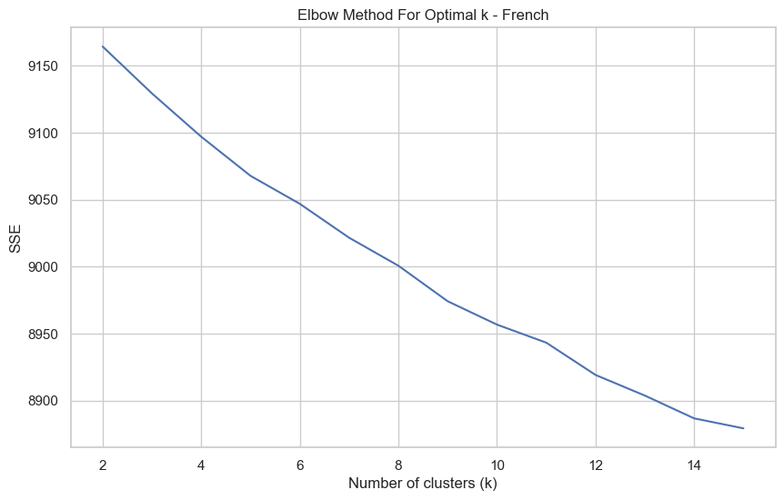
Elbow Method For Optimal k - French

Slide 25
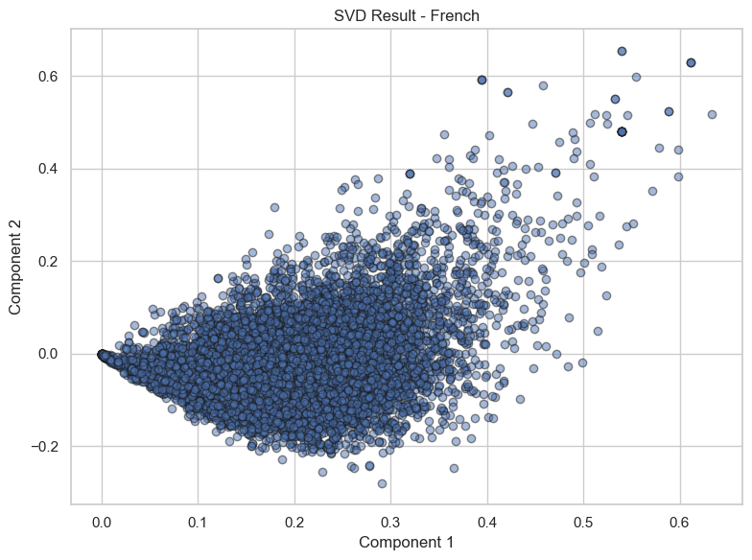
SVD Result

Slide 26
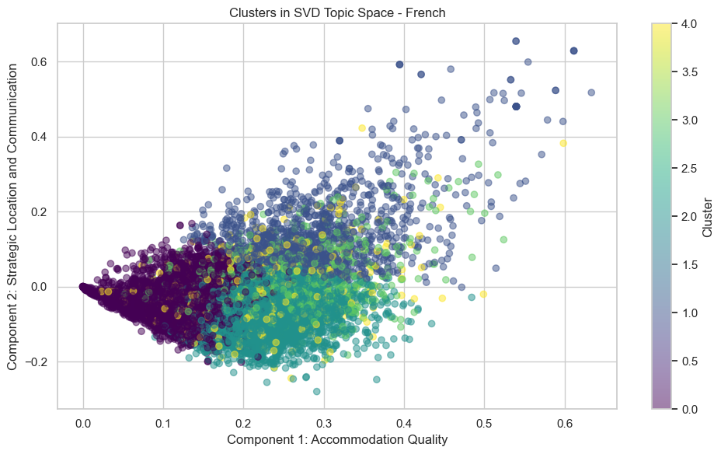
Clusters in SVD Topic Space - French

Slide 27
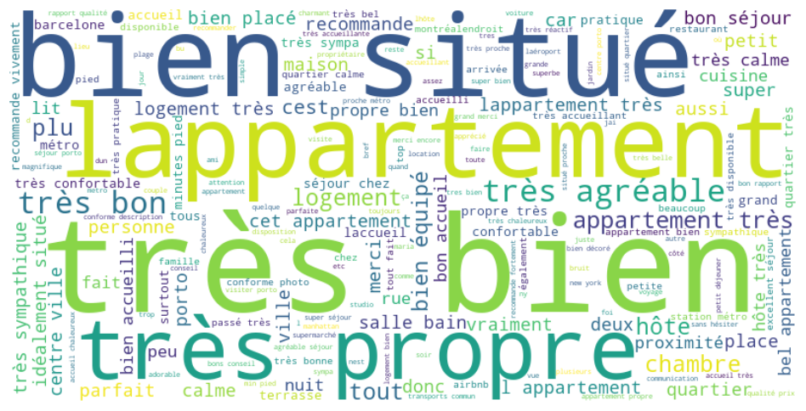
Word Cloud

Slide 28
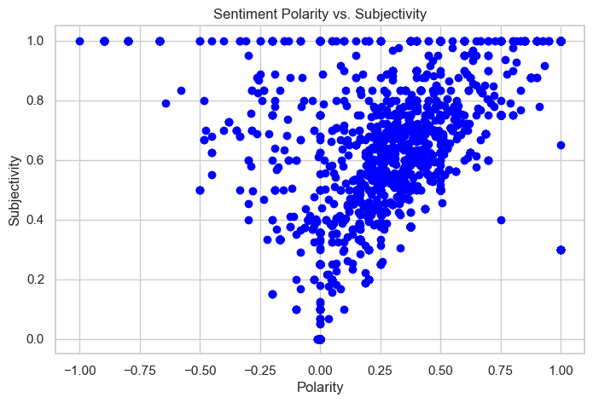
Sentiment Polarity vs. Subjectivity

Slide 29
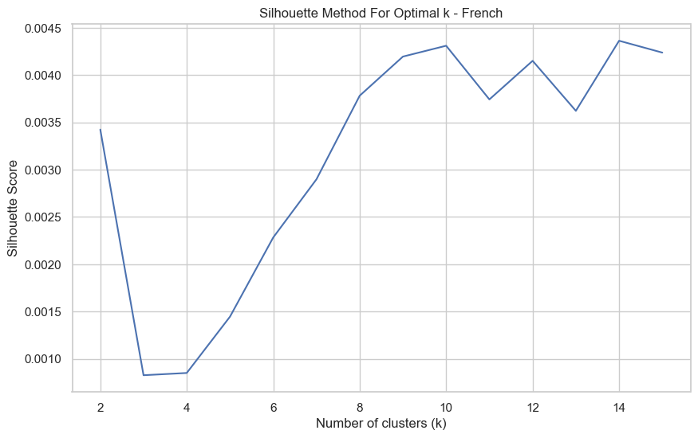
Silhouette Method For Optimal k - French

Slide 30
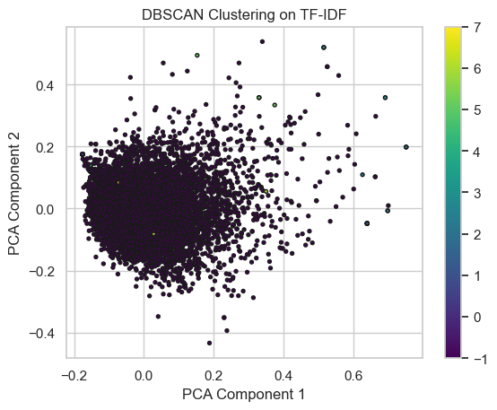
DBScan Cluster - French

Slide 31
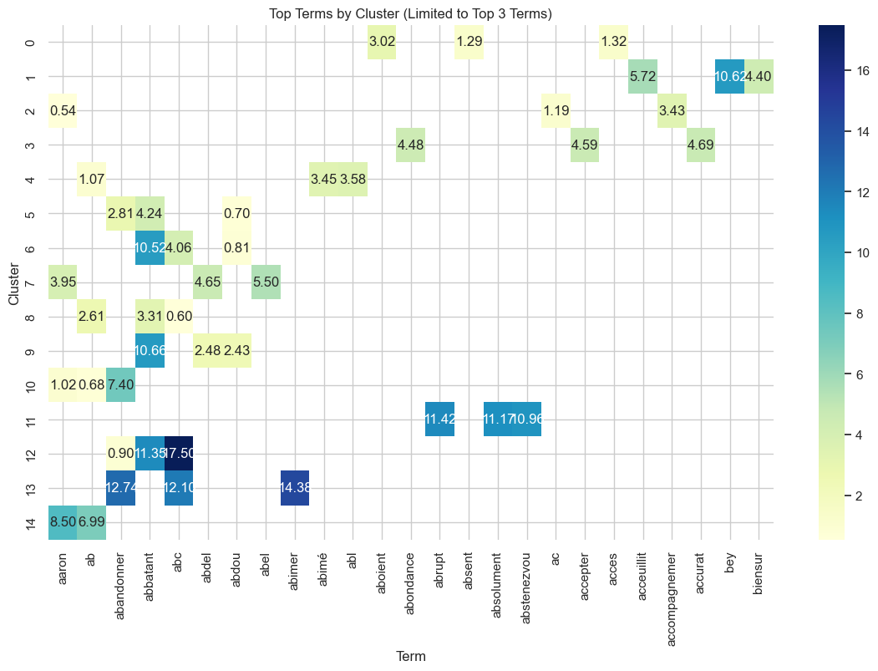
Top Terms By Cluster - French

Slide 32
Overview of Business and Host Suggestions
This presentation provides business and host suggestions based on Airbnb data analysis.
The suggestions aim to enhance customer satisfaction, optimize pricing, and improve overall listing performance.

Slide 33
Airbnb Suggestions (1/2)
Promote High Availability Listings:
Emphasize listings with high availability (365 days) in marketing campaigns, especially during off-peak seasons, to attract long-term bookings.
Pricing Strategy:
Develop dynamic pricing algorithms that consider factors like the number of beds, property type, location, and amenities to optimize revenue. Highlight properties with unique offerings like houseboats and heritage hotels in premium segments.
Cluster Analysis for Market Insights:
Utilize clustering analysis to understand distinct customer segments and tailor marketing efforts accordingly. For example, targeting customers interested in properties with high accommodation quality or strategic location and communication.
Enhance Review Features:
Improve the review system by emphasizing consistent positive aspects like cleanliness, accuracy, and value. Provide tools for hosts to manage and enhance these features.

Slide 34
Airbnb Suggestions (2/2)
Seasonal Promotions:
Launch targeted promotions during low occupancy periods (February and November) to boost bookings. Offer discounts or special packages to attract guests during these months.
Host Responsiveness:
Encourage hosts to respond within an hour by offering incentives or recognition for quick responses. This can improve customer satisfaction and increase booking rates.
Insights from Sentiment Analysis:
Use sentiment analysis to identify areas for improvement and common concerns among guests. Share these insights with hosts to help them enhance the guest experience.
Enhance Listing Descriptions:
Provide guidelines for hosts to highlight frequently mentioned positive terms like 'clean', 'well-located', and 'comfortable' in their listings. This can improve the attractiveness of the listings.

Slide 35
Host Suggestions (1/2)
Maximize Availability:
Aim to increase the availability of properties throughout the year to attract more bookings. Consider flexible booking policies to accommodate long-term stays.
Optimize Pricing:
Use data-driven insights to set competitive prices, especially for properties with unique features or high demand during certain seasons. Regularly review and adjust prices based on market trends.
Highlight Unique Features:
Emphasize unique aspects of the property, such as a heritage hotel or a houseboat, in the listing to attract higher-paying guests. Showcase amenities that differentiate the property from others.
Focus on Cleanliness and Accuracy:
Ensure the property is clean and accurately described in the listing. Positive reviews in these areas can lead to higher overall ratings and more bookings.

Slide 36
Host Suggestions (2/2)
Provide Essential Amenities:
Equip the property with essential amenities like WiFi, kitchen essentials, and TV, as these are highly valued by guests. Consider adding amenities that drive higher booking frequencies, such as a mini fridge or outdoor seating.
Improve Responsiveness:
Aim to respond to inquiries within an hour to enhance guest satisfaction and increase the likelihood of bookings. Utilize Airbnb’s tools to manage and automate responses where possible.
Seasonal Adjustments:
Prepare for seasonal fluctuations by offering special rates or packages during low occupancy months. Highlight seasonal attractions or activities near the property to attract guests.
Leverage Guest Feedback:
Actively seek and respond to guest feedback to continuously improve the property and guest experience. Address common concerns identified through sentiment analysis to enhance reviews.

