Slide 1
Exploring Airbnb Dataset
Exploratory Data Analysis with Python

Slide 2
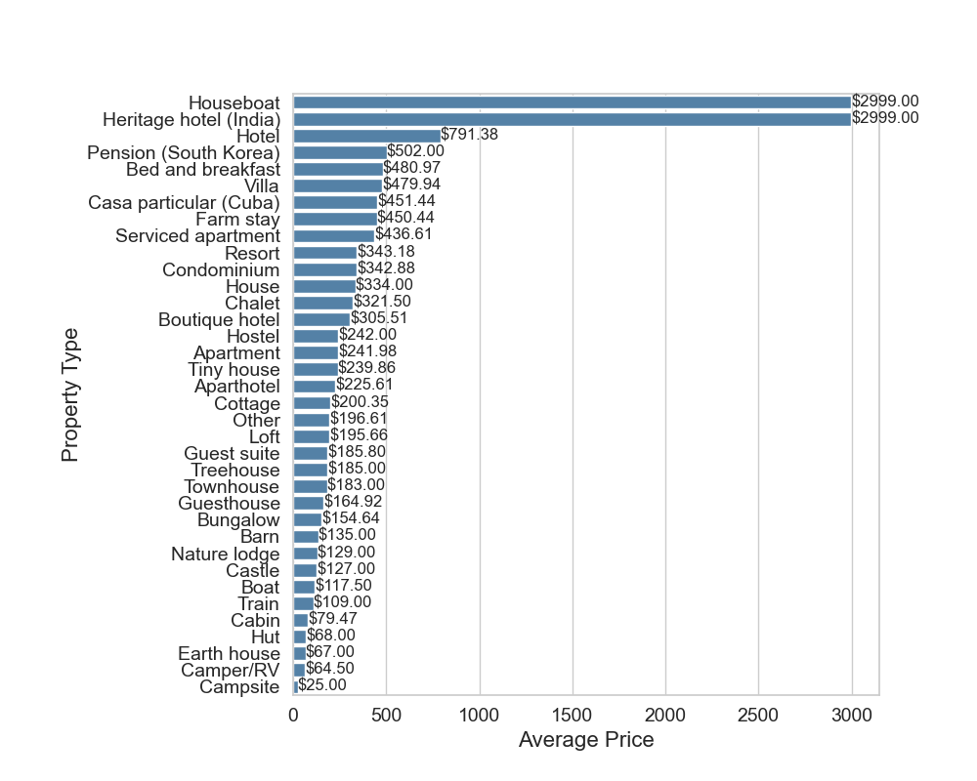
Average Price by Property Type

Slide 3
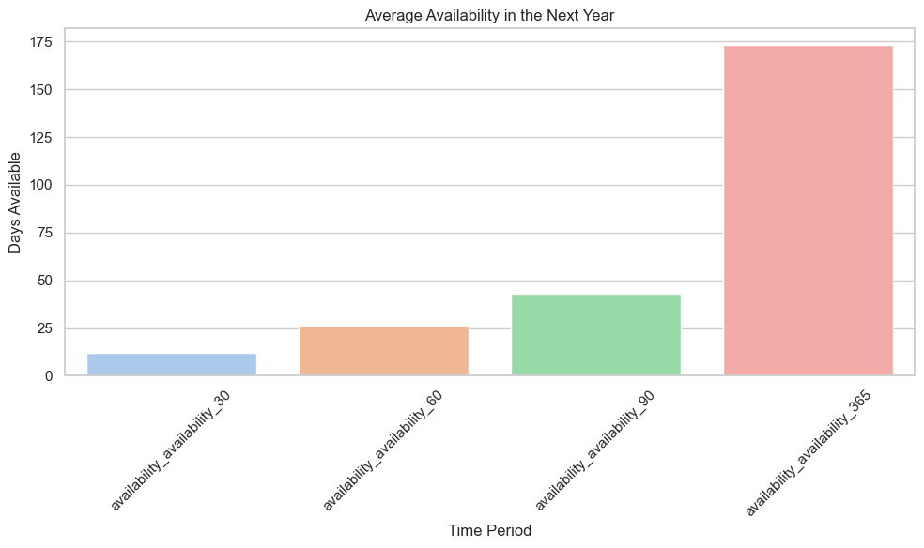
Average Price by Property Type

Slide 4
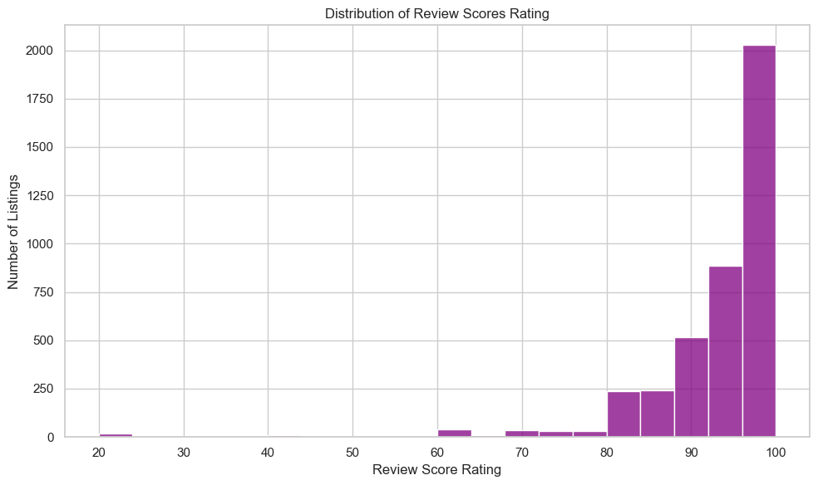
Distribution of Review Scores Rating

Slide 5
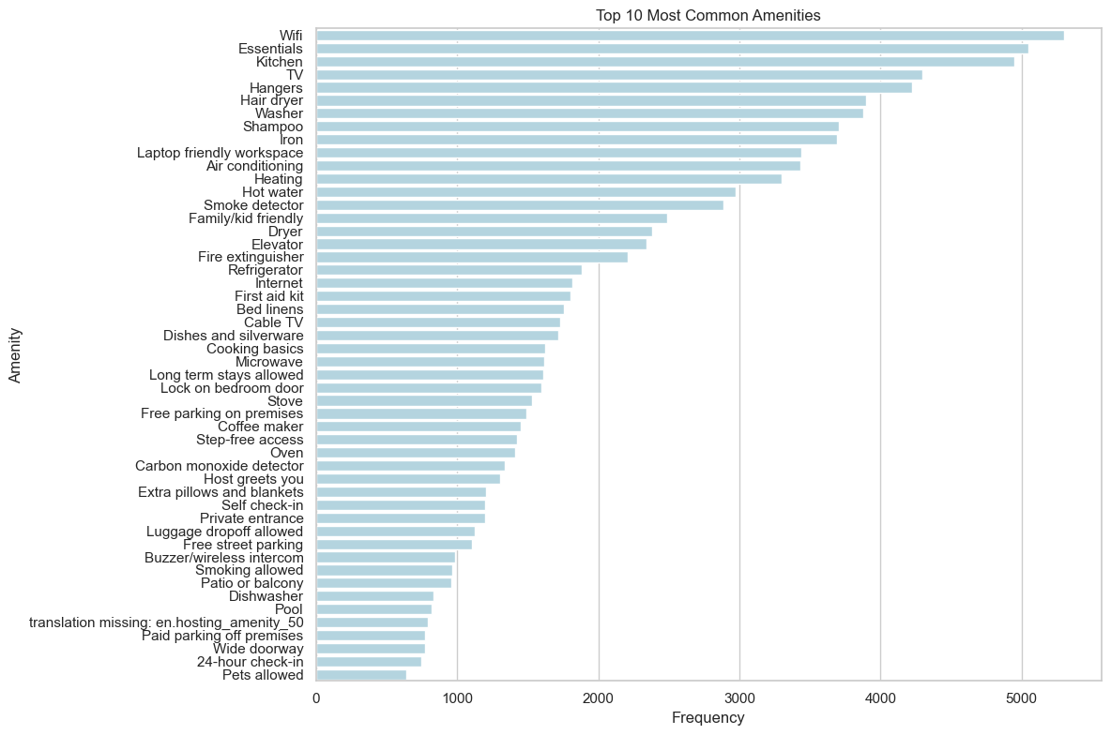
Top Common Amenities

Slide 6
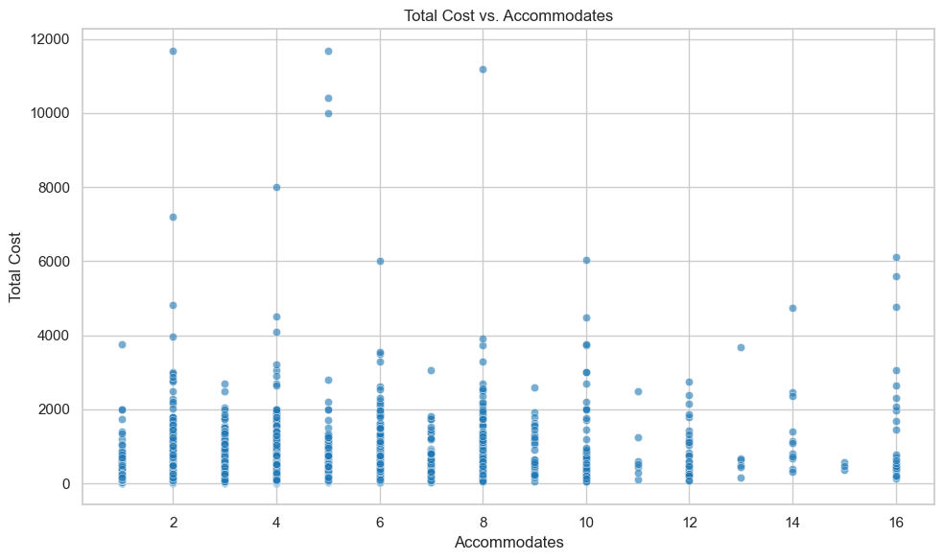
Total Cost Vs. Accommodates

Slide 7
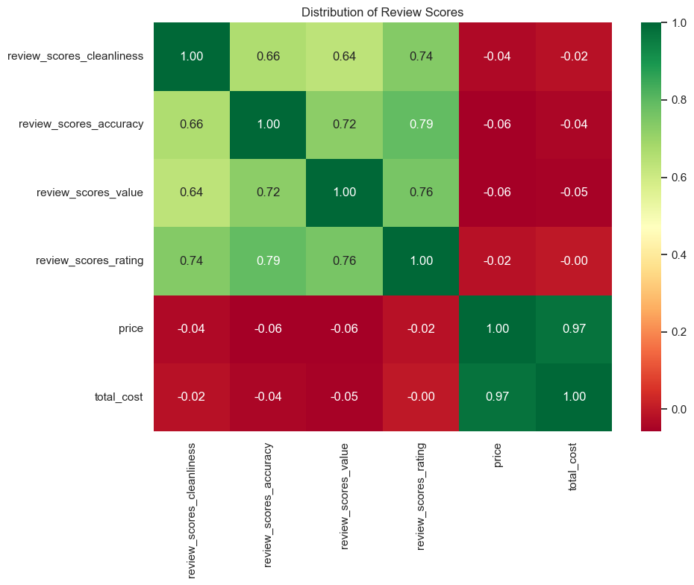
Distribution of Review Scores

Slide 8
Variance Analysis of Numeric Columns
Variance Analysis of Numeric Columns
- Accommodates Variance: 5.28
- Bedrooms Variance: 0.91
- Beds Variance: 2.62
- Number Of Reviews Variance: 2480.19
- Bathrooms Variance: 0.49
- Price Variance: 284673.12
- Security Deposit Variance: 1650179.96
- Cleaning Fee Variance: 10565.33
- Extra People Variance: 4807.63
- Availability Availability 30 Variance: 136.56
- Availability Availability 60 Variance: 551.10
- Availability Availability 90 Variance: 1240.83
- Availability Availability 365 Variance: 19553.88
- Review Scores Accuracy Variance: 0.81
- Review Scores Cleanliness Variance: 1.18
- Review Scores Checkin Variance: 0.62
- Review Scores Communication Variance: 0.65
- Review Scores Location Variance: 0.58
- Review Scores Value Variance: 0.88
- Review Scores Rating Variance: 81.42
- Host Listings Count Variance: 4336.82
- Host Total Listings Count Variance: 4336.82
- Host Response Rate Variance: 0.19
- Verification Count Variance: 4.74
- Total Cost Variance: 339515.46

Slide 9
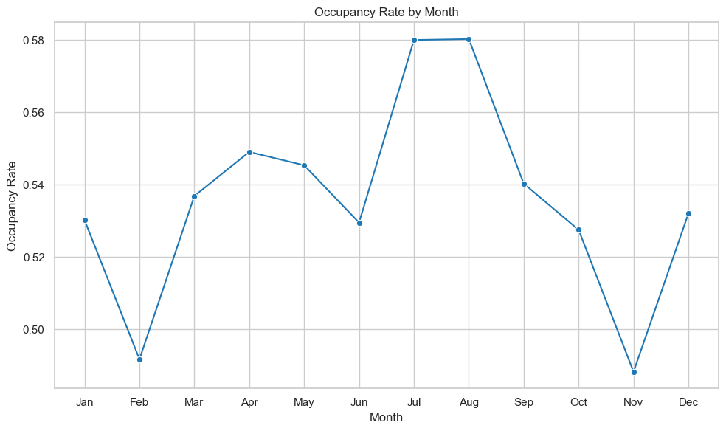
Occupancy Rate by Month (First and Last Reviews

Slide 10
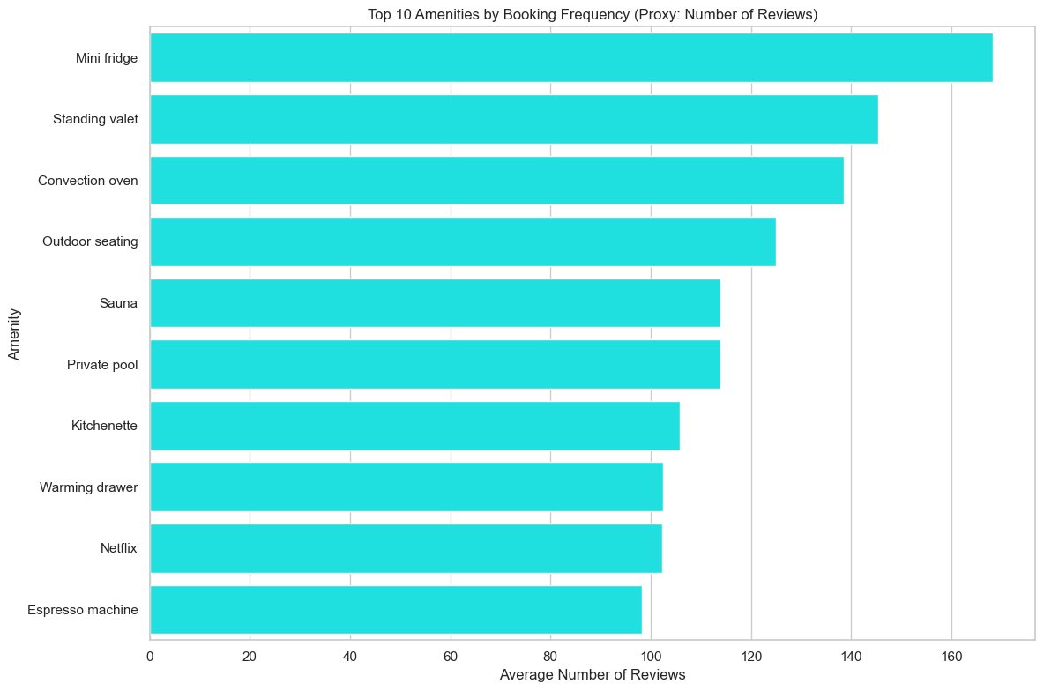
Top ten Amenities by Booking Frequency

Slide 11
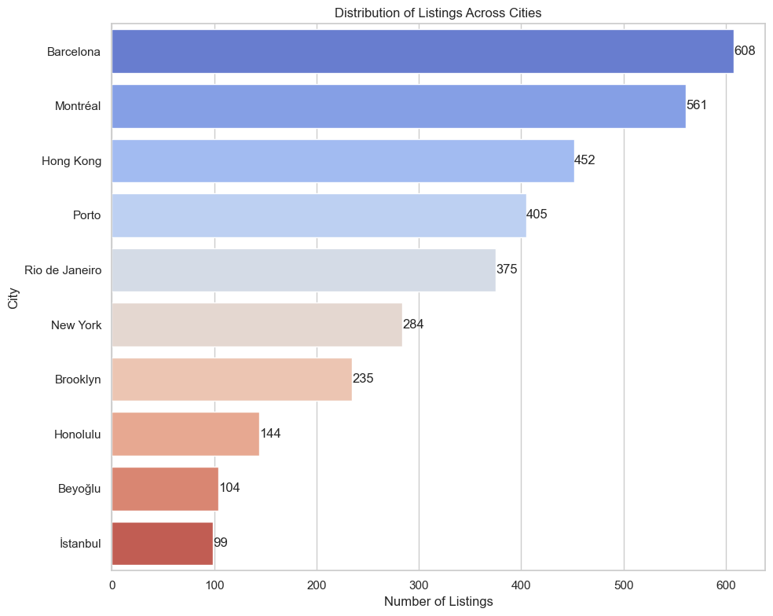
Distribution of Listings Across Cities

Slide 12
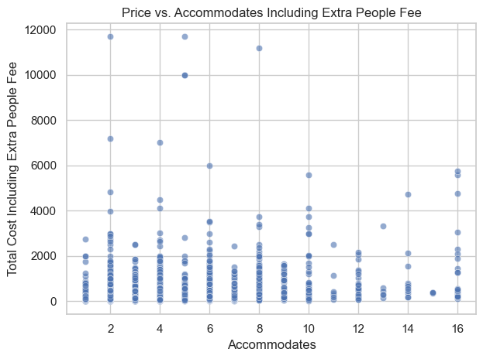
Price vs. Accommodates Including Extra People Fee

Slide 13
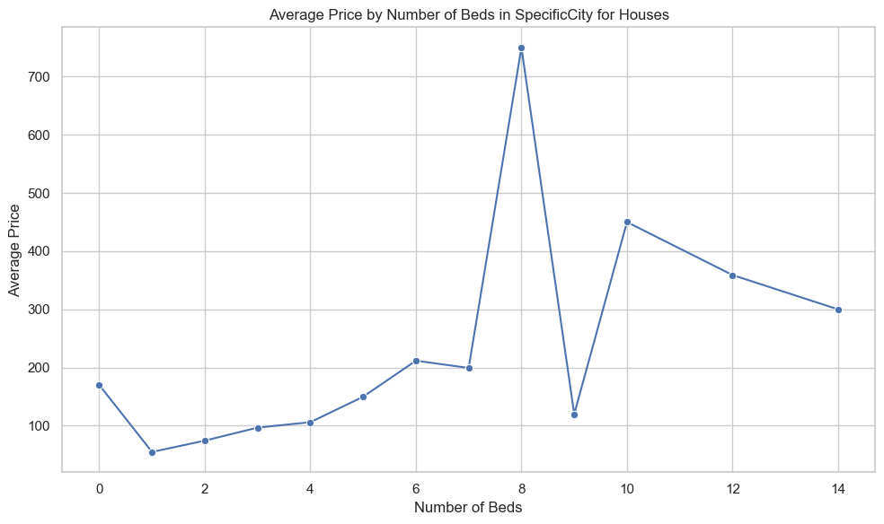
Average Price by Number of Beds in Houses

Slide 14
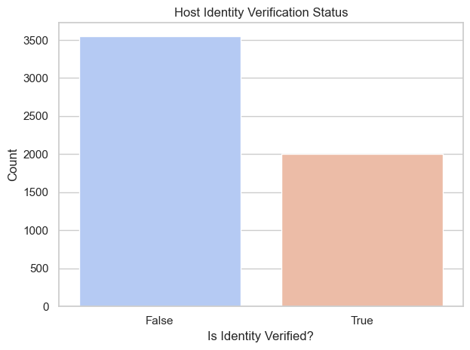
Host Identity Verification Report

Slide 15
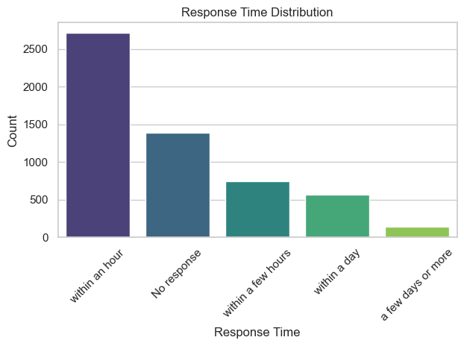
Response Time From Host

Slide 16
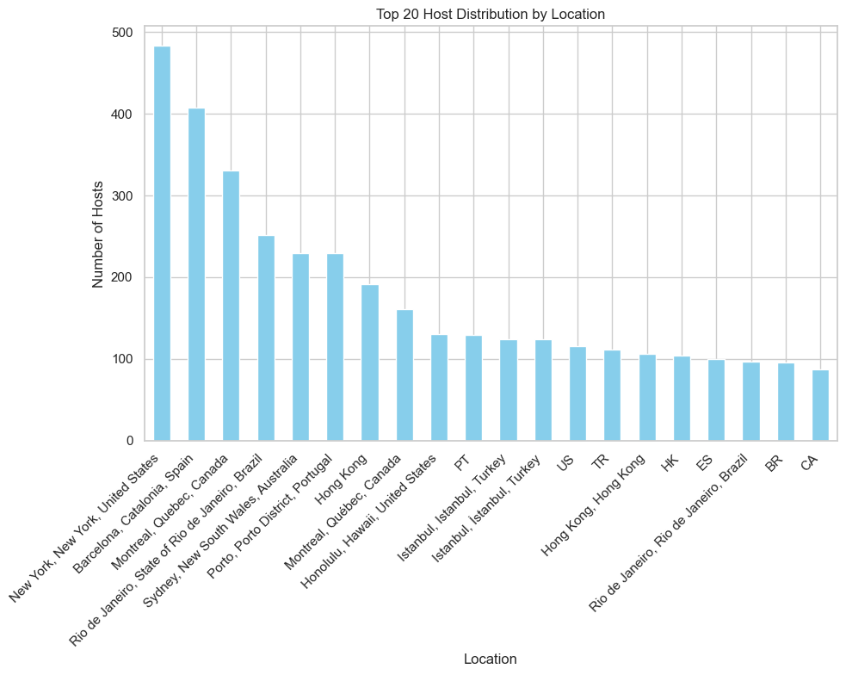
Host Distribution By Location

Slide 17
Review Scores and Beds Analysis
Review Scores Analysis
Review Scores Breakdown:
- Review Scores Accuracy:
More than 8.0: 3770
Less than 5.0: 30
- Review Scores Cleanliness:
More than 8.0: 3490
Less than 5.0: 38
- Review Scores Checkin:
More than 8.0: 3876
Less than 5.0: 16
- Review Scores Communication:
More than 8.0: 3870
Less than 5.0: 20
- Review Scores Location:
More than 8.0: 3811
Less than 5.0: 11
- Review Scores Value:
More than 8.0: 3603
Less than 5.0: 24
Beds Score Analysis:
- Beds:
More than 7.0: 72
Less than 9.0: 5510

Slide 18
DATA
New Title
Numeric data has different formats like dictionary.
Several data elements like datetime need to be transformed.
There are several numeric fields have null or NaN values in it.
Flattening is required in some cases.

Slide 19
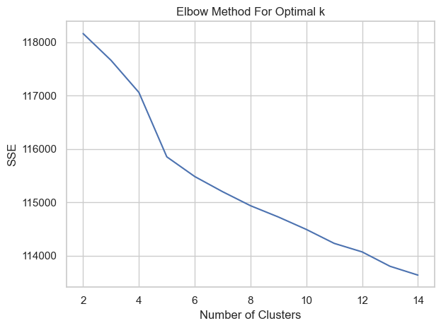
Elbow Method For Optimal k

Slide 20
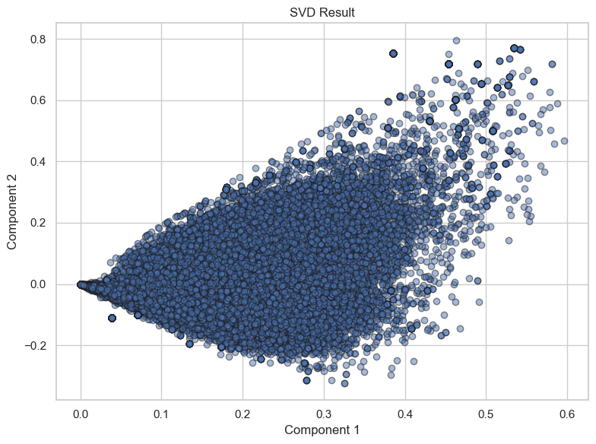
SVD Result

Slide 21
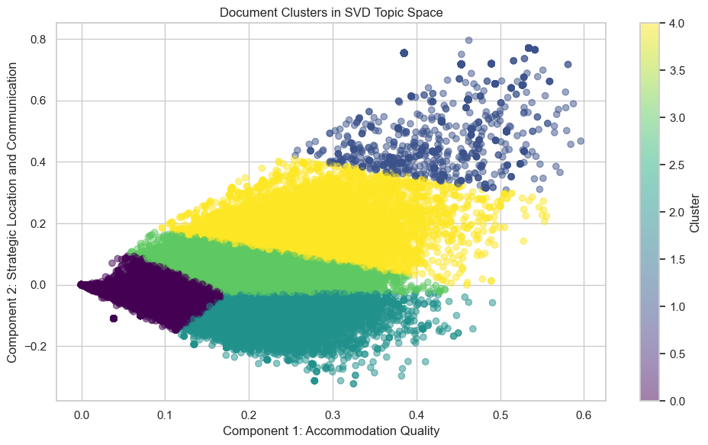
Clusters in SVD Topic Space

Slide 22
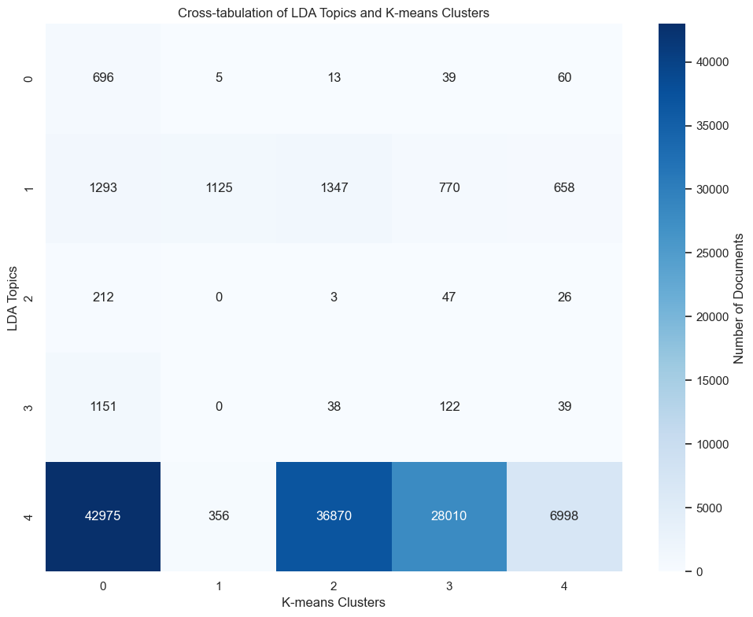
K-Means Clusters

Slide 23
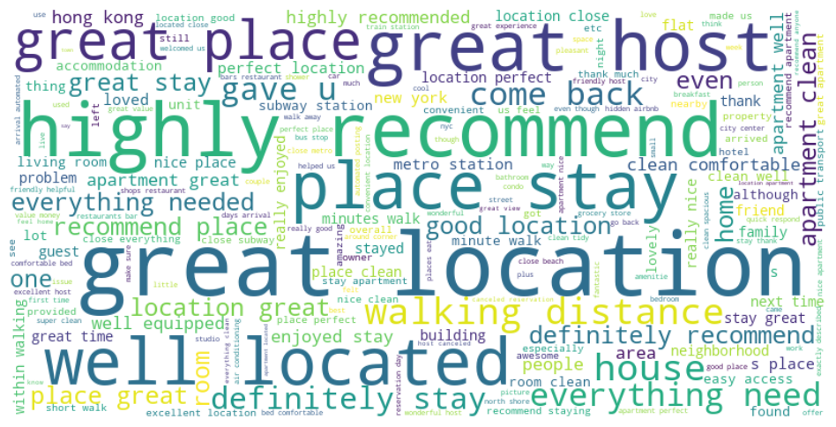
Word Cloud

Slide 24
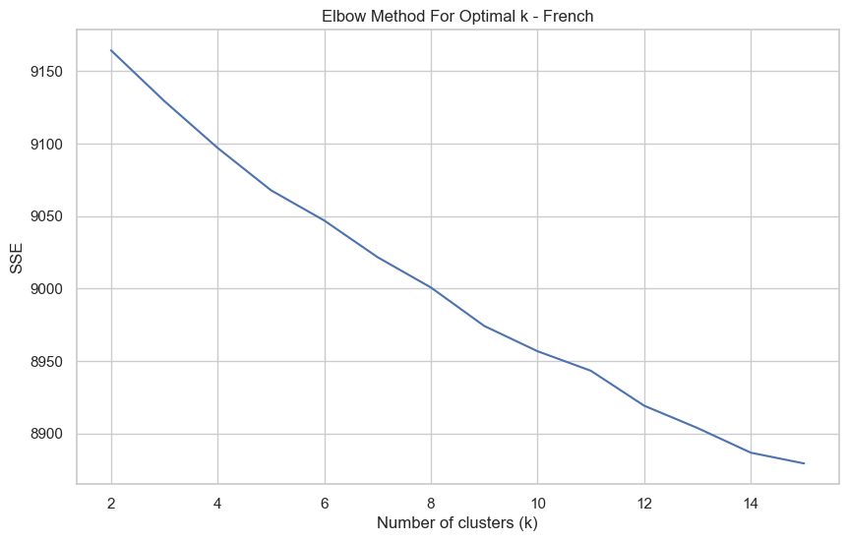
Elbow Method For Optimal k - French

Slide 25
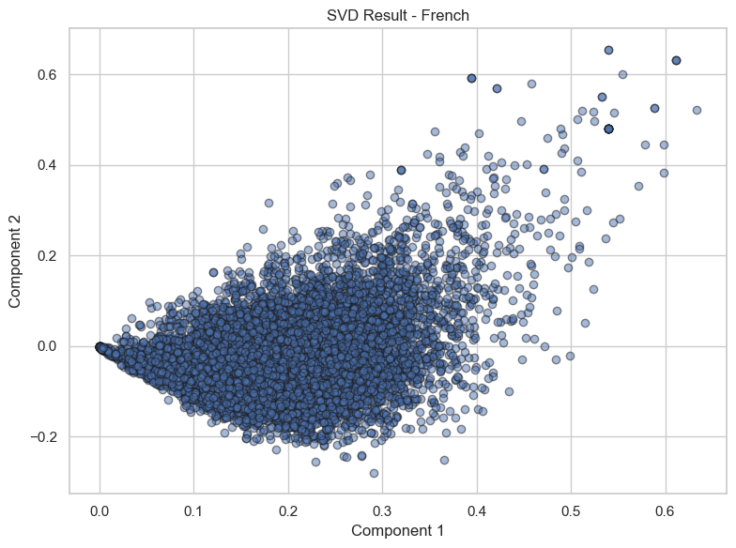
SVD Result

Slide 26
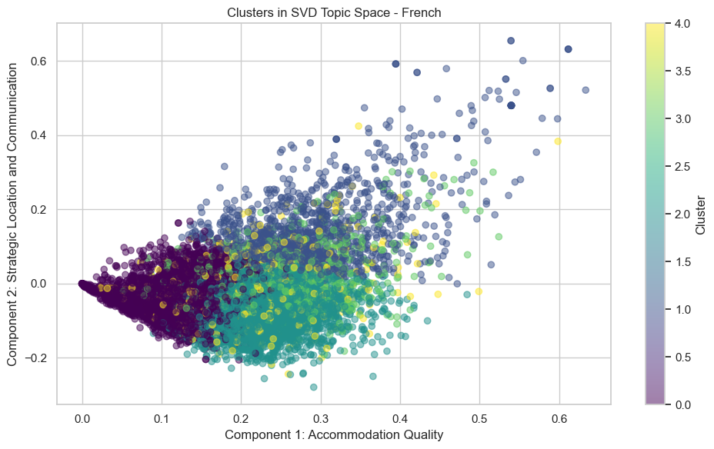
Clusters in SVD Topic Space - French

Slide 27
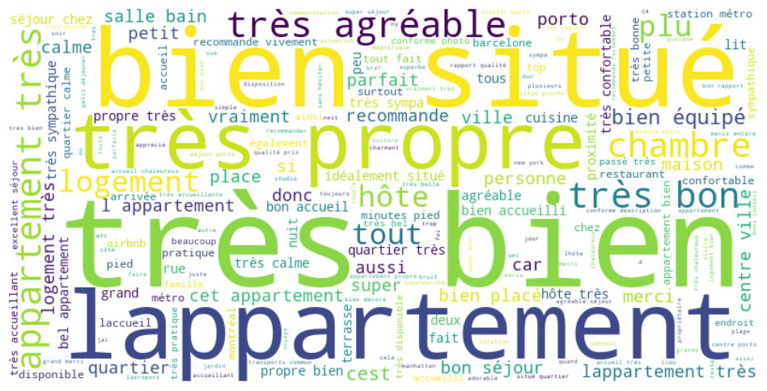
Word Cloud

