Slide 1
Semantic web: SPARQL
Sasyan Valentin

Slide 2
Why the semantic web?
The information is not understandable by computers
We need to structure the information
Example:
Winston Churchill died in the city of London
Winston Churchill is a human;
London is a city
London is the “city of death” of Churchill

Slide 3
The standardization of the semantic web
World Wild Web Consortium (W3C)
Resource Description Framework (RDF)
Graph RDF = a set of triplet
Triplet = subject, predicate, object

Slide 4
In our example
“Winston Churchill died in the city of London” :
“Winston Churchill” is the subject;
“city of death” is the predicate;
“London” is the object.

Slide 5
SPARQL
Created by the W3C
Version 1.1 (March 2013)
Adapted to RDF data
SELECT
CONSTRUCT

Slide 6
Example of request
Select all the first episodes of the first season of all series on dppedia.org :
SELECT *
WHERE {
?e <http://dbpedia.org/ontology/releaseDate> ?date .
?e <http://dbpedia.org/ontology/episodeNumber> 1 .
?e <http://dbpedia.org/ontology/seasonNumber> 1
}
ORDER BY DESC(?date)

Slide 7
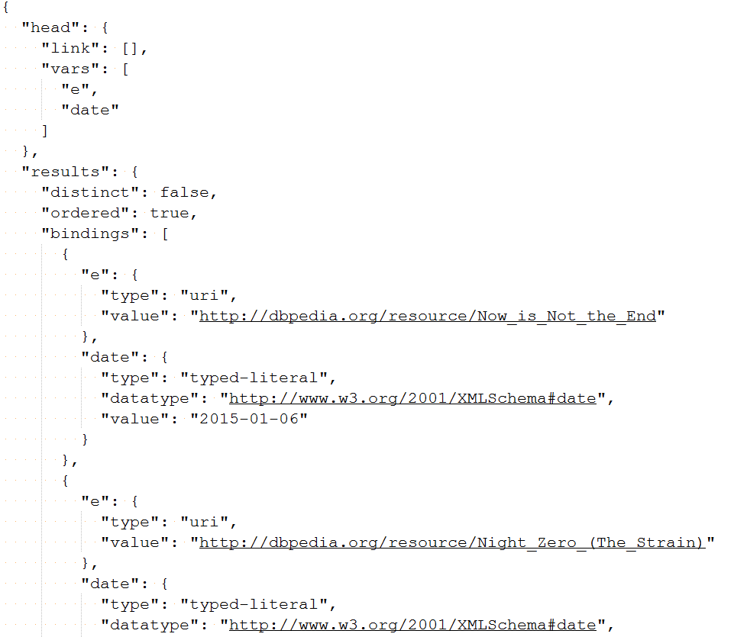
The result (JSON)

Slide 8
Conclusion
Evolution of SQL?
Computers can manage the information
Server can communicate information

