Slide 1
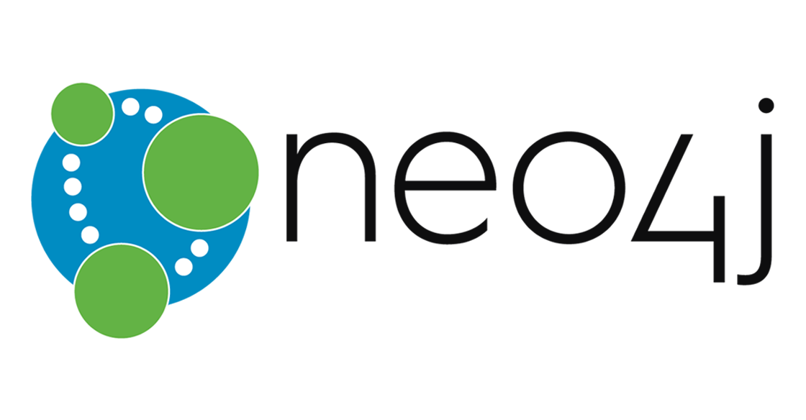
Neo4j and Cypher
Presentation in Linked Open Data and Knowledge Graphs WS2223
06.01.2023
Page <number>

Slide 2
Agenda
Bacterial small non-encoding RNA
Dataset
Creating of Knowledge Graph
Queries
06.01.2023
<number>

Slide 3
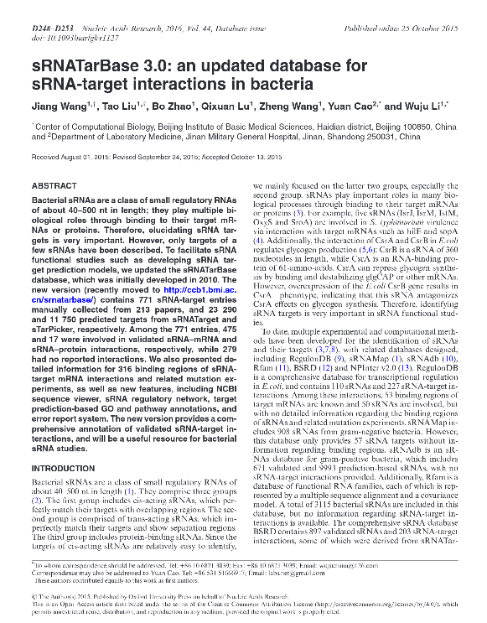
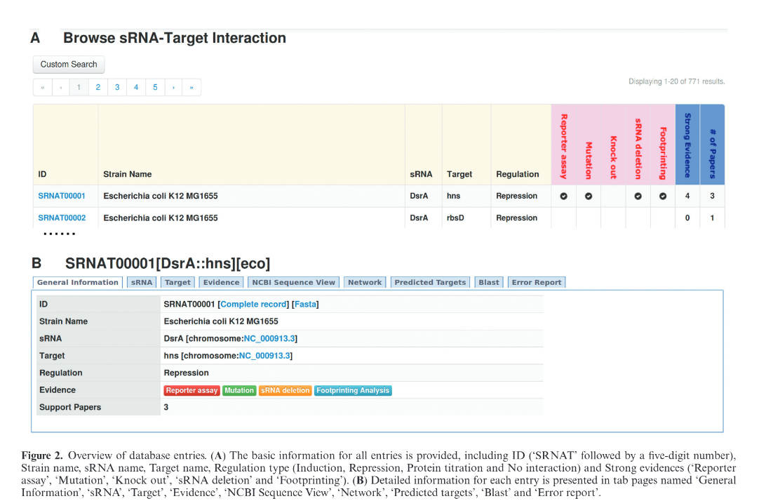
Data Source sRNATarBase 3.0 – Wang et al. - Published 2015
http://ccb1.bmi.ac.cn:81/srnatarbase/index.php?r=site/index
06.01.2023
<number>
Notes:
SPARQL (pronounced “sparkle”) is an RDF query language for the Semantic Web and first appeared in 2008.
SPARQL is developed by the World Wide Web Consortium (W3C) and along with RDF and OWL, it is one of the three core technologies of the Semantic Web.
The syntax here is relatively easy to learn, similar to SQL, and is reminiscent of English sentence structure. Like this example: "Return me all items that contain house cats.“
SPARQL is used to represent information from data stored as RDF format. The results from the queries can then in turn be visualized in different ways. For example, as in the Wikidata Query Service as a table, timeline or map.

Slide 4

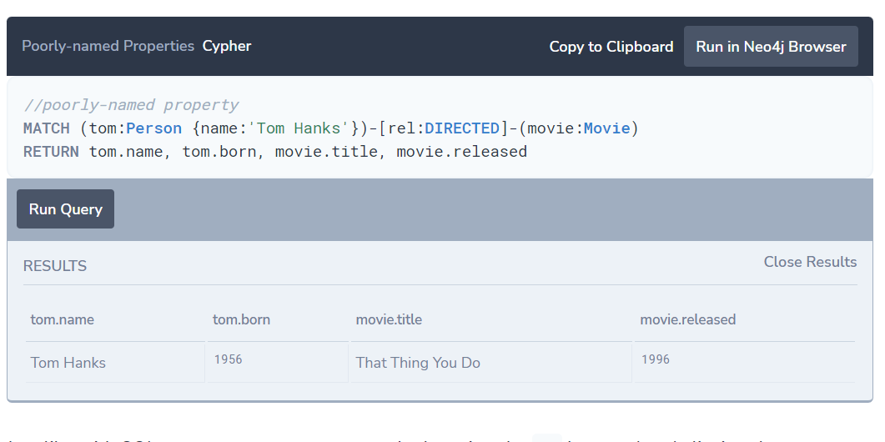
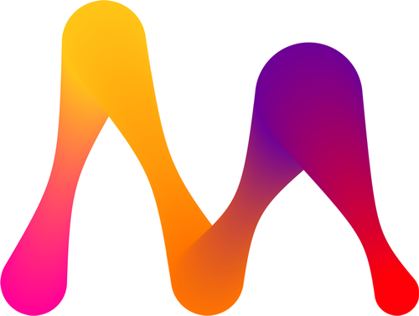


Cypher
graph query language of “Neo4j”
create – read – update – delete
easy to learn due to expressive syntax
describing visual patterns in graphs
Open-Source Project
Cypher Query Example from https://neo4j.com/developer/cypher/querying/
SPARQL
Cypher Query Structure
SPARQL Query Structure
Cypher
Conclusion
06.01.2023
<number>
Notes:
Cypher Query Language is Neo4j’s graph query language, invented by Andrés Taylor and first appeared in 2015.
It’s used to perform various operations like create, read, update, and delete on the graph databases.
Operations and Styles are inspired by SQL, the widely used structured query language, that first appeared in the 70s and is still built into pretty much every technology we know of.
Cypher is also easy to learn due to the expressive syntax and because neo4j provides good documentation on how to use Cypher.
Unlike SQL, Cypher is there for describing visual patterns in graphs.
Cypher is not limited to the Neo4j database but is an open-source project and is used in other graph database projects from e.g. Amazon, ArcadeDB, Cambridge Semantics and so on…

Slide 5
Cypher Query Structure
(node) – [:RELATIONSHIP] -> (node)
(node {key: value})–[:RELATIONSHIP*..2] -> (node)
SPARQL
Cypher Query Structure
SPARQL Query Structure
Cypher
Conclusion
06.01.2023
<number>
Notes:
Let's take a closer look at the structure of a Cypher query. Cypher is a declarative language in that we can specify in a query what data we want, not how we want it.
Behind this is also the concept of graph pattern matching. That means we define the nodes inside the round brackets and Cypher then finds them inside the graph and we can specify in the square brackets how the nodes are related to each other.
This would be a very simple query, but you can also make more complex queries, so you can also query key-value properties or variable length paths or even query more relationships.

Slide 6
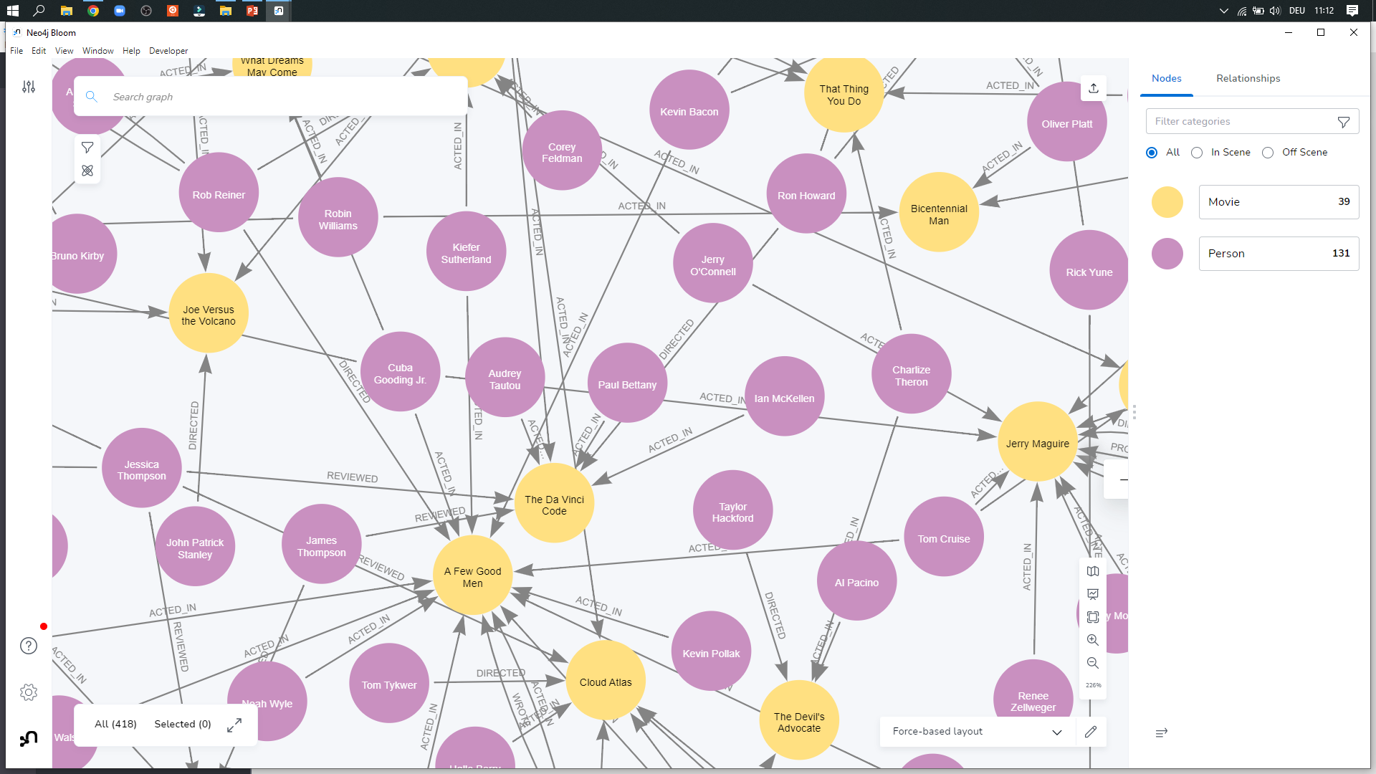
Cypher Query Example
https://neo4j.com/docs/browser-manual/current/deployment-modes/neo4j-desktop/
SPARQL
Cypher Query Structure
SPARQL Query Structure
Cypher
Conclusion
06.01.2023
<number>
Notes:
Now let's look at a real example. For our example, we have used a database from a Neo4j example, which mainly contains movies and their actors.
To run the queries we used the Neo4j Desktop Application, which is freely available for everyone.

Slide 7
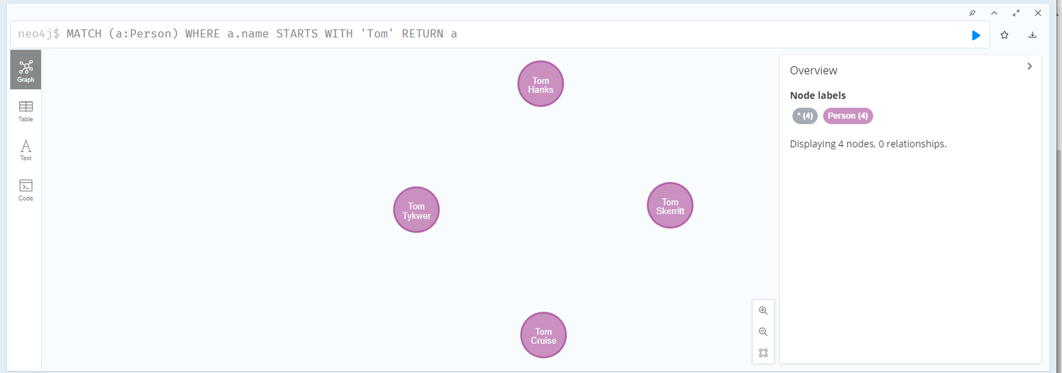
Cypher Query Example
Search for any person named "Tom"
SPARQL
Cypher Query Structure
SPARQL Query Structure
Cypher
Conclusion
06.01.2023
<number>
Notes:
In the first query, we search for all persons who have the first name Tom and exist in the Graph database and have these persons returned to us with "Return a".
Here we see, for example, Tom Hanks.

Slide 8
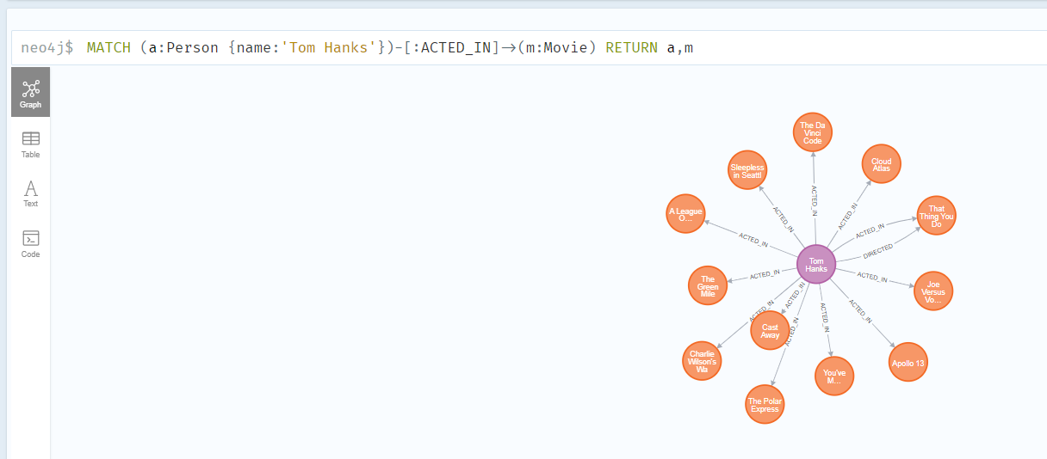
Cypher Query Structure
Show all movies Tom Hanks acted in
SPARQL
Cypher Query Structure
SPARQL Query Structure
Cypher
Conclusion
06.01.2023
<number>
Notes:
Then we wanted to know what movies Tom Hanks acted in everywhere. By having us return here not only the films but also the person. In the issue, we also see the relationship between the person and the film, i.e. "acted in".

Slide 9
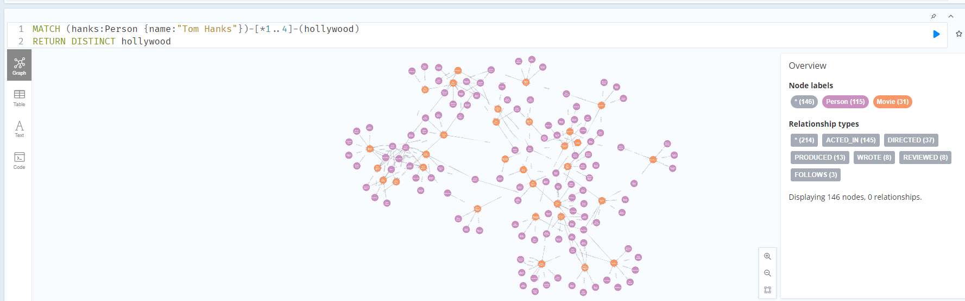
Cypher Query Structure
Movies and actors up to 4 connections away from Tom Hanks
SPARQL
Cypher Query Structure
SPARQL Query Structure
Cypher
Conclusion
06.01.2023
<number>
Notes:
And in our last example, we have displayed all the people and movies that are up to 4 connections away from Tom Hanks.
So we see that we can make both simple queries, but our requests can also be very complex

Slide 10
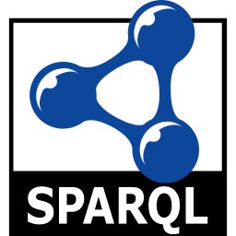
Conclusion
SPARQL
Cypher Query Structure
SPARQL Query Structure
Cypher
Conclusion
06.01.2023
<number>
Notes:
What is our conclusion about SPARQL and Cypher?
Both SPARQL and Cypher are very powerful query languages, both building on the simplicity of SQL and giving us the ability to query information from graphical databases and in turn display it visually.
Both query languages have their own advantages and can be used in different environments, being both open sources and implemented in different projects.

Slide 11

Questions?
06.01.2023
<number>

