Slide 1
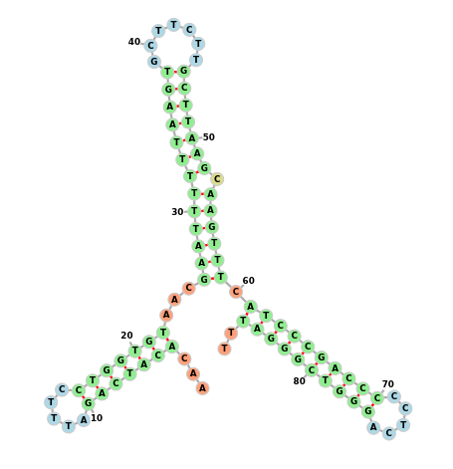

Bacterial sRNA
Presentation in Linked Open Data and Knowledge Graphs WS 22/23
07.01.2023
Page <number>

Slide 2
Agenda
Motivation
Bacterial small non-encoding RNA
Datasource
Creating of Knowledge Graph
Queries
07.01.2023
<number>

Slide 3
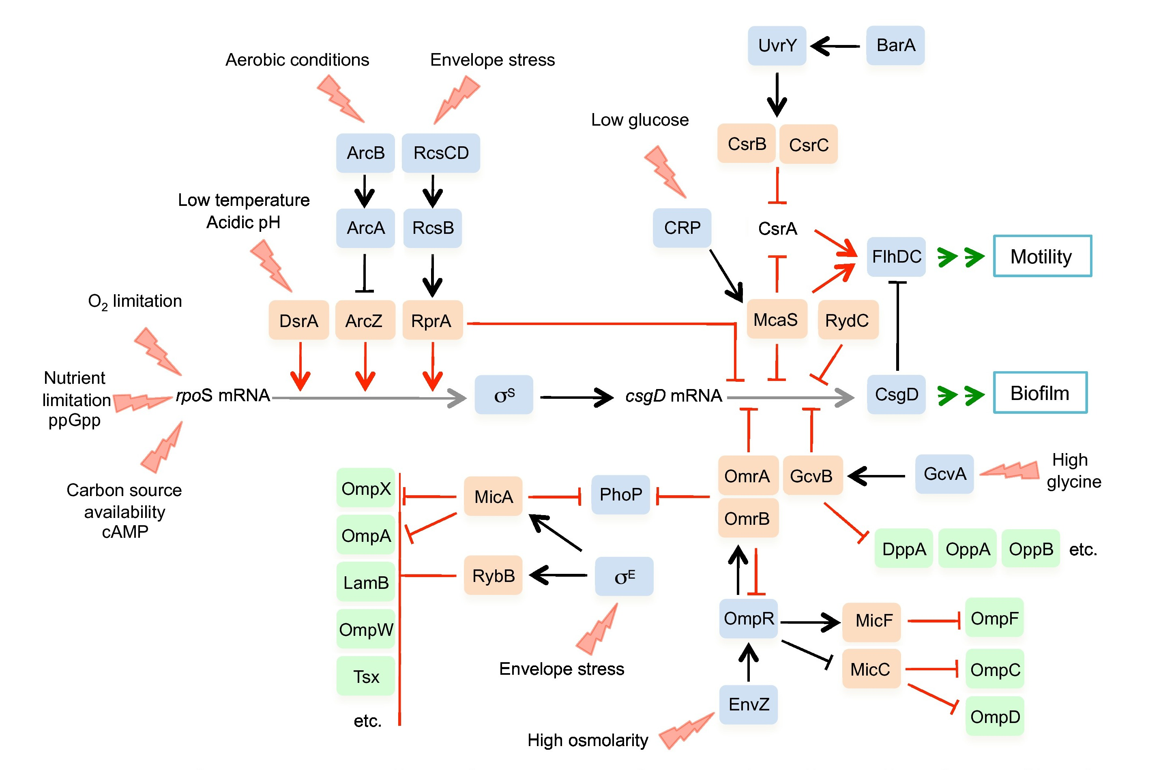
Bacterial sRNA
What are small non coding RNAs in bacteria?
Sequences that control the activity of genes.
Genregulation determines wether a mRNA or
The targeted protein is built or not.
This is important to keep the organism resilient
During stress. (heat, osmolarity, carbon)
DrsA
http://ccb1.bmi.ac.cn:81/srnatarbase/index.php?r=srnaTarget/view&id=1
07.01.2023
<number>

Slide 4
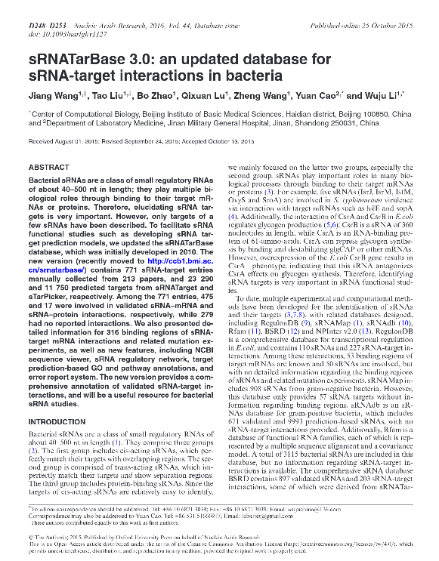
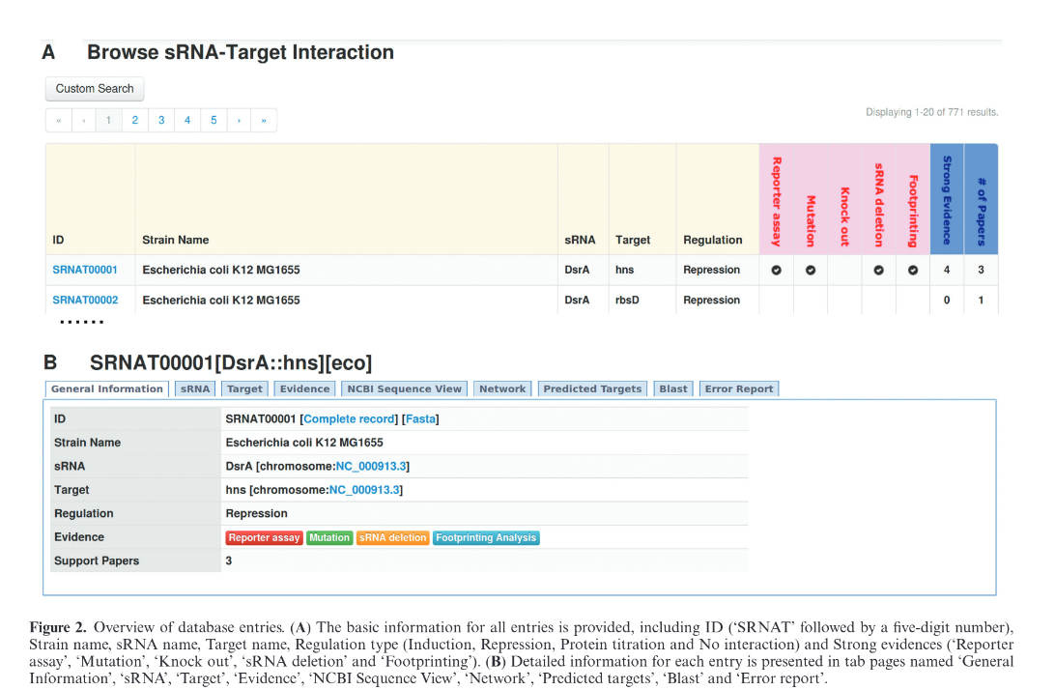
Data Source sRNATarBase 3.0 – Wang et al. - Published 2015
http://ccb1.bmi.ac.cn:81/srnatarbase/index.php?r=site/index
07.01.2023
<number>
Notes:
SPARQL (pronounced “sparkle”) is an RDF query language for the Semantic Web and first appeared in 2008.
SPARQL is developed by the World Wide Web Consortium (W3C) and along with RDF and OWL, it is one of the three core technologies of the Semantic Web.
The syntax here is relatively easy to learn, similar to SQL, and is reminiscent of English sentence structure. Like this example: "Return me all items that contain house cats.“
SPARQL is used to represent information from data stored as RDF format. The results from the queries can then in turn be visualized in different ways. For example, as in the Wikidata Query Service as a table, timeline or map.

Slide 5
Data Structure
ID
SRNA_NAME = Name der sRNA
TARGET_NAME = Name des von der sRNA
TAXID = Taxonomische ID
ORG_CODE = Organismus Code des Bakteriums
STRAIN_NAME = Erregerstamm
SRNA_TYPE = 0:NA, 1:trans-encoded asRNA, 2:cis-encoded asRNA
SRNA_LENGTH = Länge der sRNA (Menge der Nukleotide)
SRNA_START = Startpunkt
SRNA_END = Endpunkt
SRNA_STRAND = forward - reverse (sRNA-Strang vor- rückwärts
TARGET_TYPE = Art des Targets (mRNA oder Protein)
TARGET_LENGTH = Länge des Targets
TARGET_START = Startpunkt
TARGET_END = Endpunkt
TARGET_STRAND = forward - reverse
REGULATION = induktiv - repressiv > Wie RNA das Target reguliert
07.01.2023
<number>

Slide 6
(node {key: value})–[:RELATIONSHIP*..2] -> (node)
Nodes and Edges
(node) – [:RELATIONSHIP] -> (node)
LOAD CSV WITH HEADERS FROM 'https://raw.githubusercontent.com/VScharf7/DS_Linked_Open_Data_and_Knowledge_Graphs_2022_Mueller_Scharf/main/Data/sRNATarBase3_w_target_from_1_to_terminal.csv' AS row
CREATE (a:sRNA {Name: row.SRNA_NAME, sRNA_start: row.SRNA_START, sRNA_end: row.SRNA_END, Alias: row.SRNA_ALIAS, sRNA_Strand: row.SRNA_STRAND})
CREATE (b:Target {Name: row.TARGET_NAME, Target_start: row.TARGET_START, Target_end: row.TARGET_END, Alias: row.TARGET_ALIAS, Target_Strand: row.TARGET_STRAND, Region: row.TARGET_REGION})
CREATE (c:Strain {Name: row.STRAIN_NAME, Code: row.ORG_CODE, TaxID: row.TAXID})
CREATE (d:sRNA_Position {Start: row.SRNA_START, Stop: row.SRNA_END})
CREATE (f:sRNA_Length {sRNA_Lenght: row.SRNA_LENGHT})
CREATE (g:sRNA_Type {sRNA_Type: row.SRNA_TYPE})
CREATE (e:Target_Position {Target_start: row.TARGET_START, Target_end: row.TARGET_END})
CREATE (j:Target_Length {Target_Lenght: row.TARGET_LENGTH})
CREATE (k:Regulation {Regulation: row.REGULATION})
CREATE (c)-[:host_of]->(a)
CREATE (a)-[:hosted_by]->(c)
CREATE (a)-[:located_at]->(d)
CREATE (a)-[:length]->(f)
CREATE (a)-[:is_of_type]->(g)
CREATE (b)-[:located_at]->(e)
CREATE (b)-[:length]->(j)
CREATE (a)-[:affects]->(b)
CREATE (b)-[:is_affected]->(a)
CREATE (a)-[:regulates_Target]->(k)
return *
07.01.2023
<number>

Slide 7

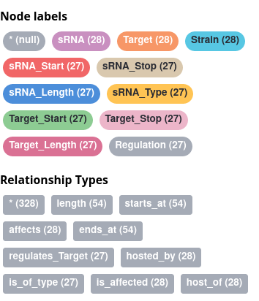
Building of Knowledge Graph
07.01.2023
<number>

Slide 8
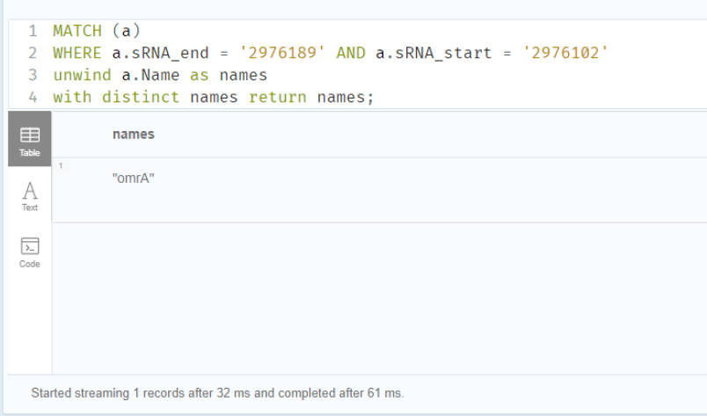
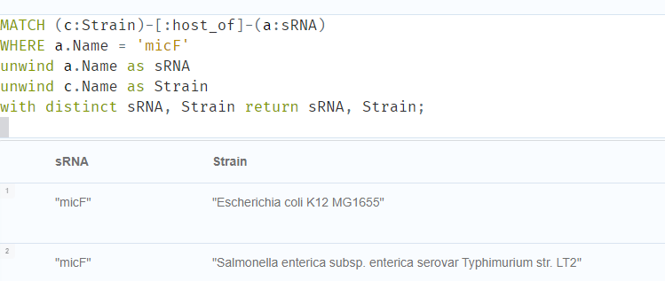
Queries
07.01.2023
<number>

Slide 9
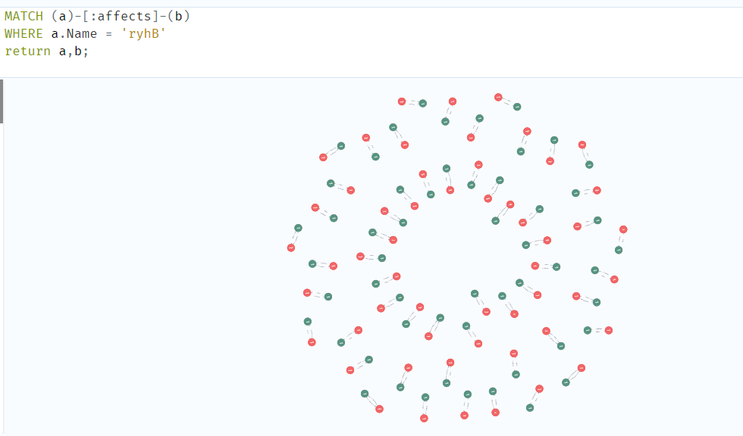
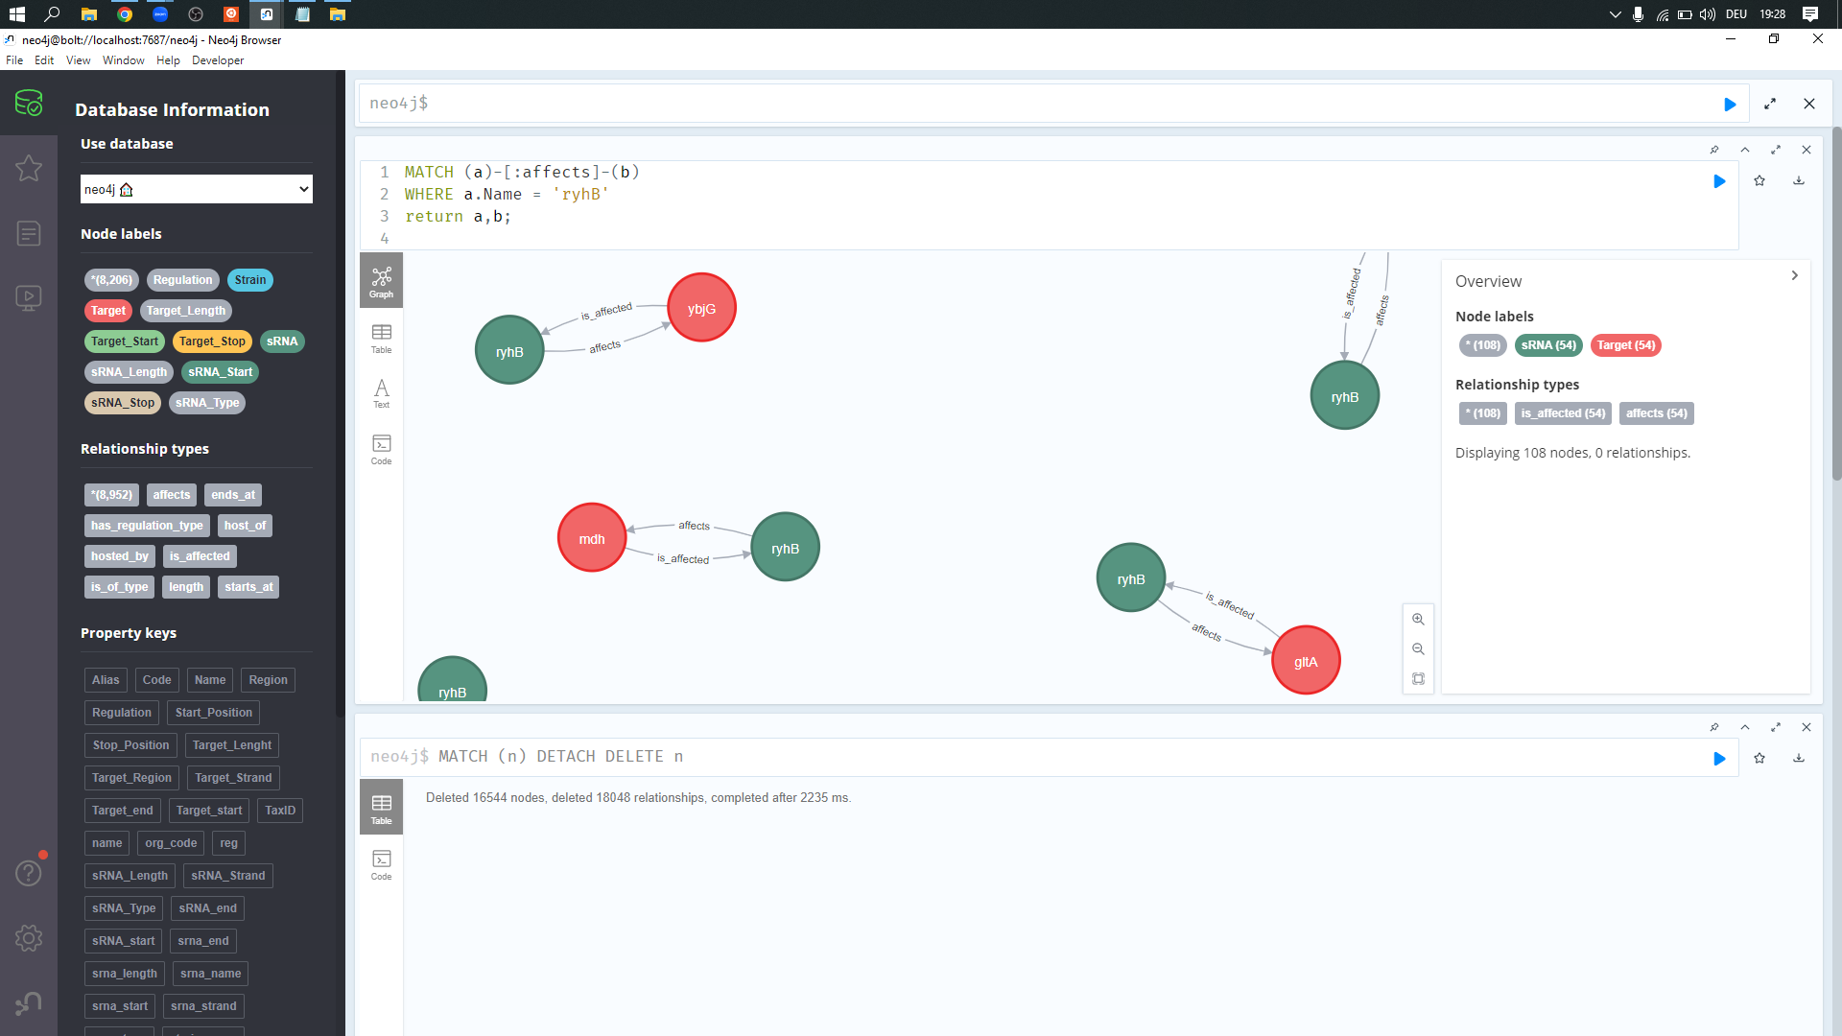
Queries
07.01.2023
<number>

Slide 10
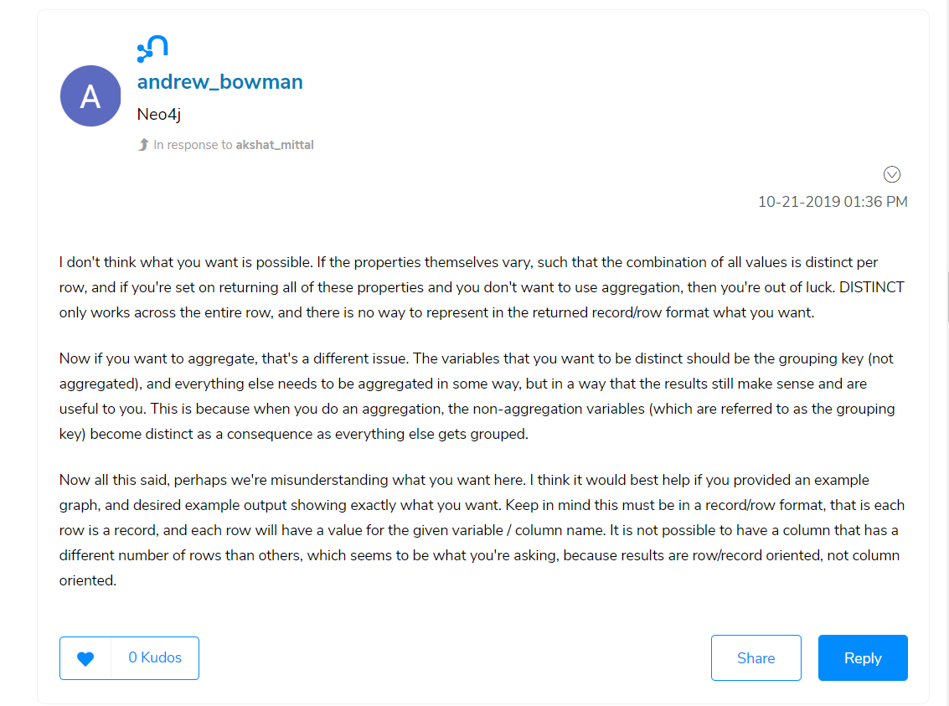
Query Problems
07.01.2023
<number>

Slide 11
Questions?
07.01.2023
<number>

