Slide 1
CUHACKIT
27
>> LOCATION: Clemson University
>> DATE: February 27th and 28th
>> EMAIL: cuhackers@clemson.edu

Slide 2

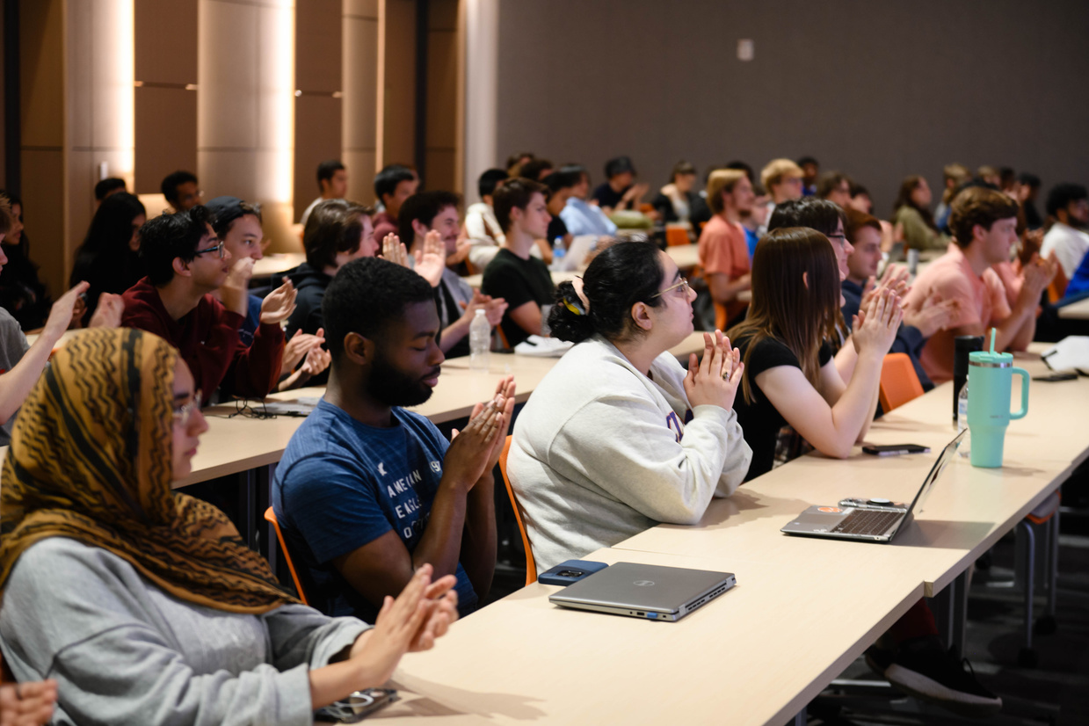
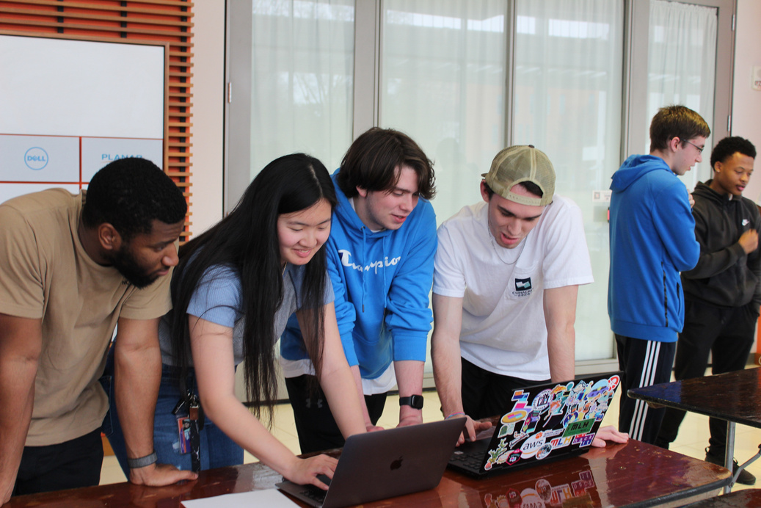
>> WHO ARE WE?
NASA Space Apps Challenge in Clemson Opening Ceremony 2025
We are South Carolina’s largest annual hackathon, led entirely by students at Clemson University!
In this 24-hour challenge, teams will create and develop an innovation under tracks and supplemental power-ups.
Our mission is to deliver the best participant experience while fostering innovation, collaboration, and growth.
img_02.png
img_01.png
CUhackit 2023

Slide 3
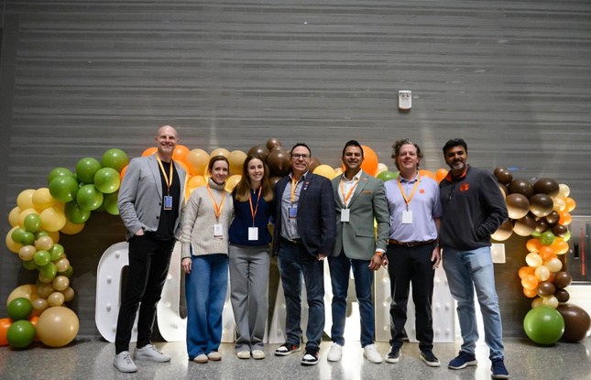
>> IMPACT
Past student projects:
A real-Time ASL learning platform
AI-powered speech accessibility platform
Wearable assistive navigation device for the visually impaired
Last year’s statistics:
285 participants at our most recent event
25+ colleges and universities represented
50+ industry representatives
img_03.png
Notes:
take about goals

Slide 4
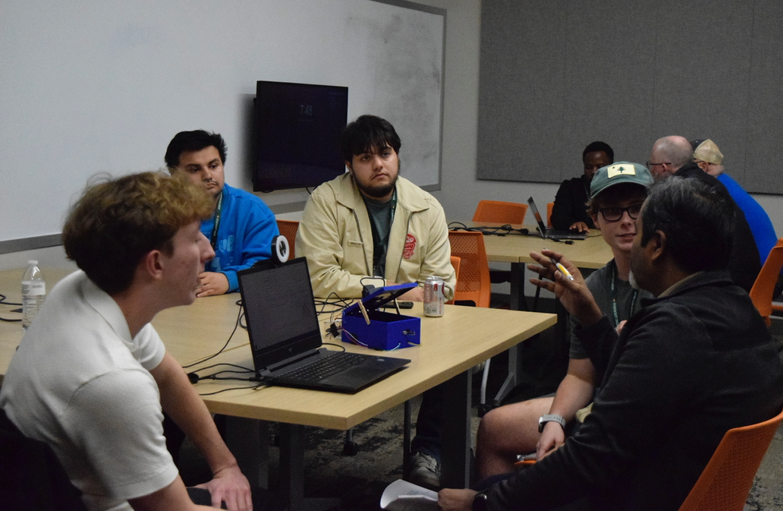
>> WHY SPONSOR?
Boost brand visibility on event materials, website, and signage
Showcase your company
Dedicated tabling opportunities and workshops
Distribute your swag
Recruit top technical talent
Mentor and engage directly with students
img_04.png
CUhackit 2026

Slide 5
>> EVENT CHALLENGES
TRACKS
POWER-UPS
CUHACKIT
GOLD
+
PLATINUM
General themes or application areas that teams choose to shape their goal.
Each team chooses 1.
Examples:
Healthcare
Education
Finance
Supplementary distinctions that shape the tech stack or features that teams use.
Each team chooses up to 2.
Examples:
Best Use of Amazon Web Services
Best Path to Market
Best User Interface

Slide 6




>> SPONSORSHIP TIERS
BRONZE
SILVER
GOLD
PLATINUM
$1,000
$2,500
$5,000
$8,000
LOGO ON WEBSITE
LOGO ON SIGNAGE
PARTICIPANT LINKEDINS
TABLING OPPORTUNITIES
DIRECT MENTORSHIP
ALL BRONZE BENEFITS
LOGO ON EVENT T-SHIRTS
BIGGER LOGO IN BRANDING
PARTICIPANT RESUMES
ALL SILVER BENEFITS
HOST A POWER-UP
HOST WORKSHOPS
NETWORKING EVENTS FOR SPONSORS
TITLE SPONSOR
ALL GOLD BENEFITS
LONGER WORKSHOPS
PROMINENT BRAND PLACEMENT

Slide 7
>> SPONSOR EXPECTATIONS
Donation through Clemson University
Event information
Logos + other branding
Power-up, workshop, prizes
T-shirt and branding approval
Your team members
Who is coming, contact info, shirt sizes
Speaker info for ceremonies
Representatives join Discord
Signups for mini-events
December 3rd
January 1st
January 13th
February 7th
February 14st

Slide 8
CUHACKIT
27
Let’s discuss!
cuhackers@clemson.edu

