Slide 1














How Did We Ket Here?
Hazel, Ryon, Toby, & Varun

Slide 2
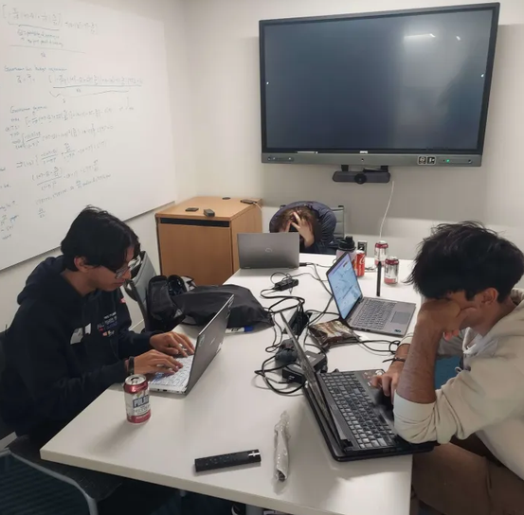

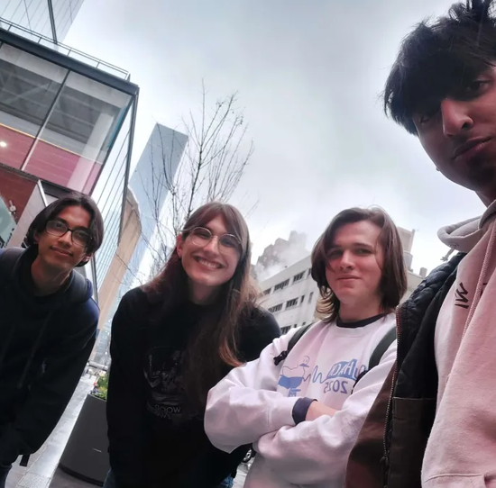
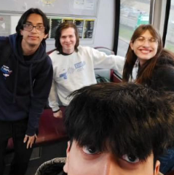
Who are we?
Clemson University Students
Sophmore Computer Science + (mostly) Math Majors
Spent the Current Academic Year Learning Quantum

Slide 3
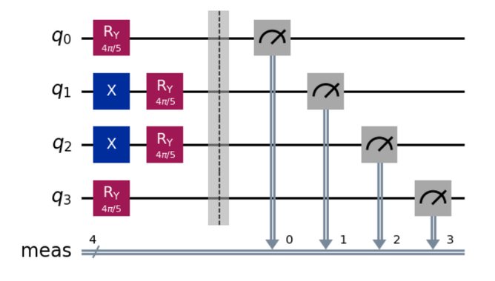
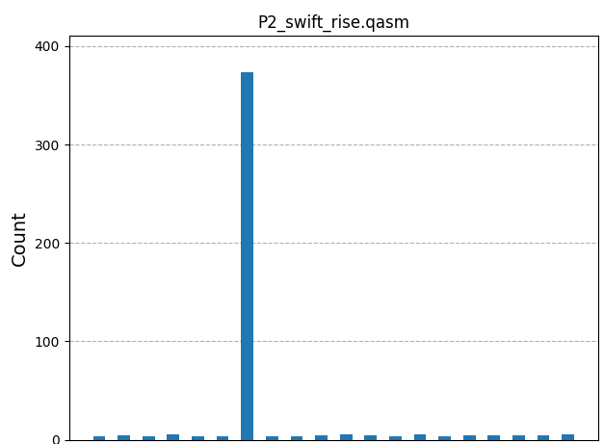
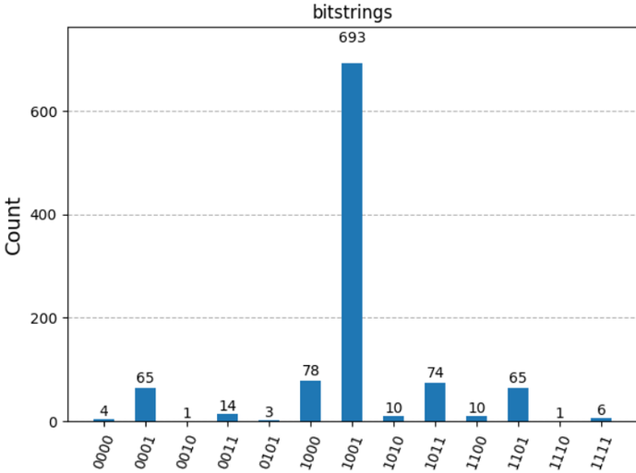
Initial Approach ⟶ Issues ⟶ New Ideas ⟶ Solution
Problems One & Two
Using Qiskit’s AerSimulator Locally
1001
1100101101100011011000011100
Notes:
Got Results (1001)

Slide 4
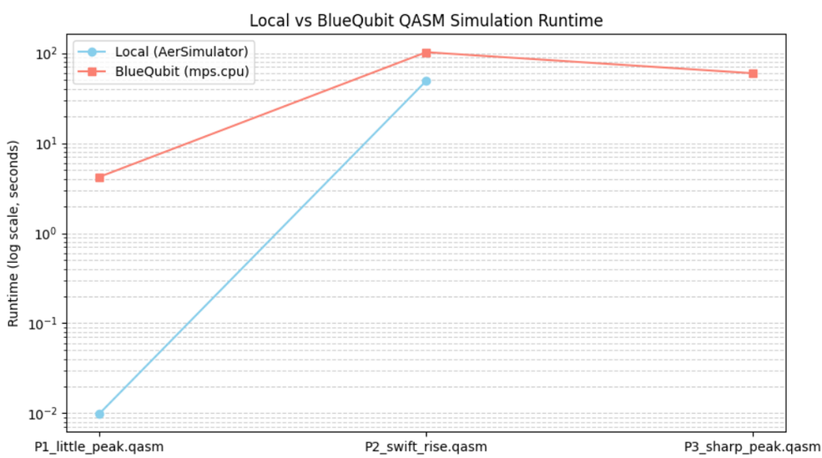
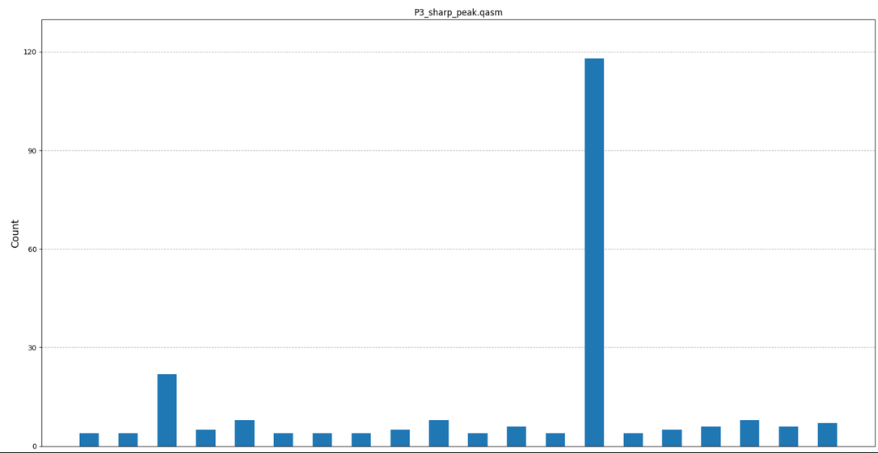
Initial Approach ⟶ Issues ⟶ New Ideas ⟶ Solution
Using BlueQubit’s Simulator
10001101010101010000011111001101000100011010
Problem 3
Notes:
Got Results (1001)

Slide 5
Initial Approach ⟶ Issues ⟶ New Ideas ⟶ Solution
Issues
Difficult to simulate large circuits
Problem 1 / 2 Solution too slow for Problem 3
Circuit simulations are memory inefficient
Notes:
Got Results (1001)

Slide 6
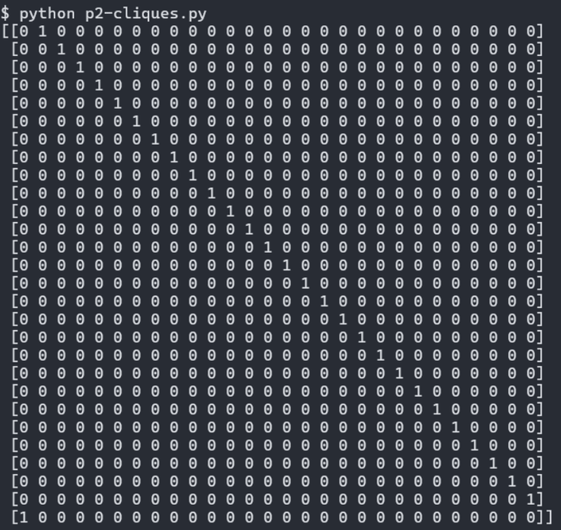
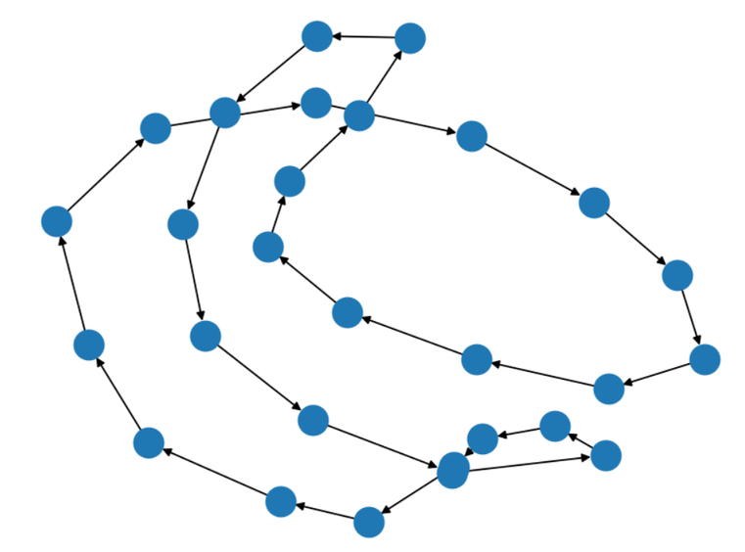
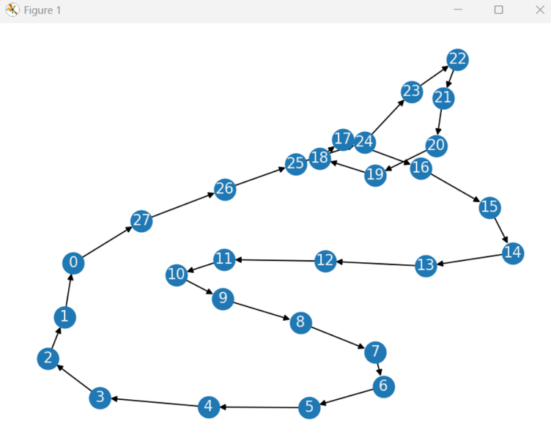
Initial Approach ⟶ Issues ⟶ New Ideas ⟶ Solution
Entanglement Graph
Important observation for P2 and P3: this graph representing how qubits are entangled is cyclic in each of these problems
Notes:
Got Results (1001)

Slide 7
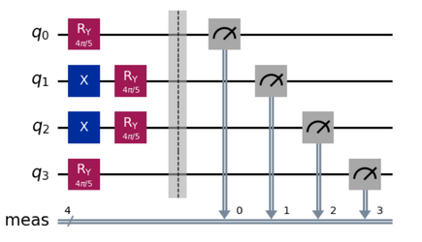
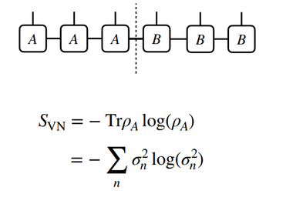
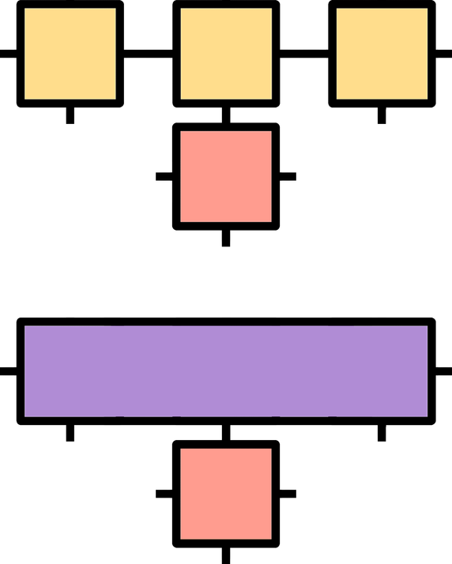
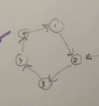
Initial Approach ⟶ Issues ⟶ New Ideas ⟶ Solution
Statevector Simulation
Matrix Product State
Used to solve P1 and P2 locally and P3 using BlueQubit’s simulator.
Was too slow and too memory inefficient to continue using after the smaller problems.
Used since we have low entanglement states in P2, P3 to provide a speedup over statevector and tensor network simulations.
Did provide a notable speedup for P3, but not for P4.
Different Paths
Tensor Network
Adjacency Graph
Instead of having a big matrix, compose in a smaller network of tensors.
Implemented using Quimb for our attempt at P4.
Build a graph representing which nodes are entangled with which others and see if this provides helpful structure.
Didn’t know how to move from adjacency matrix to a representation of circuit.

Slide 8
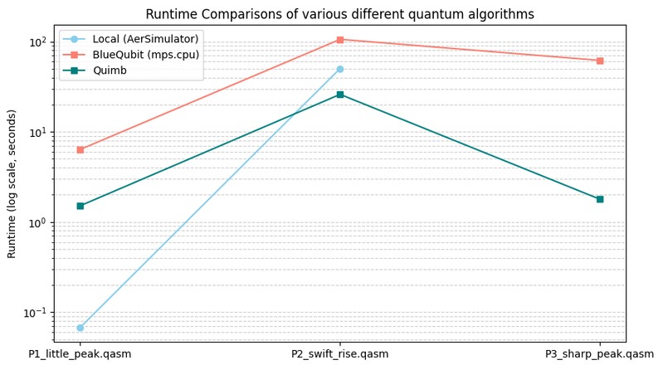
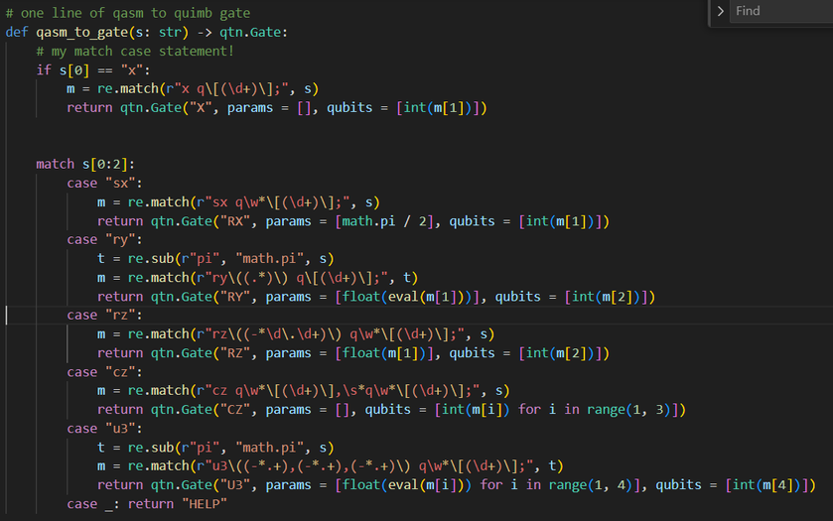
Initial Approach ⟶ Issues ⟶ New Ideas ⟶ Solution
Final Version: Tensor Network
What We Did
Used Quimb library
Much more efficent
Created Necessary Gates
Rotation (X, Y, Z), Controlled-Z, Single-Qubit Rotation Gate, Pauli X
We Can Implement Any!!!
Problem
Long compile times
Long sampling times
Issues with tuning bond

Slide 9
Initial Approach ⟶ Issues ⟶ New Ideas ⟶ Solution
Future Goals
01.
Fix Current Simulation
02.
Faster Solutions
03.
Better Visualization
04.
Finish Problem 4, 5, & 6

Slide 10
Questions?
~ Thank You ~
Clemson CECAS
YQuantum Organizers
BlueQubit Mentors

