Slide 1


Slide 2

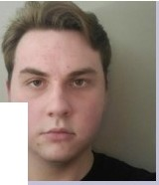
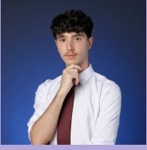
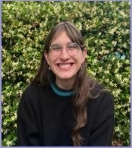

MEET THE TEAM
•
ETHAN
FRANK GONZALEZ
HERMAN

Slide 3

GIVEN DATA
Wanted
0 Task ID I Correlating Circuit (.QASM)
0 Processor (CPU or GPU) I Precision (Single or Double)
0 Threshold I Fidelity
0 Simulated Run-Time
0 Minimum Threshold
[1,2,4,8,16,32,64,128,256]
0 Estimated Runtime per Circuit
0 Bitstring I Family
0 Number of Qubits

Slide 4


Slide 5

RUNTIME
Features
D Total gate count
Understanding and Estimating the Execution Time of Quantum Circuits
NING MA, Pulytcduliquc Montr&.nl. ada
HENG LI•, Polytcdmlql.tCMontttal.Can-0.
O...e to tbc scattity orquantum compullng rtsources.r rsand dC'•c&optrs ha"(' very11:.inhcd aoct$S lo R' Iqu<tntum oompillcn.ThcrcfMc, jud:idou. planning nnd utiliuticm ofq1Qntum onmputeo:r n.intimc are cssentia1to n1.11.1tt s111ooth t)l'.«:ution and to:inplcd01i or pf\'Jj«U. Ae<un.tc- C11thnatkl.1ofa quattttllll ti.rtuil's
c:ireartion timl:U lhu.s n ryIC)pr t Un('xpcctcdlycxc«<ling t nntic;ipntcd nm rime O¥ the maximum capacity ofllitquantum cotupulcr.s;it alsoldlowis qu::1.111uin. computing plalfoniu to ltUl1c ptttisctyinlormtd p«Willioning and prioritization of quantmn com.puting jot,,. Jn this paper. ""C fi.nt Jtudy the chanictcfisticr
> ofQIW'ltum clrtui.1.s"runtimeonslmulatOJjMd realquantum computers..Tht:". introduec an ln ·ative
method that emplop n1;tmph tra:n.,fotmc."l'·boucdmodel, uti!Wngthegru.ph infarmation 1md gjc>bnl information or quantwn drwl.l'l IOtseinWc thcit exttulion till'I('. W cd«I• btnchn1atk dataset co1nprising ovct l.SIO
q nh1m ciraiits;,inilU.lty pmdict:ing th<:ir execution times on s.imu tan. ••hichyit'lded promising r«ilfl.5with 11J1R"5quared''all.ICgi'Utet II.an 955.Subsitqm-:nll•y .,.,,,,.applkd adh't'learning to sclttt 340circui1.sa.111pks with a confidence k\-do( 9S$ lo build and evalulllcour apprl»Ch (Of the etin)lllion o( dnm.it cxt-cution tiillCS on qmu\t\1m (Ofl)P'JICf$..chicYing 811avcrag R· cd V'&lueie:1u..<tcding 90$.Ourapproach('&I)btintq;ntc:4 intoqu1111tum oomputiu£ pl11t(ormJ1 to provide an acauatce.'llimlltioa ol quantum acc:utioo time andbeused u a rcfertnce for.,.-loritbJngquanrUfl'I exttutlon job9.ln addlriofl, ourflndl:nv providelns$gJt1$ forqulltltun1 pmgram dc\-clorcrs to opimixc their circuit (nr reduced cx«irtion time.
CCSCoactpcs: • SoflwaTe and Use1i.gi11ec-ring:- Software pc-rfon11a11te: • Hardware - Quantum cc:unputatiC)n.
Additional Key Words and Ph1WC$ ntumComputing.Q-.wit-.im Cil'Qlits.Quantum Computer$.Qua11t\lm ExccutM>cTiime,Gn1ph 'rr·.uuformcr
ACM Rc(cno:n« Form.al:
Ning M;annd Heng Li. 202S.Undc-:ntnndingnnd Estimating lhc Execution Ttmeof Quantum Cira1its. ACM
Thms.S-O{lw. £11&- M 1hodoL . (Novtmbc-r 202:5).3'4 pages.httpsi/doli.org/IO.l l45ftuuuuUUl.nnnnnttn
D Two-qubit gate count
a Circuit depth I Qubit count
V')
N
0
N
Insight
Research literature: predicting the runtime of circuits (in simulation and on hardware) can be difficult to do using any individual feature; combining them might yield a better correlation.
V')
1 lntToduciion

Slide 6
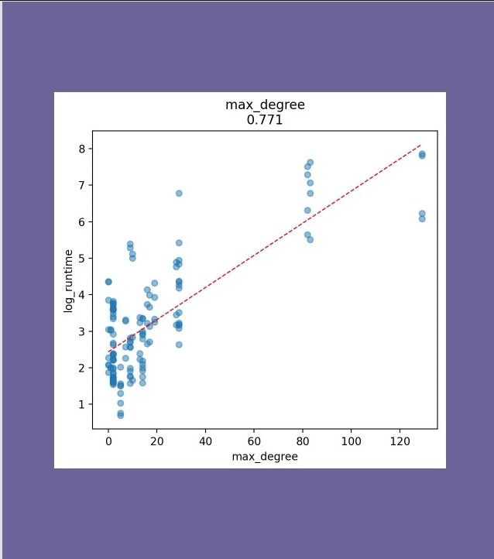
RUNTIME
Features
0 Maximum qubit degree
(local interaction bottlenecks)
0 Degree variance across qubits
0 Two-qubit gate density
0 Entanglement volume metrics
Insight
Local bottleneck features show consistent correlation, these include max_degree. Circuits with one heavily loaded qubit tend to run slower, even at similar sizes
Local entanglement bottlenecks limit parallelism and increase intermediate tensor sizes, increasing simulation cost regardless of global circuit size.

Slide 7
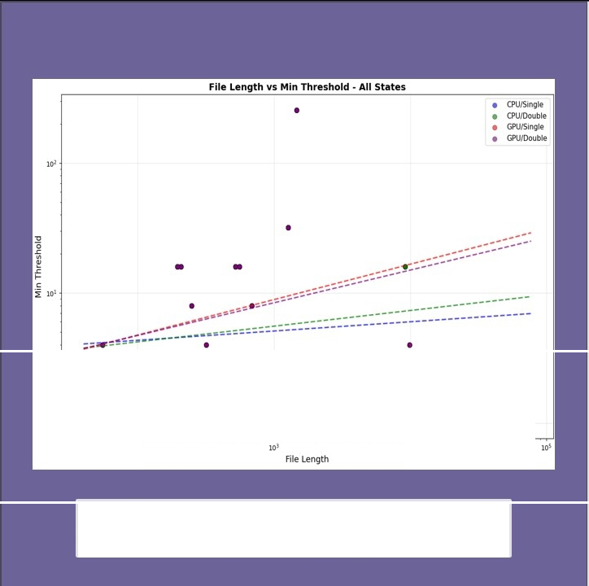
THRESHOLD
Issue
Threshold does not correlate with
Backend (CPU vs GPU)
+
Precision (single vs double)
Features
We prioritize QASM-only features for generalization.
• • •• • • •• ••
^{lo'} • • •• • • • • • • •
These features are not intrinsic to circuit difficulty and reduce effective dataset size
,..
lo'
The higher line can be partially explained for more runs timing out on the GPU, causing fewer points

Slide 8

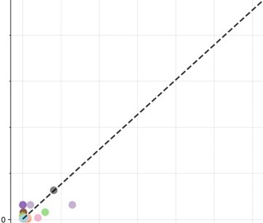
--
How can we predict threshold from QASM only features?
Etgl Prog vs Min Threshold Correlation: 0.963
•
250
eutlk11
•
O.utsch.Jo<Sa
GHZ
GraphStatt
Ground_St•te Grover_NoAncilla Grover_v _Chain Portfolto..OAOA Portfoho..VOE Pricing_Call ()W)A
QfT OfT_Entangled ()HN
OPE..Exac-t Shor
TWoLoc:alRandom
VQE
w_state
- - Tfend (COtr•0.963)
200
•
Per QASMBench, important metrics for circuit execution
•
and difficulty include: Measure Density, Entanglement Variance, Gate Density, Retention Lifespan
:2
•
•
•
0
.s::
150
E
::>
- 100
Problem: Certain features require compiling or
simulating a circuit to gain meaningful insight.
'i
50
Select only features we can extract via static analysis
0
1000 2000 3000
4000
5000 6000
Entanglement Progression

Slide 9
CLASSIFICATION OF CIRCUITS?
Different Families of Algorithm leave feature fingerprints
If we can reliably pattern match features onto circuit type, threshold and runtime prediction becomes much more granular.
Problem: Hard problem that often requires simulating or compiling circuits
Solution: Use a more general difficulty score composed from simple features.
Ius CE BE AE A."lP QPE UNC
Ali:orithm
Ground Truth
PSM
AclJcr w. °'o:ril<M• AclJcr ,./o mcrflow Amplnudc Encoding Amplnudc Esunuoon DcuL<eh-Joua GHZ Gmph Suuc Gro\u MHL | .I .I .I .I .I .I .I .I .I .I ./ .I ./ .I .I .I .I .I .I .I
.\tuluphcr QAOA | .I | .I | .I
Ql-T Ql-T w. entanglement | .I .I | ./
OPE Quantu111 Wulk Real Amplitudes Shor SU2 An"1!1 | .I .I .I | ./ .I .I .I .I |  | .I .I | ./ .I ./
VQE W-Statc |  | .I .I |  | .I
.I
TABU: II: Ab<tr.rtion of the: ground trulh. The symbol .I marks wbclhcr the com:spond1ng pa11L"mS arc pr=t incac:b algoritlun.

Slide 10

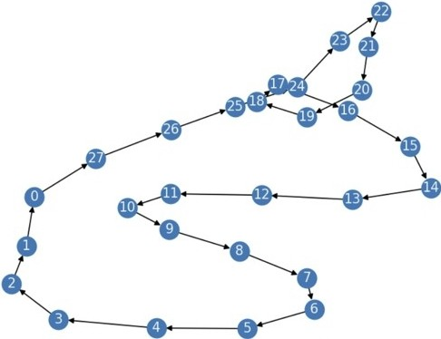
How can we statically analyze metrics representing a circuit's difficulty?
a
One of the main things that can influence a circuit's runtime and fidelity is how entangled it becomes.
We can represent this using a 2-qubit interaction graph, which connects qubits that are interacted upon together by a 2-qubit gate.
From this graph, we can extract metrics like the max degree and degree variance to understand things like how "bottlenecked" the circuit is and the strength of the connections before truncation.

Slide 11
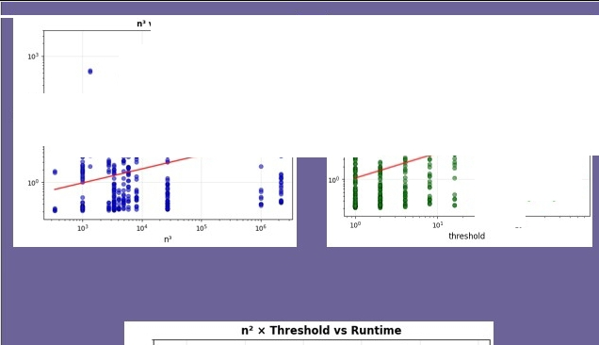
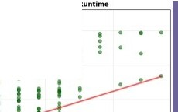
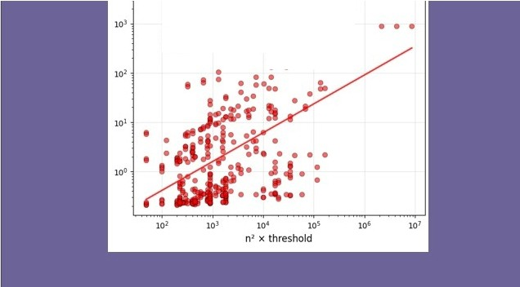
n• vs Runtime
Threshold 11s Runtime
COMPOUND FEATURES
& DIFFICULTY
Idea
Combine simple features to capture interaction effects.
..
I • • •• • • • ^{I} • • • • • • •• .•• • • I
 |  |  | •• | • • | • • | • • | • • | . •
 |  |  |  |  | • | • | •
10'
10'
1
io¹
I
•
I
...
Result
Strong improvement in correlation
Begins to separate "easy" vs "hard" circuits
I I I•
•
•
I
•
•
• •• •, •
I
Takeaway > Circuit difficulty is multiplicative,
not additive.
Product of simple features reduces impact of outliers on regressions

Slide 12

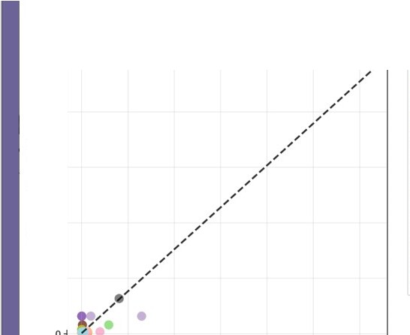
QUANTUM
PROPERTIES
Simulator perspective
Tensor-network simulators struggle when the entanglement is large, builds early, or compression opportunities are limited.
Etgl Prog vs Min Threshold Correlation: 0.963
e Amphtude_Estlmatlon CUtBell
utschjozsa
_{e} GHZ
GraphState
Ground_State
e Grover_NoAncllla
Grover_V_Chain
e Portrono_OAOA
Portfolio_VOE
e Pricing_Call
OAOA
OFT
OFT_Entangled
ONN OPE_Exact Shor
Twol.OcalRandom
VOE
w_state
- - ll'end (COIT•O.963)
250
200.
'O
0
.s::.
.:.(.). 150·
t=
E
:J
Motivated teature
Entanglement Progression = volume x packing
_{c:} 100·
so.
Interpretation
Measures how much entanglement pressure the simulator must carry.
.
.
.
0
1000
2000 3000 4000
5000
6000
Entanglement Progression

Slide 13
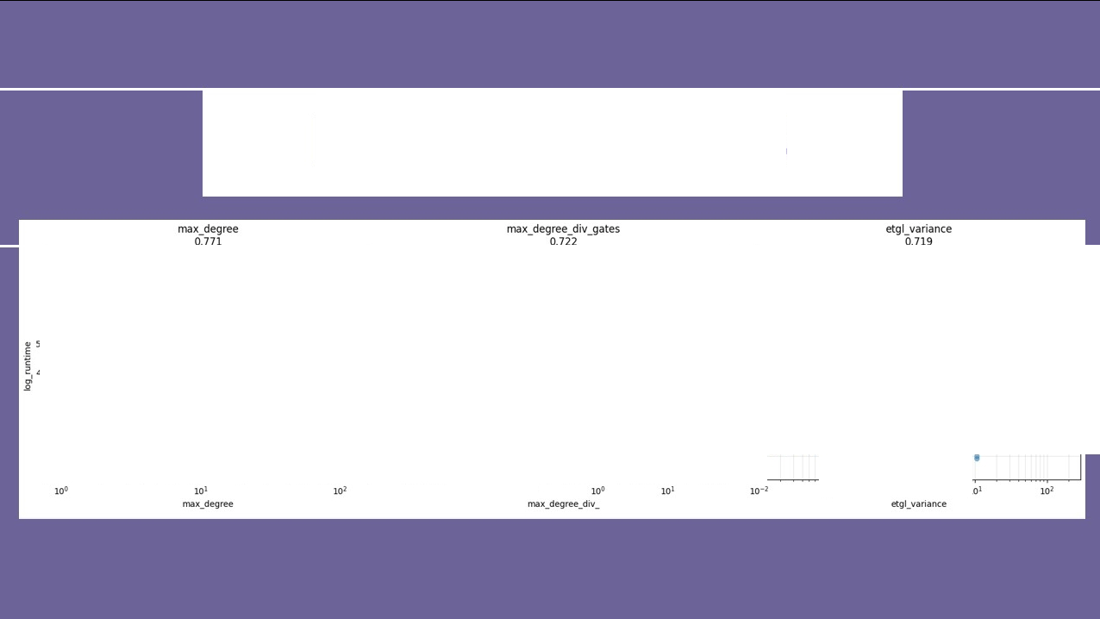
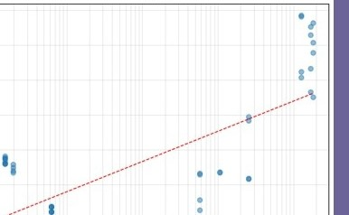
EXAMPLE METRICS
8
••
•
8
•••
8
.•• :
••
.•.••
•
•
7
•
7
6
I
6
• •
...
••
•
. .......
. : . .
6
, ...··.
.............- ---···
.
••
..·. ·""' .
5
5
. . .-
.. .
c
...... ..
: ................ .
2 4
:,.,^{I}
'
......---·-
I
i
. .... . ..
•
!!·..... ,. t
.......
3
3
•
_{.....---}...-···· • I U
I...-· • • '9
•
...............
2
.......-f
1
I· I
2
3
••
-----·-··
• I .. a •
I
•
•
•
2
io-2
io-1
10-1
io•
10'

Slide 14


FIDELITY MAPPING
Problem with using min_threshold directly
min_threshold is a discrete label chosen from a coarse ladder
Fidelity vs Threshold (5th Degree Polynomial Regression)
• •
• •
•
•
I • • • •
{l,2,4,8, 16,32,64, 128,256}
Small changes in circuit behavior can cause large jumps in min_threshold
l.O
•
•
•
t
• •
e
0.8.
• •
•
•
•
•
Observed structure in the data
Fidelity increases smoothly and monotonically with threshold
0.6
^{>-}·'=
Oi
•
•
•
"C
lI:
0.4.
Each circuit exhibits a clear transition region rather than a sharp jump
•
This transition shifts left or right depending on circuit difficulty
0.2
_{I}•
•
••
Why fidelity mapping is better
Mapping features --. fidelity curve shape preserves continuous information
The phase shift of the fidelity curve captures intrinsic difficulty This reduces discretization noise and improves correlation analysis
0.0
•
CPU/Single
.
0
2
4
6
8

Slide 15
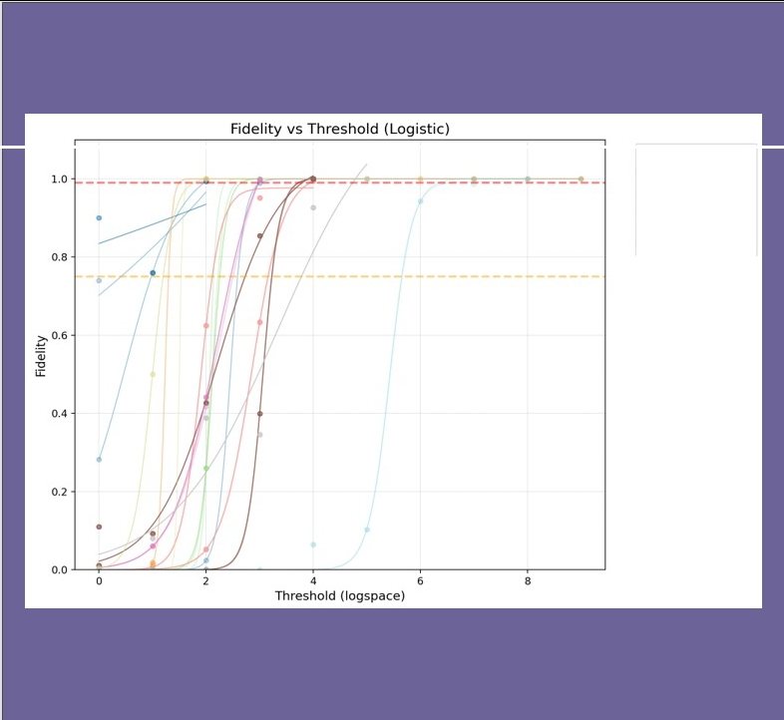
LOGISTIC FITTING
-
Esomooon
Method
Fit logistic curves to fidelity vs threshold per circuit
Extract phase-shift location
- Gt•phSt6te Ground_State PtltttOllO_0A0A Ptlrtfoho_VOE Mc•..C. ell ()NN
-
'IWot.ocolR.ondom
Result
Phase shift correlates extremely strongly with min_threshold
Structural features predict phase shift accurately

Slide 16
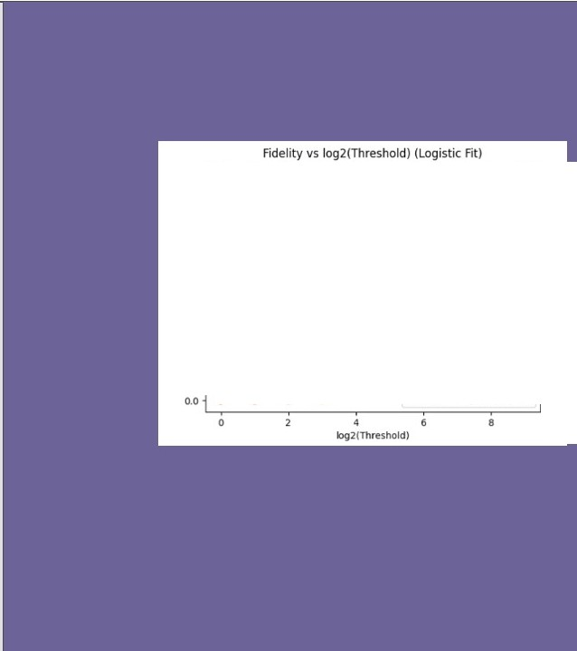
METRIC VlllDATION
Validation goaJ
Verify that our compounded structural metric captures intrinsic circuit difficulty consistently across different circuit types.
I I ₋₋:.---•---:---:
LO
•
•
•
•
•
•
•
, , " ,,-
.
o.a
,
,
,
•
Approach
Compare the compound feature (entanglement progress) against fidelity-based phase-shift measurements
minimum threshold outcomes
Evaluate correlation across all circuit families, not just individual instances.
.,,,
• ,
,,
06
,,•,.,/ :
•
•
O•
.,,, ,
.-
0.2
,,..
• •
••
•
•
O'IJ/S1ngle
- - CPU/Single logtStK lit
Key result
Strong correlation observed between the compound feature and fidelity-derived difficulty measures.
The mapping holds across diverse circuit classes (e.g., GHZ, QFT,
Grover; QAOA), not just within a single family.

Slide 17


Slide 18
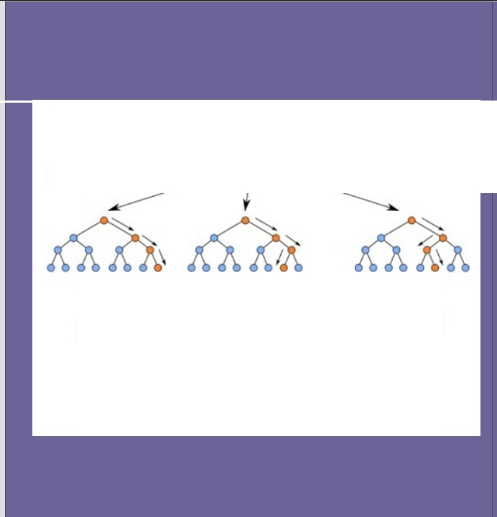
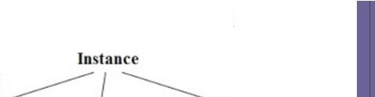
EVOLUTION
Stage 1-Regression
Random Forest Simplified
D Linear regression
D Interpretable
D Underestimates frequently
Random Forest
Stage 2- Random Forest
D Minimal baseline version
D Captures nonlinearities D Improved robustness
•••
Tree-I
Trcc-2
Tree-n
Class-A
l -
Class-B Class-B
IMajoriry-Vot 1------J
!Final-ClassI
Stage 3- Full RF
D Full Forest+ Selected features
D Balance of flexibility and generalization

Slide 19

Motivation
The regression model outputs a continuous threshold estimate The simulator only accepts discrete threshold rungs
Rounding naively can underestimate threshold, causing fidelity failure
Step I - Baseline Aggressive Fix (Prediction-Based)
We observe systematic trends in prediction error: Low predicted thresholds are more error-prone
Higher predicted thresholds tolerate more aggressive rounding We apply a prediction-dependent aggressiveness:
Small predictions ..... light adjustment
Large predictions + stronger upward bias
This corrects global underestimation trends in the model
Step 2 - Feature-Based Boost (Risk Awareness)
Some circuits are inherently riskier even at similar predictions
We compute a boost factor using the maximum of normalized difficulty metrics:
0 entanglement stress
0 entanglement volume
0 temporal packing
0 circuit depth
0 number of qubits

Slide 20


Slide 21
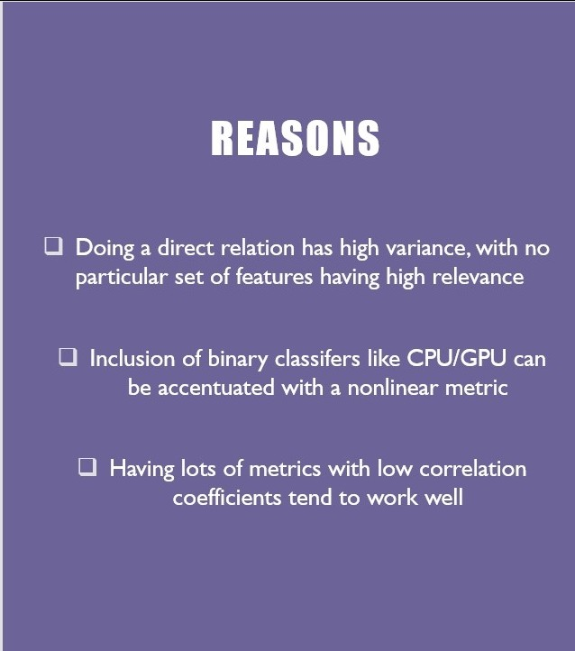
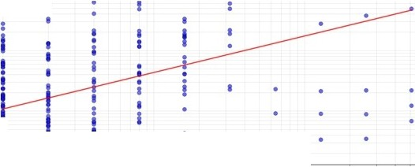
WHY MODEL?
Threshold vs Runtime
Correlation: 0,1935
,..
•
- Power law hl
I
I
I
• •
• • •
•
I
•
•
•
••
""
•
•
•
• •
...
c
0
^{.x} ...
,..
I
••
•
• • • •
...
,..
...
Threshold

Slide 22
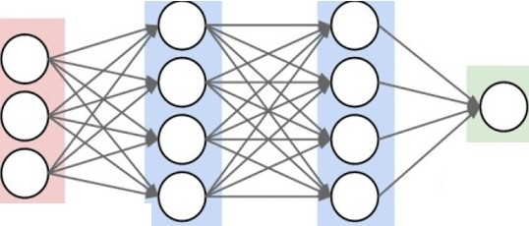
PYTORCH NEURAL NETWORK
FORMAT
Input (12 features)
!
Dense Layer ( 128 neurons) + ReLU
!
Dense Layer (64 neurons) + ReLU
!
output layer
Output (I number)= log₂(seconds)
Test: 12 Files ,Train: 24 Files
input layer
hidden layer 1
hidden layer 2
WHY NEURAl NETWORK?
I)
Captures complex, non-linear patterns
2)
Predicts continuous values
3) Hidden layers better find relations in features

Slide 23
RESULTS
PROBLEMS
Expected: 0.32s, Predicted: 0.69s, Er·r·or: 117.9% l::xpected: 0.2tls, Predicted: 0.33s, l::rr·or: 39.1% lxpected: 4. l8s, Predicted: 400.mJs, lrror: YOl/.2% I xpP(tf•d: ). ·).:;, Predicte-d: 4HH.nn.:;, I rr·or: lb899.b% l XfH'< t Pd: 4S1 .80•,, Pr·pdi ct Pd: 400.00<,, rrTor·: 11.s%
Fxpec tPd: 4}).07<.,, Pr'Pdic ted: 400.00'->, FrTor: S.4% Expected: 3.24">, Pr·edicled: 400.00<:., ErTor·: 12231.8'X Expected: 1.81s, Predicted: 400.00s, Errnr: 21940.6% lxpected: 32 .92s, Predicted: 400.00s, lrror: 21./% l xpectPd: 24. /9.:;, 1->rt>dictPd: 4nn. }B.:;, I rr·or: ) LI'%
lxpe·ctt"'d: '>.J9c.., Pr(•dictPd: J.Jf.:.,, rrror·: 'Jl.J%
rxpt'< tPd: 1.11·., Pr'(•dic tPd: J.11.... , rrT<H': 11.9% Expected: 29.90s, PrTdicled: 21.71s, ErTlH': 27.4% Expected: 16.65s, Predicted: 9.77s, Er·ror: tll.3% l::xpected: 1.08s, Predicted: 0.92s, l::rror: ltl./% lxpected: l.)tls, Predicted: l.lls, Lrror: tl'J.tl% IXpPCtPd: 1/.8)'>, Prf>dictC'd: ll.)'J'>, (r'r'Or': b.9%
rxpP<tPd: 17.'>'>'"-» rr·PdictPd: 6.47..,, rrTor·: 48.0%
FXpP< led: 0.'>6'>, Pr'('die. ll'd: 7.51<:>, FrTor·: 357.0%
Expe(ted: 0.495, Predi(ted: 1.15s, Er·r·<H': 133.8"k lxpected: 13.06s, Predicted: 16.22s, lrror: 24.2% Lxpected: ll.8ls, Predicted: Y.ltls, Lrror: l/.9% l xpPcted: 0.81<;, PredictPd: H. .-.., I rror': 'J8.8°k
( XPf'C t1•d: o. o·,, Pr·t¹d ic t Pd: o. o..,, r rr·or: 7.8%
•
Neural Network Serves as regression model
•
•
•
Had to clamp certain points due to high error
Does okay in predicting values < I second
Bad at predicting values > I second
•
Test I Train
•
Used suggested train/test split (24/ I 2)
•
Tried both random and suggested train/test split
Not much difference in results
•
Solution
•
Extract better features
Fix class imbalance I provide more datasets
FxpP< t Pd:
7.1s..,, rr·t,dic tPd: o.ns..., FrTor·: 77.1%
Expe( led: 1.645, PrTdi( led: 0.52<.:., ErT(H': 68.1%
Expected: 0.91s, Predi(ted: 1.8ls, Err·or: 105.6%
lxpected: U. 3Gs, Predicted: 0.8Gs, l:.rror: 14U.Y% I xpected: 11.GOs, Predicted: Y.8Js, l rror: 1•,.4% ( Xpt¹( tPd: 9.HJc.., PrC'dictC'd: 8.) Jc.., I rror: I5. 8",G
rxpP< t Pd: 1. }9•,, rr·Pdic t('d: 0.)1<..,, ffT(>r·: 87.0% FXpl'C. led: 1.00'.:>, rr·edie. led: 0.04<:>, FrTcn·: 95.7%
Expected: 1.495, Predi(ted: 1. 33".:., Er·r·or: 11.1% lxpected: 1. 2ls, Predicted: 0.YGs, l::rr·or: 24.9%

Slide 24
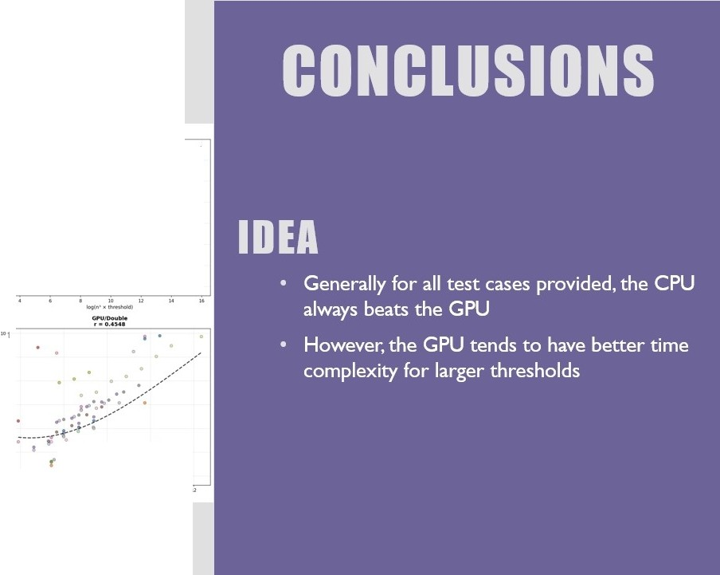
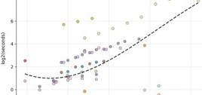
...._
.,...,.._
f •••,.,.
·---­
·---
'. 0.7).)7
-­
..
.......
··-
,/'
"
·-­
'
·.--.­..
/
,/'
.::.;-
...(. 1·.
r
:/,:;
/ ,'
c;.-v
•...._
/
... ,•
...
.. ,,''
/
1
..,,'"
·.=.-.-.
...,,-/
/
·.
•/
.·-
....... . .
.
. ._,.;­
. . .:.,"--
:.,.........
_
··---\.. ....,
.. -r··- ·-·1f · ••••
•• ,.t',' •
......⁻.....⁻.........,,.... .
'
-·
•I ...-,•
- -----
, ....u:n
I
..
.,. .
..
.
-·
!
-·
-·•-
....•._,.,...
•
•

Slide 25



Special thanks to iQuHack and iQulSE for providing us with this opportunity.
We also would like to thank Quantum Rings for giving us mentorship throughout their challenge!
QUANTUM
RINGS
Ethan, Frank. Hazel, Ryon,Varun
CHALLENGE
iQuHack
I
Winter 2026

Slide 26


