Slide 1

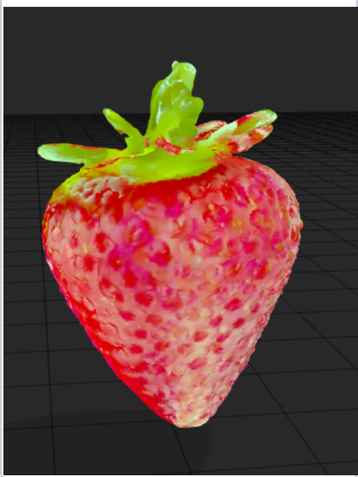
TriGenix
3D Object Generation and Analysis
Single-image reconstruction with Python and machine learning
A browser-based pipeline that turns one photograph into a coloured, inspectable 3D mesh.
Sumedha Gamare · Shruti Vyavahare
Data Science & Engineering Department · Usha Mittal Institute of Technology
SAMPLE OUTPUT · STRAWBERRY MESH

Slide 2
Project overview
PROBLEM / OBJECTIVE
WHY SINGLE-IMAGE 3D IS HARD
• A photograph gives no direct measurement of depth or hidden surfaces.
• Multi-view reconstruction needs many calibrated images; scanners add cost and equipment.
• Learned models can infer plausible geometry, but unseen details remain uncertain.
PROJECT AIM
Automate image-to-mesh generation in a local web app, then let users inspect and export the result.
INPUT
One uploaded image or webcam capture
OUTPUT
A coloured GLB mesh, browser preview, and STL / 3MF print exports
Goal: make model generation, quality checks, and print preparation accessible from one workflow.
TRIGENIX · 3D OBJECT GENERATION AND ANALYSIS
02 / 07

Slide 3
Related work
RESEARCH CONTEXT
DEPTH FROM ONE IMAGE
CONSISTENT NOVEL VIEWS
LEARNED 3D RECONSTRUCTION
Eigen et al. · 2014 · [1]
Shi et al. · 2023 · [2]
Hong et al. · 2023 · [3]
A coarse-to-fine network predicts depth from a single image. Single-view depth still has scale and hidden-surface ambiguity.
Zero123++ uses image-conditioned diffusion to generate a consistent multi-view set from one input view.
LRM predicts a neural radiance field from one image with a large transformer-based reconstruction model.
SINGLE-IMAGE MESHING
SURFACE EXTRACTION
Xu et al. · 2024 · [4]
Lorensen & Cline · 1987 · [5]
InstantMesh combines generated views with sparse-view reconstruction and differentiable mesh extraction.
Marching Cubes extracts triangle surfaces from volumetric data and relates to the project’s fallback route.
TriGenix connects view synthesis, depth estimation, mesh reconstruction, browser inspection, and print export.
TRIGENIX · 3D OBJECT GENERATION AND ANALYSIS
03 / 07

Slide 4
System workflow
IMPLEMENTATION
01
02
03
04
05
06
INPUT
PREPARE
SYNTHESIZE
ESTIMATE
RECONSTRUCT
DELIVER
›
›
›
›
›
Upload or webcam
Resolution / contrast checks
Background mask
Subject crop
Zero123++
6 novel views
Depth model
7 depth maps
TripoSR mesh
Visual-hull fallback
Repair + colour
GLB / STL / 3MF
WEB APPLICATION LAYERS
Frontend
Backend
User services
HTML / CSS / JavaScript with a Three.js model viewer.
Python API manages uploads, job progress, cancellation, and pipeline execution.
SQLite history, quality panels, accounts, and an optional print workflow.
Output files: GLB for interactive viewing; STL and 3MF for downstream 3D-printing workflows.
TRIGENIX · 3D OBJECT GENERATION AND ANALYSIS
04 / 07

Slide 5
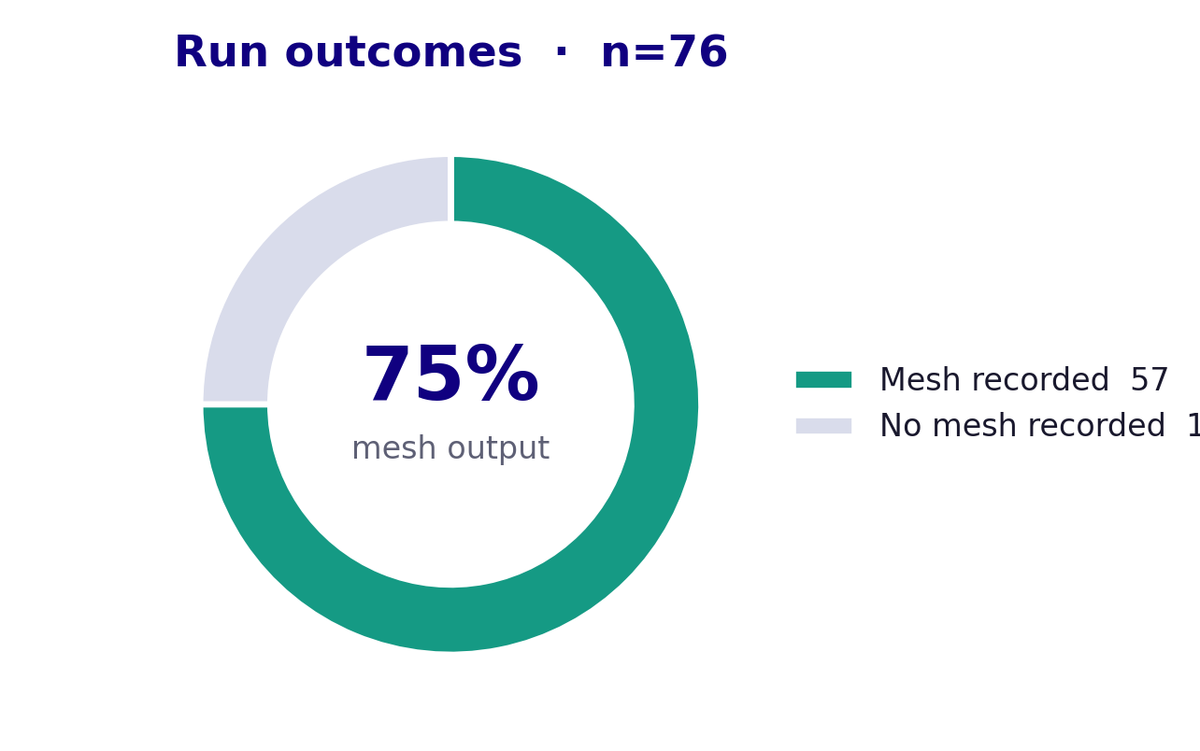
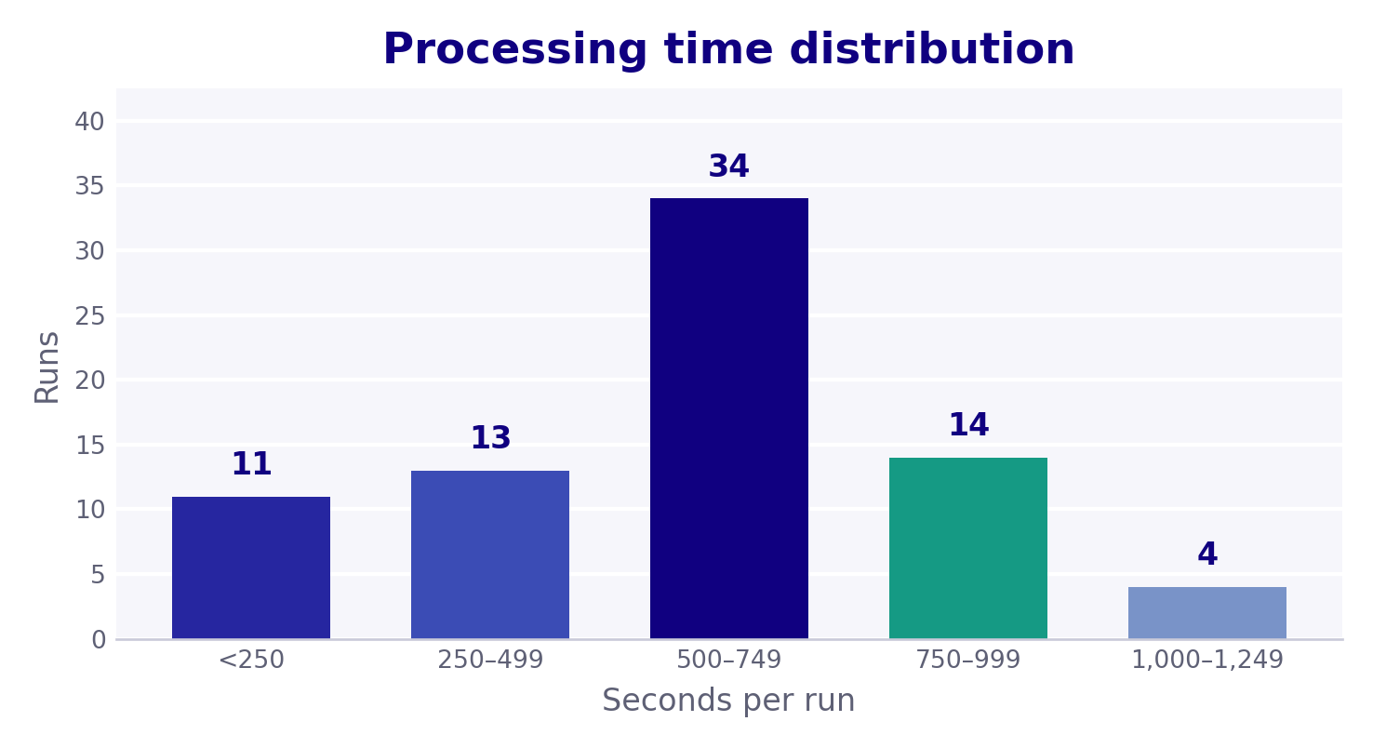
Run outcomes and performance
RECORDED PROJECT DATA
57/76 · 75%
runs with a mesh recorded
592.4 s average
Median 601.3 s · range 73.7–1154.0 s
Outcome counts measure mesh generation completion, not geometric accuracy. No reference-mesh benchmark is recorded.
TRIGENIX · 3D OBJECT GENERATION AND ANALYSIS
05 / 07

Slide 6
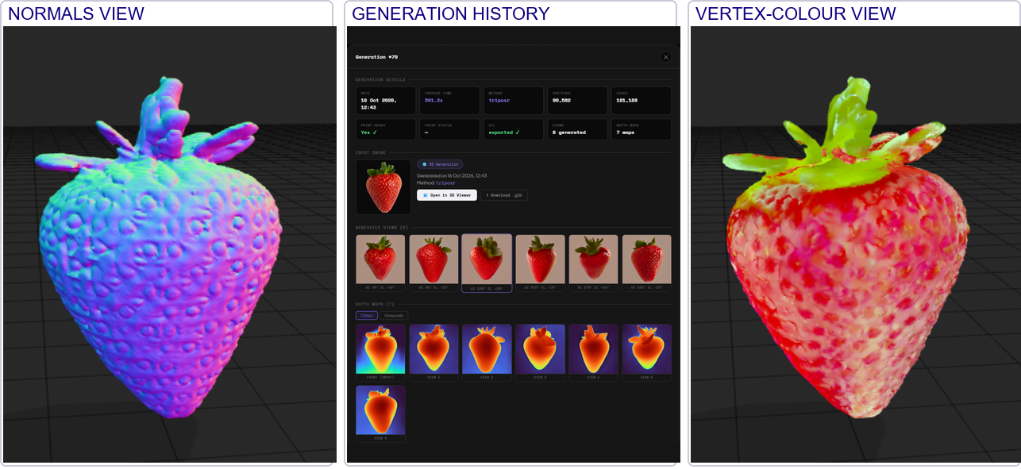
Example output
GENERATION #79
SAMPLE RUN
• Method: triposr
• Processing: 591.2 s
• Vertices: 90,582
• Faces: 181,188
• Views / depth maps: 6 / 7
• Print-ready: Yes
• STL exported: Yes
Viewer quality panel: geometry, surface, topology and texture 100; completeness 8; overall 82. These are application scores, not benchmark accuracy measurements.
Thin, hidden, or incomplete geometry still needs visual inspection before printing.
TRIGENIX · 3D OBJECT GENERATION AND ANALYSIS
06 / 07

Slide 7
Conclusion and references
SUMMARY
REFERENCES
WHAT THE PROJECT DELIVERS
• [1] D. Eigen, C. Puhrsch, and R. Fergus. “Depth Map Prediction from a Single Image Using a Multi-Scale Deep Network.” NeurIPS, 2014.
• [2] R. Shi et al. “Zero123++: A Single Image to Consistent Multi-view Diffusion Base Model.” arXiv:2310.15110, 2023.
• [3] Y. Hong et al. “LRM: Large Reconstruction Model for Single Image to 3D.” arXiv:2311.04400, 2023.
• [4] J. Xu et al. “InstantMesh: Efficient 3D Mesh Generation from a Single Image with Sparse-view Large Reconstruction Models.” arXiv:2404.07191, 2024.
• [5] W. E. Lorensen and H. E. Cline. “Marching Cubes: A High Resolution 3D Surface Construction Algorithm.” ACM SIGGRAPH Computer Graphics, 21(4), 163–169, 1987.
• A local, browser-based pipeline from one image to a coloured 3D mesh.
• Interactive inspection, run history, quality checks, and multi-format export.
• Print preparation alongside a web viewer.
NEXT STEPS
• Benchmark against reference scans and compare reconstruction methods.
• Evaluate InstantMesh, multi-GPU processing, and WebXR / Unity links.
TRIGENIX · 3D OBJECT GENERATION AND ANALYSIS
07 / 07

