Slide 1

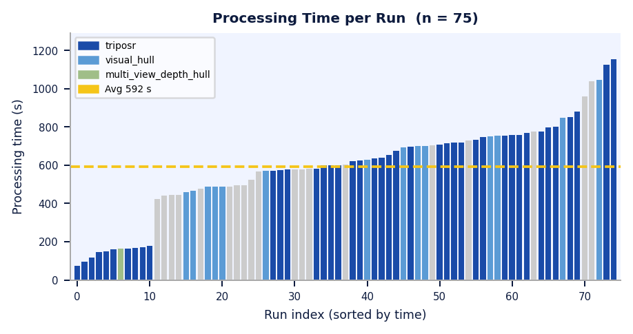
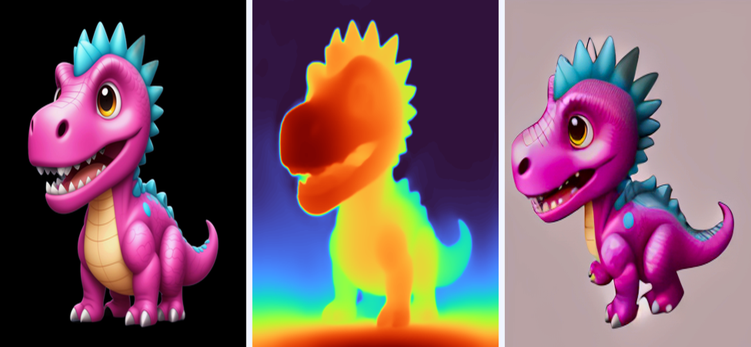
3D Object Generation and Analysis
Using Python and Machine Learning
Date: 21-10-2026
Presented by:
Sumedha Gamare
Shruti Vyavahare
Guide: Prof. Sheetal Mhatre
Usha Mittal Institute of Technology
S.N.D.T. Women's University
Data Science & Engineering Department
Abstract
Implementation / Results
Discussion
Generating a 3D model from one 2D photograph is an ill-posed computer-vision problem: depth is lost and the hidden sides are never seen. This project presents an automated web system that turns a single uploaded image (or webcam capture) into a coloured 3D mesh. Zero123++ synthesises six novel views, depth maps are estimated for all views, and a reconstruction stage (TripoSR, with a visual-hull + marching-cubes fallback) builds the mesh. The mesh is cleaned, vertex-coloured and exported as GLB for an interactive Three.js viewer. Phase-II adds quality checking, progress tracking, cancellation, e-mail alerts, analysis panels, user history and a 3D-printing workflow.
System: web app with a Python backend running the ML pipeline and a Three.js viewer in the browser.
Layers: Frontend (HTML/CSS/JS) -> Backend API (upload, progress, cancel, SQLite history) -> Processing pipeline.
Input: image upload or webcam capture, checked for resolution, brightness and contrast.
Output: coloured mesh as GLB, plus STL / 3MF for 3D printing.
1. Interpretation
One photo becomes a coloured, watertight mesh viewable in any browser.
Six synthesised views reduce the guesswork about hidden sides.
2. Literature comparison
TripoSR is fast but hallucinates unseen surfaces; photogrammetry needs 50-200 photos; scanners need special hardware; web services are paid and closed.
Ours is open, runs locally and adds progress, quality and analysis tools.
3. Analysis
39 of 51 runs (76.5%) produced a mesh; average 586.4 s per run.
Time grows with detail: under 400 s to over 1550 s per object.
4. Significance
Low-cost 3D content for e-commerce, games/VR, AR, medical models, 3D printing and robotics simulation.
1 Background removal (rembg) + crop
Table 1: Representative results
Introduction
2 Zero123++ → 6 novel views
Object | Time (s) | Verts | Faces
Toy dragon | 1553.8 | 77,726 | 155,464
Knife | 775.1 | 19,418 | 38,832
Strawberry | 878.9 | 90,582 | 181,188
3D models are needed in gaming, film, architecture, robotics, e-commerce, medical imaging and AR. Multi-view stereo needs dozens of calibrated photos, and structured-light or LiDAR scanners are costly and complex. Deep learning changes this: diffusion models synthesise consistent novel views from one image, transformers estimate depth from any photo, and large reconstruction models regress geometry directly. This project combines them into a practical, open pipeline that runs locally and gives non-technical users an interactive, downloadable 3D model from a single photograph.
3 Depth estimation → 7 depth maps
4 Mesh reconstruction (TripoSR / visual hull)
Run statistics
75 runs total, 39 with a 3D mesh
Avg 586.4 s (range: 74-1553 s)
Setup
Core i5, 16 GB RAM, 6 GB NVIDIA GPU
Python 3.11, PyTorch, Diffusers, trimesh
5 Cleanup: decimate, smooth, fill holes
Conclusion
6 Vertex-colour projection from views
A fully automated system now turns a single photograph into an interactive, coloured 3D model using Zero123++, depth estimation and mesh reconstruction, with login, history, multi-format export and a 3D-printing workflow. Future work: make InstantMesh the default to cut generation time, add multi-GPU processing, WebXR/Unity links and a mobile app.
7 GLB export → Three.js viewer
Literature Survey
Fig 1: Processing pipeline
Ranftl et al. [3] - DPT: Vision-Transformer backbone with dense heads for depth estimation.
Liu et al. [4] - Zero-1-to-3: diffusion model giving zero-shot novel views from one image.
Shi et al. [5] - Zero123++: six consistent views in a single denoising pass; used here.
Hong et al. [6] - LRM: transformer that maps images straight to a 3D triplane.
Xu et al. [7] - InstantMesh: LRM + FlexiCubes meshes from six views; our planned upgrade.
Lorensen & Cline [8] - Marching Cubes: triangle surfaces from volumetric data; used in the fallback.
References
[1] D. Eigen et al., "Depth map prediction from a single image using a multi-scale deep network," NeurIPS, 2014.
[2] B. Mildenhall et al., "NeRF: Representing scenes as neural radiance fields for view synthesis," ECCV, 2020.
[3] R. Ranftl et al., "Vision transformers for dense prediction," ICCV, 2021.
[4] R. Liu et al., "Zero-1-to-3: Zero-shot one image to 3D object," ICCV, 2023.
[5] R. Shi et al., "Zero123++: A single image to consistent multi-view diffusion base model," arXiv:2310.15110, 2023.
[6] Y. Hong et al., "LRM: Large reconstruction model for single image to 3D," ICLR, 2024.
[7] J. Xu et al., "InstantMesh: Efficient 3D mesh generation from a single image," arXiv:2404.07191, 2024.
[8] W. E. Lorensen and H. E. Cline, "Marching Cubes," ACM SIGGRAPH, vol. 21, no. 4, 1987.
Fig 2: Strawberry - masked input, depth map & novel view (90,582 vertices, 181,188 faces)

