Slide 1

23AID304- High Performance and Cloud Computing
Cloud-Based Distributed CNN for Multi-Class Blood Cancer Classification Using MPI on AWS ECS
A PRESENTATION BY TEAM NO. 5:
BL.EN.U4AID23006 (B G Rajath Siddarth)
BL.EN.U4AID23054 (V. Sidharrth)
BL.EN.U4AID23063 (Paruchuri Sai)
B. Tech Artificial Intelligence and Data Science,
Semester V, AID - F
Department of Artificial Intelligence, Amrita School of Artificial Intelligence, Bengaluru
1

Slide 2
INTRODUCTION
The project focuses on blood cancer classification using microscopic images of Peripheral Blood Smear (PBS) samples.
3,242 images (89 patients) suspected of Acute Lymphoblastic Leukemia (ALL).
The dataset includes the following classes:
Benign: 512 images
Malignant Pre-B: 955 images
Malignant Pro-B: 796 images
Malignant Early Pre-B: 979 images
A 2D Convolutional Neural Network for blood cancer classification.

Slide 3
MOTIVATION
CNN training: forward pass for feature extraction and a backward pass for updating weights.
Computational cost: During backpropagation, gradients must be calculated for every layer
Increase in training time with network depth.
Speed improvement and better utilization of resources via parallel computation.
Faster convergence and better feature representation for blood cancer image classification.

Slide 4
LITERATURE SURVEY
Title & Year | Methodology | Technologies Used | Challenges
A Hybrid CUDA, OpenMP, and MPI Parallel TCA-Based Domain Adaptation for Classification of Very High-Resolution Remote Sensing Images (2023) | Implemented a Transfer Component Analysis based convolutional neural network for domain adaptation. Optimized the entire pipeline using hybrid parallelism across multi-node, multi-GPU systems. | MPI for distributed computing, OpenMP for CPU multithreading, CUDA for GPU acceleration, SVM for classification. | Complex multi-level parallelism, high GPU–CPU data transfer cost, scalability management, maintaining classification accuracy while optimizing speed.
Parallel Paradigms in Modern HPC: A Comparative Analysis of MPI, OpenMP, and CUDA (2022) | Compared modern parallel computing paradigms. Suggested hybrid model usage for heterogeneous HPC systems. | MPI (distributed memory), OpenMP (shared memory), CUDA (GPU computing), Hybrid HPC systems. | Communication overhead in MPI, limited scalability of OpenMP beyond single node, hardware dependency of CUDA.
Parallel Classification Pipelines for Skin Cancer Detection Exploiting Hyperspectral Imaging on Hybrid Systems (2021) | Designed and evaluated 15 different pipeline variants for hyperspectral skin lesion classification. Combined CUDA and OpenMP to accelerate pre-processing, | CUDA for GPU acceleration, OpenMP for CPU parallelism, K-means segmentation, Hyperspectral Imaging (HSI). | Small dataset size, segmentation errors with similar spectral signatures, balancing CPU–GPU load for optimal speed, maintaining real-time performance.

Slide 5
LITERATURE SURVEY
Title & Year | Methodology | Technologies Used | Challenges
Deploying Deep Learning using AWS and DevOps (2022) | Proposed a step-by-step workflow for deploying trained deep learning models using AWS cloud infrastructure and DevOps practices (Docker + Flask + EC2). | AWS EC2, Docker, Flask, TensorFlow/Keras, Terraform, Python. | Lack of production-grade CI/CD setup, no autoscaling or monitoring, dependency management issues, single-instance deployment limits scalability.
Breast Cancer Detection Using Machine Learning and AWS (2021) | Applied traditional ML algorithms (SVM, KNN, Random Forest) on the Wisconsin Breast Cancer dataset for binary classification, and deployed models via AWS for web-based prediction. | AWS EC2, Python, Scikit-learn, Flask, HTML/CSS front-end. | Small dataset (risk of overfitting), limited feature engineering, simple deployment lacking monitoring, poor generalization to real-world clinical data.

Slide 6
DATA PARALLELISM
The same model is replicated across multiple devices, and each device processes a different portion of the dataset simultaneously.
Example:
Dataset of 3,242 images split across 4 nodes
Each node gets approximately 810 images.
Each node computes forward and backward passes independently.
Gradients are averaged across nodes to update model weights.

Slide 7
MODEL PARALLELISM
The model is split across multiple devices, where different layers or branches are computed on different devices.
Example:
Layer 1 (Conv2D + Pooling): Node 1
Layer 2 (Conv2D + Pooling): Node 2
Fully Connected + Output: Node 3
Each node handles part of the computation simultaneously, passing intermediate outputs forward.
Allows larger models to be trained and reduces memory bottlenecks.

Slide 8
WHY ONLY DATA PARALLELISM HAS BEEN CHOSEN OVER MODEL PARALLELISM IN THIS STUDY?
Model fits in memory.
Unnecessary complexity: Model parallelism adds overhead for layer splitting and synchronization, which isn’t needed for a relatively small model.
Efficient training with data parallelism: Dividing the dataset across nodes provides faster training with minimal overhead.

Slide 9
MASTER NODE DATA PREPARATION AND DISTRIBUTION
MPI (Message Passing Interface) used for parallel processing across CPU cores.
MPI.COMM_WORLD: group of all processes involved.
comm.Get_rank() : ID of the current process (master is rank 0).
comm.Get_size(): total number of processes running (here, 2).
Images are scanned and verified only on the master node (rank 0) to ensure data quality.
Data shuffled randomly to avoid bias and then split into train (70%), validation (15%), and test (15%) sets.
Training data divided into chunks equal to the number of processes.
comm.scatter() sends each chunk to a process, so every process gets its local training data for parallel processing.
Image augmentation (rotation, shifts, shear, zoom, flip, brightness) applied locally to batches.
Validation and test sets remain on the master node and are not augmented.

Slide 10
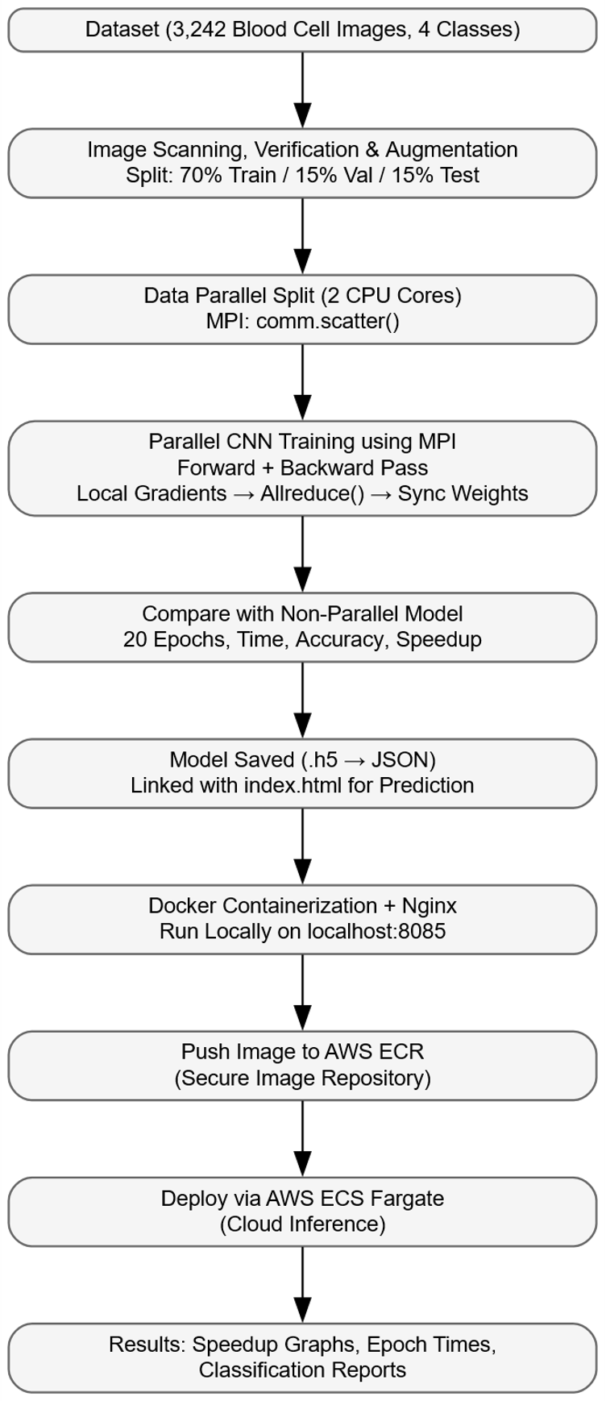
RESEARCH WORKFLOW

Slide 11
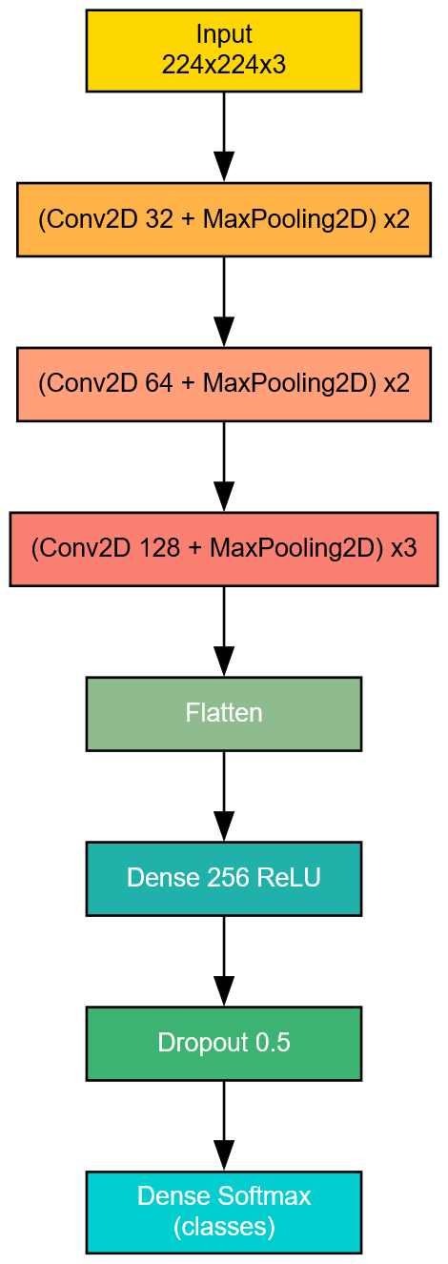
MODEL ARCHITECTURE

Slide 12
DATA PARALLELISM – FORWARD & BACKWARD PASS (LOCAL GRADIENT COMPUTATION)
Master node broadcasts initial weights to all processes using comm.Bcast() to synchronize models.
Each process performs a forward pass on its local batch and computes predicted outputs (logits).
Local loss calculated using categorical cross-entropy between predictions and true labels.
Backward pass performed using tf.GradientTape(), computing gradients of loss with respect to each model parameter.
Each process now holds local gradients for its batch.
comm.Barrier() ensures all processes finish forward and backward passes before aggregation.

Slide 13
PROPOSED METHODOLOGY
comm.Allreduce() sums gradients across all processes to obtain global gradients.
Averaged gradients computed by dividing summed gradients by the number of processes.
Each process updates its model weights synchronously using optimizer.apply_gradients().
comm.Barrier() ensures that all processes finish updating weights before moving to the next batch.

Slide 14
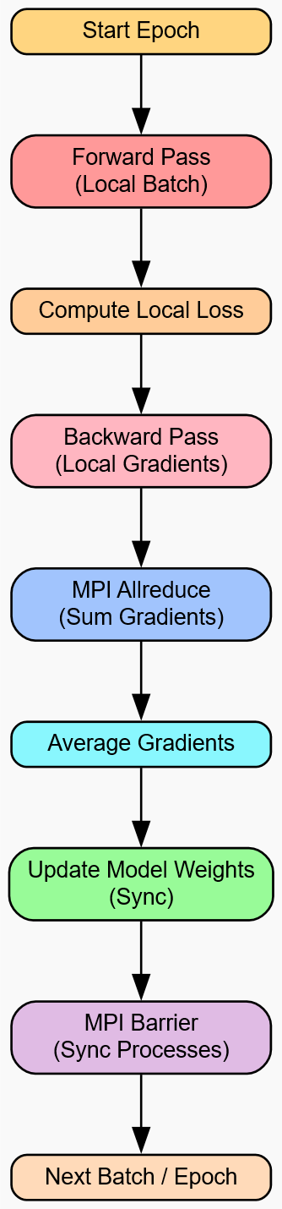
PROPOSED METHODOLOGY
Steps per epoch determined via comm.allreduce() to find minimum batches across ranks, avoiding early termination of any process.
Process repeats for all batches and epochs.

Slide 15
DOCKER DEPLOYMENT
Both parallel and non-parallel training files were run in the virtual environment.
python -m venv venv
venv\Scripts\activate
The trained model (.h5) was converted to JSON format and linked to index.html for image prediction into 4 classes.
A Docker image was created using Dockerfile based on Nginx. The image was built and tagged as first using: docker build -t second .
The container was run locally and accessed via browser at:
docker run -d -p 8085:80 second http://localhost:8085/index.html

Slide 16
CLOUD DEPLOYMENT (AWS-ECR)
The Docker image is first saved locally as a .tar file:
docker save -o second.tar second:latest
In AWS Cloud Shell, the image is uploaded and loaded using:
docker load -i second.tar
AWS ECR (Elastic Container Registry) : a secure, fully managed Docker image storage service is used to host and manage container images. We login to ECR repository.
aws ecr get-login-password --region ap-south-1 | docker login --username AWS --password-stdin 070785843125.dkr.ecr.ap-south-1.amazonaws.com
The image is tagged and pushed:
docker tag second:latest 070785843125.dkr.ecr.ap-south-1.amazonaws.com/repo1:latest
docker push 070785843125.dkr.ecr.ap-south-1.amazonaws.com/repo1:latest

Slide 17
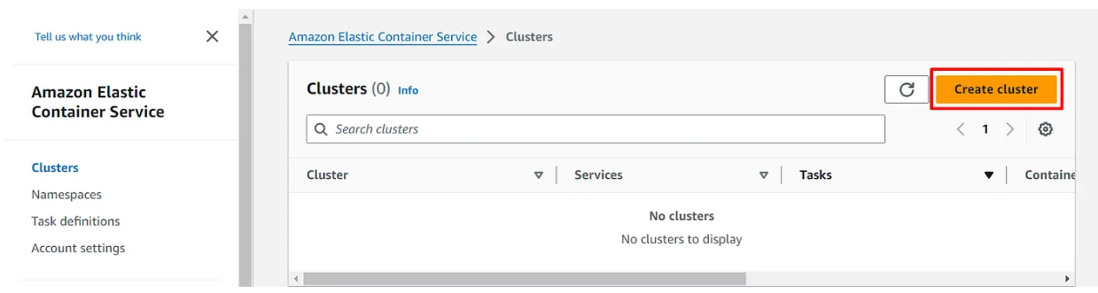
CLOUD DEPLOYMENT (AWS-ECS)
CLUSTER CREATION:
On the ECS dashboard, click on Create cluster

Slide 18
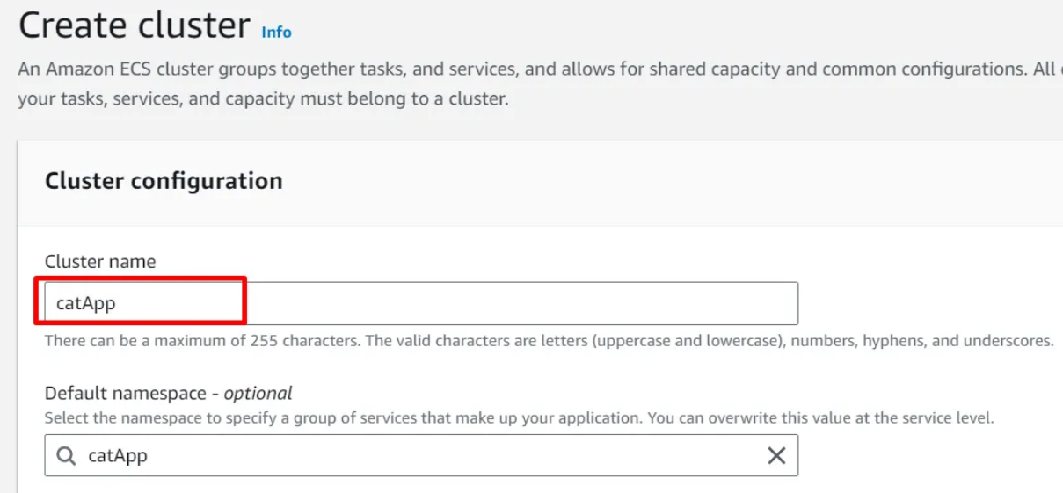
CLOUD DEPLOYMENT (AWS-ECS)
CLUSTER CREATION:
Under the Cluster configuration, enter the Cluster name

Slide 19
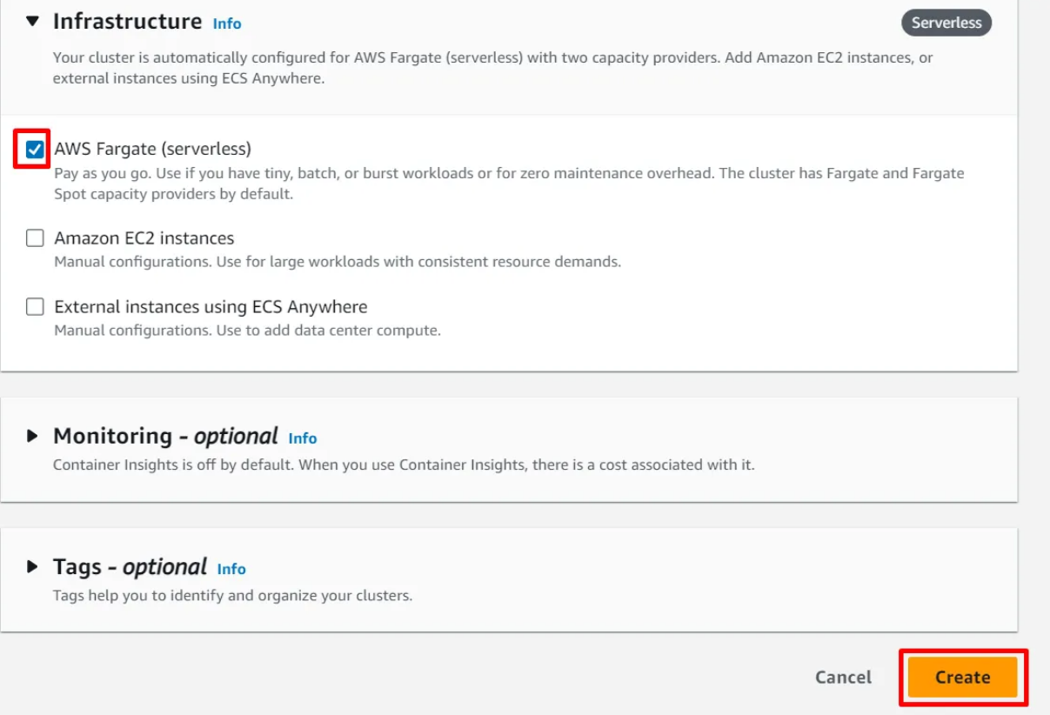
CLOUD DEPLOYMENT (AWS-ECS)
CLUSTER CREATION:
For the infrastructure, choose AWS Fargate (serverless). Scroll down and click on Create. After a few seconds, the cluster is created.

Slide 20
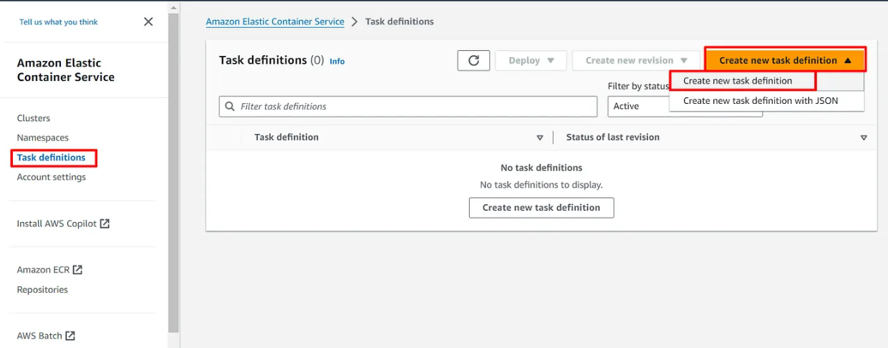
CLOUD DEPLOYMENT (AWS-ECS)
CREATING A TASK DEFINITION:
On the left navigation plane, click on Task definitions and click on Create new task definition then select Create new task definition

Slide 21
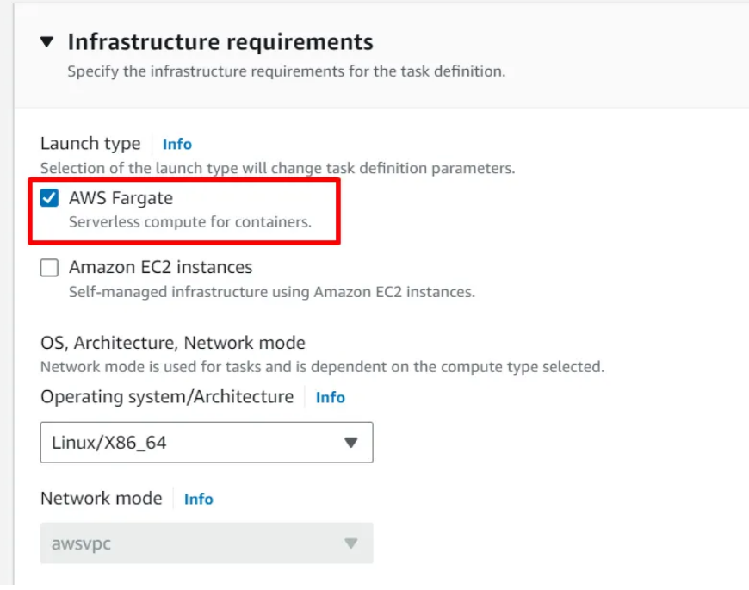
CLOUD DEPLOYMENT (AWS-ECS)
CREATING A TASK DEFINITION:
Give the task definition a family name and under the Launch type, select AWS Fargate.

Slide 22
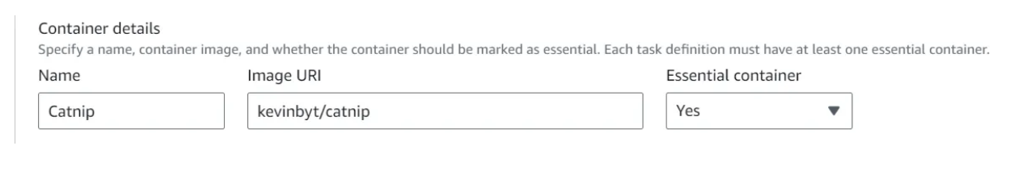
CLOUD DEPLOYMENT (AWS-ECS)
CREATING A TASK DEFINITION:
Under the container details, give the container a name and the repository url (The image url of the docker image pushed into ECR)
Set the container port to 8085 since our website runs on port 8085 and also set port 80 with TCP protocol for the container. Click on Create.

Slide 23
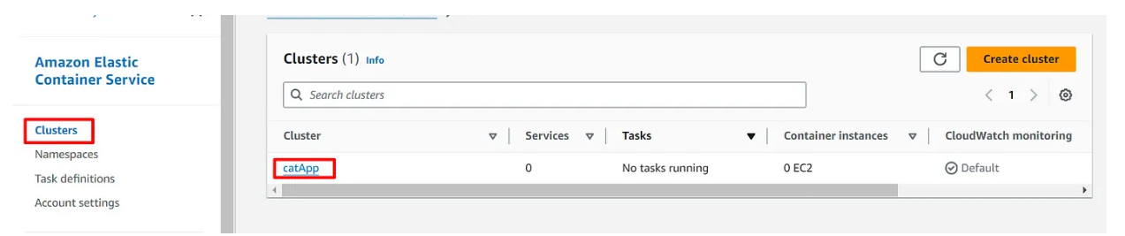
CLOUD DEPLOYMENT (AWS-ECS)
CREATING A SERVICE:
Now we need to create a service which creates the task in the task definition. On the ECS console, click on Clusters then select the cluster we created. Under the Services tab, click on Create

Slide 24
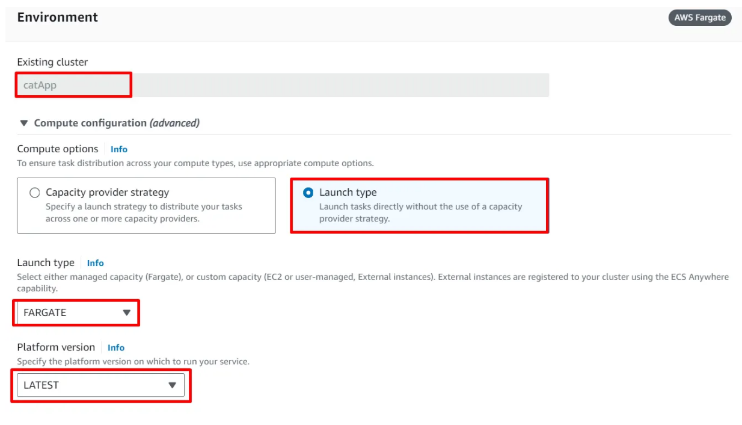
CLOUD DEPLOYMENT (AWS-ECS)
CREATING A SERVICE:
Use the following configurations:

Slide 25
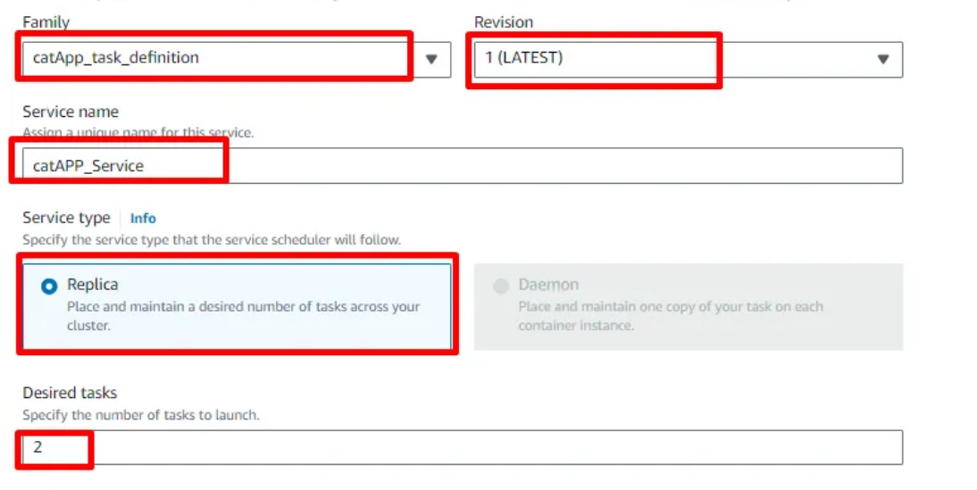
CLOUD DEPLOYMENT (AWS-ECS)
CREATING A SERVICE:
Do the following under Deployment configurations: (here we set number of tasks as 1)

Slide 26
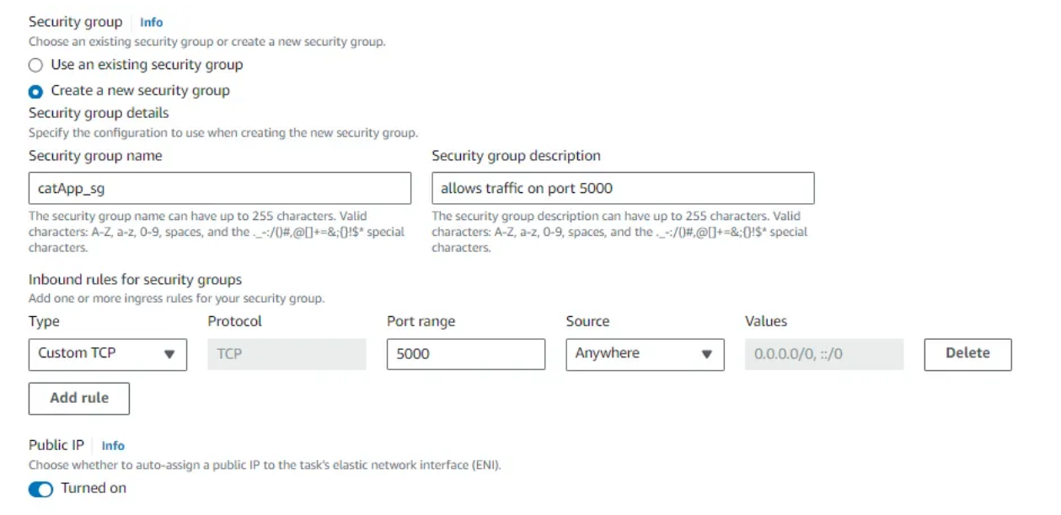
CLOUD DEPLOYMENT (AWS-ECS)
CREATING A SERVICE:
Under Networking, create a new Security group and allow TCP traffic on port 8085, as well as port 80. Here it is demonstrated for port 5000.

Slide 27
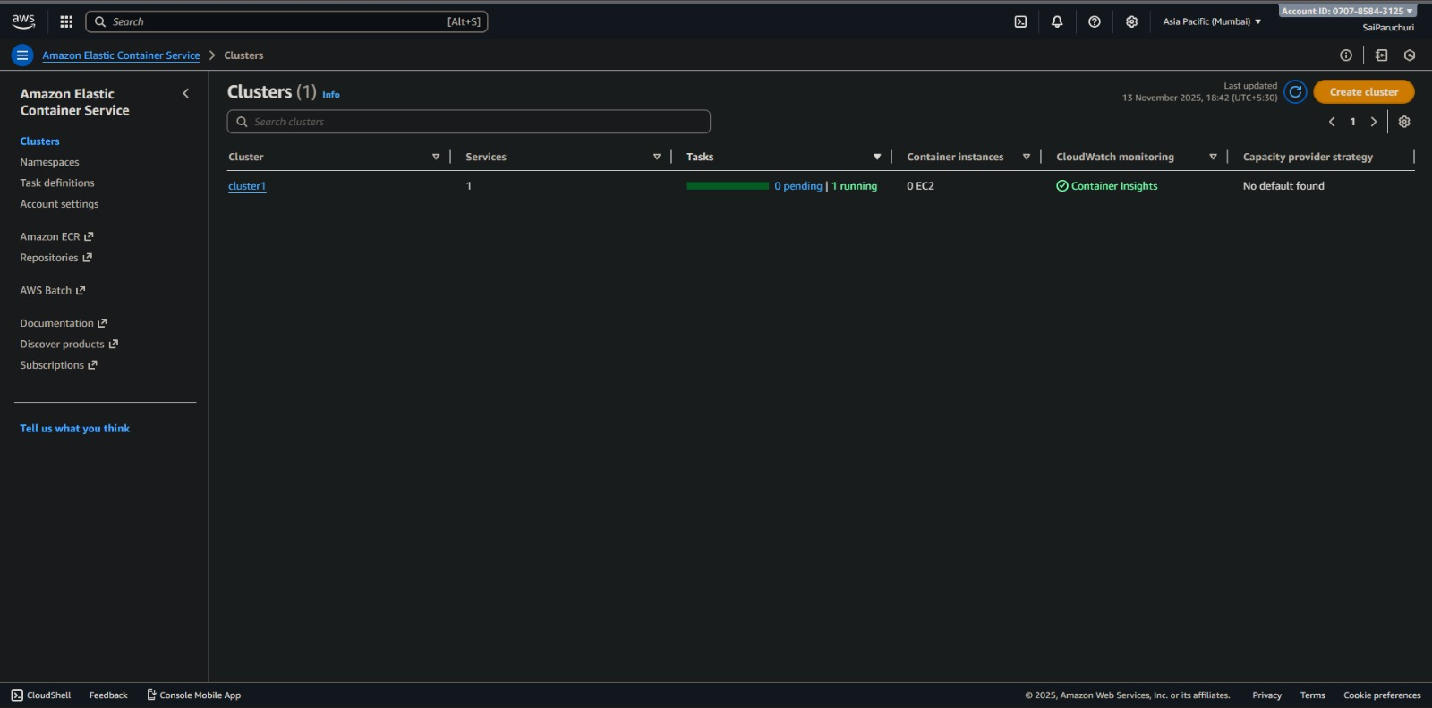
CLOUD DEPLOYMENT (AWS-ECS)
CREATING A SERVICE:
Under Networking, also create Virtual Private Cloud and subnet masks for creating public IP addresses. Scroll down and click on Create. Give it some time for the service to deploy successfully.

Slide 28
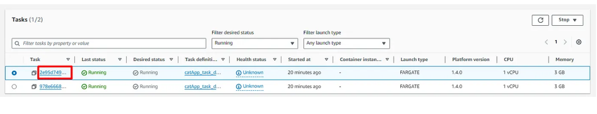
CLOUD DEPLOYMENT (AWS-ECS)
CREATING A SERVICE:
Select the service you created. Move to the Tasks tab and click on one of the running tasks.
Copy the ip address and paste it on a browser. Add the port number to the ip address. The app loads on the browser

Slide 29
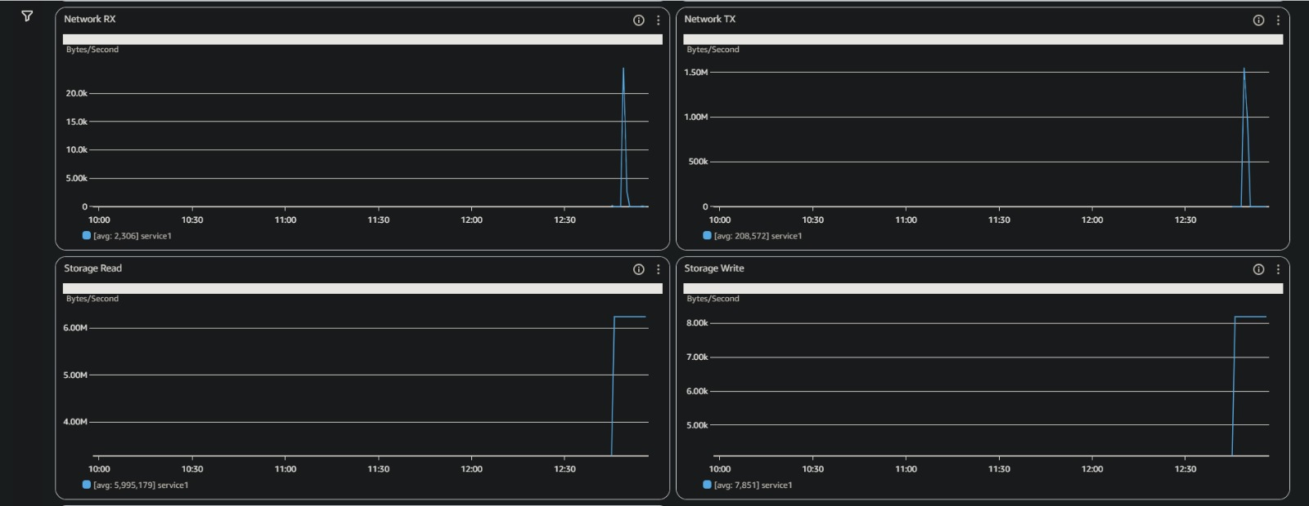
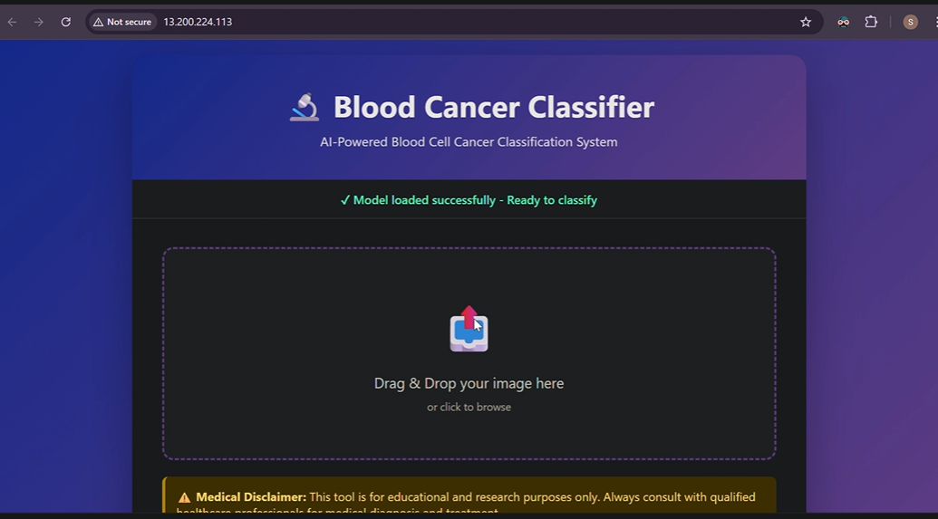
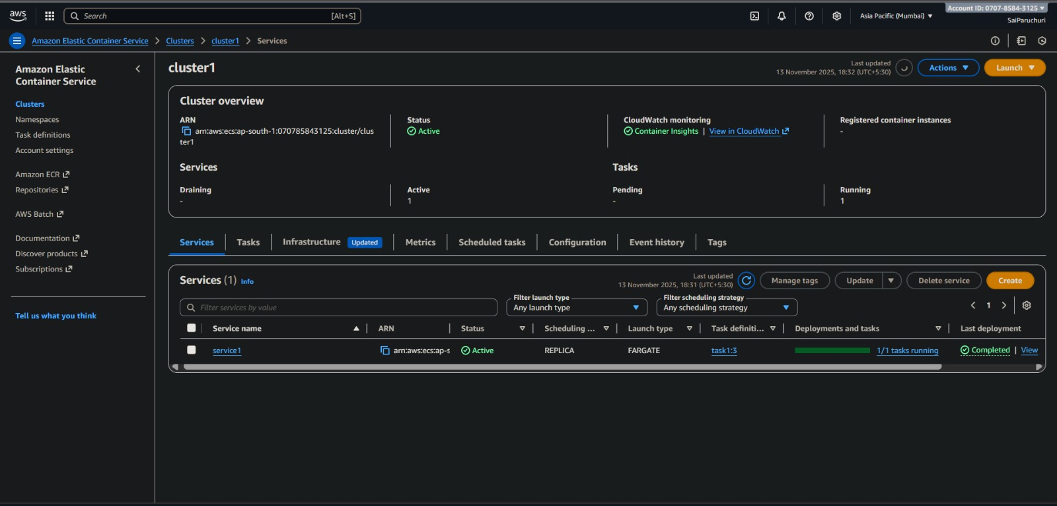
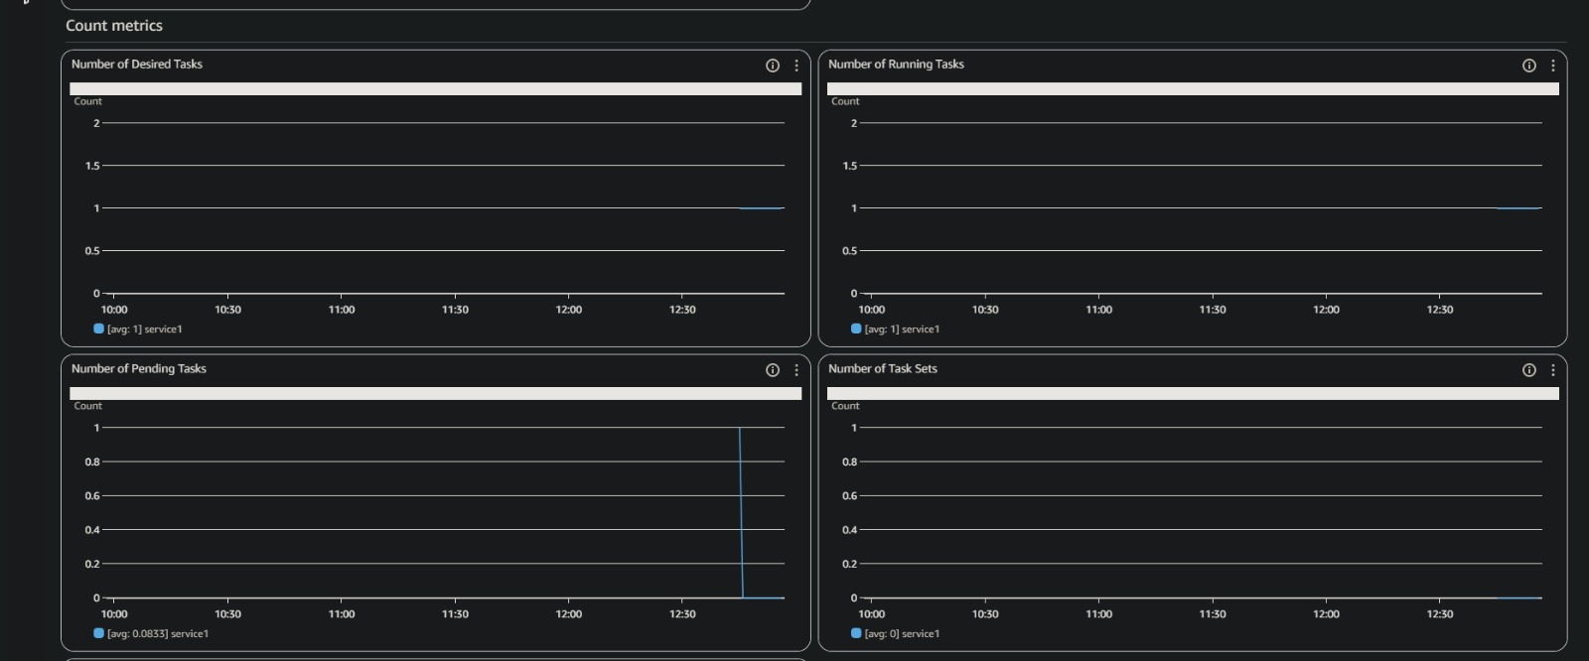

Slide 30
RESULTS AND ANALYSIS
Metric | Non-Parallel | Parallel (MPI)
Total Training Time (s) | 3117.43 | 3468.29
Validation Accuracy | 0.9321 | 0.9095
Test Accuracy | 0.9446 | 0.9055
Validation Loss | 0.2055 | 0.2752
Test Loss | 0.1896 | 0.2688
Train Throughput (img/s) | 0.7278 | 0.6542
Test Throughput (img/s) | 47.00 | 35.42
Parallelization slightly increased training time due to inter-process communication overhead, but maintained comparable accuracy and generalization performance.

Slide 31
RESULTS AND ANALYSIS
Class | Precision (Non-Parallel) | Recall (Non-Parallel) | F1 (Non-Parallel) | Precision (MPI) | Recall (MPI) | F1 (MPI)
Benign | 0.95 | 0.63 | 0.76 | 0.85 | 0.54 | 0.66
[Malignant] Pre-B | 0.99 | 0.98 | 0.98 | 0.99 | 0.93 | 0.96
[Malignant] Pro-B | 0.99 | 1.00 | 1.00 | 0.98 | 0.99 | 0.99
[Malignant] Early Pre-B | 0.87 | 0.99 | 0.93 | 0.80 | 0.96 | 0.88
Overall Accuracy | 0.94 |  |  | 0.91
MPI model achieved slightly lower accuracy in benign class due to smaller batch distribution, but malignant detection remained strong.

Slide 32
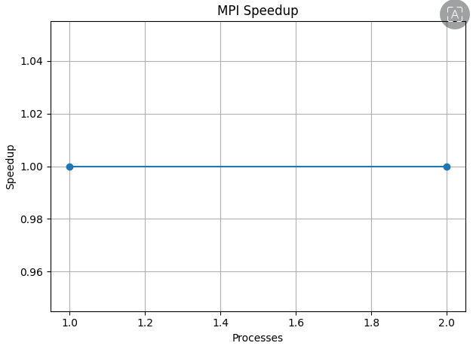
RESULTS AND ANALYSIS
Since the experiment ran on only two CPU cores, the communication overhead dominated the computational gain resulting in negligible speedup. Future scalability tests (on 4–8 cores) can show more benefit.

Slide 33
CONCLUSION
Successfully implemented data parallelism using MPI to train a CNN on a 3,242-image blood cancer dataset (4 classes).
Although parallelism added communication overhead, the model achieved similar accuracy as the non-parallel version.
The speedup remained 1.0 since inter-process communication cost outweighed computation benefits at small scale.
The trained model was effectively containerized using Docker with an Nginx web interface for real-time image prediction.
The Docker image was uploaded to AWS ECR (Elastic Container Registry) successfully.
The model was successfully deployed via AWS ECS Fargate, enabling scalable, cloud-based inference.
The workflow demonstrates the complete pipeline from parallel training to cloud deployment.

Slide 34
THANK YOU

