Slide 1

AMRITA SCHOOL OF ARTIFICIAL INTELLIGENCE, BENGALURU
B. Tech in Artificial Intelligence and Data Science (AID)
Fourth Semester, Section F, Academic Year: 2024-25
INTRODUCTION TO IOT (23AID212)
END-TERM PROJECT PRESENTATION
on
TRAFFIC SIGNAL OPTIMIZATION AND EMERGENCY VEHICLE PRIORITY SYSTEM
Presented by Group No. 05
B G Rajath Siddarth (BL.EN.U4AID23006)
V. Sidharrth (BL.EN.U4AID23054)
Palle Venkata Dharaneswara Reddy (BL.EN.U4AID23065)

Slide 2
Problem Statement
The increasing complexity of urban mobility
-persistent traffic congestion
-elevated fuel consumption
-environmental stress.
Conventional traffic control systems: time-based signal cycles.
Operate in isolation: inefficient traffic handling.
The lack of integration with real-time sensing and decentralized control mechanisms highlights the necessity for an intelligent, IoT-driven traffic management system capable of dynamic signal adaptation based on live traffic data and emergency event detection.

Slide 3
Introduction
Efficient traffic management: a need
Demand of smarter infrastructures by growing cities.
AI based or camera driven systems expensive.
IR sensors for vehicle detection and sound sensors for emergency detection.
ESP32 microcontrollers.
Designed to enhance traffic flow, reduce fuel wastage, and support emergency services efficiently.

Slide 4
Functionalities
Operates autonomously for traffic management using real-time sensor data and inter-node communication.
Vehicle density monitored via IR sensors positioned at a faraway point from the junction.
Dynamic count increase by 1, when a vehicle gets detected through the IR sensor.
Sound sensors: Automatically prioritize the corresponding lane by triggering the green signal.
Inter-node communication allows sharing of vehicle density between junctions.
Preemptive signal adjustment at downstream intersections for smoother traffic flow
Uses HTTP protocol to dynamically update webpage which gets updated every 5 seconds, based on traffic flow.

Slide 5
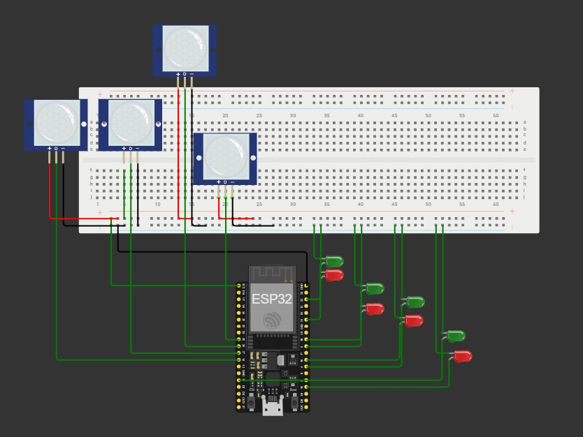
CIRCUIT DIAGRAM
Figure 1. Circuit Diagram

Slide 6
Hardware Components
Table 1. Hardware Components and their purpose
Component | Purpose
ESP32 | Central microcontroller for each intersection
IR Sensors | To detect intensity of traffic
KY-038 (Sound Sensors) | Emergency vehicle siren detection
Red and Green LEDs | Traffic light indicators
Breadboards | Mounting and wiring ESP32 and components

Slide 7
Conclusion
The proposed system offers a cost-effective, autonomous solution to modern traffic congestion challenges.
Eliminates reliance on expensive AI or camera-based systems by using IR and sound sensors for traffic and emergency detection.
ESP32-based nodes work both independently and cooperatively through Wi-Fi intercommunication, ensuring adaptive, decentralized traffic control.
Real-time data sharing and dynamic signal adjustment significantly improve traffic flow and reduce delays.
The system’s scalable design and use of affordable IoT components make it a practical foundation for next-generation smart city infrastructure.
Demonstrates how intelligent integration of sensing and connectivity can transform traditional traffic systems into responsive, efficient networks.

