Slide 1
Quantum-Classical Hybrid Classification for Malaria Cell Images
23AID303 – Quantum Computing and Applications
Team Number: 05
Reg.No | Name of the Student
BL.EN.U4AID23006 | B G Rajath Siddarth
BL.EN.U4AID23054 | V. Sidharrth
BL.EN.U4AID23063 | Paruchuri Sai

Slide 2
Introduction/Motivation
Malaria remains a global health issue.
Microscopic blood-smear cell images used for diagnosis.
Deep learning is effective; quantum methods emerging.
Goal: Apply hybrid quantum- classical classification on the Kaggle dataset.

Slide 3
Problem Statement
Problem definition: Binary classification of RBC
images as Infected or Uninfected.

Slide 4
Proposed Objectives
Objectives:
Build classical & hybrid quantum models.
Compare accuracy, F1-score, AUC, etc.
Analyze resource usage (parameters, qubits).

Slide 5
Dataset Details
Dataset: Kaggle Cell Images for Detecting Malaria
Total: 27,558 images (balanced)
Source: NIH blood smear dataset
Preprocessing: resize, normalize, augment
Common sizes: 64x64 or 128x128 pixels

Slide 6
Literature Review
Year | Title | Methodology | Results
2018 | Malaria Cell Image Classification Using Deep Convolutional Neural Networks | CNN with multiple convolutional layers; 80–20 train-test split; Adam optimizer | Achieved ~96% accuracy for classifying parasitized vs. uninfected cells
2019 | Transfer Learning for Malaria Cell Detection using VGG16 and ResNet50 | Fine-tuning pre-trained VGG16 and ResNet50; data augmentation to reduce overfitting | ResNet50 achieved 97.1% accuracy, outperforming CNN and SVM
2019 | Malaria Parasite Detection Using Image Segmentation and Classical ML | Segmentation + handcrafted features (GLCM, LBP) used with Random Forest, SVM, KNN | SVM achieved best performance with 92% accuracy
2020 | Efficient Malaria Detection Using CNN with Batch Normalization and Dropout | Custom CNN with dropout and batch normalization to improve generalization | Achieved 95.8% accuracy with reduced overfitting

Slide 7
Literature Review
Year | Title | Methodology | Results
2021 | Hybrid CNN-SVM Model for Malaria Diagnosis | CNN for deep feature extraction and SVM for final classification | Outperformed standalone CNN (98.1% accuracy vs. 96.5%)
2021 | Ensemble Learning for Malaria Detection | Combined outputs of ResNet, DenseNet, and InceptionV3 using majority voting | Achieved 98.7% accuracy with improved stability
2022 | Explainable Malaria Detection with Grad-CAM on ResNet50 | Used Grad-CAM on ResNet50 for interpretable predictions; tested on Kaggle dataset | Achieved 97.5% accuracy with visual explanations
2022 | Attention-based CNN for Malaria Cell Classification | Added attention mechanism to CNN to focus on infected cell regions | Accuracy improved to 98.4%, surpassing baseline CNN
2023 | Optimized CNN with Adaptive Learning Rate for Malaria Detection | Used AdamW with cosine decay for dynamic learning rate adjustment | Achieved 99.1% accuracy with faster convergence

Slide 8
Literature Review
Year | Title | Methodology (Classical + Quantum / Hybrid) | Results / Notes
2021 | Malaria Parasite Detection Using a Quantum-Convolutional Network | Classical preprocessing and localization → segmentation → hybrid classification where one branch uses quantum-convolutional layers; compared with a classical CNN | Quantum-convolutional model reported 100% accuracy on a validation split; classical CNN achieved ~98–99% accuracy
2024 | Quantum Convolutional Neural Networks for Malaria Cell Classification: A Comparative Study with Classical CNNs | Hybrid QCNN vs classical CNN on malaria cell classification using a standard Kaggle-like dataset | Classical CNN outperformed QCNN: CNN ≈ 75% accuracy, QCNN ≈ 54%

Slide 9
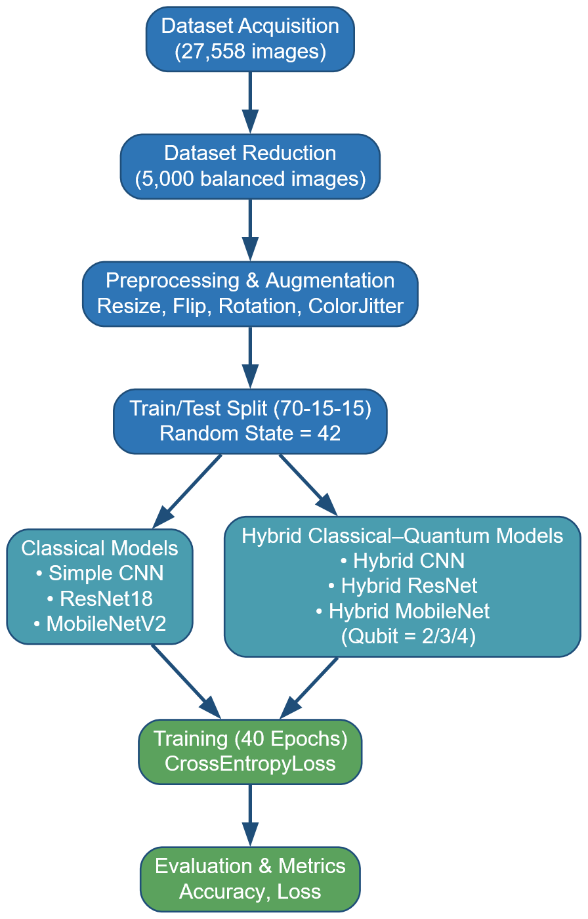
System Architecture

Slide 10
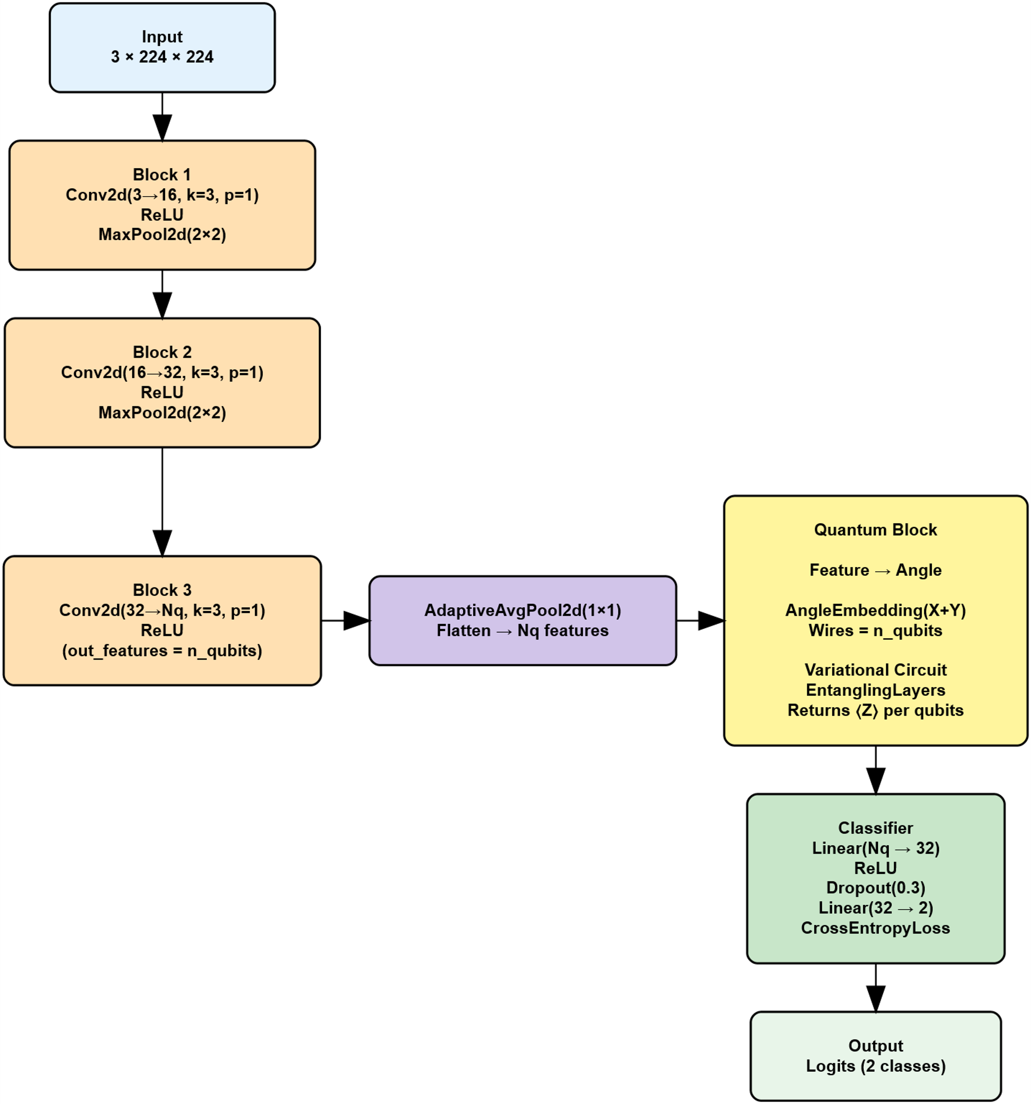
Methodology/Design
Hybrid CNN Architecture

Slide 11
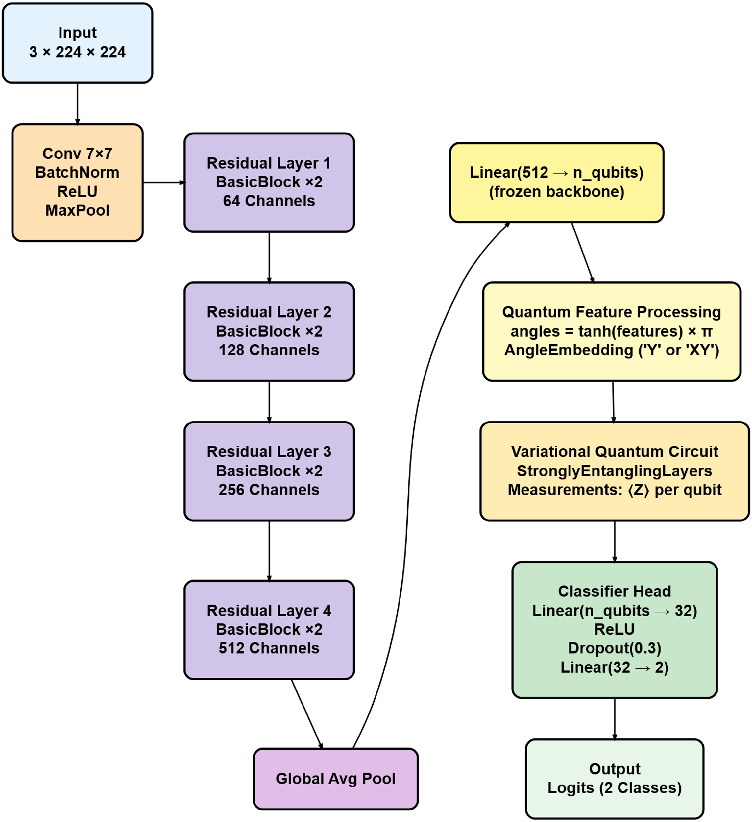
Methodology/Design
Hybrid ResNet Architecture

Slide 12
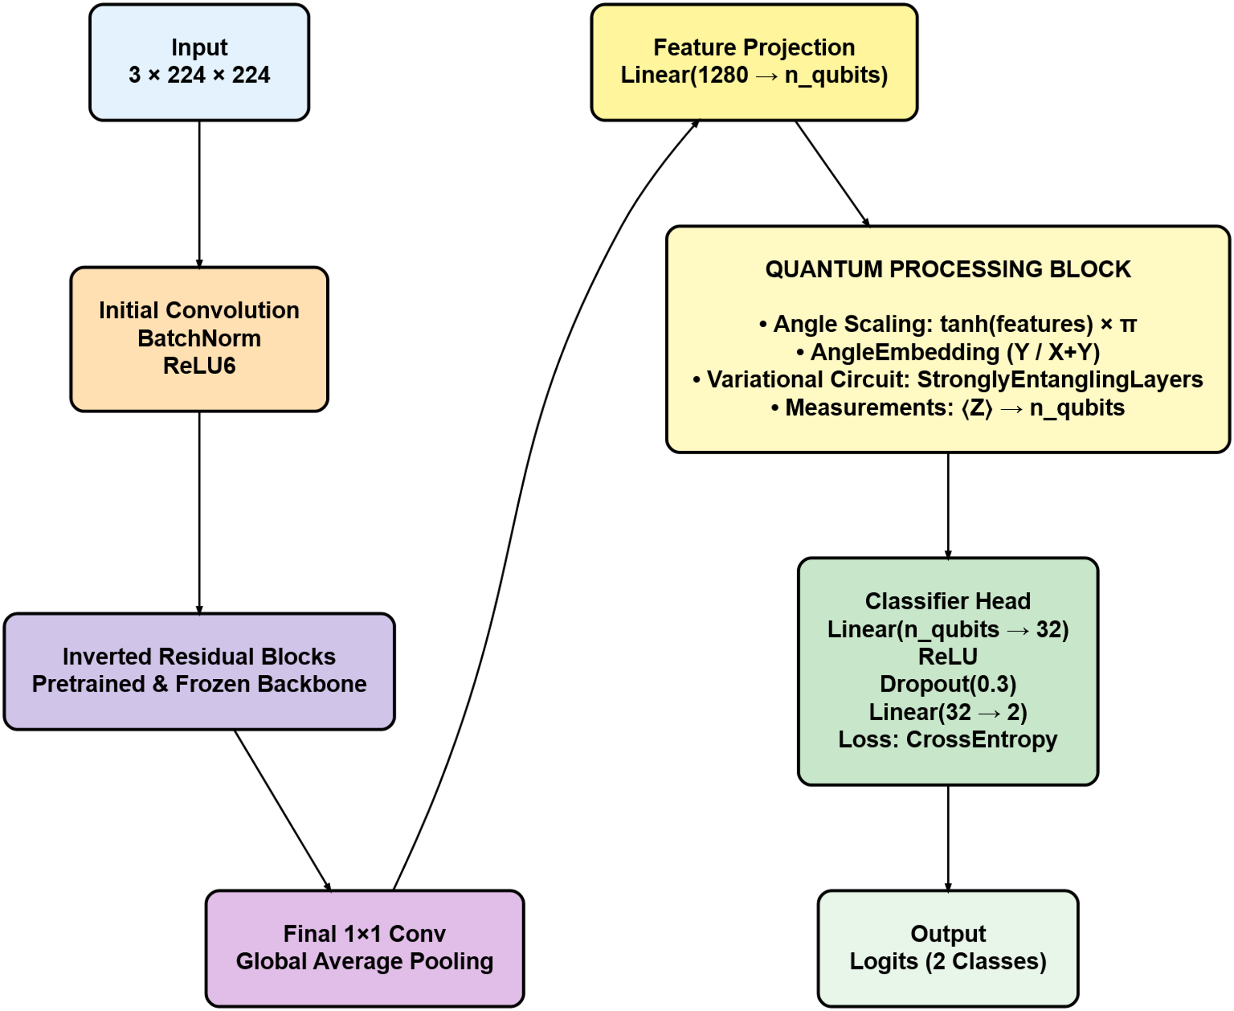
Methodology/Design
Hybrid MobileNet Architecture

Slide 13
Implementation Details
1.Dataset Preparation
Selected a balanced subset of 5000 images (2500 parasitized, 2500 uninfected).
All images were resized to 64×64 pixels to maintain uniformity across architectures.
Ensured full reproducibility using SEED = 42 for dataset selection and loader shuffling.
2. Data Augmentation
Applied augmentations to increase dataset diversity:
  Random horizontal flip
  Random rotation (20°)
  Color jitter (brightness, contrast, saturation)
  Tensor conversion
Ensured augmentation did not distort medically relevant features.
3. Dataset Splitting
Divided the dataset into:
  70% training, 15% validation, 15% testing
Provided a reliable balance between training volume and evaluation fairness.

Slide 14
Implementation Details
4. Classical & Hybrid Architectures
Implemented three classical models: Custom CNN, MobileNetV2, ResNet18.
Built corresponding hybrid versions: QCNN, Q-MobileNetV2, Q-ResNet18.
Classical backbones extracted 2–4 features which served as inputs to the quantum circuit in hybrid models.
5. Correlation-Based Circuit Configuration
Computed feature correlation matrices from classical backbones.
Circuit decision strategy:
  If off-diagonal correlation > 0.3 → use entanglement + XY rotations
  Else → use Y rotations only, no entanglement
Enabled dynamic selection of quantum circuit complexity based on learned feature relationships.

Slide 15
Implementation Details
6. Quantum Layer & VQC Implementation
Quantum Layer maps classical features into a quantum state via AngleEmbedding (Y or X+Y rotations).
Quantum Feature Mapping elevates data to Hilbert space, allowing nonlinear pattern capture.
Variational Quantum Circuit (VQC):
  Built using Strongly Entangling Layers with 2 variational layers (n_layers=2).
  Layers combine RX/RY rotations and CX entanglement gates.
Measurement: Each qubit measured in the Pauli-Z basis, producing one classical value per qubit.
Classical Head: Fully connected classifier processes quantum outputs → final binary classification.

Slide 16
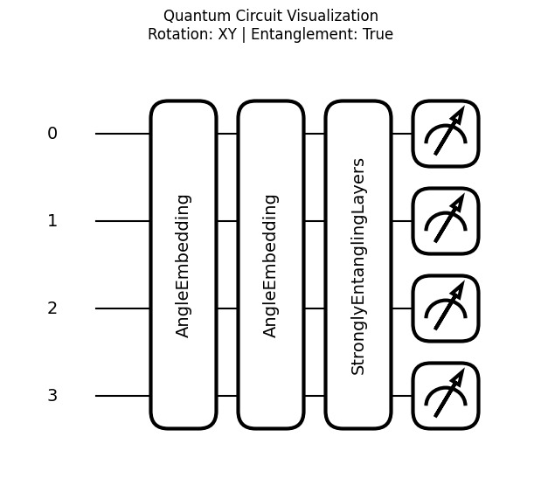
Implementation Details

Slide 17
Implementation Details
7. Training Configuration
Common hyperparameters:
  40 epochs, batch size 32, learning rate 0.001, Adam optimizer
  CrossEntropyLoss for binary output.
8. Evaluation Metrics
Models evaluated using:
  Accuracy, precision, recall, F1-score
  Full classification report
  Confusion matrix
Enabled systematic comparison of all classical and hybrid models.

Slide 18
Results and Discussion
Model | Accuracy (%) | Precision | Recall | F1-Score
Classical CNN | 92.93 | 0.9375 | 0.9200 | 0.9287
Classical MobileNetV2 | 60.67 | 0.6020 | 0.6293 | 0.6154
Classical ResNet18 | 87.87 | 0.8515 | 0.9173 | 0.8832
QCNN (2 qubits) | 87.60 | 0.8597 | 0.8987 | 0.8787
QCNN (3 qubits) | 92.67 | 0.9103 | 0.9467 | 0.9281
QCNN (4 qubits) | 93.47 | 0.9223 | 0.9493 | 0.9356
Q-MobileNetV2 (4q) | 87.07 | 0.8620 | 0.8827 | 0.8722
Q-ResNet18 (4q) | 86.00 | 0.8444 | 0.8827 | 0.8631

Slide 19
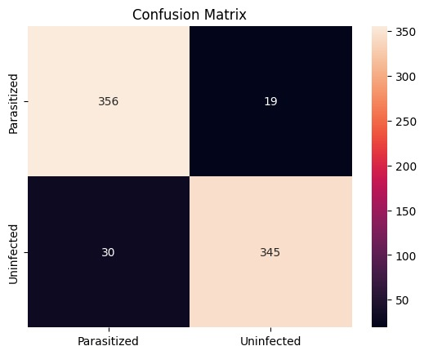
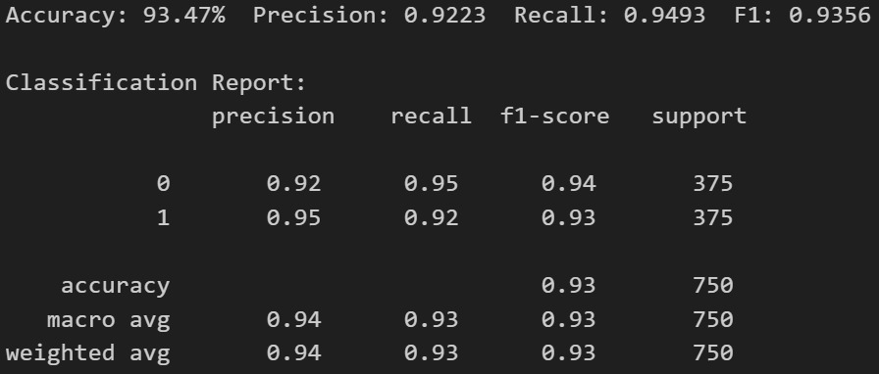
Results and Discussion
Report of Best Model QCNN with 4 qubits
Classification Report

Slide 20
Innovation/Critical Insight
Systematic Quantum Exploration: Conducted controlled experiments by varying qubit counts (2, 3, and 4 qubits) to identify the optimal quantum capacity; results showed 4 qubits consistently delivered the highest accuracy (93.47%) without excessive simulation overhead.
Adaptive Model Refinement: Based on the qubit optimization study, standardized all hybrid models (QCNN, Q-MobileNetV2, Q-ResNet) to 4-qubit VQCs to ensure fairness, stability, and meaningful cross-model comparison.
Architectural Diversity Testing: Explored how different feature extractors interact with quantum layers—demonstrating that quantum layers can significantly enhance lightweight networks (e.g., Q-MobileNet outperforming MobileNet) and boost representational richness in deeper models.
Evidence-Driven Methodology: Used real metric outcomes (accuracy, precision, recall, F1-score, confusion matrices) to iteratively refine design decisions, ensuring that conclusions are based on measurable performance rather than theoretical assumptions.

Slide 21
References
Rajaraman et al. (2018) – Demonstrated that pre-trained CNNs can serve as strong feature extractors for malaria parasite detection in thin blood smear images.
Liang et al. (2019) – Proposed an end-to-end deep CNN framework for automated malaria diagnosis using high-resolution smear images.
Sriporn & Wilaiprasitporn (2020) – Compared ResNet, Xception, VGG, and other deep learning architectures for malaria detection, showing ResNet’s strong performance.
Patel & Shah (2020) – Introduced lightweight CNN architectures suitable for mobile and edge-based malaria screening in low-resource environments.
Banerjee et al. (2022) – Developed a hybrid residual-attention network combined with SVM for improved parasite identification accuracy.
Hassan & Zhang (2022) – Utilized transformer and attention-based vision models for interpretable, globally contextual malaria parasite detection.
Kumar & Gupta (2021) – Explored a hybrid quantum–classical CNN architecture using parameterized quantum circuits for malaria parasite classification.

Slide 22
THANK YOU

