Slide 1

AMRITA SCHOOL OF ARTIFICIAL INTELLIGENCE, BENGALURU
B. Tech in Artificial Intelligence and Data Science (AID)
Third Semester, Section F, Academic Year: 2023-24
SOFTWARE DEFINED COMMUNICATION SYSTEMS (23AID203)
END-TERM PROJECT PRESENTATION
on
CLASSIFICATION OF WIDEBAND FREQUENCY MODULATION TECHNIQUES AND LOWER SIDE BAND MODULATION USING RTL-SDR
Presented by Group No. 04
B G Rajath Siddarth (BL.EN.U4AID23006)
V. Sidharrth (BL.EN.U4AID23054)
Palle Venkata Dharaneswara Reddy (BL.EN.U4AID23065)

Slide 2
Introduction
Enormous requirement of data transfer.
Spectral congestion and interference problems.
Development of communication systems.
Essential need for classifying modulation techniques.
Bandwidth efficiency, power efficiency, and error tolerance
Software Defined Radio and MATLAB

Slide 3
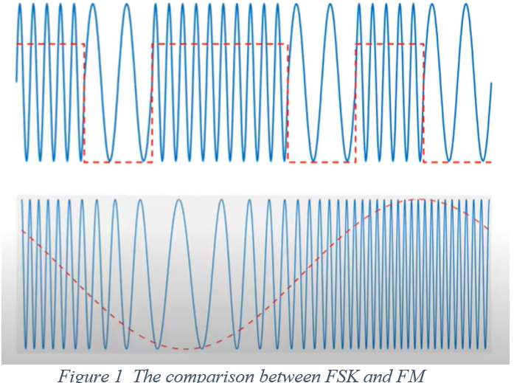
Simulation project
Binary Frequency Shift Keying:
To transmit digital information by switching a carrier between discrete frequencies.

Slide 4
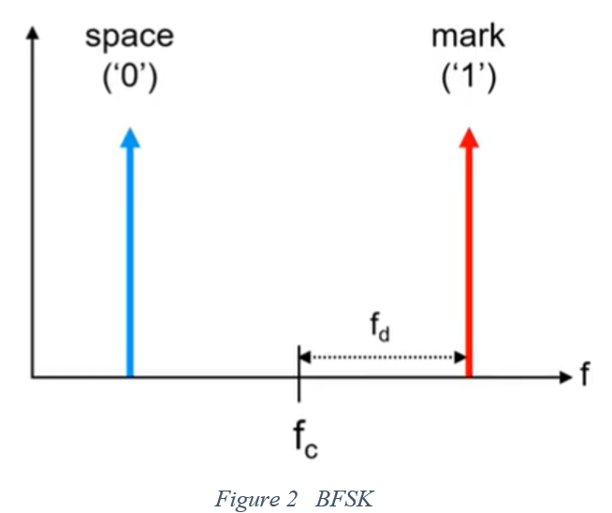
The number of discrete frequencies can be:
Two- binary FSK
More than two: M-ary FSK
Binary FSK (or BFSK) uses two frequencies:
Mark
Space
What is frequency deviation or shift?

Slide 5
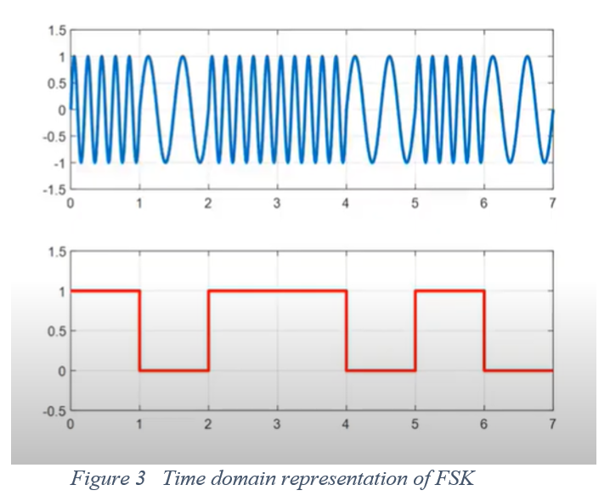
Bit rate = Baud rate.
In each symbol interval a zero or a one, can be transmitted.
Looking at the time domain representation of FSK, it can be clearly seen that the amplitude of carrier does not change.
Used in amplifier design and selection.

Slide 6
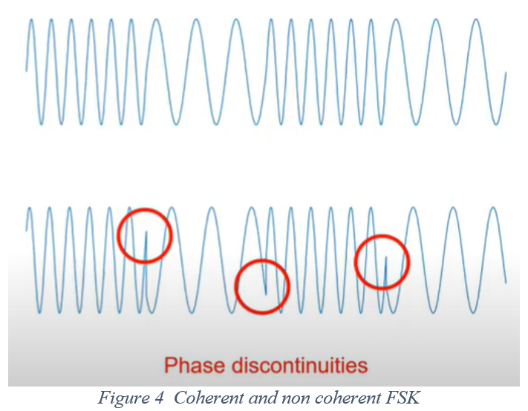
Coherent FSK: Same oscillator
Non coherent FSK: Separate oscillators
Non coherent FSK- phase discontinuities
Disadvantageous yet cheap!
Variants of coherent FSK

Slide 7
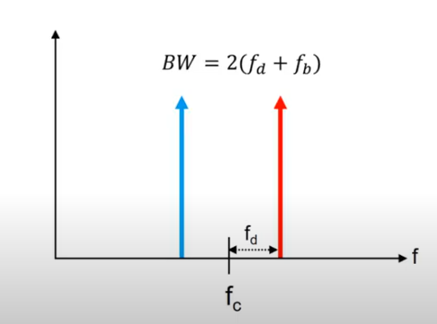
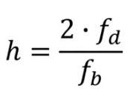
Minimum bandwidth and modulation index
Optimal detection h>=1
Some coherent FSKs detect signal when h<1
Figure 5 Minimum FSK bandwidth

Slide 8
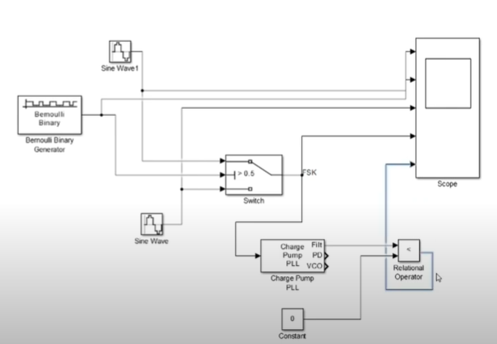
FSK Modulation and Demodulation
Figure 6 FSK Modulation and demodulation

Slide 9
Hardware Project
Workflow of the project
Interface the RTL SDR source in GNU Radio Companion.
Make the necessary connections as per the block diagram.
Extracting the real and imaginary components of the signal, i.e., the inphase and quadrature part by connecting to a file sink block.
Tune the FM signals for better hearing in the audio sink and extract the CSV files from file sink.

Slide 10
Upload the captured signals files to Google Collaboratory and convert to array with the help of numpy dependency.
Convert the arrays to Pandas Dataframe by importing pandas dependency and label the target column accordingly.
Extract the relevant no. of instances from each dataset.
Check for missing values in each dataframe and remove them.
Concatenate the three dataframes into one dataframe.

Slide 11
Assign the training data size as 80% and keep aside 20% of data as training data.
Train the machine learning models and generate the classification report.

Slide 12
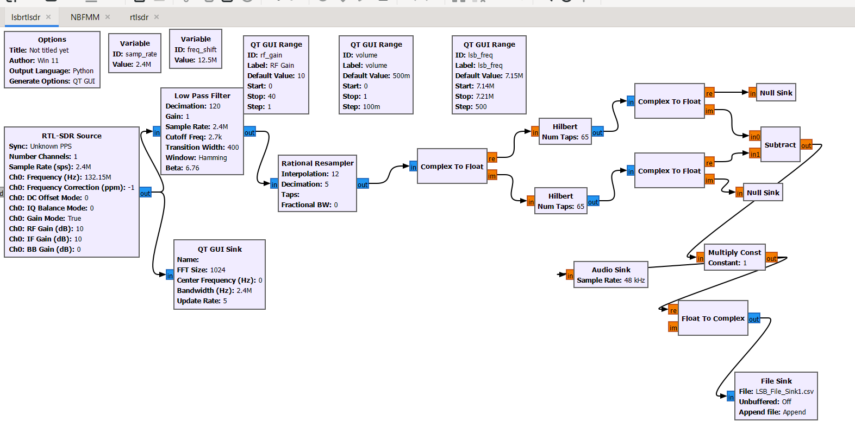
Lower Side Band Modulation

Slide 13
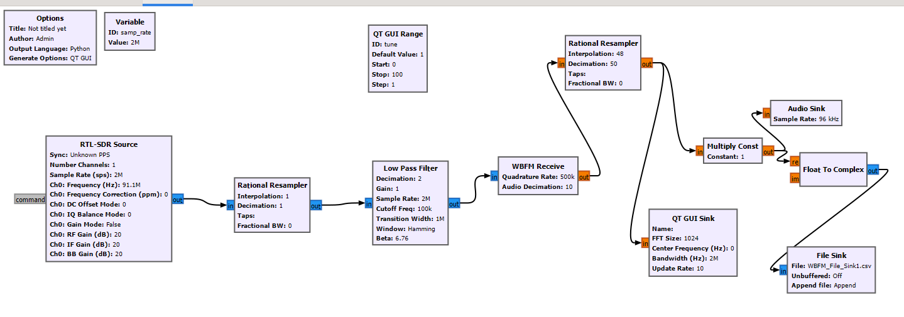
Wideband frequency modulation:

Slide 14
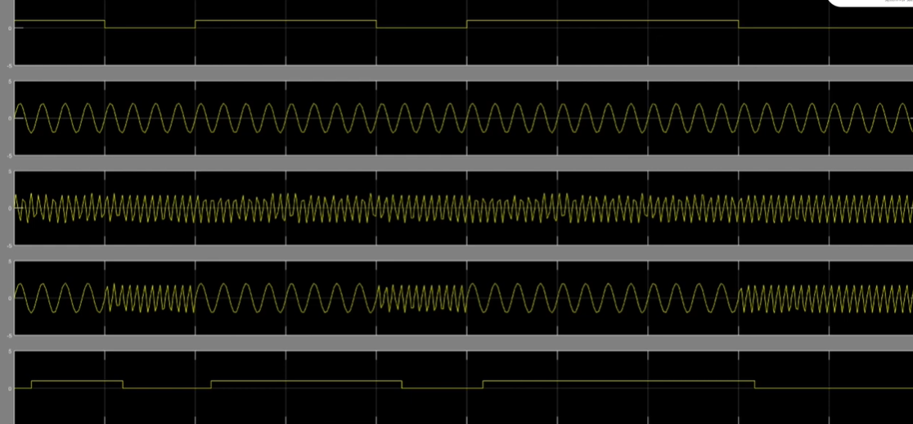
Results and analysis
Simulation project:

Slide 15
Hardware Project:
Highest accuracy: 77%
Real and imaginary components: not proper validation of patterns of features of signal.
Model | Accuracy
KNN | 77
Decision Tree | 73
Random Forest | 73
XGBoost | 72

Slide 16
Thank You!

