Slide 1

23AID311- Analog Computing
Van der Pol Oscillator
A PRESENTATION BY TEAM NO. 3:
- BL.EN.U4AID23003 (Amara Pranav)
BL.EN.U4AID23006 (B G Rajath Siddarth)
BL.EN.U4AID23054 (V. Sidharrth)
BL.EN.U4AID23063 (Paruchuri Sai)
Course Mentor:
Dr. Sirisha Tadepalli
B. Tech Artificial Intelligence and Data Science,
Semester VI, AID - F
Department of Artificial Intelligence, Amrita School of Artificial Intelligence, Bengaluru
1

Slide 2
INTRODUCTION
At the beginning of the twentieth century, vacuum tubes were used to control the flow of electricity in the circuitry of transmitters and receivers.
Van der Pol experimented with oscillations in a vacuum tube triode circuit.
All initial conditions converged to the same periodic orbit of finite amplitude.
Behaviour different from that of solutions of linear equations.

Slide 3
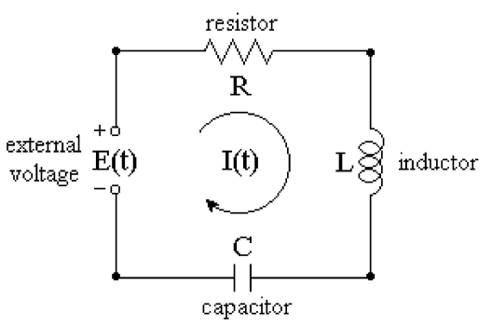
BACKGROUND
Consider an electrical RLC circuit.
Consists of an inductor, a capacitor, a resistor.
Assume that the voltage source is a battery (E(t) = E constant).
When the battery switch is closed, a current I(t) begins to flow in the circuit according to Kirchhoff’s Voltage Law:
LI’ + RI + Q/C = E
where Q’=I
Differentiating both sides of this equation:
LI” + RI’ + I/C = 0
Compare the above with damped harmonic oscillator
my’’+dy’+ky=0
Therefore, this represents a second order linear ODE which is a damped harmonic oscillator.

Slide 4
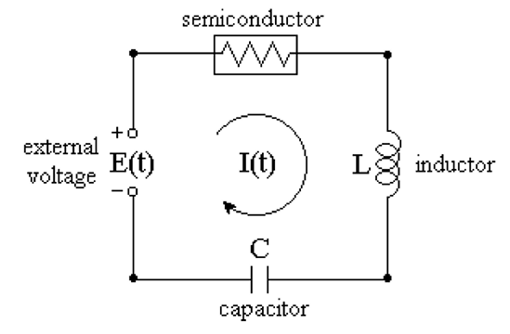
MODIFIED CIRCUIT
Used an active element (an array of vacuum tubes – semiconductor) instead of a passive resistor.
Semiconductor when current is:
Low: Acts as if pumping energy in system.
High: Acts as if damping energy of system.
But resistor simply dissipates energy.
Interplay between energy injection and energy absorption
->periodic oscillation in voltages and currents.
Suppose a power supply is attached to circuit and circuit is energized.
At time t=0, the external source is switched out, E(t)=0.
Voltage drop at semiconductor: NOT a linear function of I(t).

Slide 5
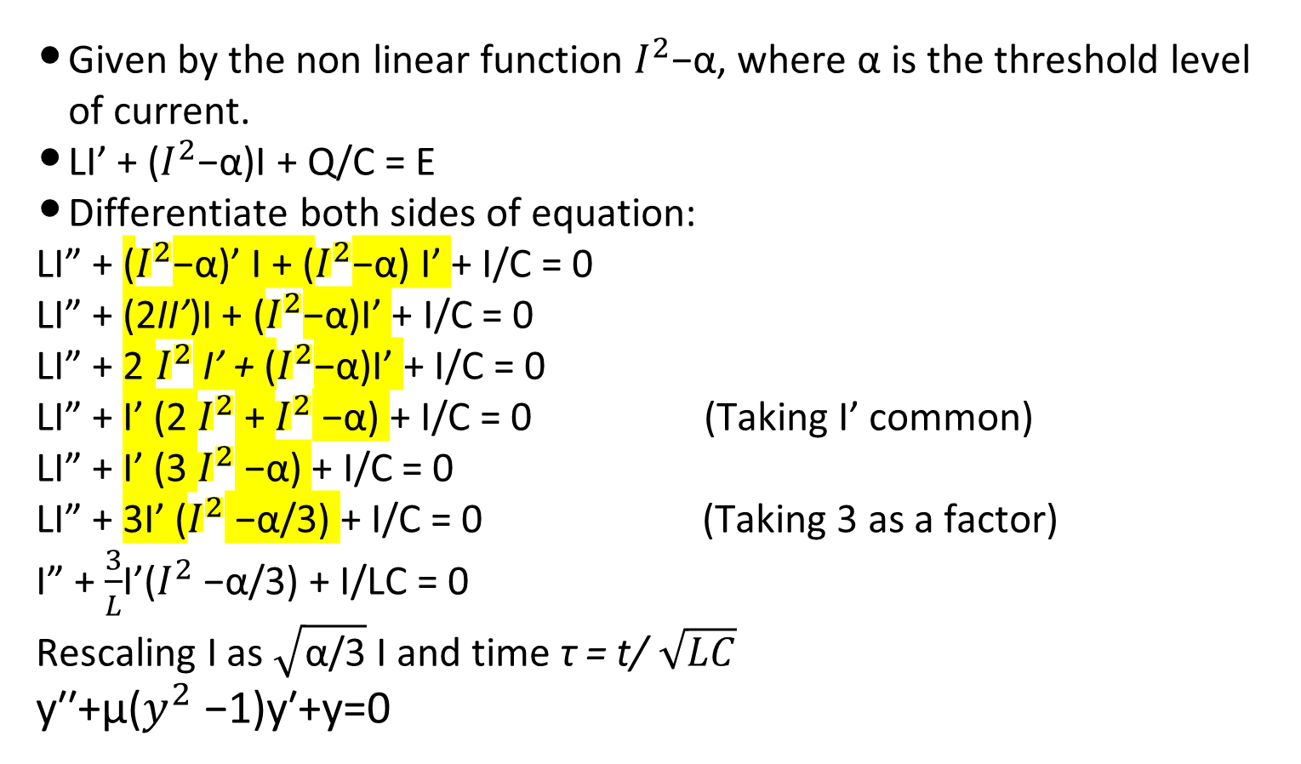
MODIFIED CIRCUIT
Given by the non linear function $I^{2}$−α, where α is the threshold level of current.
LI’ + ($I^{2}$−α)I + Q/C = E
Differentiate both sides of equation:
LI” + ($I^{2}$−α)’ I + ($I^{2}$−α) I’ + I/C = 0
LI” + (2II’)I + ($I^{2}$−α)I’ + I/C = 0
LI” + 2 $I^{2}$ I’ + ($I^{2}$−α)I’ + I/C = 0
LI” + I’ (2 $I^{2}$ + $I^{2}$ −α) + I/C = 0 (Taking I’ common)
LI” + I’ (3 $I^{2}$ −α) + I/C = 0
LI” + 3I’ ($I^{2}$ −α/3) + I/C = 0 (Taking 3 as a factor)
I” + $\frac{3}{L}$I’($I^{2}$ −α/3) + I/LC = 0
Rescaling I as $\sqrt{\text{α}\text{/3}}$ I and time τ = t/ $\sqrt{LC}$
y′′+μ($y^{2}$−1)y′+y=0

Slide 6

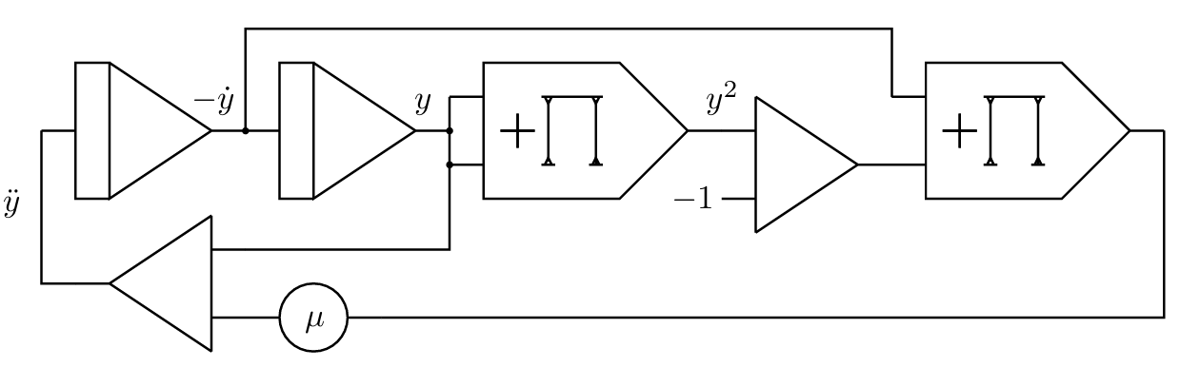
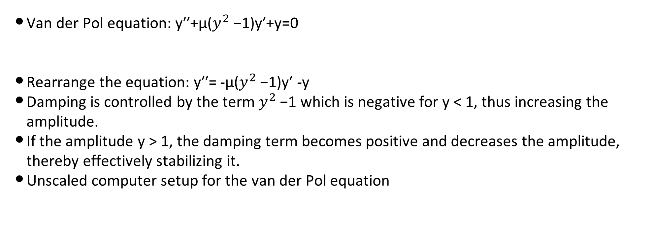
VAN DER POL EQUATION
Van der Pol equation: y′′+μ($y^{2}$−1)y′+y=0
Rearrange the equation: y′′= -μ($y^{2}$−1)y′ -y
Damping is controlled by the term $y^{2}$−1 which is negative for y < 1, thus increasing the amplitude.
If the amplitude y > 1, the damping term becomes positive and decreases the amplitude, thereby effectively stabilizing it.
Unscaled computer setup for the van der Pol equation

Slide 7
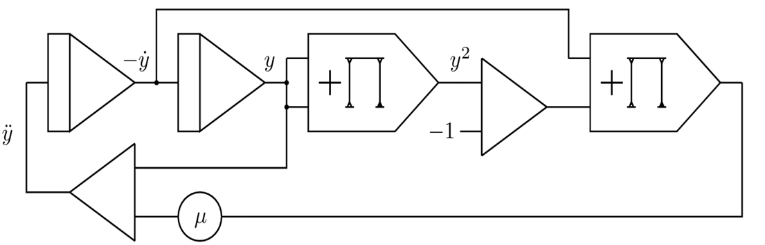
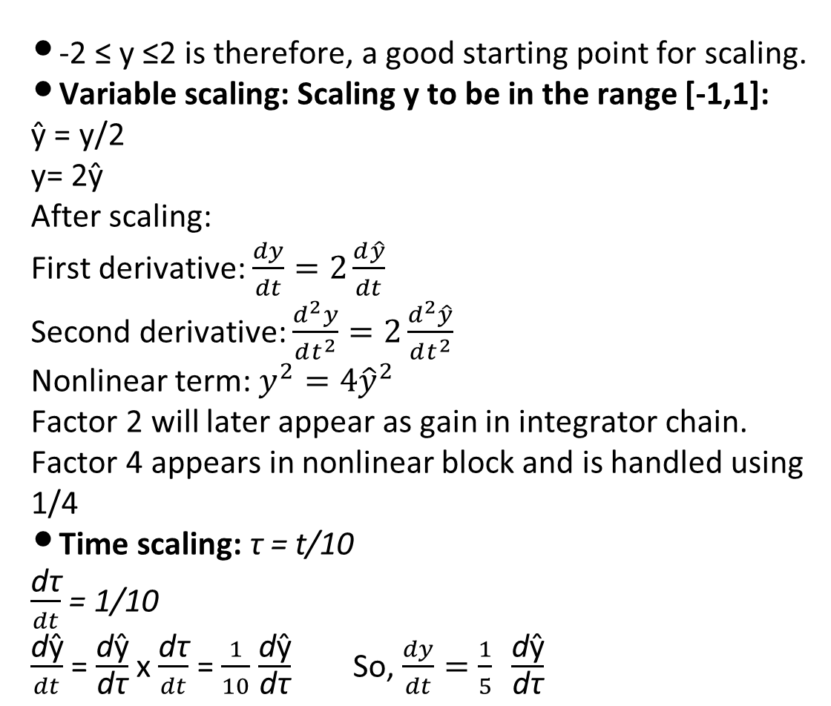
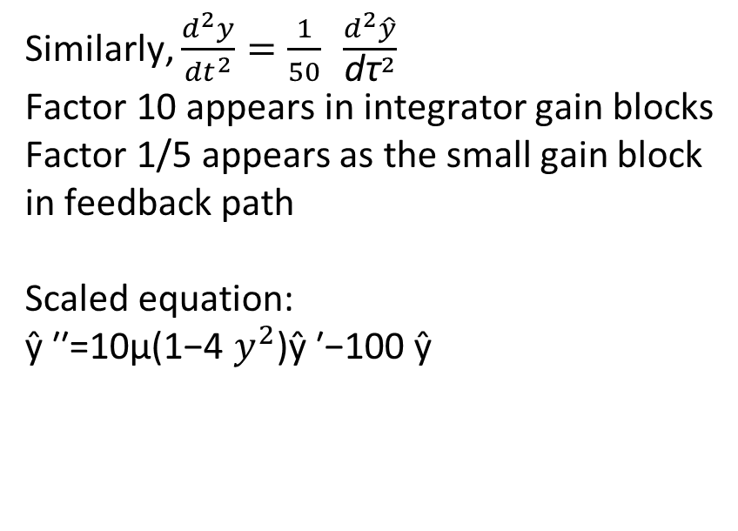
VAN DER POL EQUATION
-2 ≤ y ≤2 is therefore, a good starting point for scaling.
Variable scaling: Scaling y to be in the range [-1,1]:
ŷ = y/2
y= 2ŷ
After scaling:
First derivative: $\frac{dy}{dt}=2\frac{d\hat{y}}{dt}$
Second derivative: $\frac{d^{2}y}{dt^{2}}=2\frac{d^{2}\hat{y}}{dt^{2}}$
Nonlinear term: $y^{2}=4{\hat{y}}^{2}$
Factor 2 will later appear as gain in integrator chain. Factor 4 appears in nonlinear block and is handled using 1/4
Time scaling: τ = t/10
$\frac{\text{d}\text{τ}}{dt}$ = 1/10
$\frac{\text{d}\text{ŷ}}{dt}$ = $\frac{\text{d}\text{ŷ}}{\text{d}\text{τ}}$ x $\frac{\text{d}\text{τ}}{dt}$ = $\frac{1}{10}$ $\frac{\text{d}\text{ŷ}}{\text{d}\text{τ}}$ So, $\frac{dy}{dt}=\frac{1}{5} \frac{\text{d}\text{ŷ}}{\text{d}\text{τ}}$
Similarly, $\frac{d^{2}y}{{dt}^{2}}=\frac{1}{50} \frac{d^{2}\hat{y}}{{\text{d}\text{τ}}^{2}}$
Factor 10 appears in integrator gain blocks
Factor 1/5 appears as the small gain block in feedback path
Scaled equation:
ŷ ​′′=10μ(1−4 $y^{2}$)ŷ ​′−100 ŷ

Slide 8
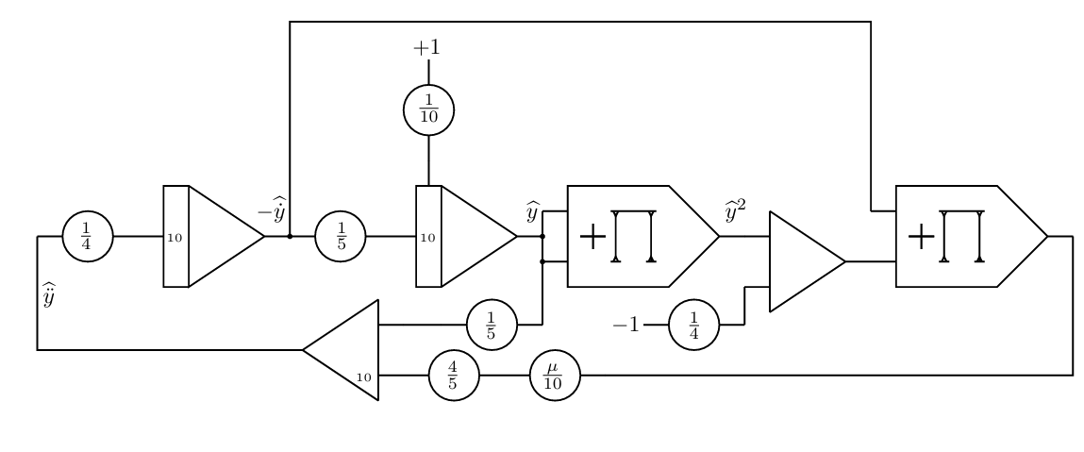
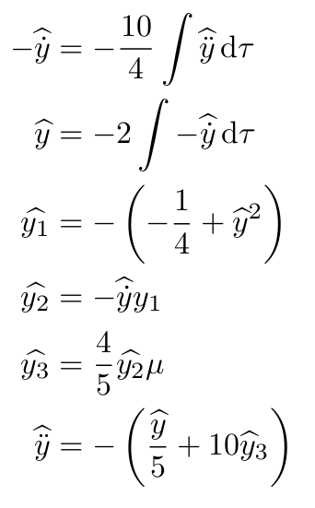
SCALING VAN DER POL EQUATION
Executing this process for all variables within the program yields the following set of equations with auxiliary variables y1, y2, and y3, which can be readily converted into a scaled computer setup:
Each constant in the diagram originates from:
• Variable scaling: 2, 4
• Time scaling: 10, 1/5
• Gain distribution: 1/4, 4/5, 10
The circuit is thus a distributed implementation of the original nonlinear equation.

Slide 9
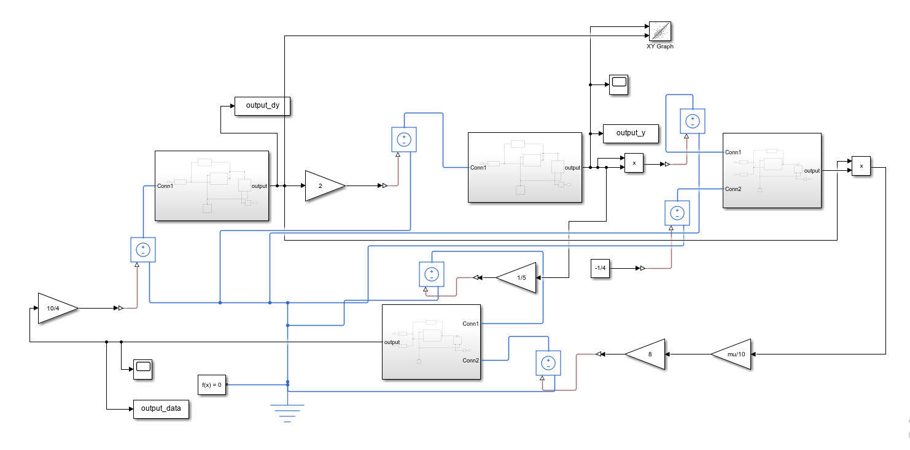
ANALOG SETUP

Slide 10
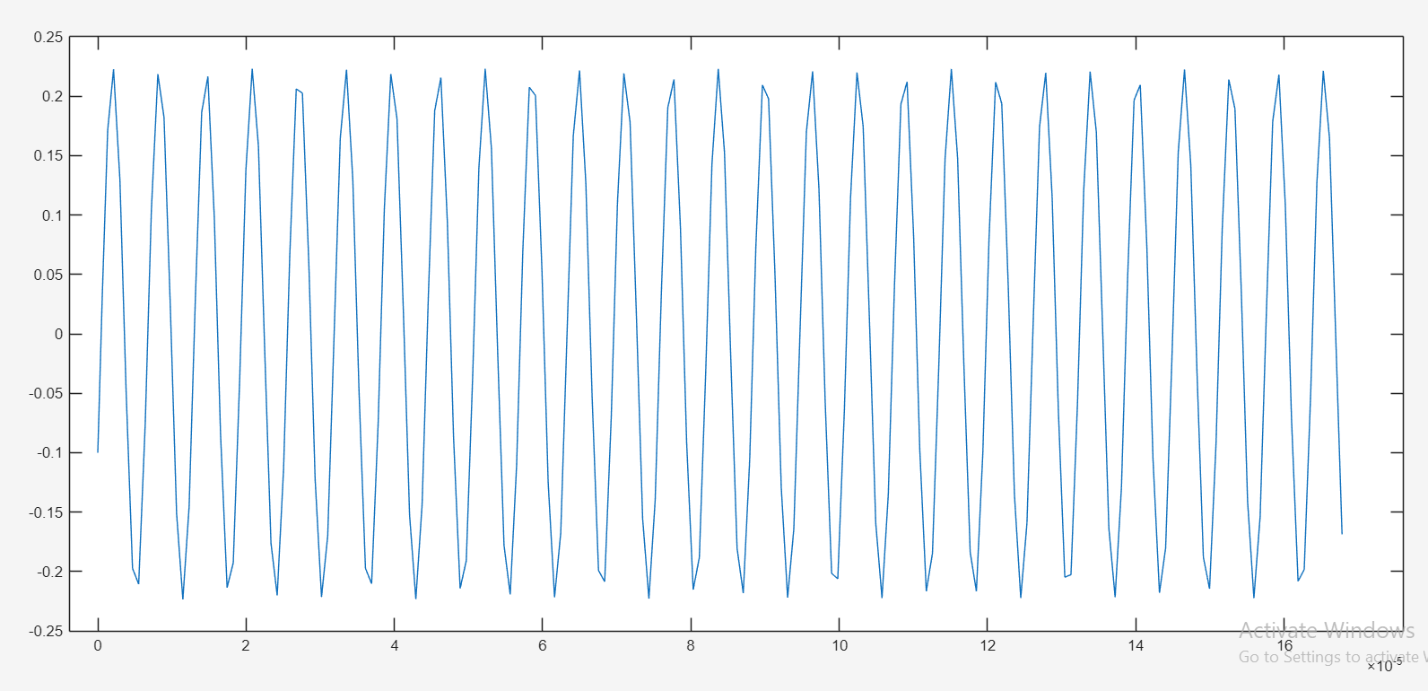
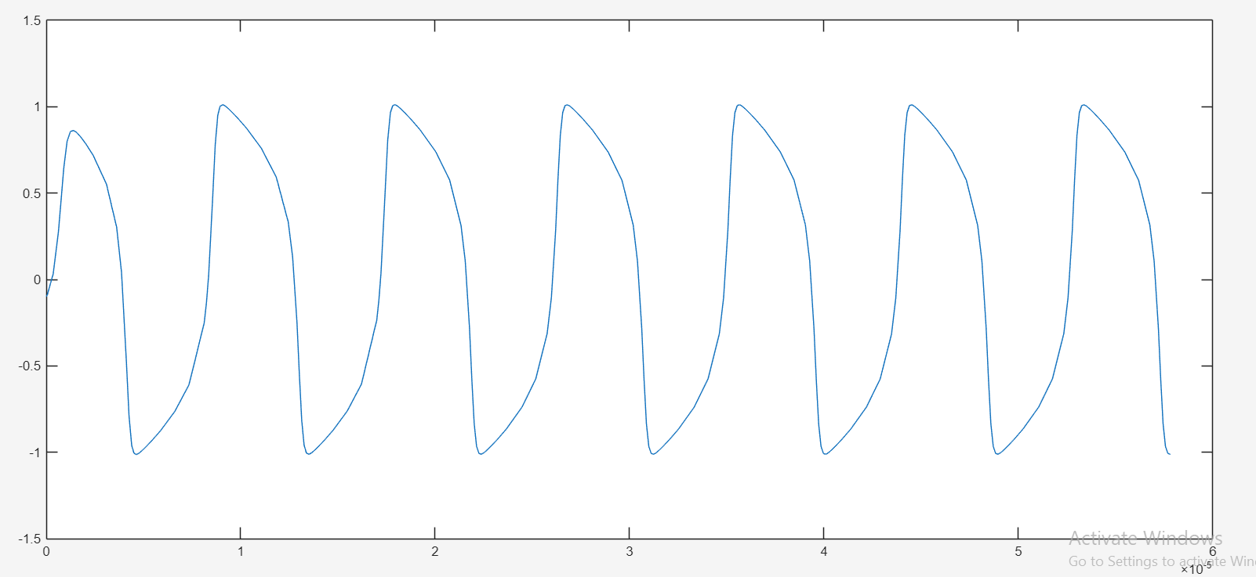
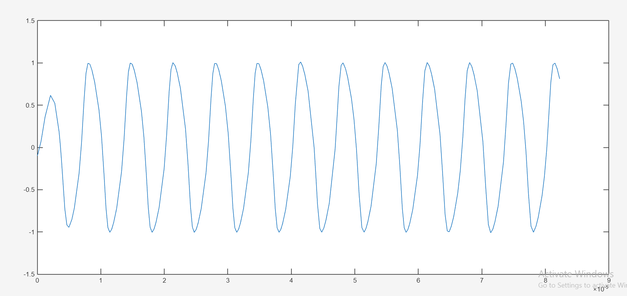
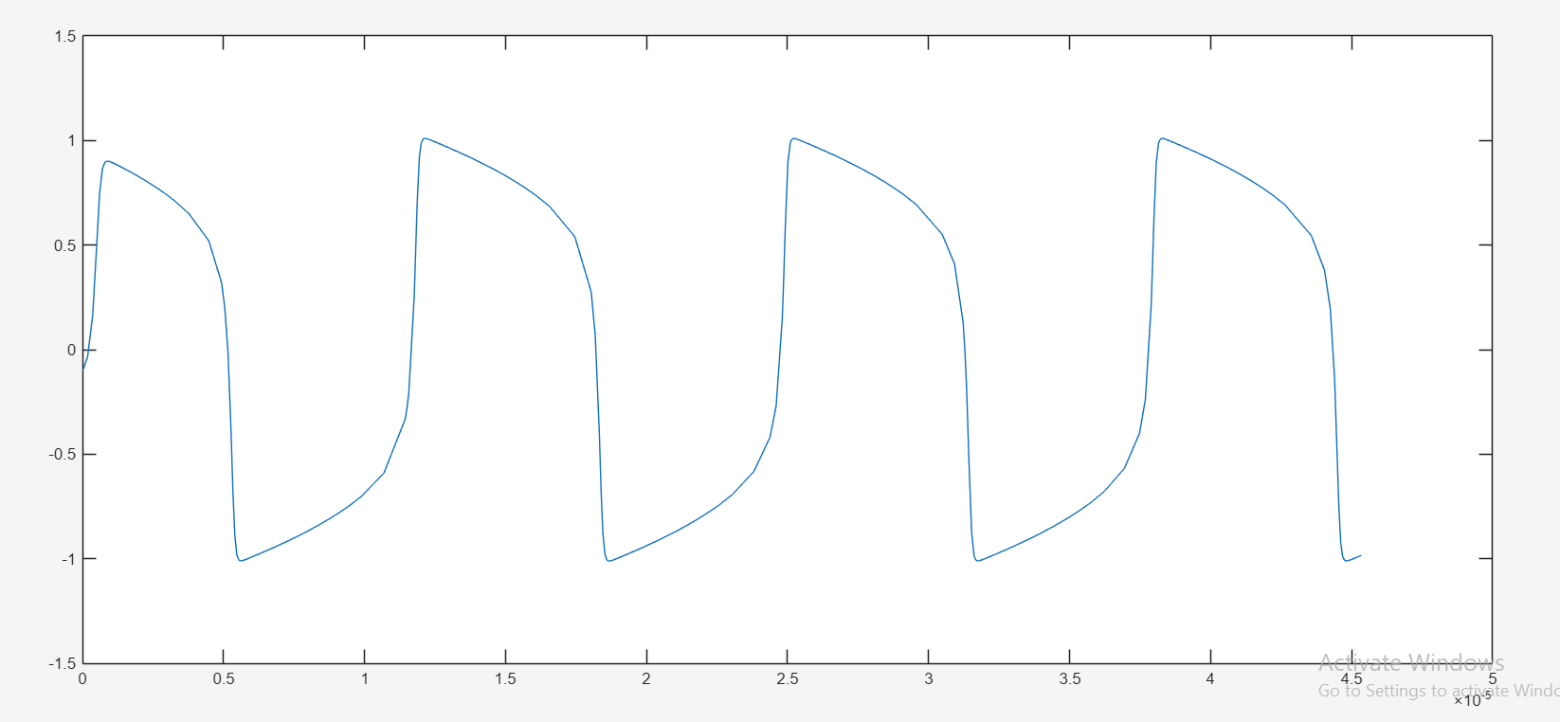
SYSTEM RESPONSE

Slide 11
DATASET GENERATION
A script file named dataset_generation.m is created in the same directory as that of the Simulink file.
2. Different ranges of the various categories of oscillation behaviour created by varying the mu parameter and iterating throughout.
3. Simulation setup:
Regime | Mu values
Harmonic Region | 0, 10⁻¹⁰, 10⁻⁹, 10⁻⁸, 10⁻⁷
Weak Nonlinear Region | 0.01, 0.05, 0.1, 0.2, 0.5
Strong Nonlinear Region | 2, 3, 4, 5, 7
Relaxation Oscillation Region | 10, 12, 15, 18, 20
Parameter | Value
Solver | ODE45
Solver Type | Variable-step
Stop Time | 0.2 s

Slide 12
DATASET GENERATION
4. The Simulink model of Vanderpol was executed.
5. The following signals were extracted from Simulink outputs via the To Workspace blocks:
6. Data Validation:
Before processing, the generated signals were checked for invalid values.
The simulation output was rejected if:
the signal was empty,
NaN values existed,
Infinite values existed,
This ensured numerical stability and prevented corrupted samples from entering the dataset.
7. Removal of Initial Transient:
The first 20% of samples were removed. Initial transient portions do not represent steady oscillatory behaviour. Removing them ensures that extracted features correspond only to stable system dynamics.
Signal | Meaning
y | Oscillator displacement
dy | First derivative (velocity)
ddy | Second derivative (acceleration)

Slide 13
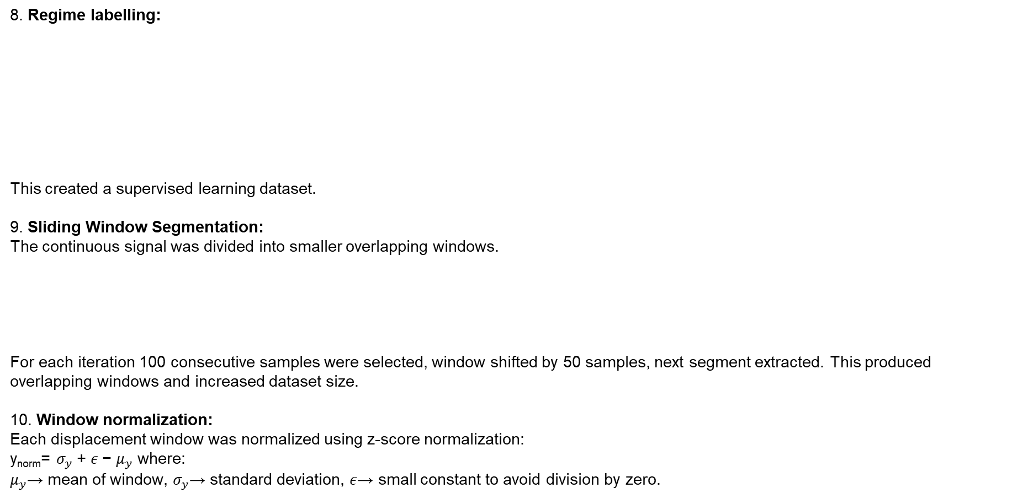
DATASET GENERATION
8. Regime labelling:
This created a supervised learning dataset.
9. Sliding Window Segmentation:
The continuous signal was divided into smaller overlapping windows.
For each iteration 100 consecutive samples were selected, window shifted by 50 samples, next segment extracted. This produced overlapping windows and increased dataset size.
10. Window normalization:
Each displacement window was normalized using z-score normalization:
y_{norm}​= $σ_{y}$+ $ε$− $μ_{y}$ where:
$μ_{y}$→ mean of window, $σ_{y}$→ standard deviation, $ε$→ small constant to avoid division by zero.
Condition | Label
μ ≤10⁻⁷ | Harmonic
10⁻⁷<μ<1 | Weak_Nonlinear
1≤μ<10 | Strong_Nonlinear
μ≥10 | Relaxation
Parameter | Value
Window Size | 100 samples
Stride | 50 samples

Slide 14
DATASET GENERATION
Necessity of windowing:
1. Increases Dataset Size
One long signal produces many samples.
Single signal → hundreds of windows
More windows → more training data
2. Captures Local Signal Dynamics
Different regions may contain: varying nonlinearities, different oscillatory characteristics. Windowing preserves local behaviour.
3. Reduces Computational Complexity
Feature extraction on small windows is faster than processing an entire long signal at once.
Without windowing:
Longer simulations are required to generate enough samples.
Entire long-duration signals must be processed together.
Feature extraction becomes computationally expensive.
With windowing:
Shorter simulation duration can generate many overlapping samples efficiently.

Slide 15
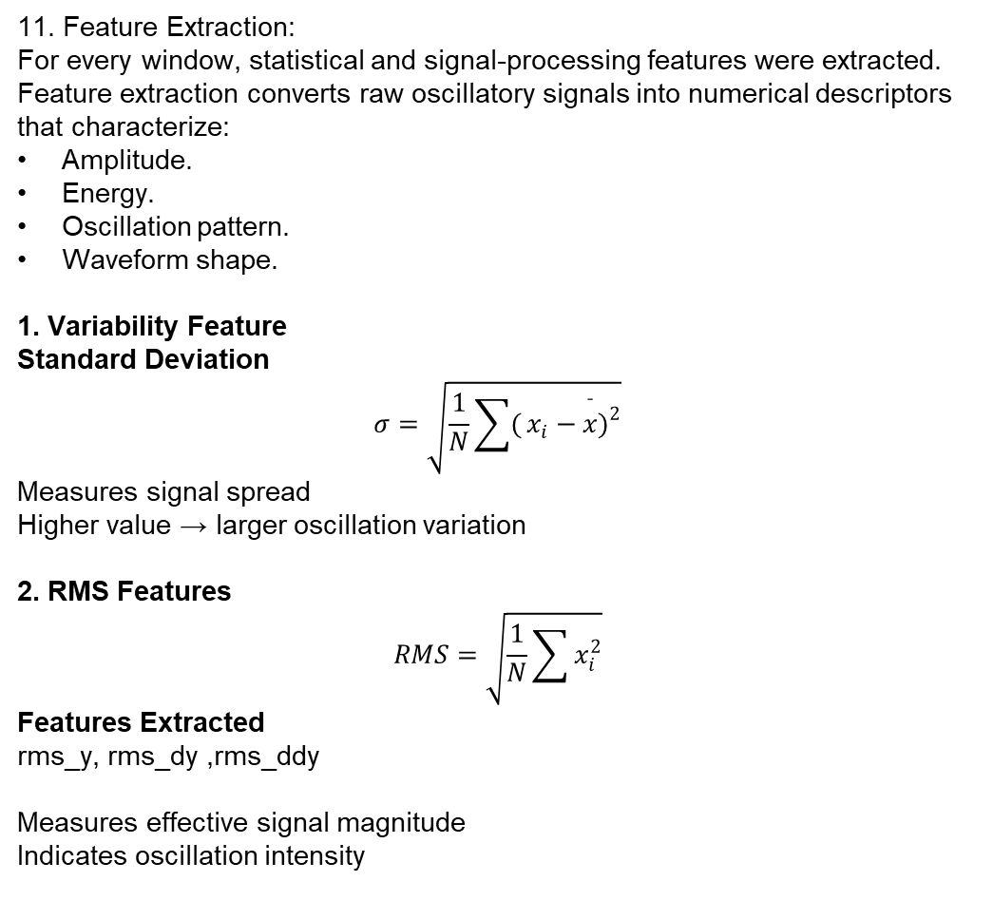
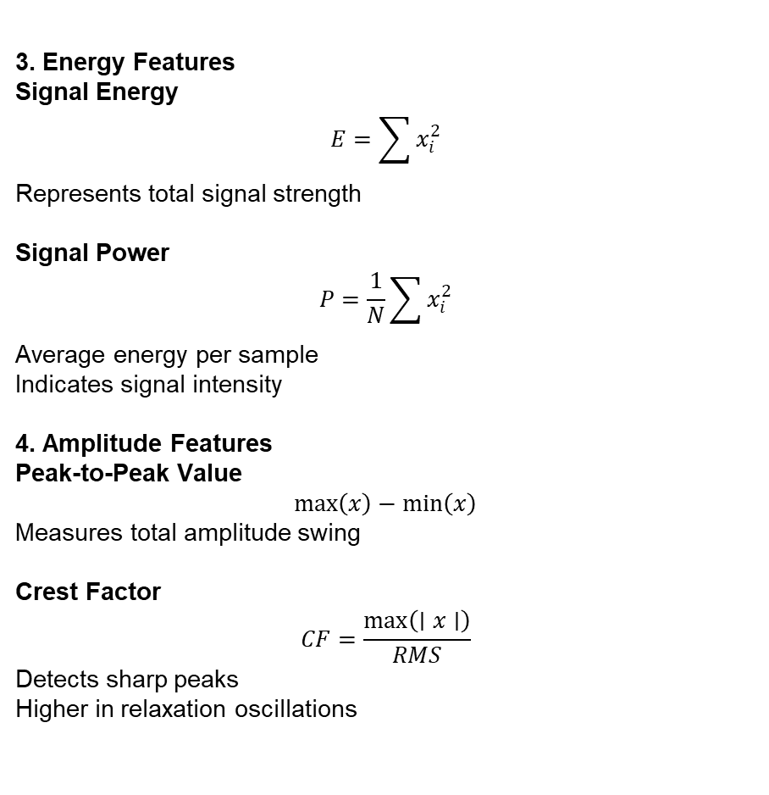
FEATURE EXTRACTION
11. Feature Extraction:
For every window, statistical and signal-processing features were extracted.
Feature extraction converts raw oscillatory signals into numerical descriptors that characterize:
Amplitude.
Energy.
Oscillation pattern.
Waveform shape.
1. Variability Feature
Standard Deviation
$$σ=\sqrt{\frac{1}{N}\sum{(}\left.x_{i}−\overset{ˉ}{x}{\left.)\right.}^{2}\right.}$$
Measures signal spread
Higher value → larger oscillation variation
2. RMS Features
$$RMS=\sqrt{\frac{1}{N}\sum{x_{i}^{2}}}$$
Features Extracted
rms_y, rms_dy ,rms_ddy
Measures effective signal magnitude
Indicates oscillation intensity
3. Energy Features
Signal Energy
$$E=\sum{x_{i}^{2}}$$
Represents total signal strength
Signal Power
$$P=\frac{1}{N}\sum{x_{i}^{2}}$$
Average energy per sample
Indicates signal intensity
4. Amplitude Features
Peak-to-Peak Value
$$max⁡\left(x\right)−min⁡\left(x\right)$$
Measures total amplitude swing
Crest Factor
$$CF=\frac{max⁡\left(∣x∣\right)}{RMS}$$
Detects sharp peaks
Higher in relaxation oscillations

Slide 16
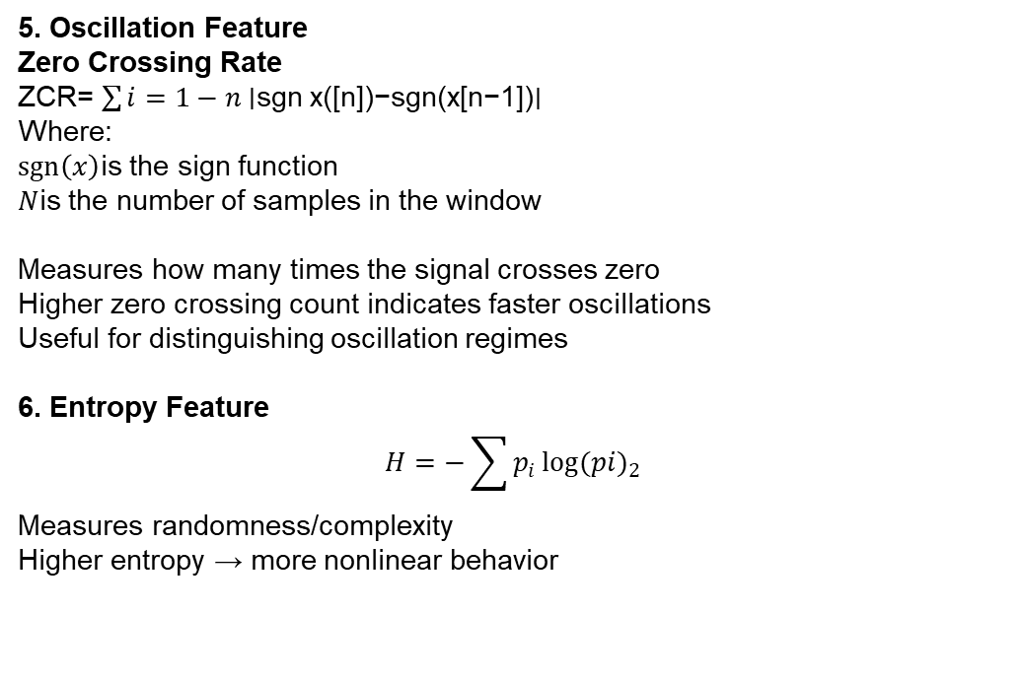
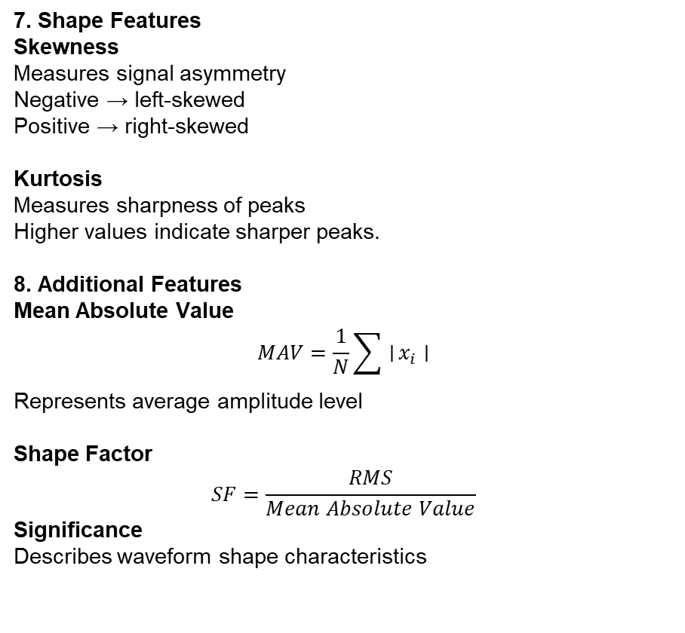
FEATURE EXTRACTION
7. Shape Features
Skewness
Measures signal asymmetry
Negative → left-skewed
Positive → right-skewed
Kurtosis
Measures sharpness of peaks
Higher values indicate sharper peaks.
8. Additional Features
Mean Absolute Value
$$MAV=\frac{1}{N}\sum{∣}x_{i}∣$$
Represents average amplitude level
Shape Factor
$$SF=\frac{RMS}{Mean Absolute Value}$$
Significance
Describes waveform shape characteristics
5. Oscillation Feature
Zero Crossing Rate
ZCR=​ $\sum{i=1−n}$∣sgn x([n])−sgn(x[n−1])∣
Where:
$sgn⁡\left(x\right)$is the sign function
$N$is the number of samples in the window
Measures how many times the signal crosses zero
Higher zero crossing count indicates faster oscillations
Useful for distinguishing oscillation regimes
6. Entropy Feature
$$H=−\sum{p_{i}}{\log{(pi)}}_{2}$$
Measures randomness/complexity
Higher entropy → more nonlinear behavior

Slide 17
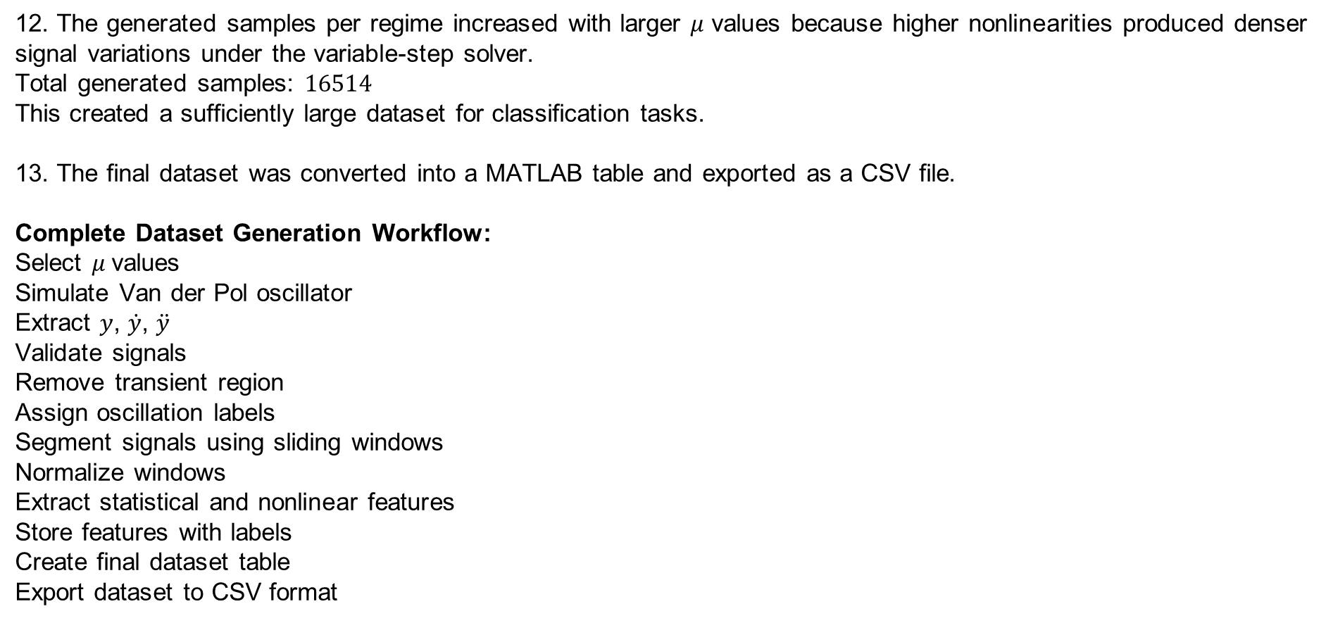
FEATURE EXTRACTION
12. The generated samples per regime increased with larger $μ$ values because higher nonlinearities produced denser signal variations under the variable-step solver.
Total generated samples: $16514$
This created a sufficiently large dataset for classification tasks.
13. The final dataset was converted into a MATLAB table and exported as a CSV file.
Complete Dataset Generation Workflow:
Select $μ$values
Simulate Van der Pol oscillator
Extract $y$, $\dot{y}$, $\ddot{y}$
Validate signals
Remove transient region
Assign oscillation labels
Segment signals using sliding windows
Normalize windows
Extract statistical and nonlinear features
Store features with labels
Create final dataset table
Export dataset to CSV format

Slide 18
Avoiding Data Leakage Using µ-Based Splitting
Why Data Leakage Occurs
The dataset was generated using overlapping sliding windows.
Adjacent windows from the same oscillator trajectory are highly correlated.
Random train-test splitting may place nearly identical windows in both datasets.
This leads to artificially inflated classification accuracy and unreliable model evaluation
µ-Based Train-Test Splitting Strategy
Training µ values: Testing µ values:
Advantages of µ-Based Splitting
Prevents overlap between train and test trajectories
Ensures independent evaluation
Evaluates models on unseen nonlinear conditions
Provides realistic generalization capability
Oscillation Regime | µ Values
Harmonic | 0, 10⁻¹⁰, 10⁻⁹
Weak Nonlinear | 0.01, 0.05, 0.1
Strong Nonlinear | 2, 3, 4
Relaxation | 10, 12, 15
Oscillation Regime | µ Values
Harmonic | 10⁻⁸, 10⁻⁷
Weak Nonlinear | 0.2, 0.5
Strong Nonlinear | 5, 7
Relaxation | 18, 20

Slide 19

DATASET DISTRIBUTION AND BALANCING
Training Dataset Before Balancing
Balancing Strategy
Minimum Sample Count $N_{min}=354$
Random undersampling applied
354 samples selected from each training µ value
Balanced Training Dataset
Final Dataset Size
Why Testing Dataset Was Left Unbalanced
Preserves natural nonlinear oscillation distribution
Enables realistic performance evaluation
Measures true generalization on unseen oscillator dynamics
µ Value | Samples
0 | 354
10⁻¹⁰ | 354
10⁻⁹ | 354
0.01 | 375
0.05 | 373
0.1 | 372
2 | 780
3 | 900
4 | 1006
10 | 1294
12 | 1378
15 | 1588
Oscillation Regime | Samples
Harmonic | 1062
Weak Nonlinear | 1062
Strong Nonlinear | 1062
Relaxation | 1062
Dataset | Samples
Balanced Training Dataset | 4248
Testing Dataset (Unbalanced) | 7386

Slide 20
MACHINE LEARNING MODELS AND EVALUATION METRICS
Category | Models
Linear Models | Ridge Classifier, Logistic Regression, SGD Classifier, Passive Aggressive, Linear SVM, Perceptron
Probabilistic Models | Gaussian NB, Bernoulli NB, Multinomial NB
Discriminant Analysis | LDA, QDA
Distance-Based Models | KNN, Nearest Centroid
Kernel-Based Models | SVM (RBF), NuSVC (RBF)
Neural Networks | MLP (Shallow), MLP (Wide), MLP (Deep)
Tree & Ensemble Models | Decision Tree, Random Forest, Extra Trees, Bagging, AdaBoost, Gradient Boosting, Histogram Gradient Boosting
Hyperparameter Optimization Using Grid Search
Grid Search was used to identify optimal hyperparameters.
Exhaustive search performed over predefined parameter combinations. Best configuration selected based on validation performance.
Parameters Tuned
Regularization strength
Learning rate
Kernel type
Number of estimators
Tree depth
Number of neighbors
Hidden layer architecture
Activation functions
Splitting criteria
Distance metrics
Evaluation Metrics Used
Accuracy, Weighted Precision, Weighted Recall, Weighted F1-Score, Macro Precision, Macro Recall, Macro F1-Score, Cross-Validated Weighted F1-Score, One-vs-Rest ROC-AUC (roc_auc_ovr), Model Training Time, Prediction Time

Slide 21
MACHINE LEARNING PERFORMANCE ANALYSIS
Model | Accuracy | Weighted Precision | Weighted Recall | Weighted F1 | Macro F1 | ROC-AUC | Train Time (s) | Predict Time (s)
Ridge Classifier | 99.70 | 99.70 | 99.70 | 99.70 | 99.80 | 0.9967 | 2.06 | 0.50
Logistic Regression | 96.28 | 96.53 | 96.28 | 96.21 | 97.38 | 1.0000 | 10.05 | 0.20
LDA | 95.80 | 96.12 | 95.80 | 95.72 | 97.04 | 1.0000 | 0.35 | 0.08
SGD Classifier | 93.95 | 94.87 | 93.95 | 93.17 | 88.43 | 0.9900 | 3.08 | 0.21
Passive Aggressive | 92.08 | 93.15 | 92.08 | 91.28 | 88.13 | 0.9982 | 1.67 | 0.15
Linear SVM | 90.41 | 91.93 | 90.41 | 89.64 | 86.97 | 1.0000 | 2.32 | 0.39
Nearest Centroid | 87.99 | 88.57 | 87.99 | 87.07 | 84.19 | 0.9857 | 0.13 | 0.09
MLP (Shallow) | 87.71 | 90.08 | 87.71 | 86.90 | 84.99 | 0.9988 | 46.32 | 0.17
MLP (Wide) | 86.45 | 89.30 | 86.45 | 85.58 | 84.04 | 0.9983 | 143.92 | 0.37
MLP (Deep) | 86.52 | 87.18 | 86.52 | 85.48 | 83.15 | 0.9938 | 86.09 | 0.25
Multinomial NB | 85.31 | 85.93 | 85.31 | 84.19 | 82.12 | 0.9757 | 0.61 | 0.08
QDA | 84.62 | 85.25 | 84.62 | 83.43 | 81.57 | 0.9677 | 0.32 | 0.18
Bernoulli NB | 83.59 | 87.59 | 83.59 | 82.44 | 84.88 | 0.9632 | 0.64 | 0.09
NuSVC (RBF) | 83.25 | 83.92 | 83.25 | 81.90 | 80.45 | 0.9876 | 71.13 | 0.87
Hist Gradient Boosting | 80.69 | 81.40 | 80.69 | 78.93 | 78.25 | 0.9493 | 20.67 | 0.35
SVM (RBF) | 80.50 | 81.21 | 80.50 | 78.70 | 78.08 | 0.9894 | 49.09 | 0.24
Extra Trees | 80.02 | 80.71 | 80.02 | 78.11 | 77.64 | 0.9928 | 25.76 | 0.16
KNN | 79.10 | 79.77 | 79.10 | 76.98 | 76.79 | 0.8188 | 1.32 | 0.39
Random Forest | 78.82 | 85.04 | 78.82 | 76.77 | 77.43 | 0.9634 | 64.02 | 0.15
Gaussian NB | 78.70 | 79.36 | 78.70 | 76.50 | 76.42 | 0.9606 | 0.48 | 0.09
Gradient Boosting | 78.51 | 84.84 | 78.51 | 76.37 | 77.11 | 0.9557 | 132.77 | 0.14
Bagging (Tree) | 78.36 | 84.82 | 78.36 | 76.18 | 76.97 | 0.9651 | 19.21 | 0.25
Perceptron | 77.23 | 84.26 | 77.23 | 74.68 | 75.81 | 0.9783 | 1.85 | 0.26
Decision Tree | 72.03 | 71.04 | 72.03 | 67.35 | 69.35 | 0.7699 | 0.98 | 0.08
AdaBoost | 33.74 | 14.06 | 33.74 | 19.49 | 23.16 | 0.9584 | 46.25 | 0.33

Slide 22
MACHINE LEARNING PERFORMANCE ANALYSIS
Ridge Classifier achieved the best overall performance with:
99.70% Accuracy
99.70% Weighted F1-Score
excellent ROC-AUC performance.
Logistic Regression and LDA also showed strong classification capability, indicating that the extracted features were highly separable.
Linear models performed better than many complex nonlinear models, suggesting that:
the statistical features captured regime information effectively,
feature scaling improved linear separability.
Neural network models (MLP variants) achieved good ROC-AUC scores but required significantly higher training time.
Ensemble learning methods such as Random Forest, Extra Trees, and Gradient Boosting showed moderate performance but higher computational complexity.
Distance-based methods such as KNN were affected by overlapping nonlinear feature distributions.
Decision Tree and AdaBoost produced lower classification performance, indicating limited robustness for nonlinear oscillatory regime discrimination.
ROC-AUC values close to 1 for several models confirmed strong probabilistic discrimination between oscillation regimes.
The µ-based train-test splitting strategy ensured realistic evaluation by testing models on unseen nonlinear conditions.
Overall results demonstrate that the extracted statistical and nonlinear features effectively characterize Van der Pol oscillatory dynamics across multiple nonlinear regimes.

Slide 23
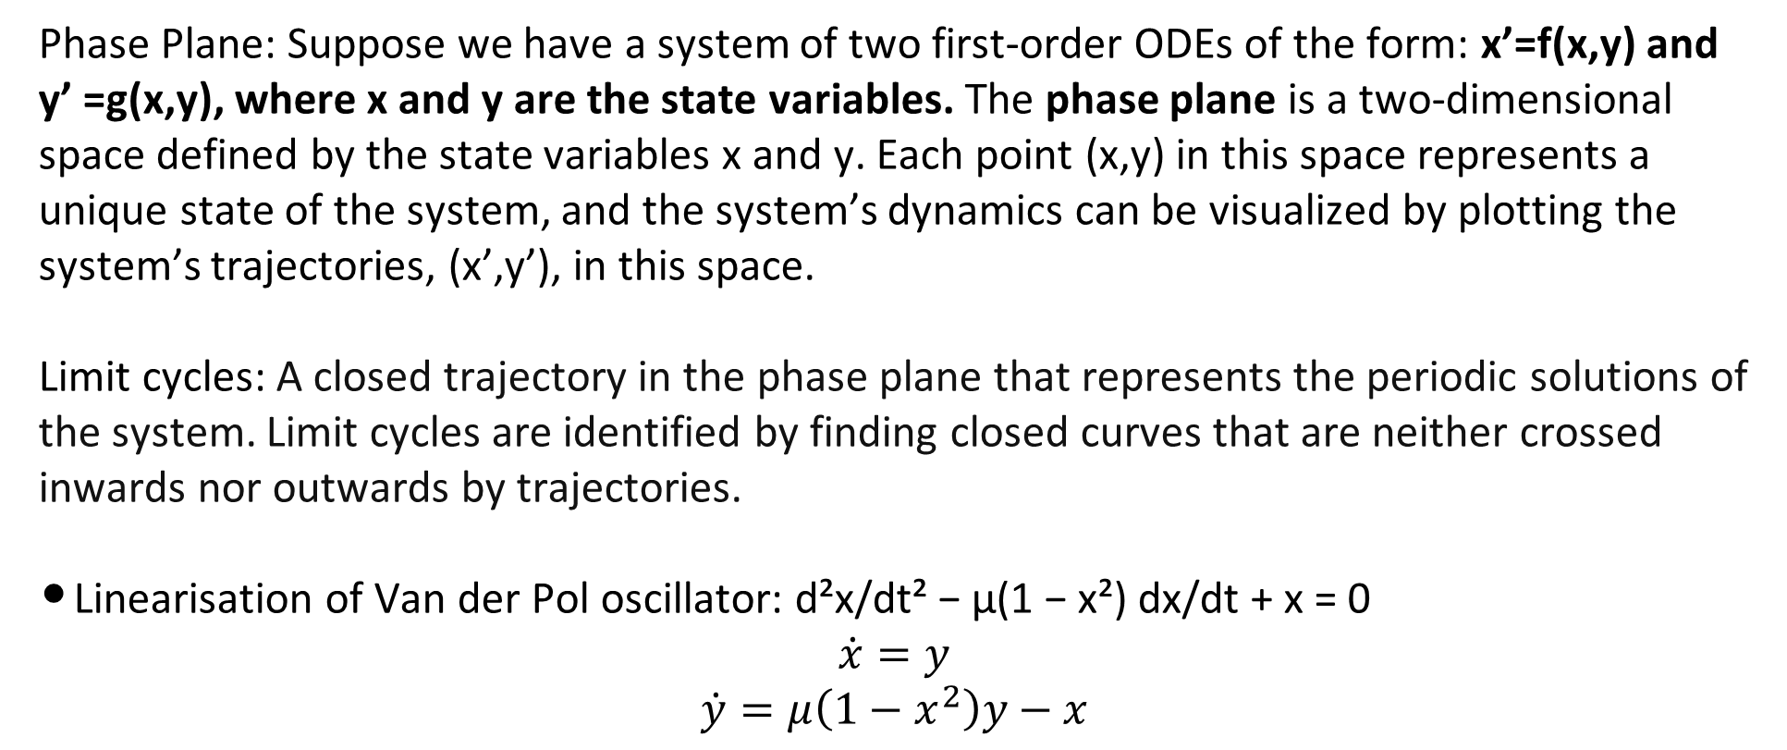
SYSTEM RESPONSE
Phase Plane: Suppose we have a system of two first-order ODEs of the form: x’=f(x,y) and y’ =g(x,y), where x and y are the state variables. The phase plane is a two-dimensional space defined by the state variables x and y. Each point (x,y) in this space represents a unique state of the system, and the system’s dynamics can be visualized by plotting the system’s trajectories, (x’,y’), in this space.
Limit cycles: A closed trajectory in the phase plane that represents the periodic solutions of the system. Limit cycles are identified by finding closed curves that are neither crossed inwards nor outwards by trajectories.
Linearisation of Van der Pol oscillator: d²x/dt² − μ(1 − x²) dx/dt + x = 0
$$\dot{x}=y$$
$$\dot{y}=μ\left(1−x^{2}\right)y−x$$

Slide 24
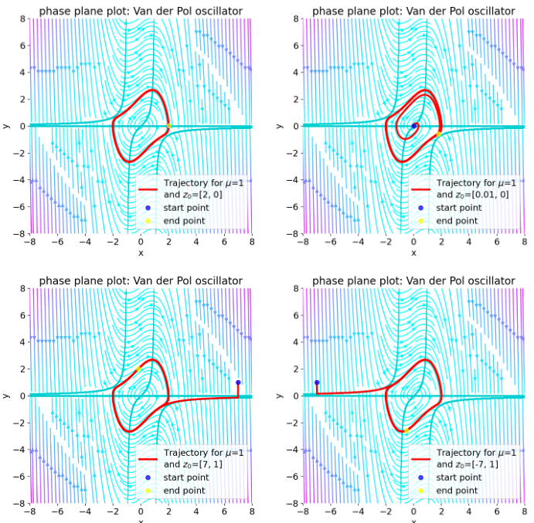
SYSTEM RESPONSE
Change the initial conditions and μ to see how the system’s behavior changes.
Blue arrows (Vector Field):Indicate direction of motion at each point.
Red curve (Trajectory):Actual path followed by system.
Start point (Blue dot):Initial condition.
End point (Yellow dot):Final state (approaches limit cycle).
All trajectories converge to a closed loop. This loop is called a LIMIT CYCLE. It is independent of initial condition.

Slide 25
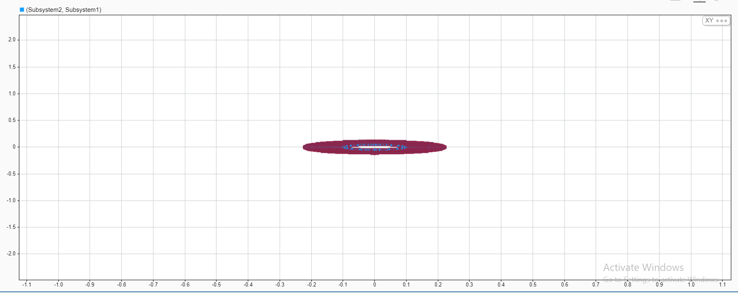
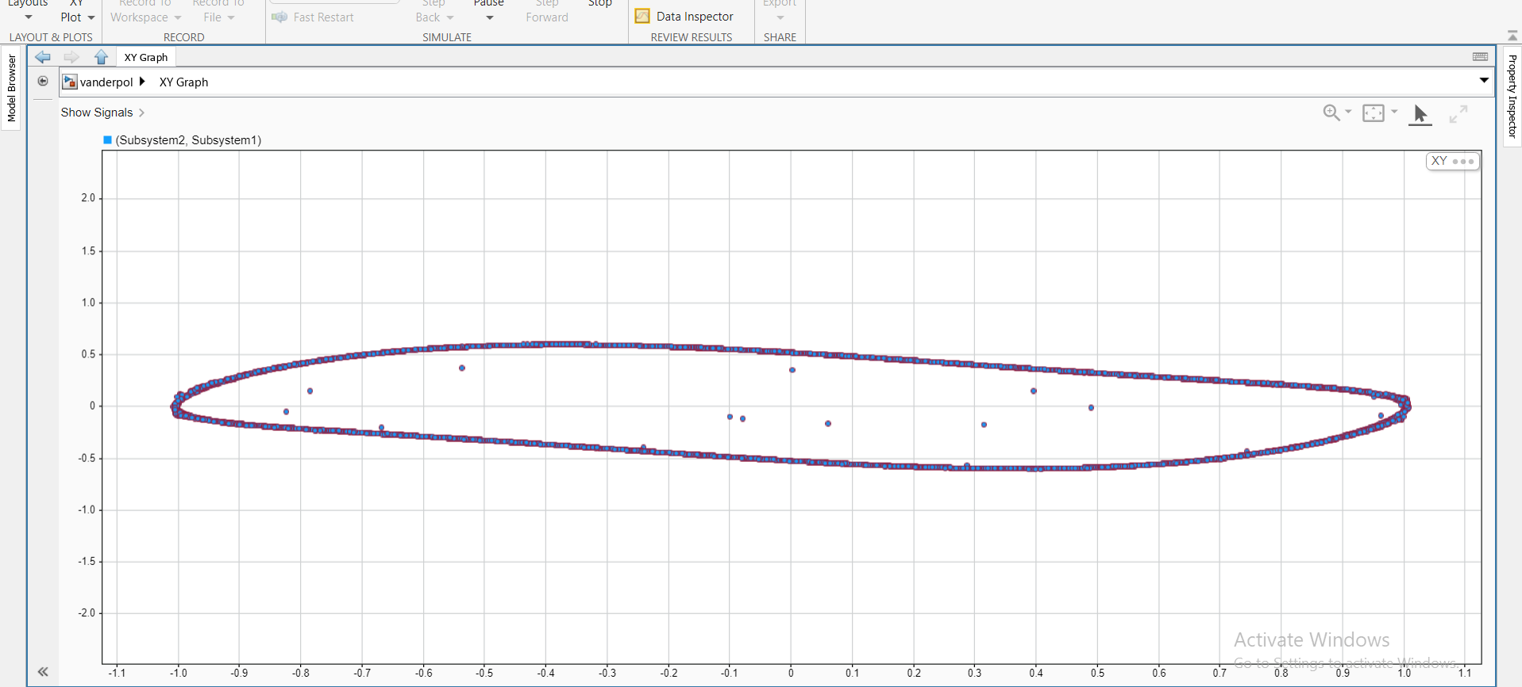
SYSTEM RESPONSE
Case 1: μ=0: (Linear Oscillator)
Perfect circular trajectories. No convergence/divergence
System behaves like simple harmonic oscillator.
Energy is conserved. No limit cycle exists.
Case 2: μ=1: (Moderate Nonlinearity)
Trajectory starts near the origin. Moves outward in a
spiral path. Eventually settles into a closed loop (limit cycle).
Interpretation: The origin is an unstable equilibrium point. Small disturbances cause the system to move away. As the trajectory grows, nonlinear damping regulates the motion. The system does not return to
rest or diverge infinitely. It converges to a stable limit cycle, producing sustained periodic oscillations.

Slide 26
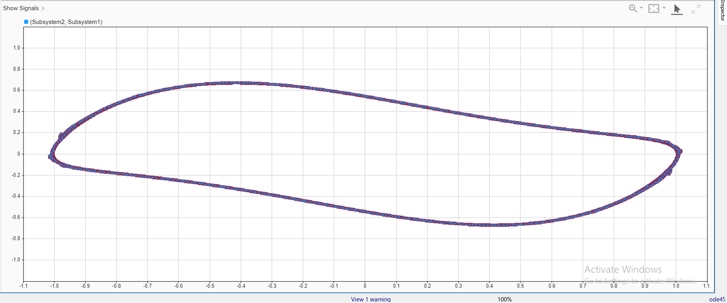
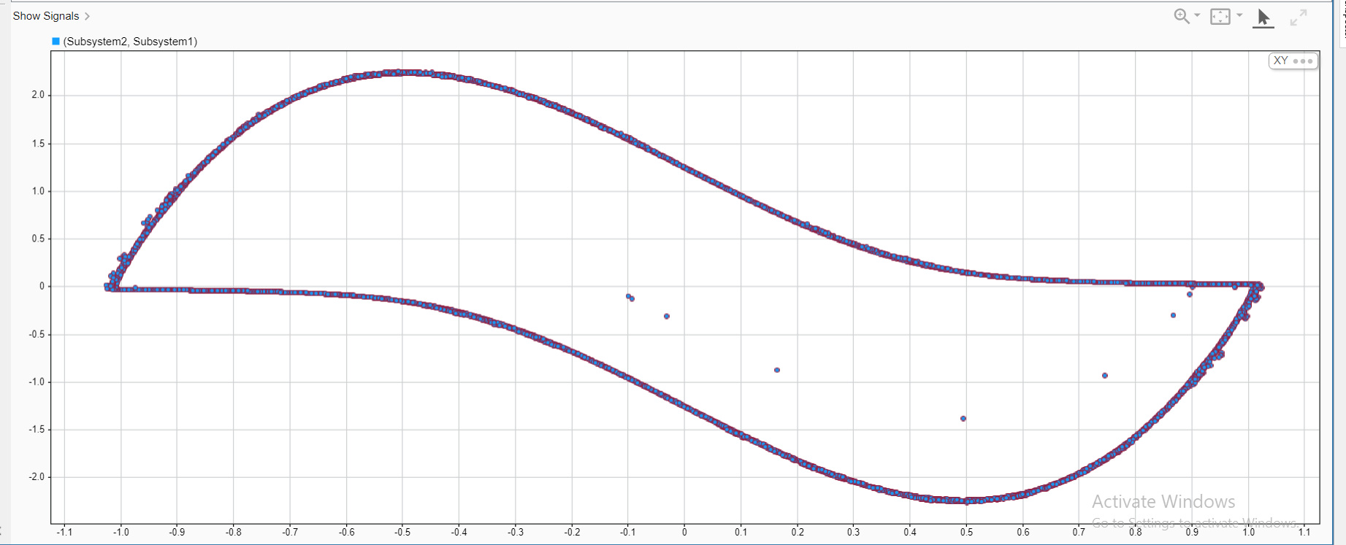
SYSTEM RESPONSE
Case 3: μ=2: (Stronger Nonlinearity)
Limit cycle becomes sharper and more elongated. Trajectories converge faster to the closed loop. Motion is uneven across regions (not uniform like a circle).
Increased μ introduces stronger nonlinear damping. System quickly corrects deviations from the limit cycle. Energy is added rapidly at small amplitudes, dissipated strongly at large amplitudes. The oscillation is no longer smooth or sinusoidal. Nonlinearity dominates -> distorted periodic motion.
Case 4: μ=12: (High Nonlinearity)
Limit cycle becomes very sharp and rectangular-like. Trajectories show abrupt transitions between regions. Motion is highly non-uniform across cycle. Strong nonlinear damping leads to relaxation oscillations. System alternates between slow evolution (gradual change in state) and rapid jumps (sudden transitions between states). Oscillations are highly distorted and non-sinusoidal.

Slide 27
OVERALL ANALYSIS OF SYSTEM RESPONSE
μ | Behavior Type | Phase Plot Shape | Energy Mechanism | Convergence Speed | Oscillation Type | Key Characteristics
0 | Linear | Circular | No energy change (conservative) | No convergence | Sinusoidal | Simple harmonic motion, no limit cycle
1 | Weak Nonlinear | Smooth closed loop | Energy added (small x), removed (large x) | Moderate | Periodic | Stable limit cycle forms, smooth oscillations
2 | Strong Nonlinear | Elongated loop | Stronger energy correction | Faster | Distorted | Non-sinusoidal oscillation, sharper transitions
12 | Highly Nonlinear | Rectangular-like loop | Rapid energy addition & dissipation | Very fast | Relaxation oscillation | Slow evolution + sudden jumps, strong nonlinear effects

Slide 28
THANK YOU

