Slide 1
Seismic Hazard Assessment for Mainland Portugal
Vitor Silva, Amir Taherian, Alexandra Carvalho, Vanessa Cimbron

Slide 2
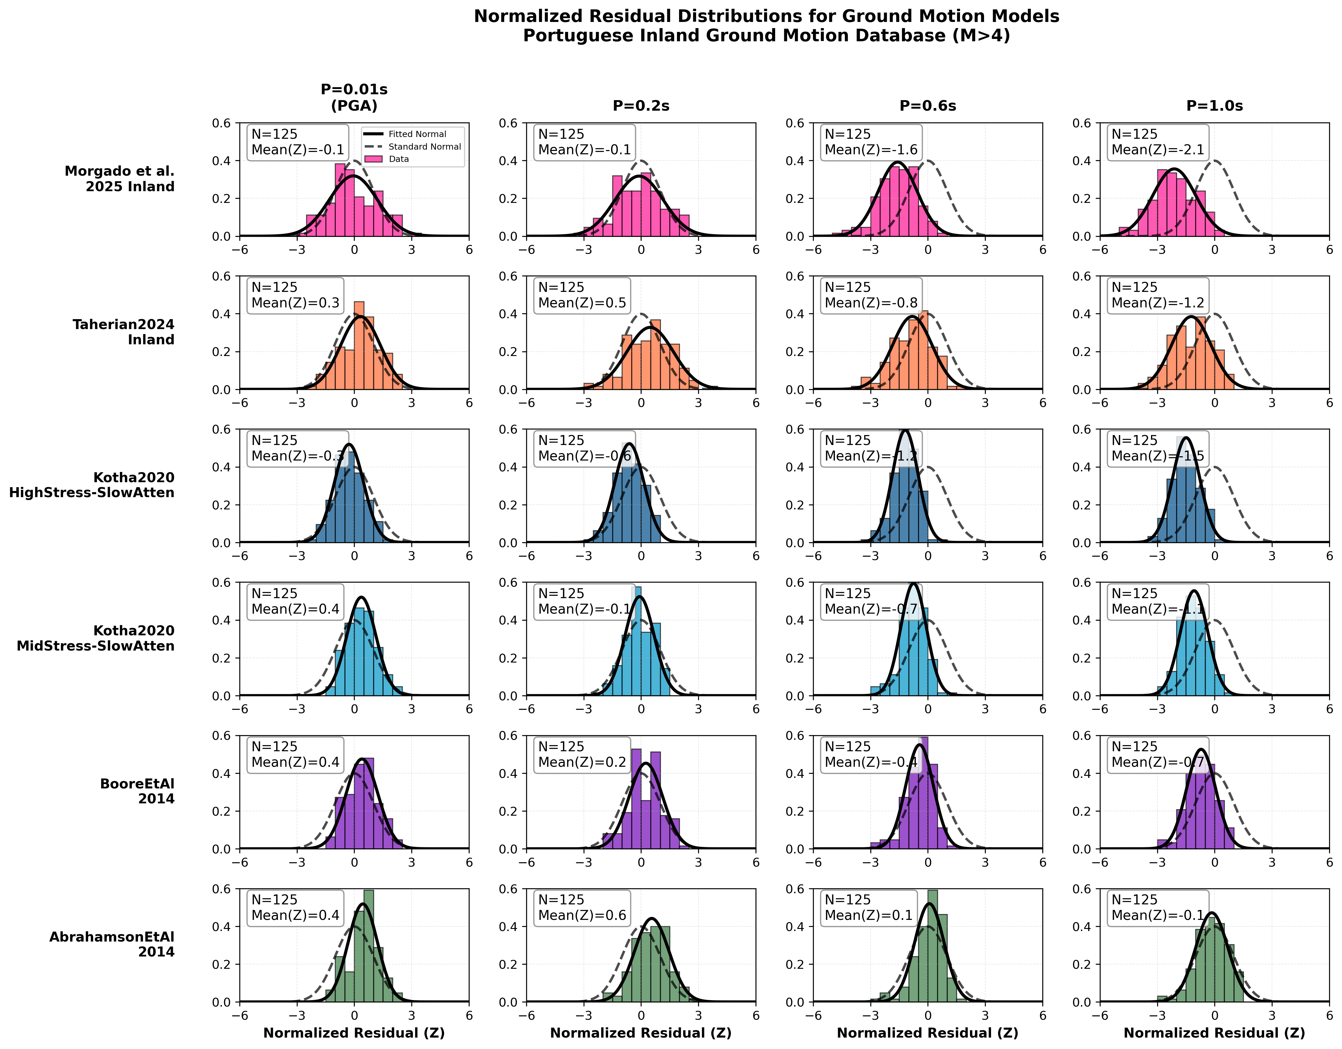
Seismic Hazard Assessment for Mainland Portugal
Past studies and current ground motion data indicate a large epistemic uncertainty in the selection of ground motion models for Portugal. In particular, several studies indicate different seismogenic trends (e.g., stress drop, geometric attenuation) between inland and offshore events, due to the predominantly stable continental crust.
We performed residual anlysis considering a large suite of ground motion models to identify which proposal seem to predict ground shaking adequately. This figure presenta the results for 5 of the candidate models.

Slide 3
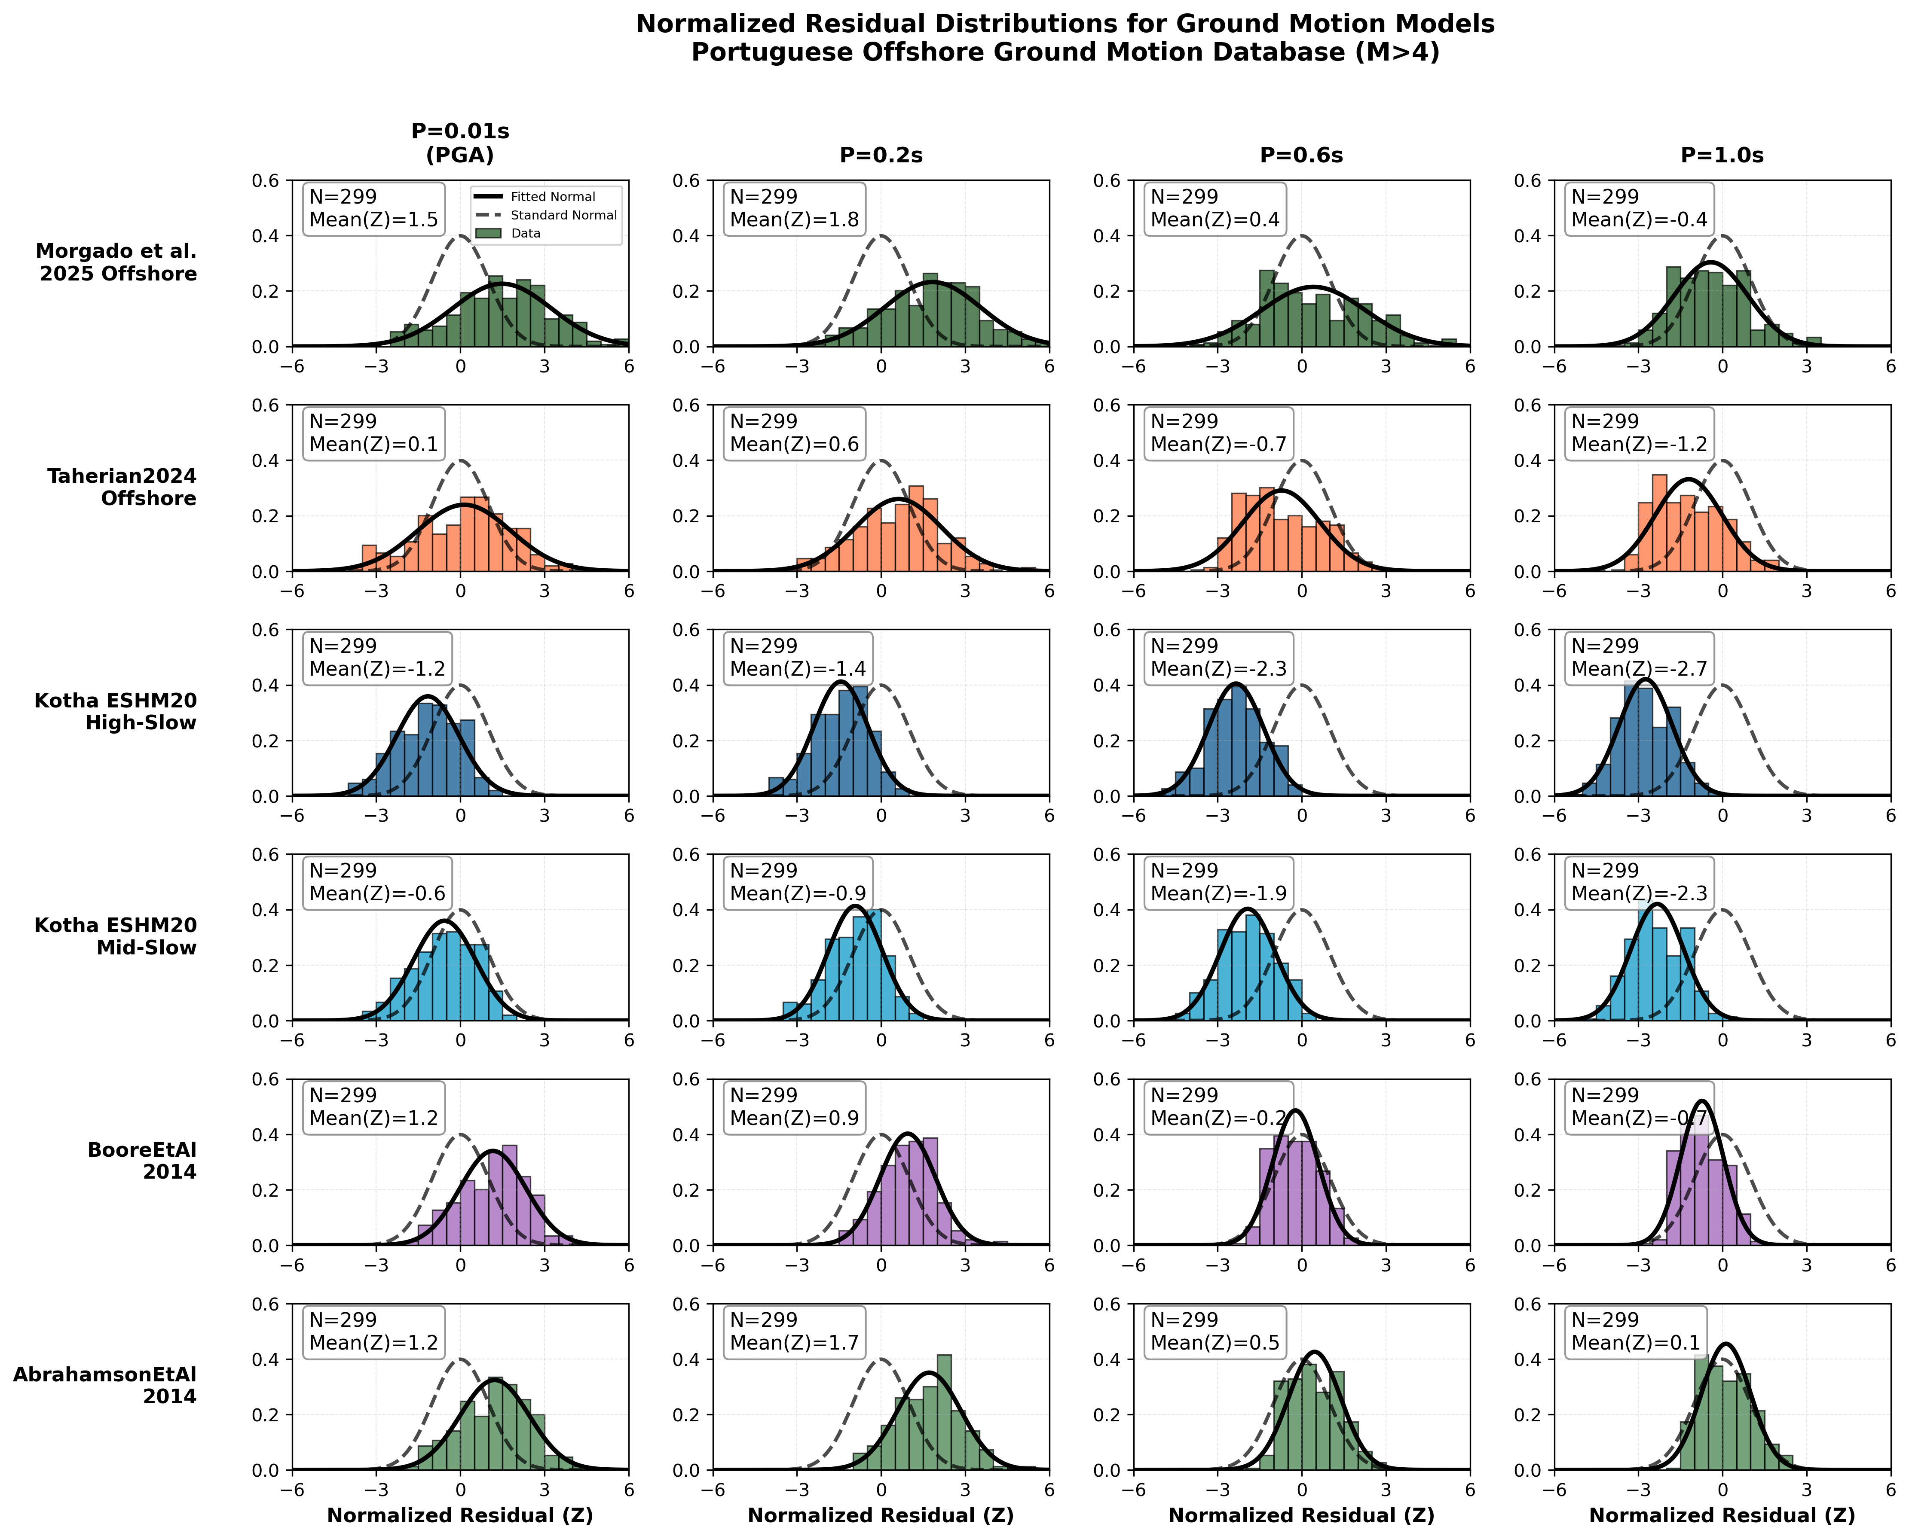
Seismic Hazard Assessment for Mainland Portugal
Past studies and current ground motion data indicate a large epistemic uncertainty in the selection of ground motion models for Portugal. In particular, several studies indicate different seismogenic trends (e.g., stress drop, geometric attenuation) between inland and offshore events, due to the predominantly stable continental crust.
We performed residual anlysis considering a large suite of ground motion models to identify which proposal seem to predict ground shaking adequately. This figure presenta the results for 5 of the candidate models.

Slide 4
Seismic Hazard Assessment for Mainland Portugal
Morgado et al. 2026 (inland)
The residual analyses allowed reducing the candidate models to 4 for inland and offshore events, as presented in this logic tree. We have selected 2 national models and 2 regional/global models for each type of event.
The following slides present the resulting seismic hazard (PGA for the 475 years return period) for mainland Portugal, considering different combinations of ground motion models.
Taherin et al. 2025 (inland)
Inland events
Kotha et al. 2020 (mid-slow)
Boore et al. 2014
Morgado et al. 2026 (offshore)
Taherin et al. 2025 (offshore)
Offshore events
Kotha et al. 2020 (high-slow)
Abrahanson et al. 2014
National model
Regional/global model

Slide 5
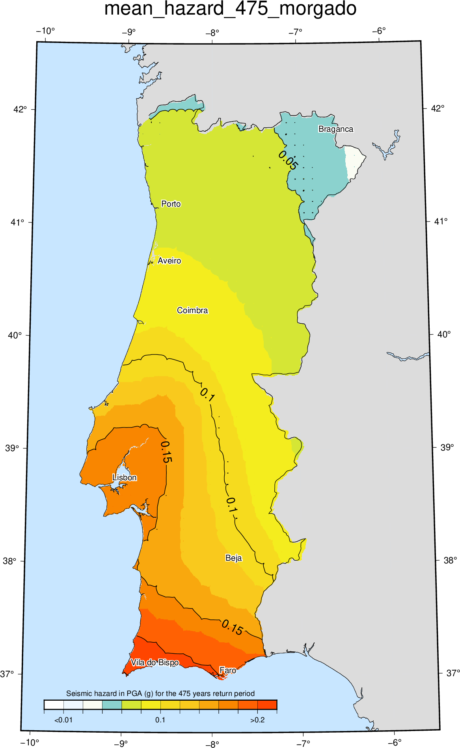
Seismic Hazard Assessment for Mainland Portugal
Seismic hazard (PGA for the 475 years return period) for mainland Portugal, using:
Inland events
Morgado et al. 2026 (inland)
Offshore events
Morgado et al. 2026 (offshore)

Slide 6
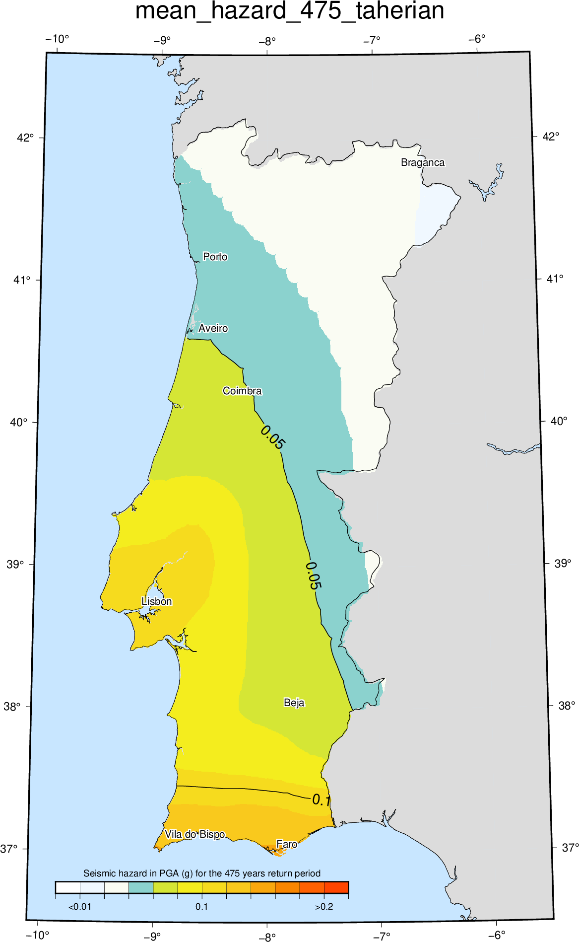
Seismic Hazard Assessment for Mainland Portugal
Seismic hazard (PGA for the 475 years return period) for mainland Portugal, using:
Inland events
Taherian et al. 2026 (inland)
Offshore events
Taharian et al. 2026 (offshore)

Slide 7
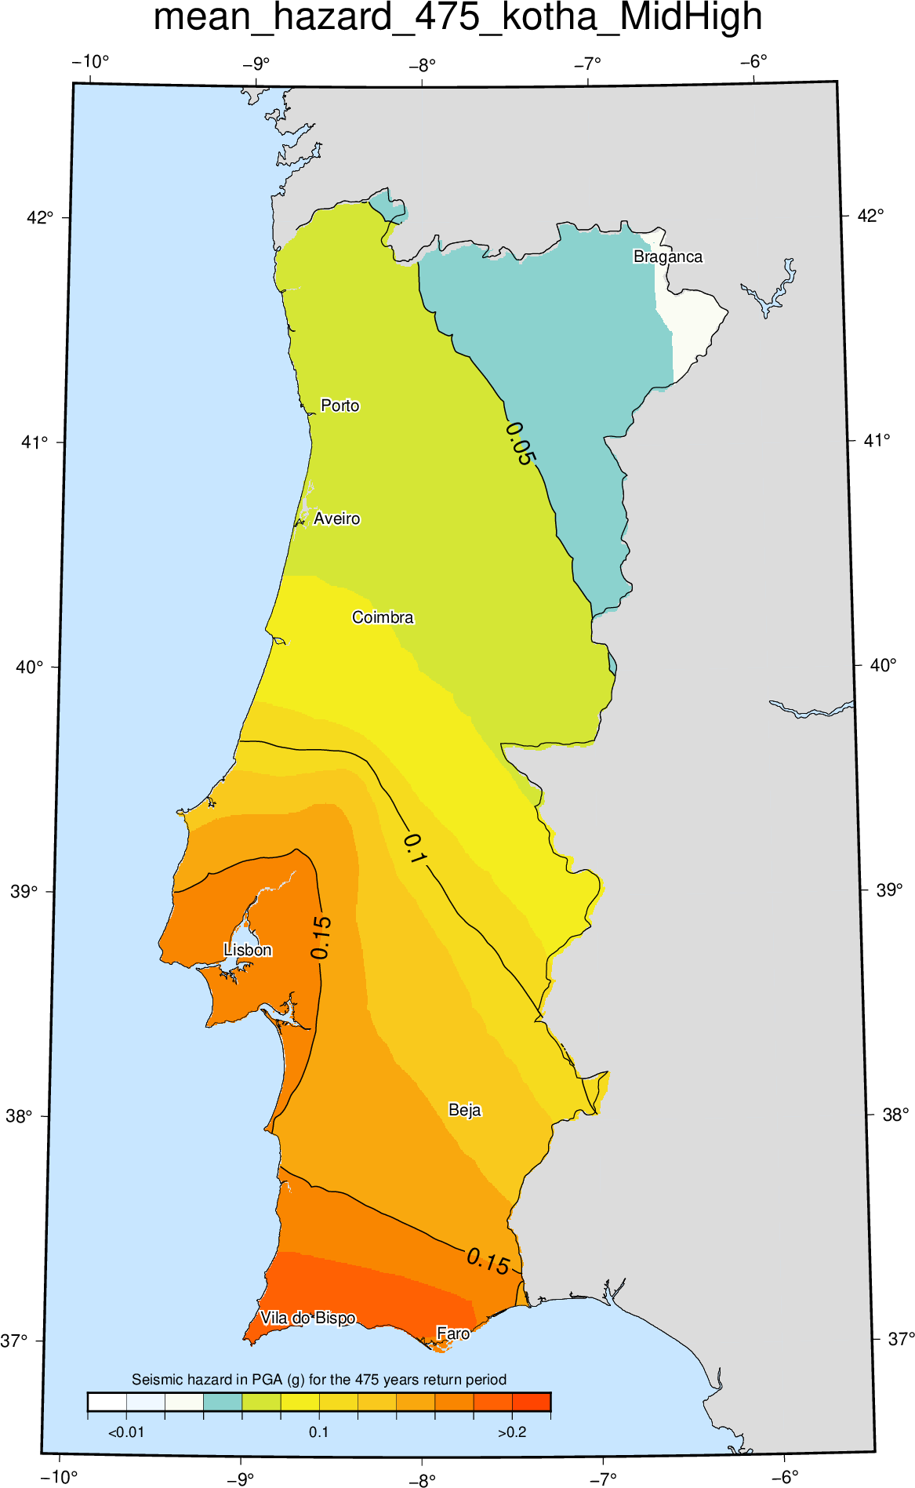
Seismic Hazard Assessment for Mainland Portugal
Seismic hazard (PGA for the 475 years return period) for mainland Portugal, using:
Inland events
Kotha et al. 2020 (mid-slow)
Offshore events
Kotha et al. 2020 (high-slow)

Slide 8
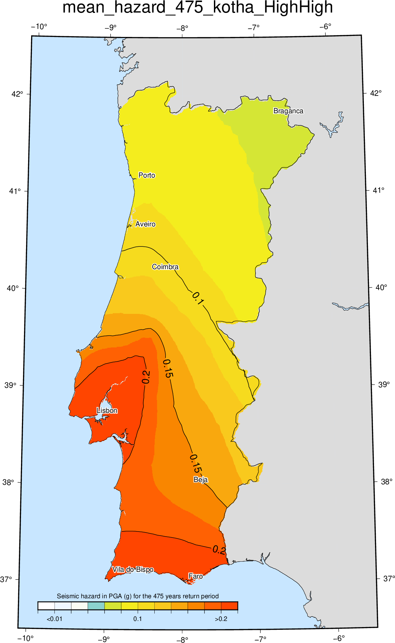
Seismic Hazard Assessment for Mainland Portugal
Seismic hazard (PGA for the 475 years return period) for mainland Portugal, using:
Inland events
Kotha et al. 2020 (high-slow)
Offshore events
Kotha et al. 2020 (high-slow)

Slide 9
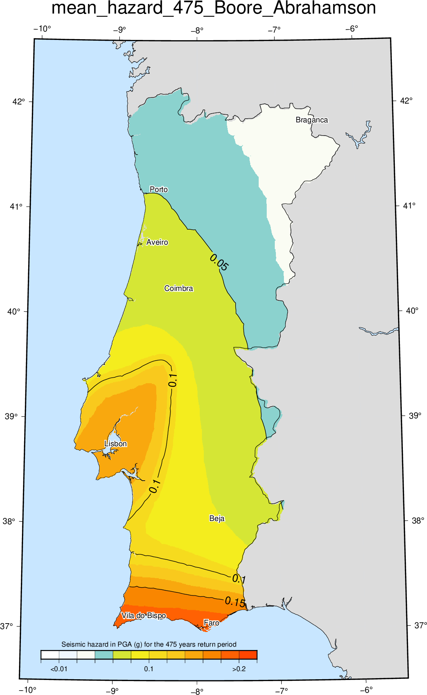
Seismic Hazard Assessment for Mainland Portugal
Seismic hazard (PGA for the 475 years return period) for mainland Portugal, using:
Inland events
Boore et al. 2014
Offshore events
Abrahamson et al. 2014

Slide 10
Seismic Hazard Assessment for Mainland Portugal
Next steps:
Verify how the ground motion models estimate ground shaking for strong magnitudes
Estimate seismic hazard disaggregation for specific locations in Portugal (Lisbon, Porto, Vila do Bispo)
Investigate the influence of the weights from the various ground motion models
Evaluate the potential consequences of changing the seismic demand in the safety and costs of the buildings

