Slide 1
Comparing Sbert Models
Brandon Adams

Slide 2

Overview
This project explores the comparative performance of two SBERT models in a Retrieval-Augmented Generation (RAG) pipeline using Qdrant.
The objective is to measure their semantic search performance across three datasets.

Slide 3
Models Used
SBERT Models Evaluated:
sbert1: all-MiniLM-L6-v2 – General-purpose model for semantic similarity.
sbert2: multi-qa-MiniLM-L6-cos-v1 – Fine-tuned for question-answering.

Slide 4
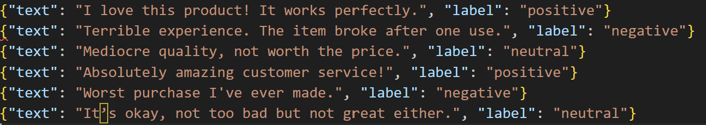
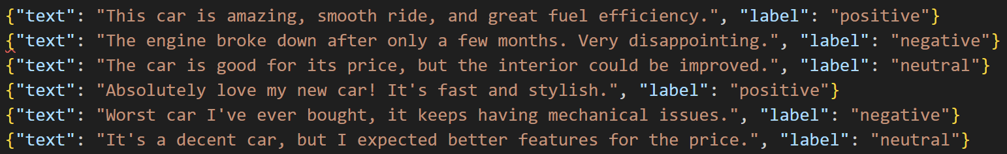
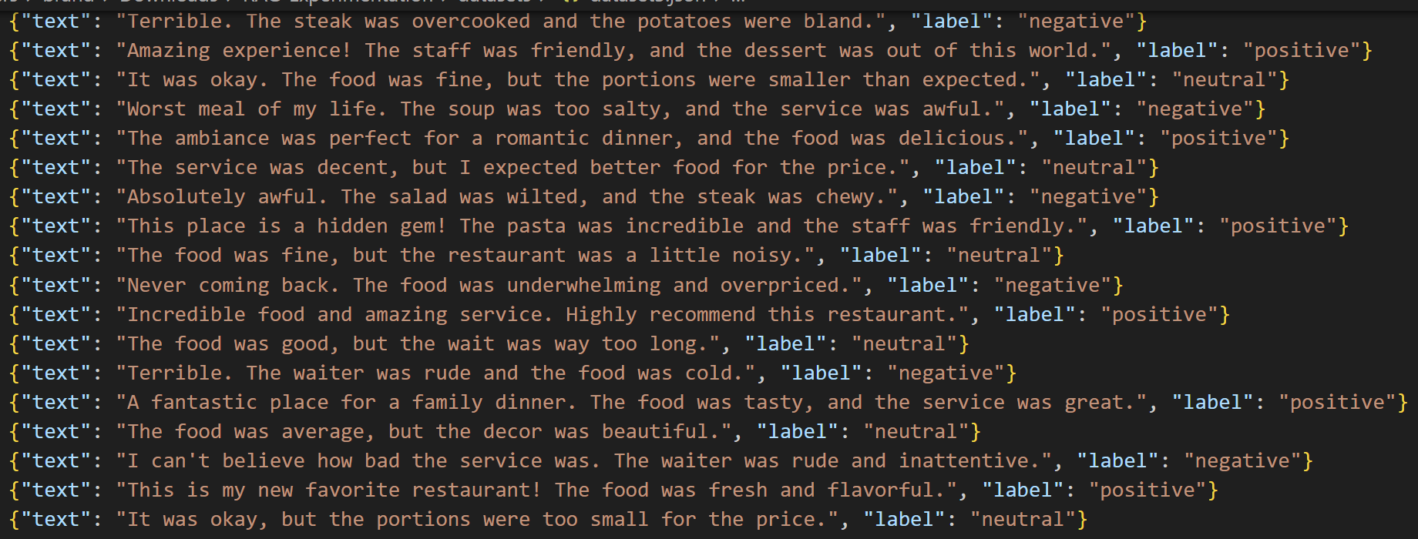
Datasets
Dataset1:
Product reviews (small size)
Dataset2:
Car reviews (larger)
Dataset3:
Restaurant reviews (largest)

Slide 5
Search Evaluation Examples
Example from dataset1:
Query: “terrible”
--- sbert1 Results ---
It’s okay, not too bad but not great either. (?)
Worst purchase I've ever made. (✓)
Terrible experience. The item broke after one use. sbert1 Results: Emphasized flavor, steak, and desserts; consistent theme around meal quality. (✓)

Slide 6
Search Evaluation Examples
Example from dataset1:
Query: “terrible”
--- sbert2 Results ---
Worst purchase I've ever made. (✓)
It’s okay, not too bad but not great either. (?)
Absolutely amazing customer service! ⮽

Slide 7
Search Evaluation Examples
Example from dataset2:
Query: “good”
--- sbert1 Results ---
Good but not great. It's a reliable car but lacks excitement. (✓)
Good car, but not as fast as I expected. (✓)
I’m not satisfied, it keeps having electrical issues. ⮽

Slide 8
Search Evaluation Examples
Example from dataset2:
Query: “good”
--- sbert2 Results ---
Good but not great. It's a reliable car but lacks excitement. (✓)
Good car, but not as fast as I expected. (✓)
I’m very pleased with this car. Excellent value for the money. (✓)

Slide 9
Final Results
Overall all-MiniLM-L6-v2 (sbert1) did a better job than the other model. It had more hits from each query and less outliers in its results.

Slide 10
Observations
Sensitivity to Vocabulary: Rare or expressive adjectives not present in the dataset led to noisy results, even for very close terms.
Speed: Embedding and search speed was performant for both models, completing searches in under a second per query on local hardware.

Slide 11
Conclusion
This evaluation confirms that both all-MiniLM-L6-v2 and multi-qa-MiniLM-L6-cos-v1 are viable for short-text RAG tasks. While general-purpose models like all-MiniLM-L6-v2 offer fast and broad coverage, domain-tuned models like multi-qa-MiniLM-L6-cos-v1 may slightly outperform in tasks involving nuanced question-answering.
Future steps could involve:
Adding more diverse queries including negatives or domain-specific jargon.
Incorporating a scoring metric
Expanding to a larger, more realistic dataset

