Slide 1



CODEBASICS RESUME PROJECT #8
Provide Insights to the Product Strategy Team in the Banking Domain
-V.Soundarya Lakshmi

Slide 2

Project Overview
Mitron Bank is a legacy financial institution headquartered in Hyderabad. They want to introduce a new line of credit cards, aiming to broaden its product offerings and reach in the financial market.
AtliQ Data Services came to know about this through an internal link and approached Mitron Bank with a proposal to implement this project. However, the strategy director of Mitron Bank, Mr. Bashnir Rover is skeptical and asked them to do a pilot project with the sample data before handing over them the full project. They provided a sample dataset of 4000 customers across five cities on their online spending and other details.
Peter Pandey is a data analyst at AtliQ Data Services and was asked by his manager to take over this project. His role is to analyse the provided sample data and report key findings to the strategy team of Mitron Bank. This analysis is expected to guide them in tailoring the credit cards to customer needs and market trends.

Slide 3
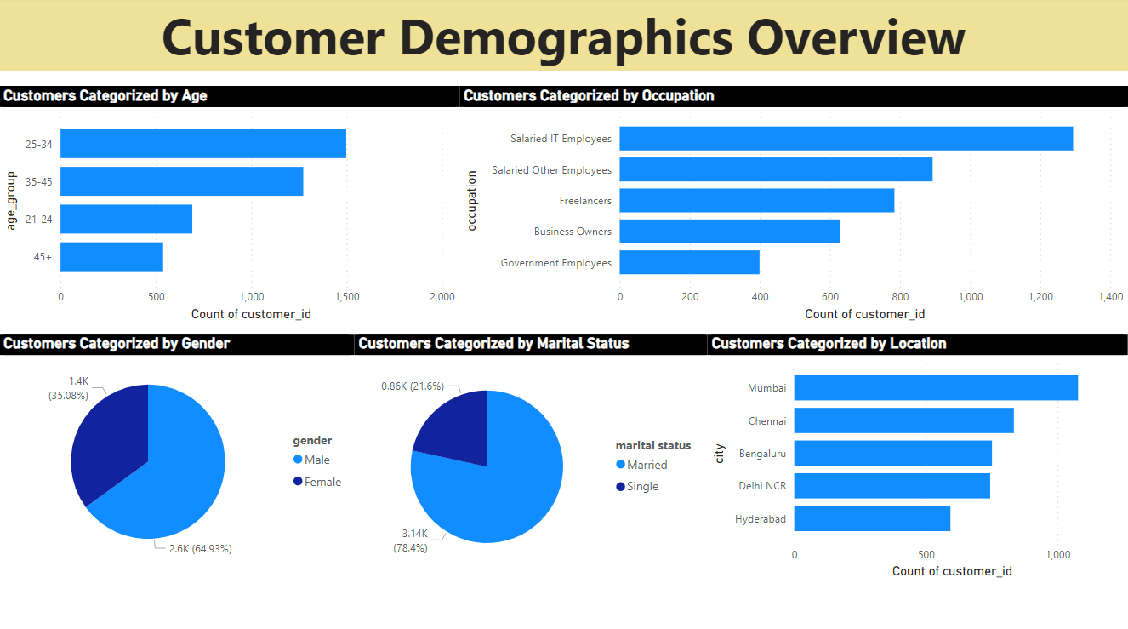

Slide 4
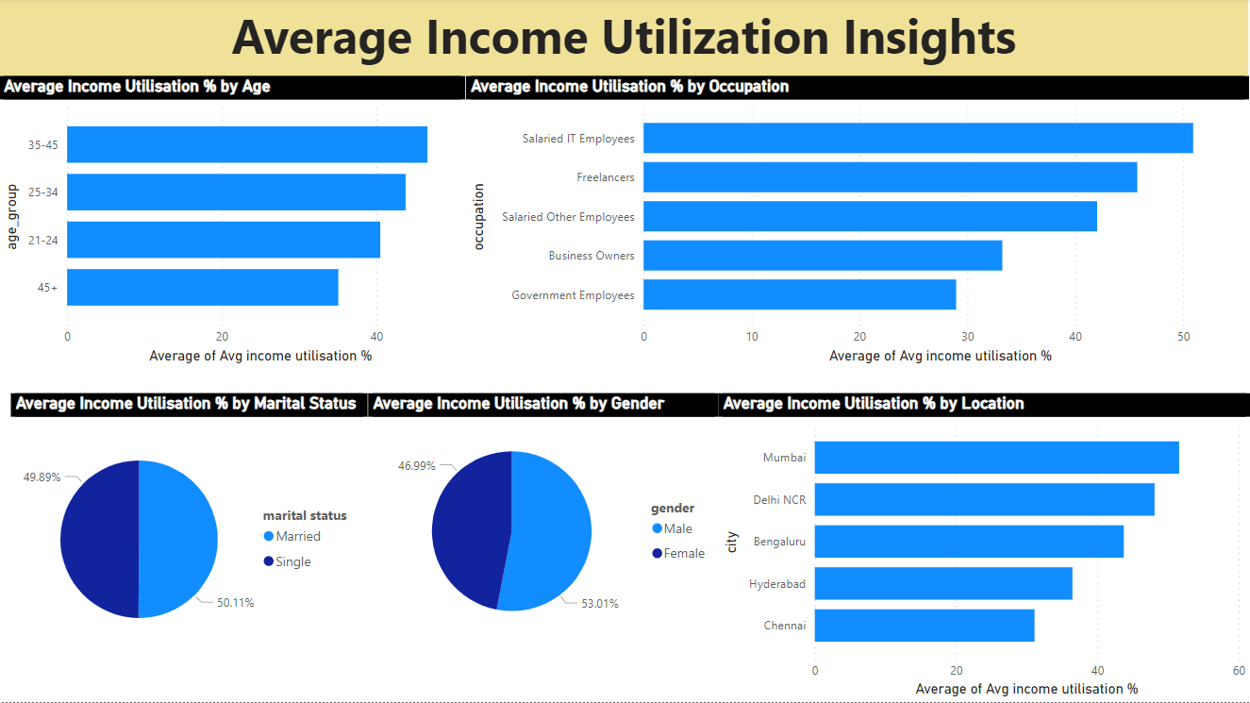

Slide 6
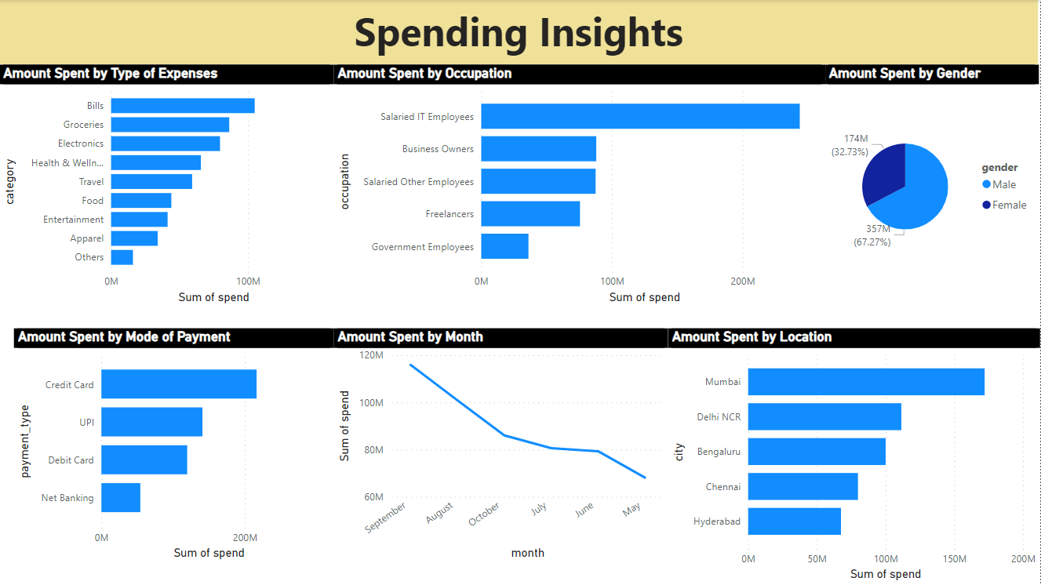

Slide 8
Key Points
Category | High | Low
Age-group | 35-45 | 45+
Occupation | Salaried IT Employees | Government Employees
Location | Mumbai | Hyderabad
Mode of Payment | Credit Card | Net Banking
Gender | Male | Female
Marital Status | Married | Single
Type of Expenses | Bills | Others

Slide 9
Recommendations
Special extra reward points for Top 1% Customers. It could also be narrowed down to Top 1% of a particular location.

Slide 10
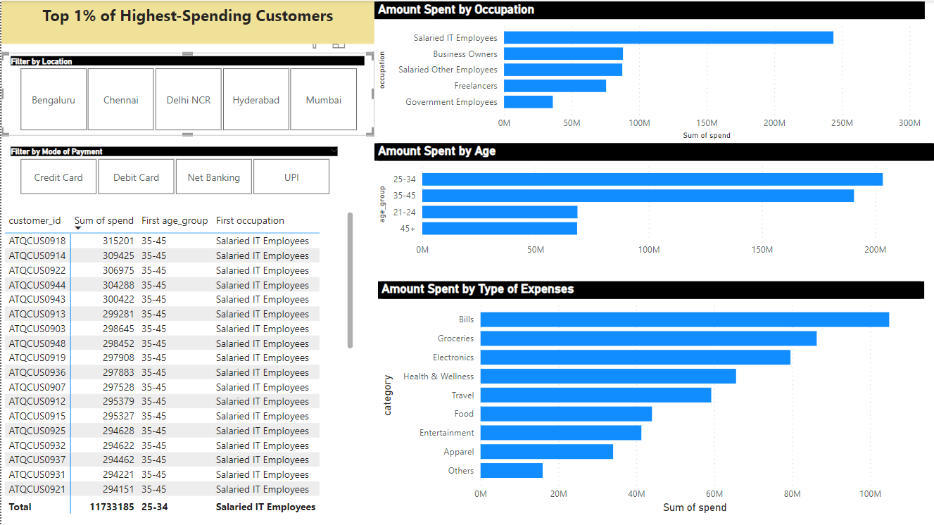

Slide 11
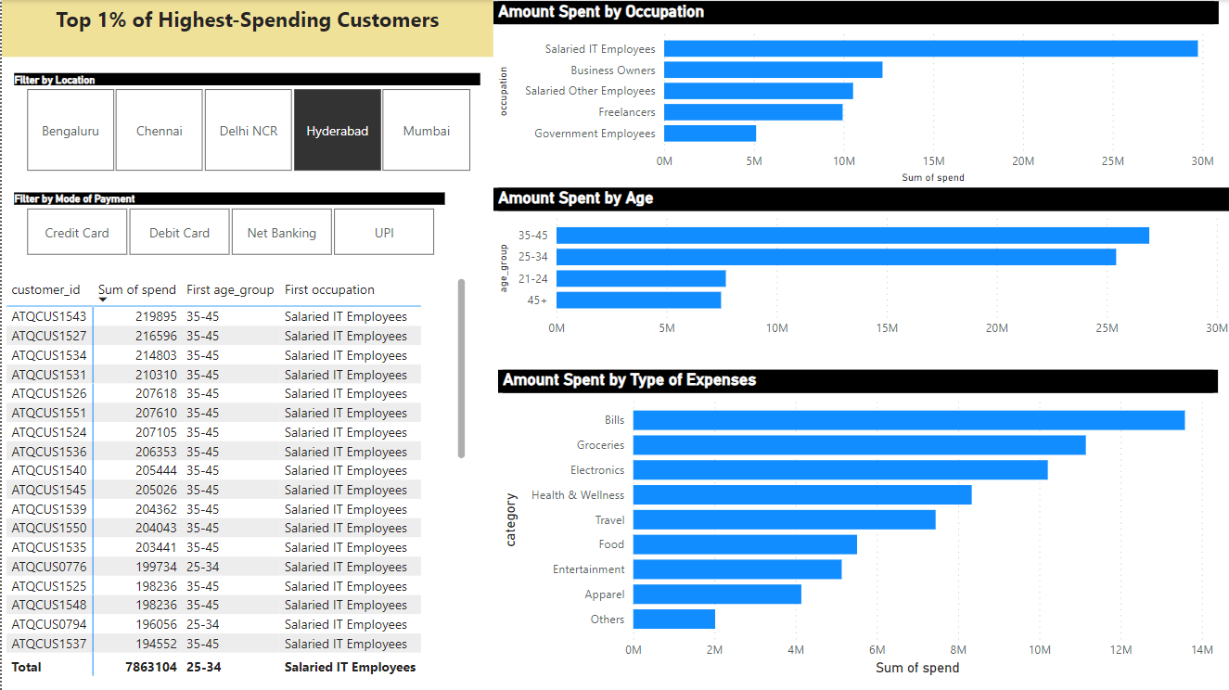

Slide 12
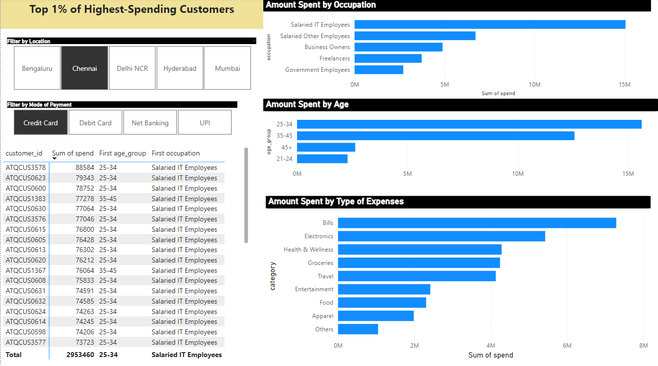

Slide 13
Recommendations
2. A small amount of convenience fee can be included for categories where people spend more.
Some examples:
Delhi-UPI- Groceries
Delhi-Credit Card-Electronics

Slide 14
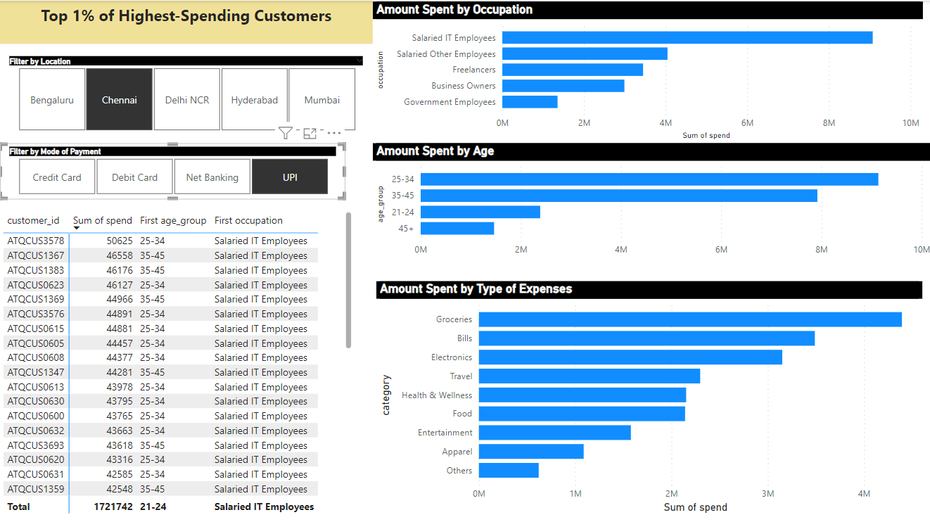

Slide 15
Recommendations
3. Provide cashbacks to people who spend less.
Some examples:
Mumbai-Debit Card-Others
Mumbai-Net banking-Others

Slide 17
Thank You

