Slide 1
: Prof. Sharayu
Hierarchical Inference
Vinay Sutar, 21d070078
Supervisor

Slide 2

TABLE OF CONTENTS
Problem Statement
Datasets and Models
Initial Approach
Algorithm
Experimental Results

Slide 3
Problem Statement
A Edge Device (ED) with a small-size ML model (S-ML) and an Edge Server (ES) with a large-size ML model (L-ML) are used for classiﬁcation.
S-ML offers lower accuracy but reduces latency, bandwidth, and energy consumption, while L-ML improves accuracy but increases resource usage.
Hierarchical Inference (HI) aims to balance the tradeoff by accepting S-ML’s inference when correct, ofﬂoading incorrect samples to ES.
Since ED cannot directly know S-ML’s correctness, a framework is proposed to predict the correctness based on the output by S-ML and decide whether to ofﬂoad the data.
The primary task is to implement a decision module for accepting or ofﬂoading the SML outputs.

Slide 4
Datasets and Models
Edge Device:
Resource Constrained
Limited computational Power
Limited Storage
Lower inference accuracy for ML/DL models
Edge Server:
Higher storage capacity
Higher computational power
Hosts a model with higher inference accuracy
Using Hierarchical Inference one can achieve the accuracy of LM on a small device.
Datasets: Imagenet-1K and CIFAR100
Models: ResNet50, ResNet18, ShufﬂeNet-V2, ResNet101, ResNet152

Slide 5
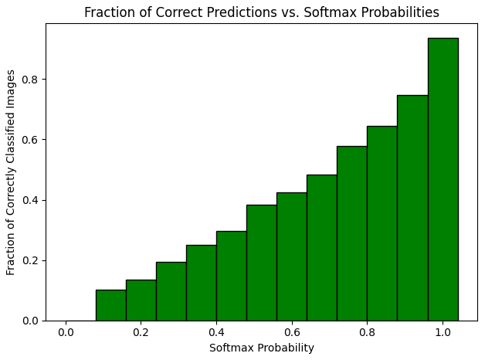
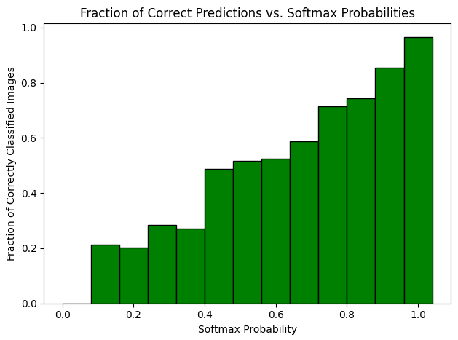
Initial Approach
For the chosen datasets and models above, lets look at the plot of fraction of samples correct for a given output softmax probability.
The output softmax probability refers to the maximum of the softmax values corresponding to the classes.
(a) ResNet 101 on CIFAR100 (b) ResNet50 on ImageNet-1K
Figure: Fraction of correctly classiﬁed images vs Softmax probability

Slide 6
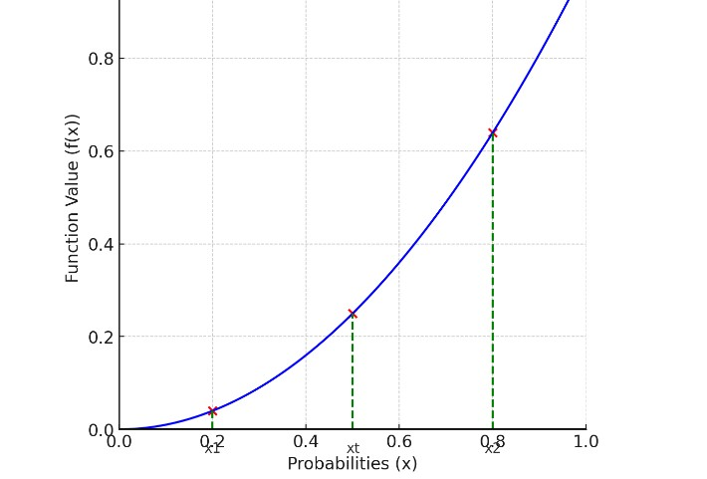
Approach
With appropriate bin size on the x-axis, it is clear the the fraction of correctly classiﬁed images is a non-decreasing function. (Tested over multiple models and datasets).
This can be modeled as: f(xt) = P(inference is correct | conﬁdence = xt), where the probability is shown on the y axis and f(.) is the non-decreasing function that is used to models this non-decreasing structure.

Slide 7
Approach
Cost structure:
Ofﬂoad Cost = τ
Accept but incorrect inference = 1
Accept and correct inference = 0
From the deﬁnition of f(.), we note the following:
f(xt) - Probability of correct inference given conﬁdence is xt
1-f(xt) - Probability of incorrect inference given conﬁdence is xt
Thus, the decision rule we adopt is, ofﬂoad when expected cost of ofﬂoad is less than expected cost of incorrect ofﬂoad.
Expected cost of ofﬂoad = τ
Expected cost of incorrect inference = 1.(1 - f(xt)) + 0.(1 - (1 - f(xt))) = 1 - f(xt)

Slide 8
Decision Module
Ofﬂoad Decision: τ < 1 - f(xt) =⇒ f(xt) < 1 - τ
The decision, in the end, reduces to ﬁnding x where f(.) intersects y = 1 - τ .
To the right of this intersection point ( f(x) > 1 - τ ) accept the data samples and ofﬂoad any data samples to the left ( f(x) < 1 - τ ).
Preliminaries:
The SML output is converted to a 4 bit value (convenient to keep track).
The interval [0, 1] is divided into 15 intervals with boundaries generated by these 4 bit values.
The estimate ^{ˆ}f(.) is maintained for each of these 16 values.

Slide 9
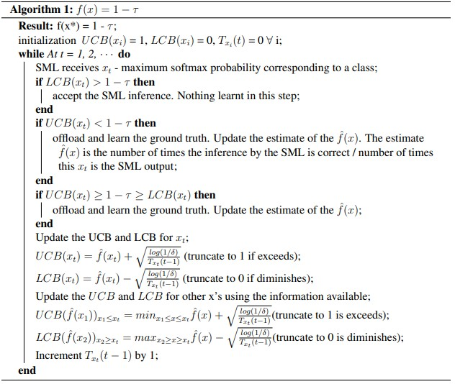
Algorithm
Figure: Algorithm

Slide 10
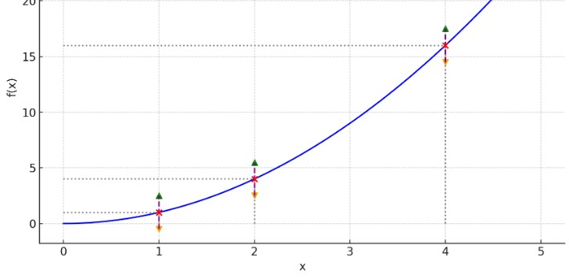
Algorithm
For each value/threshold on the x axis, along with ^{ˆ}f(.), a UCB(.) and LCB(.) is maintained as a measure of uncertainty in the estimate of f(.).
Figure: Structural Property of f(.)
The data samples whose LCB lies above 1 - τ (to the right) are certainly accepted
The data samples whose UCB lies above 1 - τ are certainly ofﬂoaded
The data samples for the 1 - τ lie between the LCB and UCB then ofﬂoad due to ambiguity.

Slide 11
Algorithm
The UCB and LCB for the received probability output is updated as per the standard UCB algorithm (except a modiﬁcation where the uncertainty is scaled to not exceed 1 initially as the UCB cannot exceed 1).
We can take advantage of the structural property of the function f(.)
It is evident that UCB of a threshold cannot exceed the UCB of any threshold on its right, so the UCB of some x1 < xt at time instant t when the SML output is xt will be the minimum of the UCB of x, where x ∈ [x1, xt].
Similarly, LCB of a threshold cannot be lower than the LCB of any threshold on its left, so the LCB of some x2 > xt at time instant t when the SML output is xt will be the maximum of the LCB of x, where x ∈ [xt, x2].

Slide 12
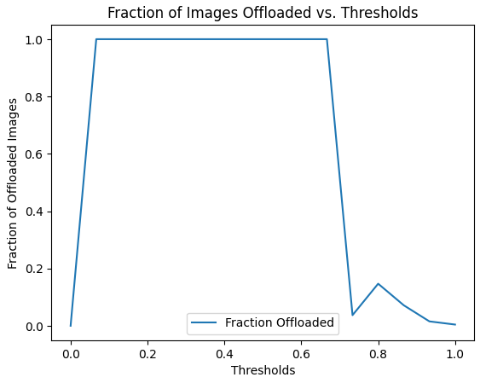
Testing
For testing purposes, the following models and datasets are used:
ResNet50 with CIFAR100 with an accuracy of 50.14%
ShufﬂeNet-V2 with IMageNet-1K with an accuracy of 60.64%
Since LML model is assumed to be always correct, so the ground truth labels are directly used as the LML outputs. However, an ofﬂoad cost is still considered.
Figure: Fraction of ofﬂoaded images vs output probability(ResNet50 with ImageNet-1K_V1)

Slide 13
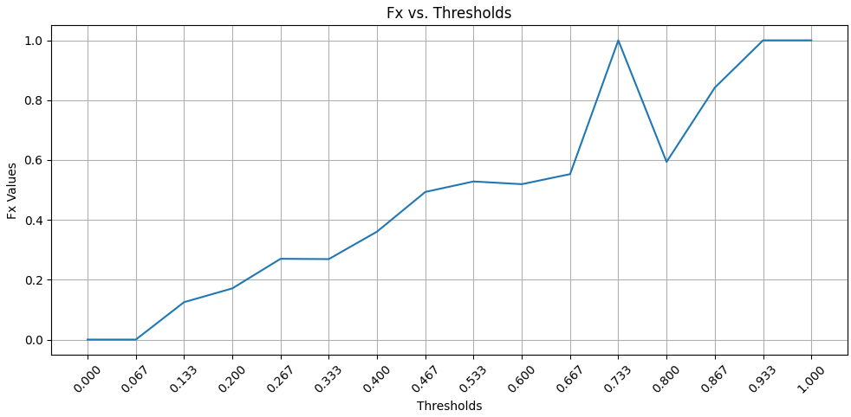
Testing
Figure: Plot of estimated ^{ˆ}f(.)
The hypothesis of f being a increasing function is validated here.

Slide 14
Testing
The performance of these algorithm in terms of cost are compared.
No Ofﬂoad - All the inference by the SML are accepted
All Ofﬂoad - All the data samples are ofﬂoaded irrespective of the SML conﬁdence.
Ofﬂine Optimal - Use the ground truth to ofﬂoad only the samples for which the inference is incorrect.
Hedge Algorithm - (Prediction with experts problem) Assign weights to each threshold(expert).
LCB-UCB algorithm - The algorithm described here is called LCB-UCB algorithm.
LCB-UCB no info - In this algorithm the 2 steps where the structural information of f(.) is exploited are omitted.
Min Loss LCB - At any instant t, the threshold with minimum loss until that time is chosen to make decisions.

Slide 15
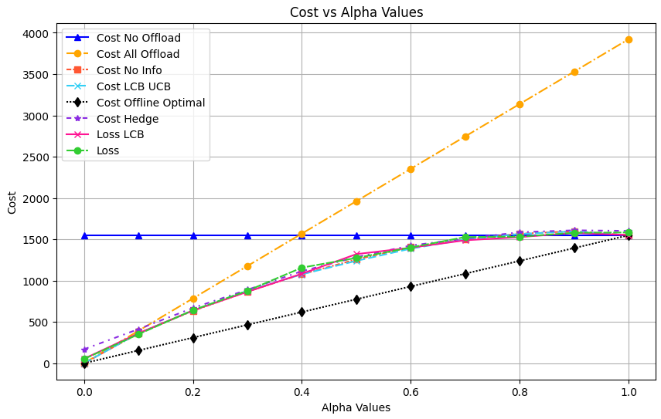
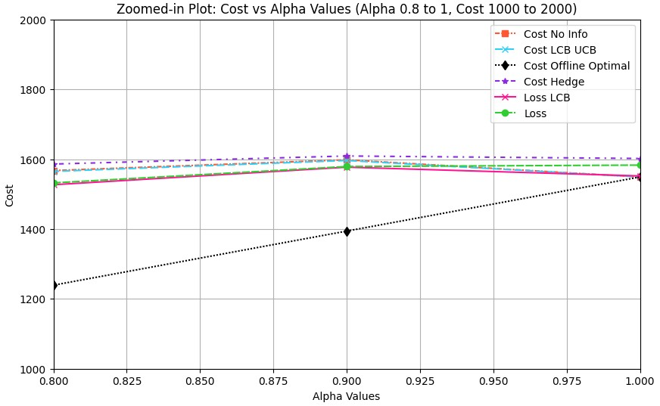
Comparison (Cost)
The following cost plot vs ofﬂoad cost τ is obtained.
(a) Cost vs τ (b) Zoomed in - Cost vs τ
Figure: Cost vs τ for ShufﬂeNet-V2 with ImageNet-1K
The no ofﬂoad algorithm gives a constant cost equal to the (number of incorrect samples)*1
The all ofﬂoad algorithm gives a linearly increasing cost with τ
The ofﬂine optimal is the best performance that can be obtained.
• The other algorithm perform approximately similar within a margin of 5%.

Slide 16
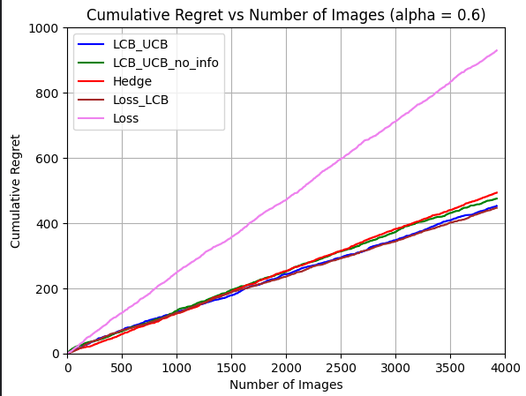
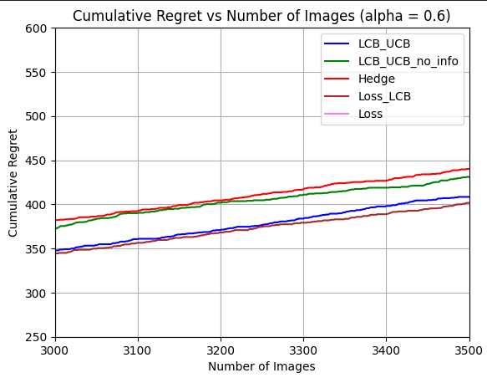
Comparison (Regret)
The following regret plot vs ofﬂoad cost τ is obtained.
(a) Regret vs τ (b) Zoomed in - Regret vs τ
Figure: Regret vs τ for ShufﬂeNe-V2 with ImageNet-1K

Slide 17
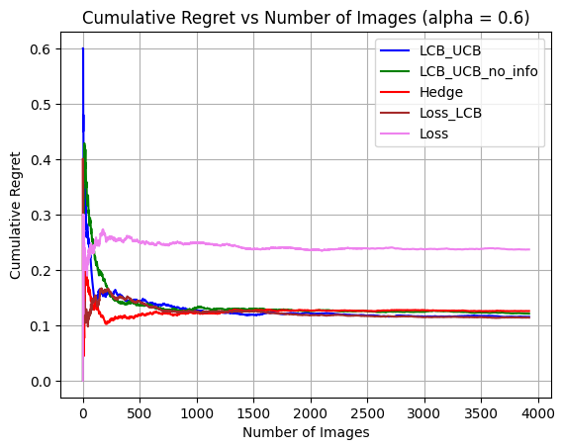
Comparison (Regret)
Figure: Cumulative Average regret vs τ for ShufﬂeNet-V2 with ImageNet-1K
Since the regret varies sublinearly and the number of image increases linearly, the average regret is expected to decrease with time as is validated from the
graph above.

Slide 18
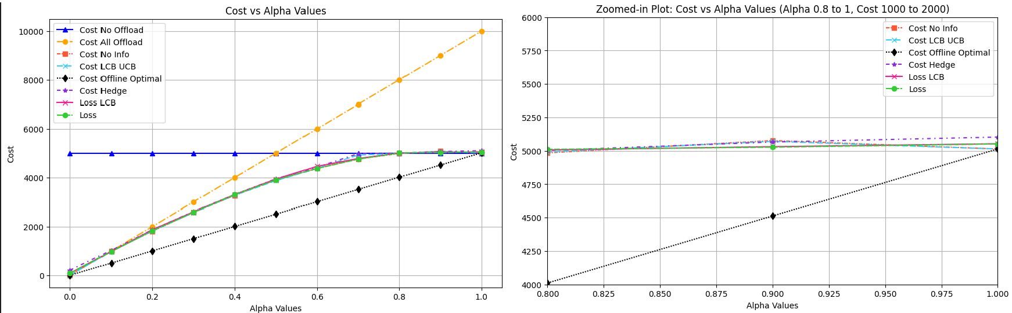
Comparison (Cost)
The following cost plot vs ofﬂoad cost τ is obtained.
(a) Cost vs τ (b) Zoomed in - Cost vs τ
Figure: Cost vs τ for ResNet50 with CIFAR100
The no ofﬂoad algorithm gives a constant cost equal to the (number of incorrect samples)*1
The all ofﬂoad algorithm gives a linearly increasing cost with τ
The ofﬂine optimal is the best performance that can be obtained.
• The other algorithm perform approximately similar within a margin of 5%.

Slide 19
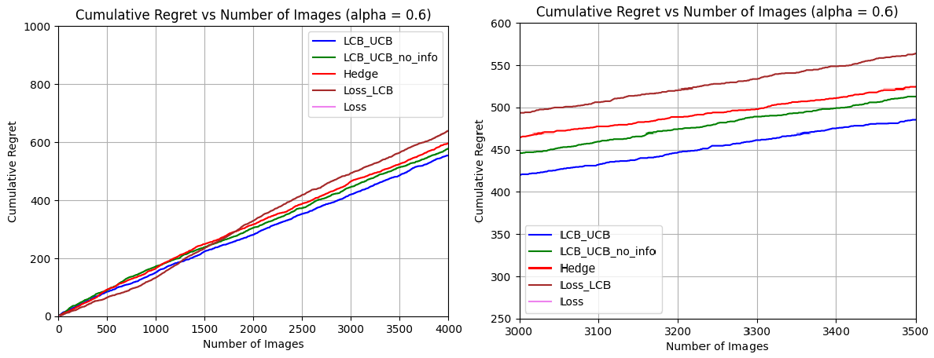
Comparison (Regret)
The following regret plot vs ofﬂoad cost τ is obtained.
(a) Regret vs τ (b) Zoomed in - Regret vs τ
Figure: Regret vs τ for ResNet50 with CIFAR100

Slide 20
Future Work
Work out the regret analysis bounds for the proposed algorithm.
Test the consistency of the algorithm over multiple datasets and algorithms
Dynamically update the hyper parameters while training
Use multiple layer Hierarchical Inference like device to edge and then edge to cloud
Instead of ofﬂoading the entire data samples, just ofﬂoad features captured from initial layers of the SML and used these features to capture more intrinsic details.

